Slide 1
Project 2.2
Daniel Chawla, Olivia Justynski, Jay Stanley, and Jiawei Wang

Slide 2
CRISPR and personal genomics: The impact of SNPs on sgRNA sets and off target mutations.

Slide 3
Writing
How might SNPs in Carl’s genome impact the use of CRISPR as a treatment? Discuss how individual SNPs would impact the off-target effects in the presence of the SNP.

Slide 4
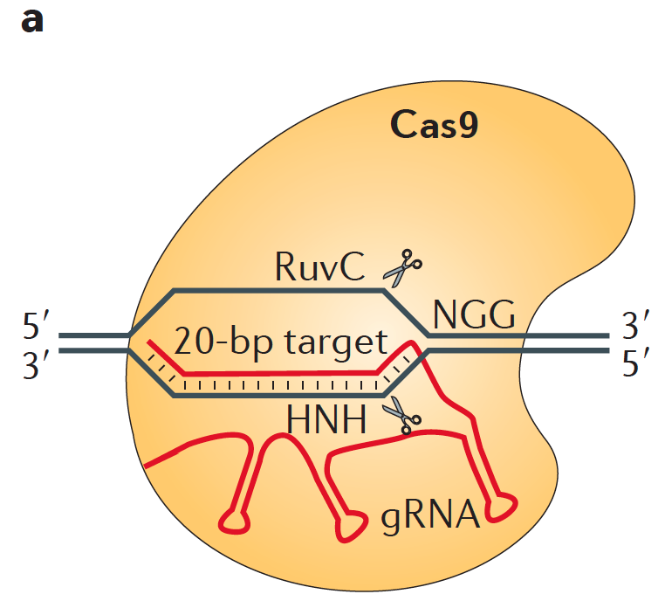

Slide 5
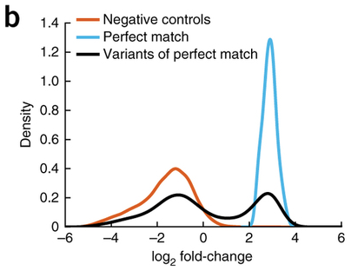

Slide 6
Overall, the best way to avoid SNPs causing both undesired off-target effects or decreased therapeutic efficiency is probably through thorough sequencing and screening of the patient’s genome prior to construction of CRISPR gRNA sequences.

Slide 7
Coding
Propose a tool that finds PAM sites in the human reference genome as well as Carl’s genome and compares the similarity of the two sets.

Slide 8
Coding idea
Take the commonly used CRISPR/Cas9 PAM sites: NGG as example
Find all the NGG (GG) sites on the reference genome (GRCh37)
Find all the NGG (GG) sites on the altered genome (Zimmerome)
Compare the NGG distribution on the two genomes

Slide 9
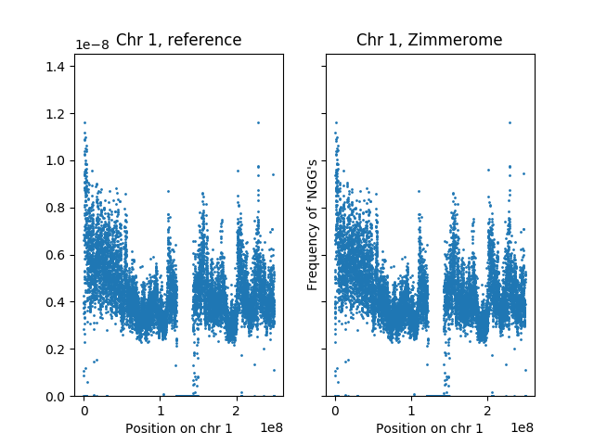
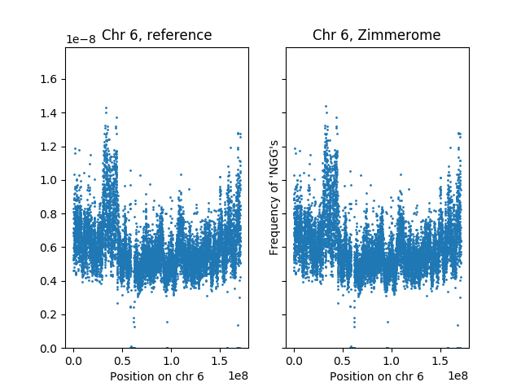
The uneven distribution of NGGs

Slide 10
Gained and lost PAM sites due to SNPs
#chrom | pos | change | #chrom | pos | change
1 | 58209 | gained | 1 | 79049 | lost
1 | 65743 | gained | 1 | 88176 | lost
1 | 74553 | gained | 1 | 91473 | lost
1 | 122813 | gained | 1 | 91474 | lost
1 | 127489 | gained | 1 | 101266 | lost
1 | 230057 | gained | 1 | 133482 | lost
1 | 250232 | gained | 1 | 239162 | lost
1 | 537535 | gained | 1 | 239163 | lost
1 | 537536 | gained | 1 | 242424 | lost

Slide 11
Influence of SNPs on PAM sites

Slide 12
Coding: Approach
Data I/O
Find PAM Sites
Look for 5’-NGG-3’ and 3’-CCN-5’ motifs on each chromosome
Compare Sets
Append 20 NTs upstream for specificity
Find intersection of Zimmerome and reference genome PAM+gRNA sequences

Slide 13
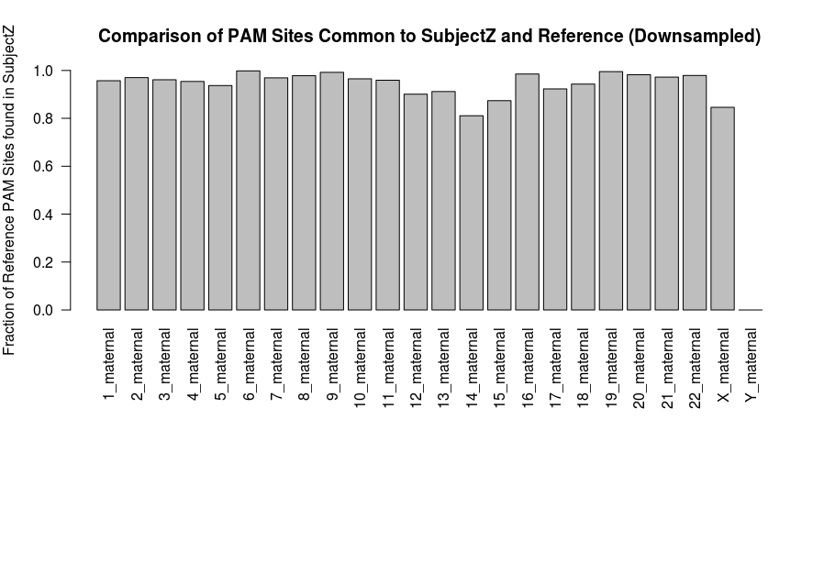
Coding Results
Many but not all reference PAM sites with matched upstream sequences are present in the Zimmerome

Slide 14
Pipeline
Calculate the sgRNA libraries for the reference genome and Carl’s genome. How different are these two sets?

Slide 15
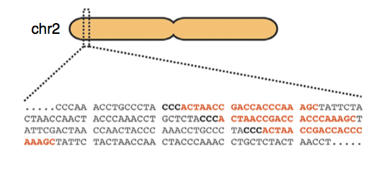
Goal of pipeline:
Generate single guide RNA (sgRNA) libraries from Carl’s genome and compare it to the reference genome
Two genome files for Carl: maternal and paternal
One reference genome: 37

Slide 16
GuideScan Software Implementation
Dependencies:
samtools==1.3.1
pysam==0.8.3, pyfaidx==0.4.7.1, bx-python==0.7.3
biopython>=1.66
Sklearn==0.16.1

Slide 17
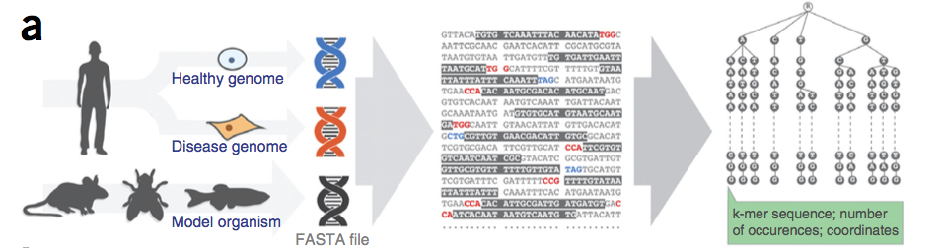
GuideScan: Inputs
.fasta (or .fa) file of genome
gRNA sequence length (20 – 100 bases, excluding PAM site)
Alternative PAM sequence
Chromosomes (list, comma separated)
Min and Max allowed mismatches for off-target statistics
Perez et. al., Nature Biotechnology, 2017

Slide 18
GuideScan: Inputs and Outputs
Outputs:
Target site coordinates (start and end)
sgRNA sequence
For a given sgRNA:
Off target sites, gRNA sequence, (M:N_{M}|Q:N_{Q} )
M = number of allowed mismatches (min) within gRNA sequence to be considered the gRNA, N_{M} is the number of times it occurs
Q = number of mismatches to sequence to be considered off-target site, N_{Q} is the number of occurances
Cutting efficiency score, specificity score for ea. OT site

Slide 19
Our sgRNA Libraries
Zimmer_mom
Zimmer_dad
Human reference genome 37
Chromosome 18
20 base-long gRNA sequences
Canonical PAM sequence NGG
~5.75 M gRNA for each

Slide 20
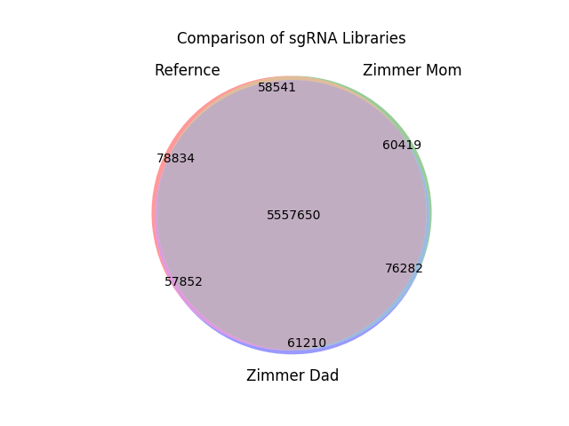

Slide 21
What we found
Unique to each library:
Mom: 1.05% of 5,752,892
Dad: 1.06% of 5,752,994
Ref: 1.37% of 5,752,877
5.557 M gRNAs in common

Slide 22
What we found
Maternal-Reference:
58,541
Paternal-Reference:
57,852
Maternal-Paternal
76,282
Zimmer mom and dad have slightly more in common than with either does with the reference.

