Slide 1
CRISPR and personal genomics: The impact of SNPs on sgRNA sets and off target mutations
CBB752 final project 2-2
May 18, 2017
Jay Stanley, Acer Xu and Jiawei Wang

Slide 2
Introduction

Slide 3
Writing
How might SNPs in Carl’s genome impact the use of CRISPR as a treatment? Discuss how individual SNPs would impact the off-target effects in the presence of the SNP.

Slide 4
Coding
Propose a tool that finds PAM sites in the human reference genome as well as Carl’s genome and compares the similarity of the two sets.

Slide 5
Coding idea
Take the commonly used CRISPR/Cas9 PAM sites: NGG as example
Find all the NGG (GG) sites on the reference genome (GRCh37)
Replace the reference genome with Zimmrome SNPs
Find all the NGG (GG) sites on the altered genome (Zimmerome)
Compare the NGG distribution on the two genomes

Slide 6
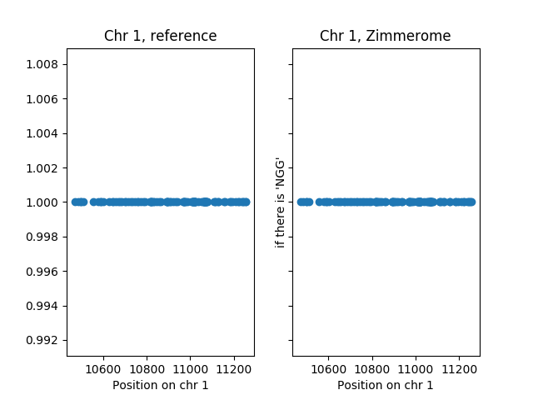
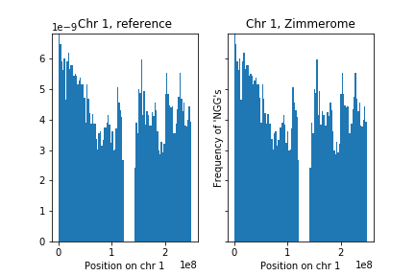
NGG sites on chromosomes

Slide 7
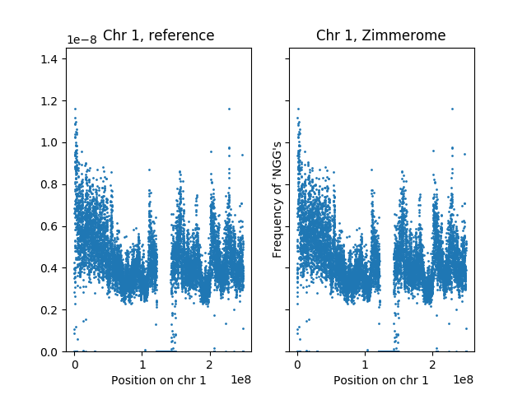
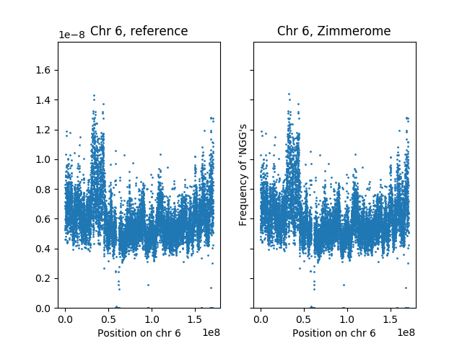
The uneven distribution of NGGs

Slide 8
Gained and lost PAM sites due to SNPs
#chrom | pos | change | #chrom | pos | change
1 | 58209 | gained | 1 | 79049 | lost
1 | 65743 | gained | 1 | 88176 | lost
1 | 74553 | gained | 1 | 91473 | lost
1 | 122813 | gained | 1 | 91474 | lost
1 | 127489 | gained | 1 | 101266 | lost
1 | 230057 | gained | 1 | 133482 | lost
1 | 250232 | gained | 1 | 239162 | lost
1 | 537535 | gained | 1 | 239163 | lost
1 | 537536 | gained | 1 | 242424 | lost

Slide 9
Summary statistics
chr | reference | Zimmerome | gained | %gained | lost | %lost
1 | 12264104 | 12261798 | 27176 | 0.221589771 | 29482 | 0.240392612
2 | 11987524 | 11985172 | 27521 | 0.229580354 | 29873 | 0.249200752
3 | 9540307 | 9538887 | 23103 | 0.242162018 | 24523 | 0.257046236
4 | 8480633 | 8478943 | 23941 | 0.28230204 | 25631 | 0.302229798
5 | 8601743 | 8600170 | 20683 | 0.240451267 | 22256 | 0.258738258
6 | 8148515 | 8147001 | 21947 | 0.269337419 | 23461 | 0.287917492
7 | 8004650 | 8003284 | 19381 | 0.242121767 | 20747 | 0.259186848
8 | 7132394 | 7130922 | 18268 | 0.256127185 | 19740 | 0.276765417
9 | 6395239 | 6394260 | 14755 | 0.230718508 | 15734 | 0.246026771
10 | 7046754 | 7045331 | 18080 | 0.256572033 | 19503 | 0.276765728
11 | 7091678 | 7090700 | 18156 | 0.256018392 | 19134 | 0.269809205
12 | 6762794 | 6761892 | 16542 | 0.244603044 | 17444 | 0.257940727

Slide 10
Summary statistics
chr | reference | Zimmerome | gained | %gained | lost | %lost
13 | 4370828 | 4370107 | 12652 | 0.289464605 | 13373 | 0.305960335
14 | 4609762 | 4609181 | 11214 | 0.243266355 | 11795 | 0.255870043
15 | 4528515 | 4527322 | 10647 | 0.235110185 | 11840 | 0.261454362
16 | 4915413 | 4914933 | 11686 | 0.237741976 | 12166 | 0.247507178
17 | 5022588 | 5021820 | 10011 | 0.199319554 | 10779 | 0.214610476
18 | 3647641 | 3646846 | 9958 | 0.272998357 | 10753 | 0.294793265
19 | 4057174 | 4056403 | 8753 | 0.215741302 | 9524 | 0.234744677
20 | 3611014 | 3610301 | 7553 | 0.209165625 | 8266 | 0.228910771
21 | 1824254 | 1823997 | 4967 | 0.272275681 | 5224 | 0.286363631
22 | 2482215 | 2481813 | 4891 | 0.197041755 | 5293 | 0.213236968
X | 7355128 | 7355146 | 8185 | 0.111282904 | 8167 | 0.111038176
Y | 1268519 | 1268488 | 294 | 0.023176634 | 325 | 0.025620428

Slide 11
Influence of SNPs on PAM sites

Slide 12
Pipeline
Calculate the sgRNA libraries for the reference genome and Carl’s genome. How different are these two sets?

Slide 13
References
Doench, John G., et al. "Optimized sgRNA design to maximize activity and minimize off-target effects of CRISPR-Cas9." Nature biotechnology (2016).
Perez, Alexendar R., et al. "GuideScan software for improved single and paired CRISPR guide RNA design." Nature Biotechnology 35.4 (2017): 347-349.

