Slide 1
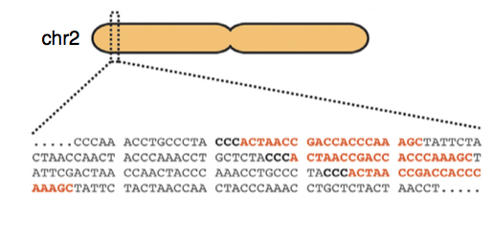
Goal of pipeline:
Generate single guide RNA (sgRNA) libraries from Carl’s genome and compare it to the reference genome
Two genome files for Carl: maternal and paternal
One reference genome: 37

Slide 2
GuideScan Software Implementation
Dependencies:
samtools==1.3.1
pysam==0.8.3, pyfaidx==0.4.7.1, bx-python==0.7.3
biopython>=1.66
Sklearn==0.16.1

Slide 3
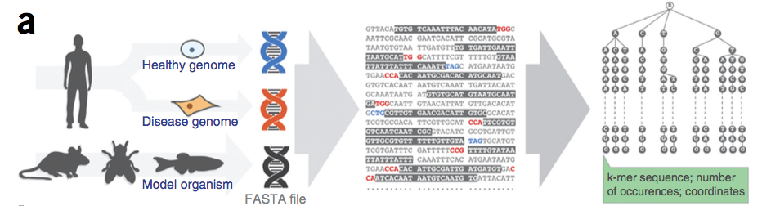
GuideScan: Inputs
.fasta (or .fa) file of genome
gRNA sequence length (20 – 100 bases, excluding PAM site)
Alternative PAM sequence
Chromosomes (list, comma separated)
Min and Max allowed mismatches for off-target statistics
Perez et. al., Nature Biotechnology, 2017

Slide 4
GuideScan: Inputs and Outputs
Outputs:
Target site coordinates (start and end)
sgRNA sequence
For a given sgRNA:
Off target sites, gRNA sequence, (M:N_{M}|Q:N_{Q} )
M = number of allowed mismatches (min) within gRNA sequence to be considered the gRNA, N_{M} is the number of times it occurs
Q = number of mismatches to sequence to be considered off-target site, N_{Q} is the number of occurances
Cutting efficiency score, specificity score for ea. OT site

Slide 5
Our sgRNA Libraries
Zimmer_mom
Zimmer_dad
Human reference genome 37
Chromosome 18
20 base-long gRNA sequences
Canonical PAM sequence NGG
~5.75 M gRNA for each

Slide 6
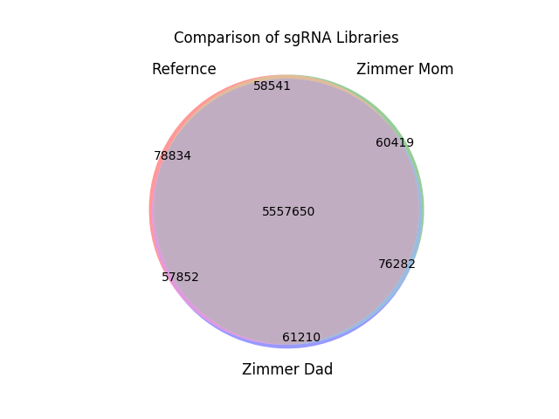

Slide 7
What we found
Unique to each library:
Mom: 1.05% of 5,752,892
Dad: 1.06% of 5,752,994
Ref: 1.37% of 5,752,877
5.557 M gRNAs in common

Slide 8
What we found
Maternal-Reference:
58,541
Paternal-Reference:
57,852
Maternal-Paternal
76,282
Zimmer mom and dad have slightly more in common than with either does with the reference.

