Slide 1
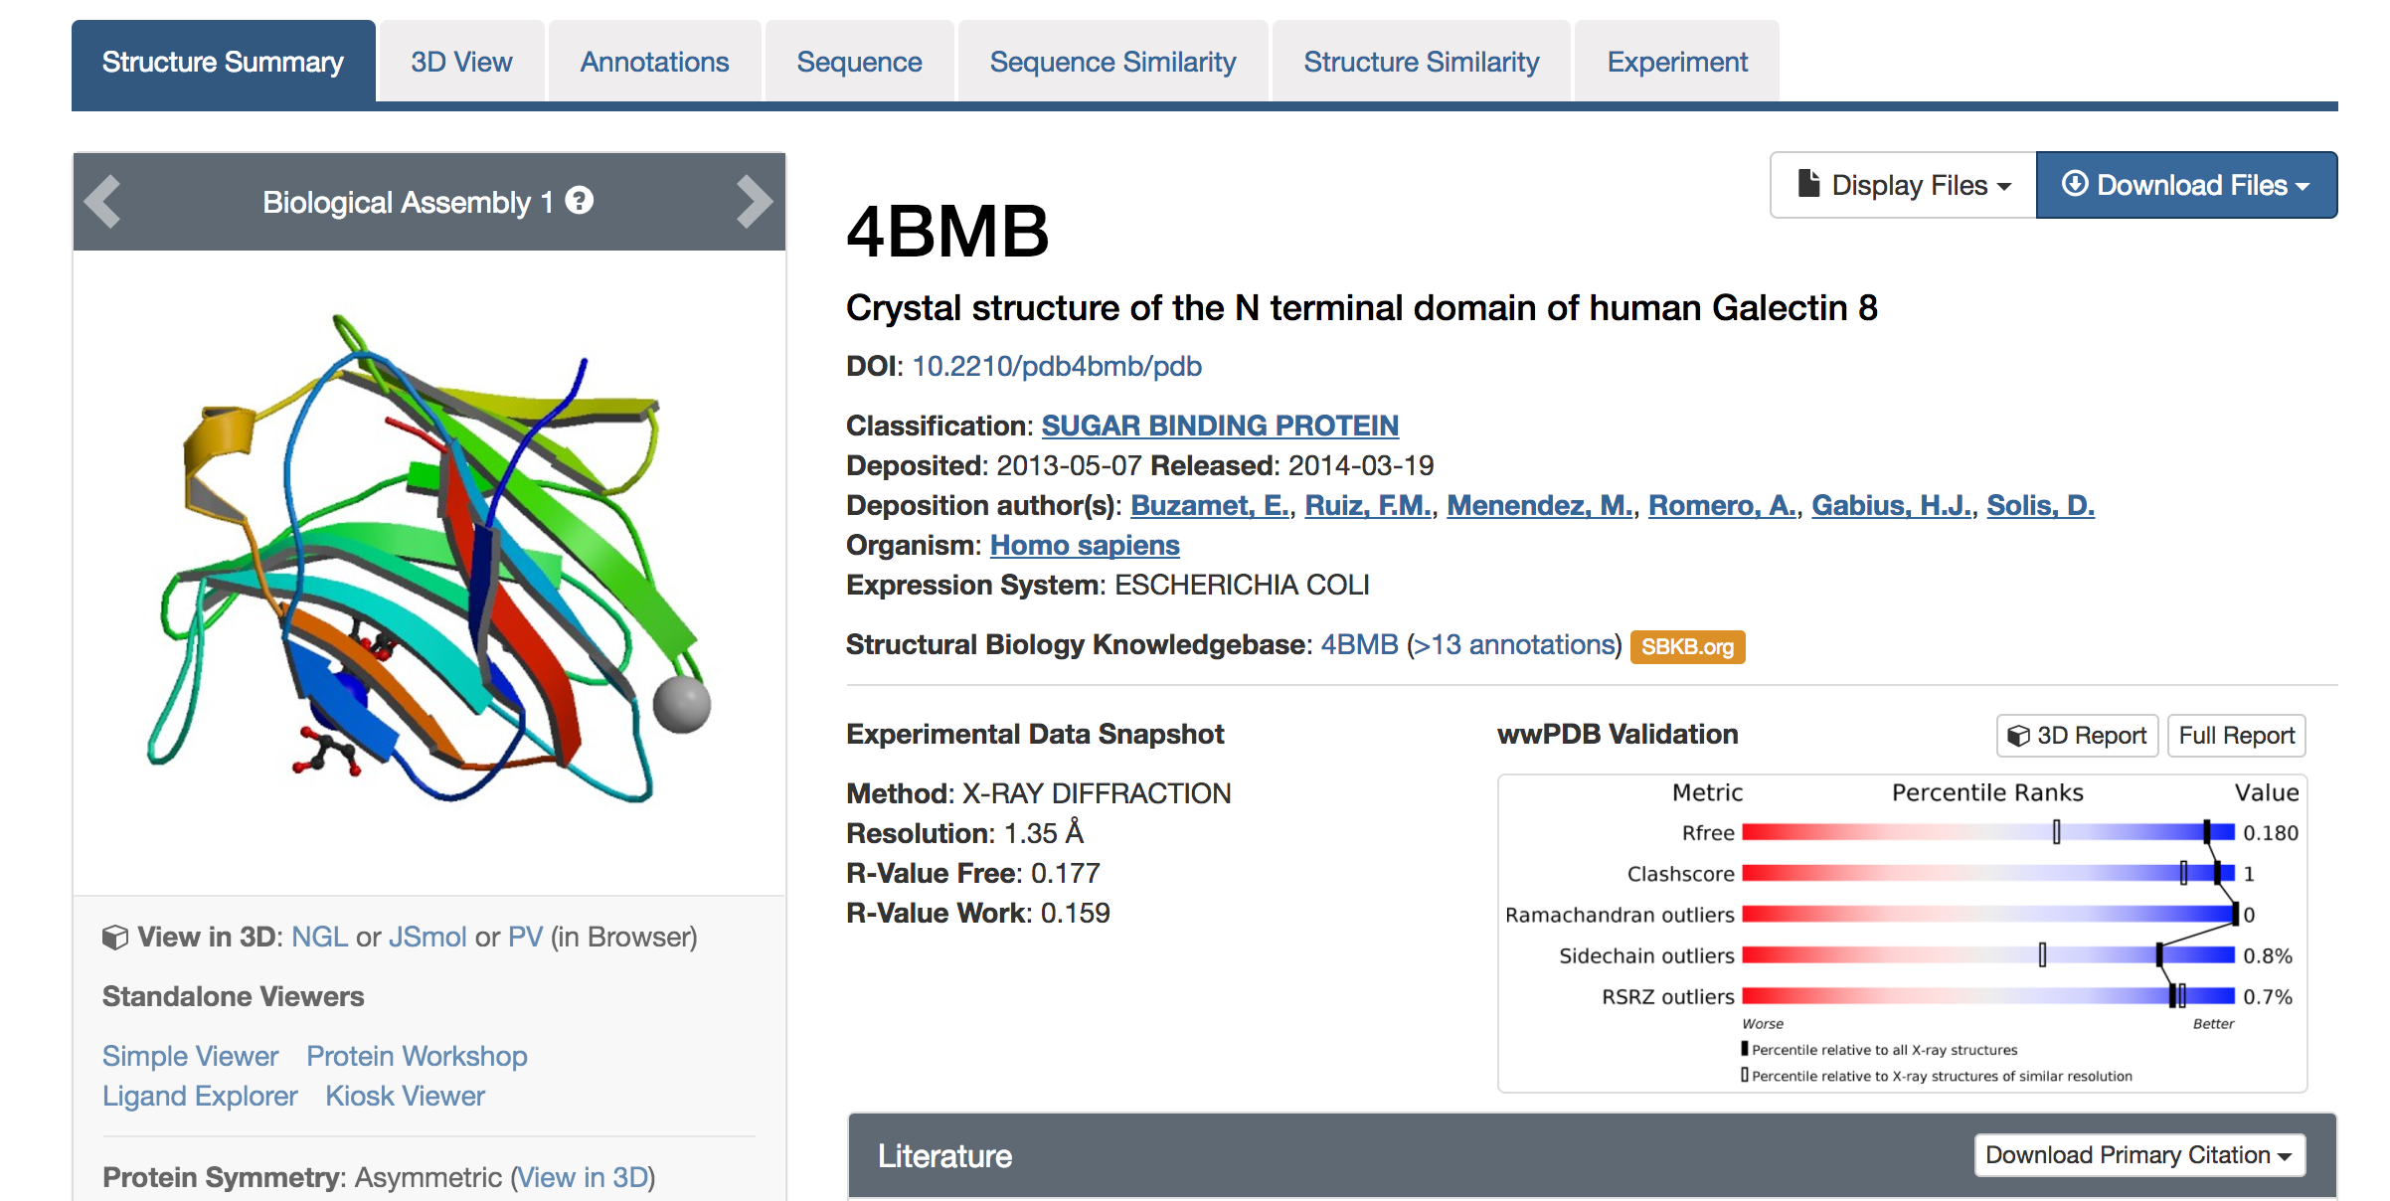
Pipeline
Rosetta 2017.08
4BMB PDB file
Six steps
Relaxing the protein PDB file
Repacking the structure
Calculating Delta G of the wild type protein
Repacking the structure with a point mutation at position 19
Calculating Delta G' of the mutated protein
Calculating the change in binding energy.

Slide 2
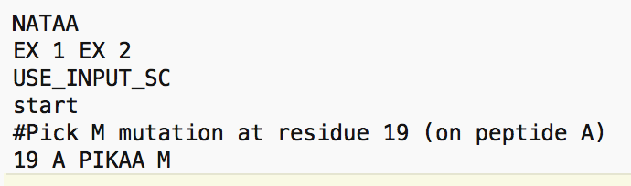
Pipeline
Commands
Step 1 relax.default.macosclangrelease -s 4bmb.pdb -ignore_unrecognized_res -out:path:pdb results -out:file:scorefile results/relax_4bmb.sc -nstruct 1
Steps 2-5 rosetta_scripts.default.macosclangrelease -parser:protocol mutation_script.xml -s 4bmb_relaxed.pdb -ignore_unrecognized_res -out:path:pdb results -out:path:score results -nstruct 1
Step 6 tail -n 3 4bmb_relaxed_M.pdb | awk 'BEGIN{i=0}{if($2 != "") {a[i] = $2; i++}}END{print a[0]-a[1]}'

Slide 3
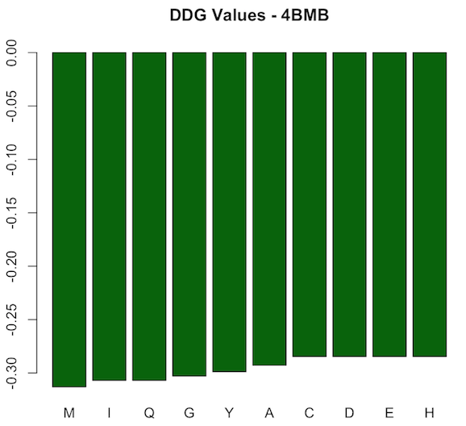
Pipeline
10 AA point mutations at position 19 of 4BMB
All stabilizing ddG < 0
Most stabilizing: M
Least stabilizing: C, D, E, and H

Slide 4
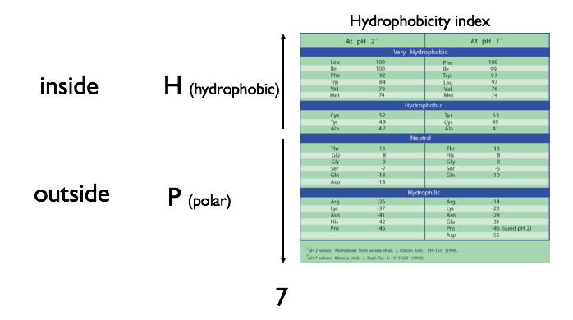
Pipeline
Why M?
M & T are “very hydrophobic”
Other AAs among chosen 10 are either hydrophilic or “hydrophobic”

Slide 5
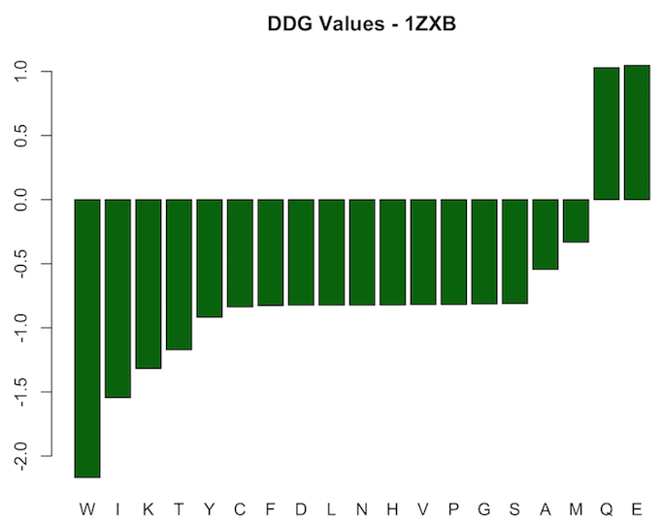
Pipeline
10 AA point mutations at position 19 of 1ZXC
Most are stabilizing (ddG < 0), 2 are destabilizing (ddG > 0)

Slide 6
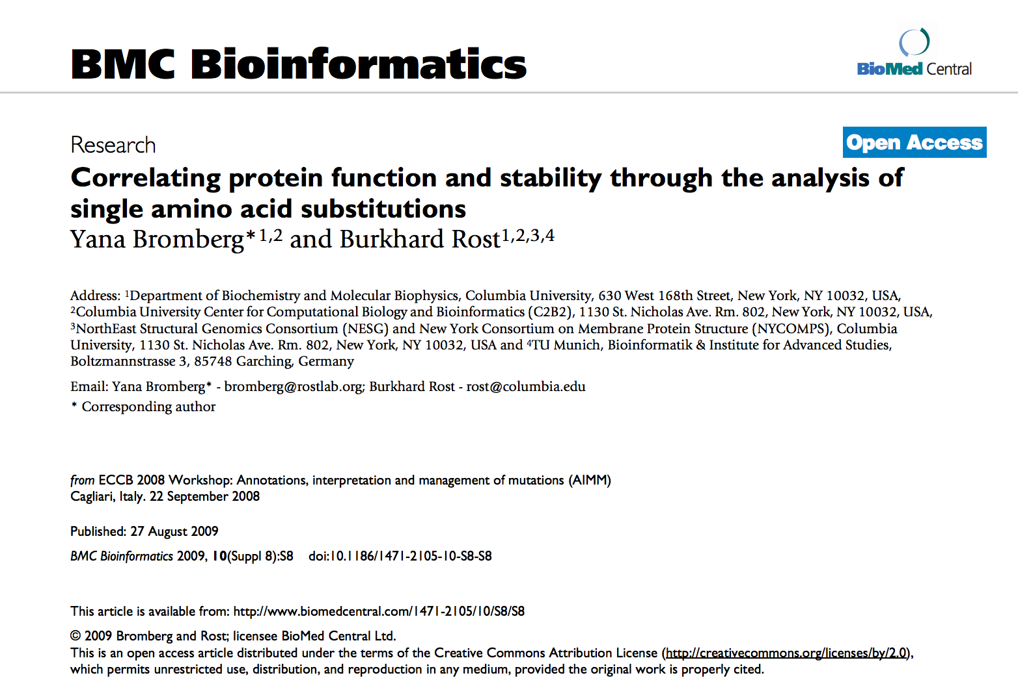
Pipeline
Changes in stability might lead to changes in protein function

