Slide 1
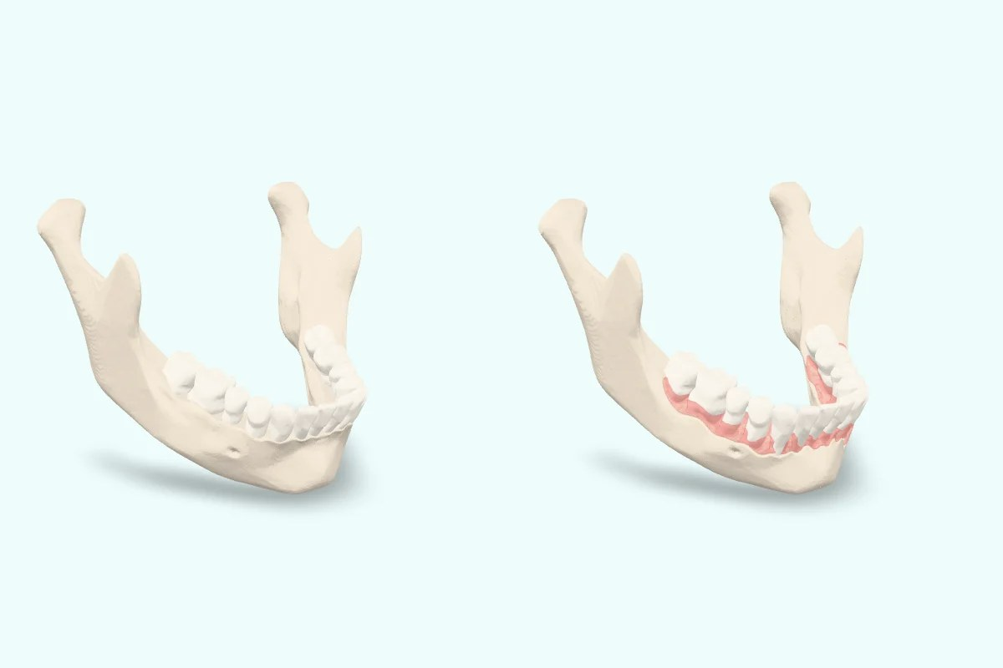
Vivatheca · 3D model
Gum disease (periodontitis), Stages I to IV
[Your slide title]
[Your key points: one idea per line]
Model: “Gum disease (periodontitis), Stages I to IV” (version 0.1), Vivatheca, https://vivatheca.com/periodontitis/. Licensed under CC BY-SA 4.0 (creativecommons.org/licenses/by-sa/4.0). Changes: [none, or describe your changes].
Not yet clinically reviewed. Educational model only. It shows typical anatomy or disease, not any real patient, and is simplified and may contain errors. Not for diagnosis, treatment planning, surgical guides or use in or on the body. vivatheca.com/disclaimer

