Slide 1
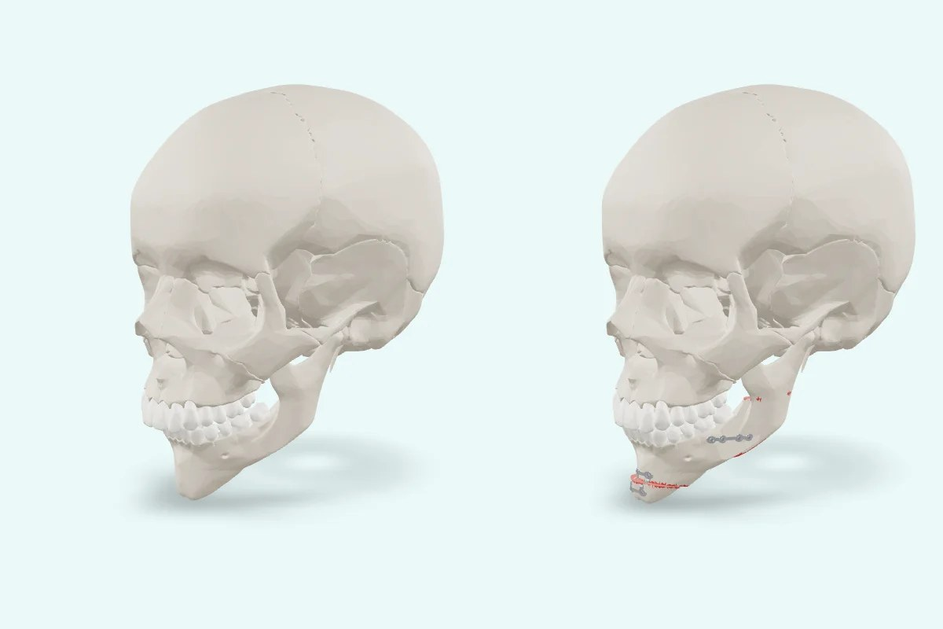
Vivatheca · 3D model
Jaw surgery to correct the bite
[Your slide title]
[Your key points: one idea per line]
Model: “Jaw surgery to correct the bite” (version 0.2), Vivatheca, https://vivatheca.com/orthognathic/. Licensed under CC BY-SA 4.0 (creativecommons.org/licenses/by-sa/4.0). Changes: [none, or describe your changes].
Not yet clinically reviewed. Educational model only. It shows typical anatomy or disease, not any real patient, and is simplified and may contain errors. Not for diagnosis, treatment planning, surgical guides or use in or on the body. vivatheca.com/disclaimer

