Slide 1
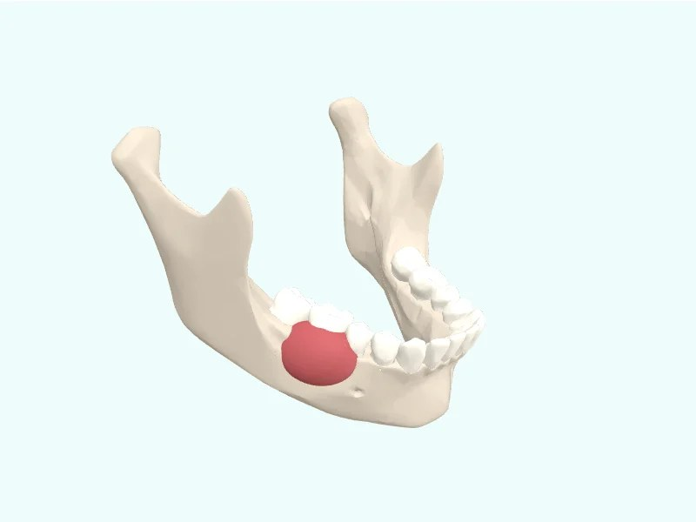
Vivatheca · 3D model
Mouth cancer in the lower jaw
[Your slide title]
[Your key points: one idea per line]
Model: “Mouth cancer in the lower jaw” (version 1.0), Vivatheca, https://vivatheca.com/head-neck/scc/. Licensed under CC BY-SA 4.0 (creativecommons.org/licenses/by-sa/4.0). Changes: [none, or describe your changes].
Not yet clinically reviewed. Educational model only. It shows typical anatomy or disease, not any real patient, and is simplified and may contain errors. Not for diagnosis, treatment planning, surgical guides or use in or on the body. vivatheca.com/disclaimer

