Slide 1
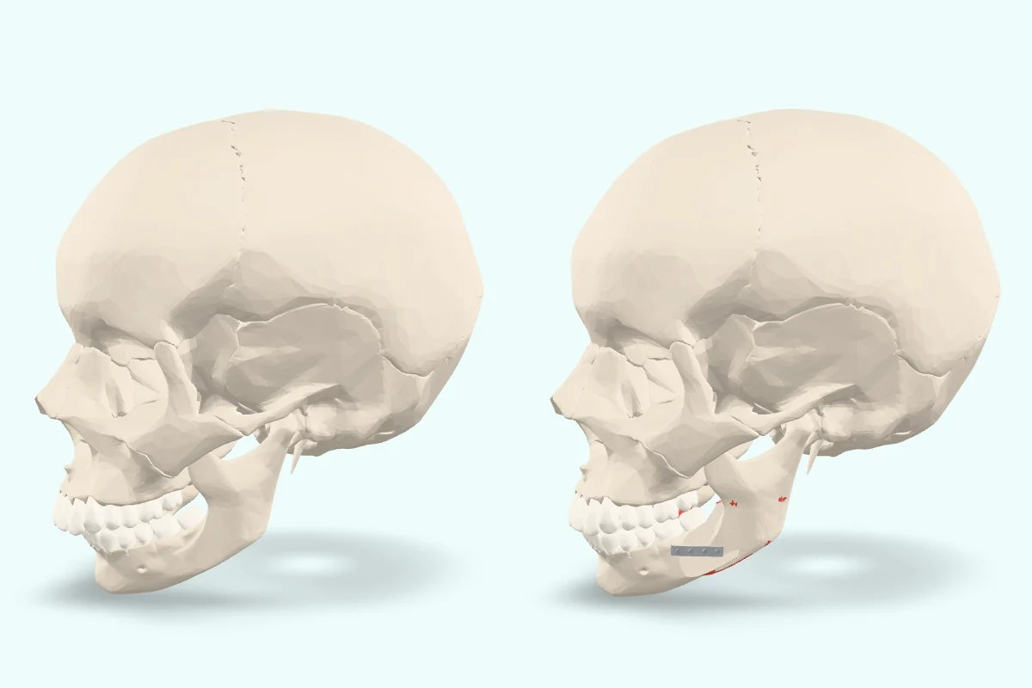
Vivatheca · 3D model
Jaw surgery to correct the bite
What this model shows
[Describe what the patient can see, in plain words. Short sentences, everyday words first.]
What it means for you
[Explain what it means for this patient. Give risks as “X in 100”. Cite your sources.]
Questions to ask
[List questions the patient may want to ask you.]
[Your clinic name and contact details]
Model: “Jaw surgery to correct the bite” (version 0.1), Vivatheca, https://vivatheca.com/orthognathic/. Licensed under CC BY-SA 4.0 (creativecommons.org/licenses/by-sa/4.0). Changes: [none, or describe your changes].
Not yet clinically reviewed. Educational model only. It shows typical anatomy or disease, not any real patient, and is simplified and may contain errors. Not for diagnosis, treatment planning, surgical guides or use in or on the body. vivatheca.com/disclaimer

