Slide 1
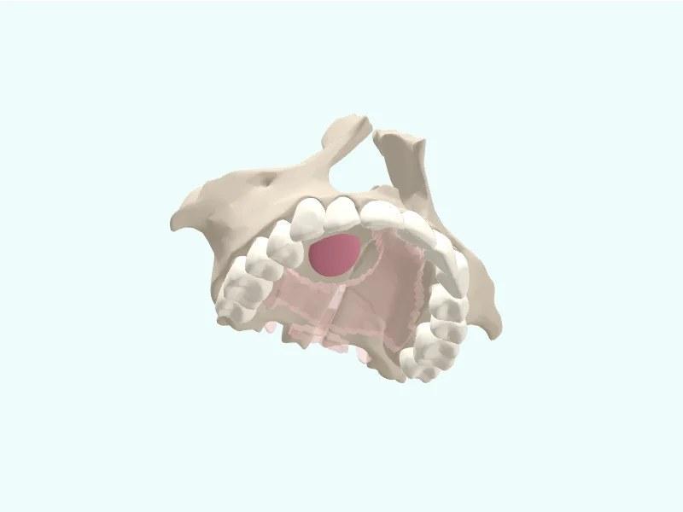
Vivatheca · 3D model
Cancer of a small spit gland in the roof of the mouth
[Your slide title]
[Your key points: one idea per line]
Model: “Cancer of a small spit gland in the roof of the mouth” (version 1.0), Vivatheca, https://vivatheca.com/head-neck/mec/. Licensed under CC BY-SA 4.0 (creativecommons.org/licenses/by-sa/4.0). Changes: [none, or describe your changes].
Not yet clinically reviewed. Educational model only. It shows typical anatomy or disease, not any real patient, and is simplified and may contain errors. Not for diagnosis, treatment planning, surgical guides or use in or on the body. vivatheca.com/disclaimer

