Slide 1
HDAT9700 Statistical Modelling II: Overview
Masters in Health Data Science
Term 2 2022

Slide 2
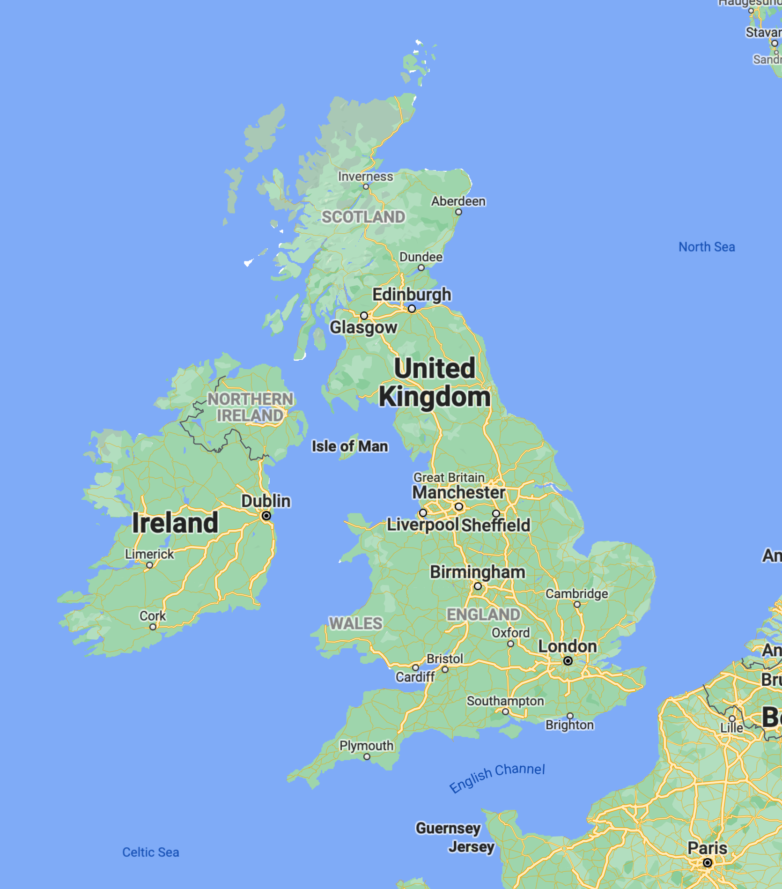
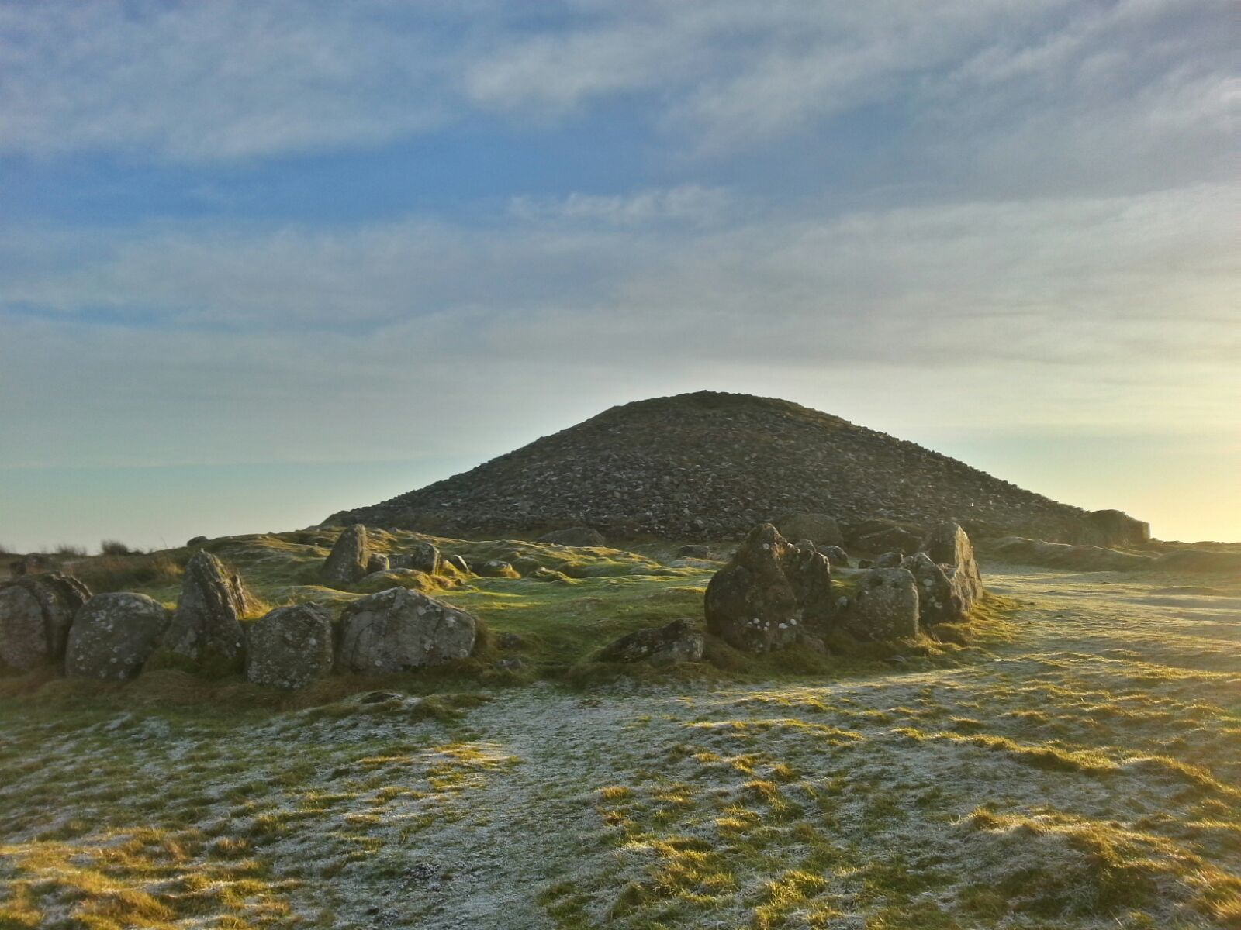



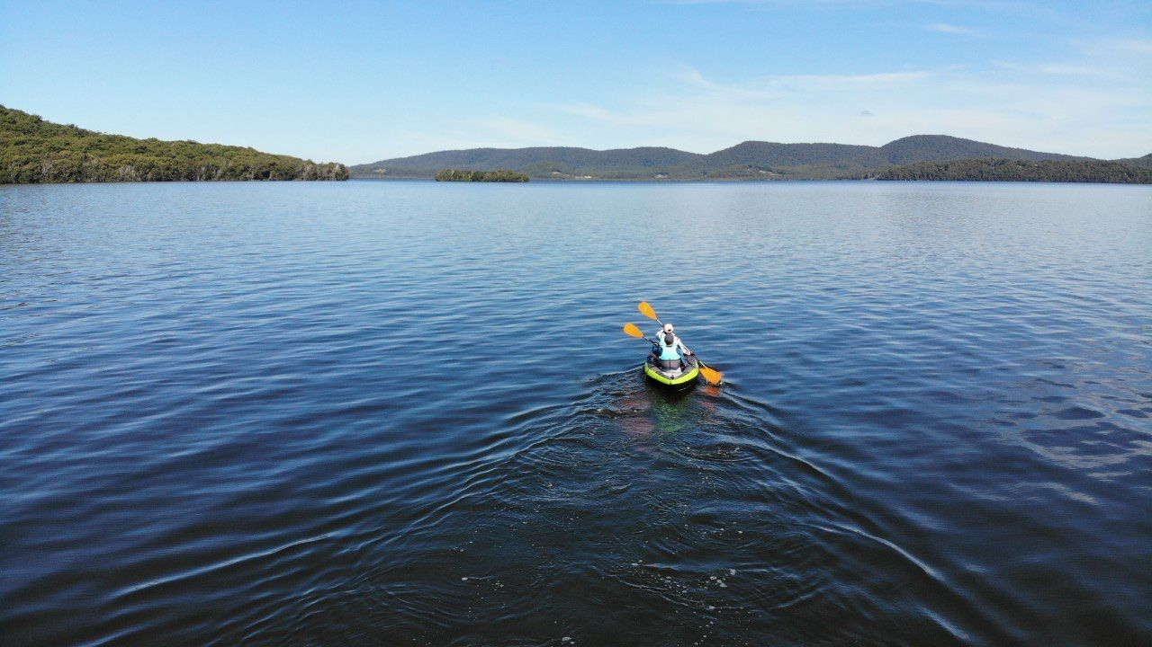
Hi, I’m Mark

Slide 3
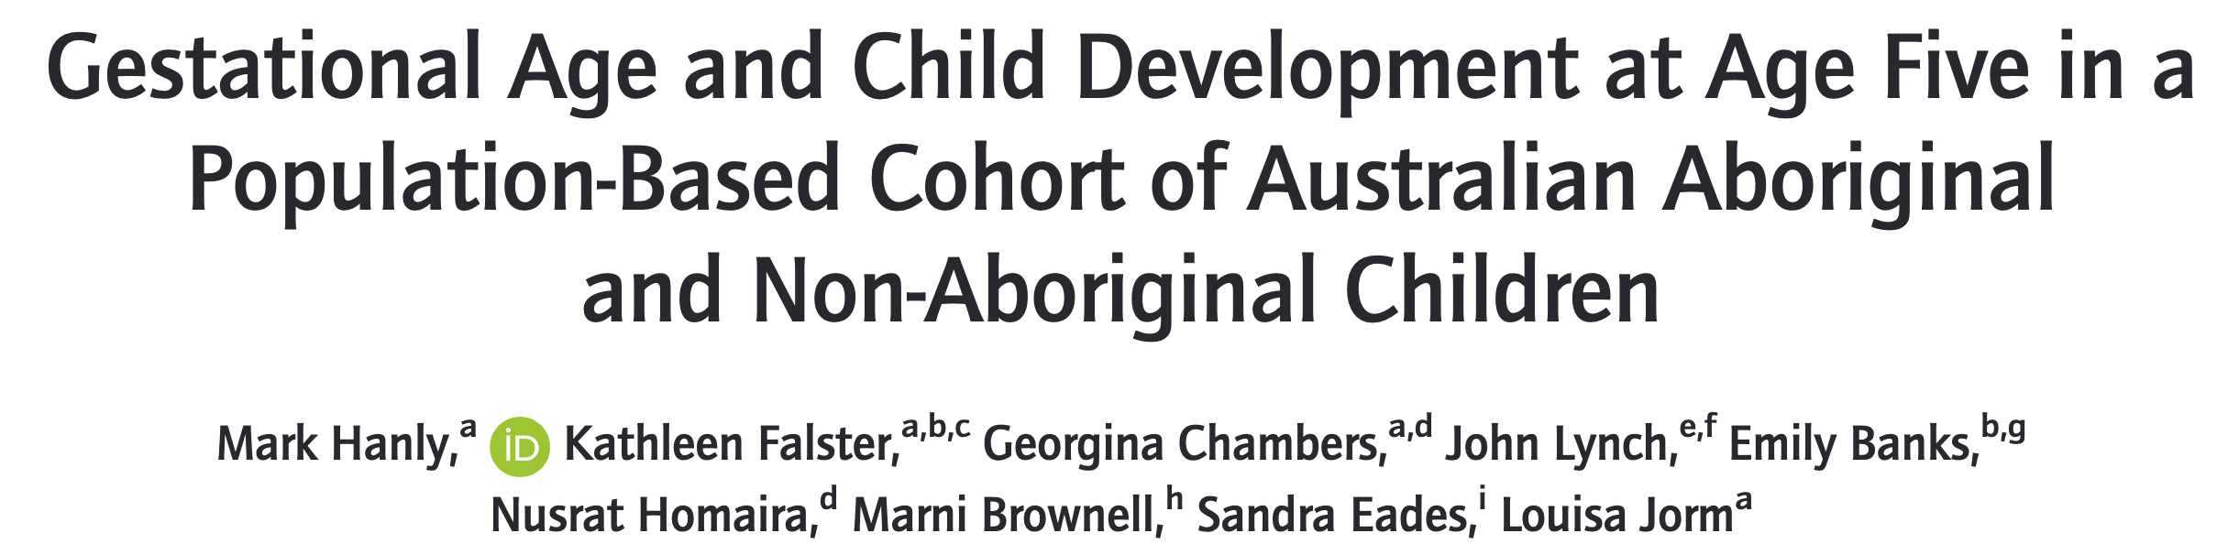
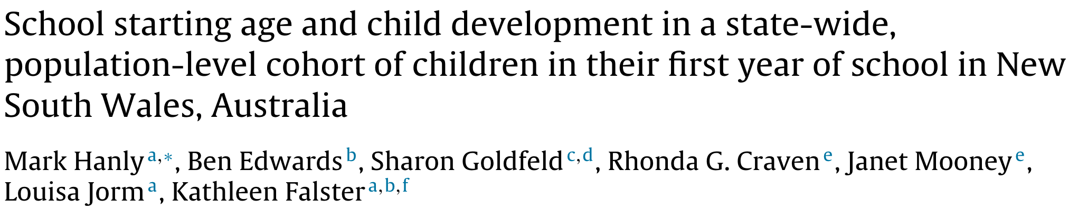

My research

Slide 4

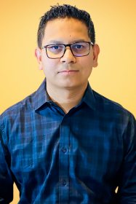
People
Course convenors
Mark Hanly (Ch. 1 - 9)
Guest lecturers
Md Shajedur Rahman Shawon (Ch. 10)
Mark
Shawon
Notes:
The course is delivered by biostatisticians and epidemiologists from the CBDRH and the syllabus and lectures are very much drawn from the methods and skills that we we use in our own research work. Rather than go in to depth on one particular topic we aimed to introduces a variety of scenarios and modelling approaches that you are likely to encounter when modelling health data

Slide 5
Course Content
Chapter | Chapter topic | Lecturer
1 | Directed Acyclic Graphs (DAGs) | Mark Hanly
2 | Causal inferences from observational data | Mark Hanly
3 | Multilevel modelling I (Introduction) | Mark Hanly
4 | Multilevel modelling II (Beyond the basics) | Mark Hanly
5 | Multilevel modelling III (Repeated measures analysis) | Mark Hanly
6 | Reading week
7 | Time series analysis | Mark Hanly
8 | Interrupted time series analysis | Mark Hanly
9 | Missing data and multiple imputation | Mark Hanly
10 | Presenting and summarising model results | Md Shajedur Rahman Shawon
Notes:
The course starts with an overview of different research designs and chapters 2 and 3 focus on methods for the analysis of observational data.
Chapters 4 and 5 focus on the analysis of time series data and in chapters 6 to 8 we will cover multilevel modelling. The final two chapters cover two topics that are relevant to any analysis, missing data and presenting results.

Slide 6
Assessments
Assessment | Topic | Week
1A | Causal inference | 1 – 2
1B | Multilevel modelling | 3 – 5
1C | Time series analysis | 7 – 8
2 | Final report | Your choice
50%
50%
Notes:
There are 2 assessments. Assessment 1 is continuous assessment which is split up into 3 individual assignments covering Chapters 1 to 8. In Assessment 2, you will complete a mini analysis and report to address a research question focusing on one of these three subject areas, and you can choose your preferred topic. The weighting is 50% towards the continuous assessment assignments and 50% towards the final report.

Slide 7




Software and platforms
Course website: cbdrh-hdat9700.github.io
Online tutorials
Notifications & Discussion
forecast
MatchIt
lme4
Getting started?
happygitwithr.com
Rmarkdown cheatsheet
Notes:
We will use a variety of different software platforms throughout the course, and most of you will be familiar with these. OpenLearning is the main hub for announcements, questions and sharing links and file.
All coding will be in R, as are our interactive R tutorials. You can also expect to install and use a lot of new R packages for example MatchIt for propensity score matching, forecast for timeseries analysis and lme4 for analysis of multilevel data.
You will prepare your assessments in R Markdown and submit using GitHub, which mimics best practice datasciecne workflow. If you have taken the 9800 Visualisation course you will be familiar with this; if not I recommend these links to get started and you are welcome to reach out if you are having any issues

Slide 8
Workflow expectations
UNSW expectation is 10-15 hours of study and learning activities per week for a six-units-of-credit course
Each week you are expected to complete:
Core chapter readings
Interactive learnr tutorials
Weekly online sessions (Mondays 5-7pm)
Be present on Teams, e.g. keep an eye out for posts and discussions
Notes:
You should note that UNSW expects a minimum of 10 hours a week dedicated to a six-units of credit course. You should use that time each week to check out the chapter pre-readings, attend the online tutorials, work through he interactive R tutorials and to ask and answer questions on OpenLearning.

Slide 9
Contact and questions
Teams best ☺
Remember to tag me!
Weekly online sessions (Monday 5-7pm)
Weekly office hours (flexible times – email/message to arrange)

