Slide 1
HDAT9700
Multilevel modelling I
Online tutorial

Slide 2
Housekeeping
Assessment 1a due Monday 27 June
Camera on, if possible, please
Record

Slide 3
Outline today
Part 1: Comments on pre-reading
Part 2: MLM overview
Part 3: Illustration with Shiny app

Slide 4
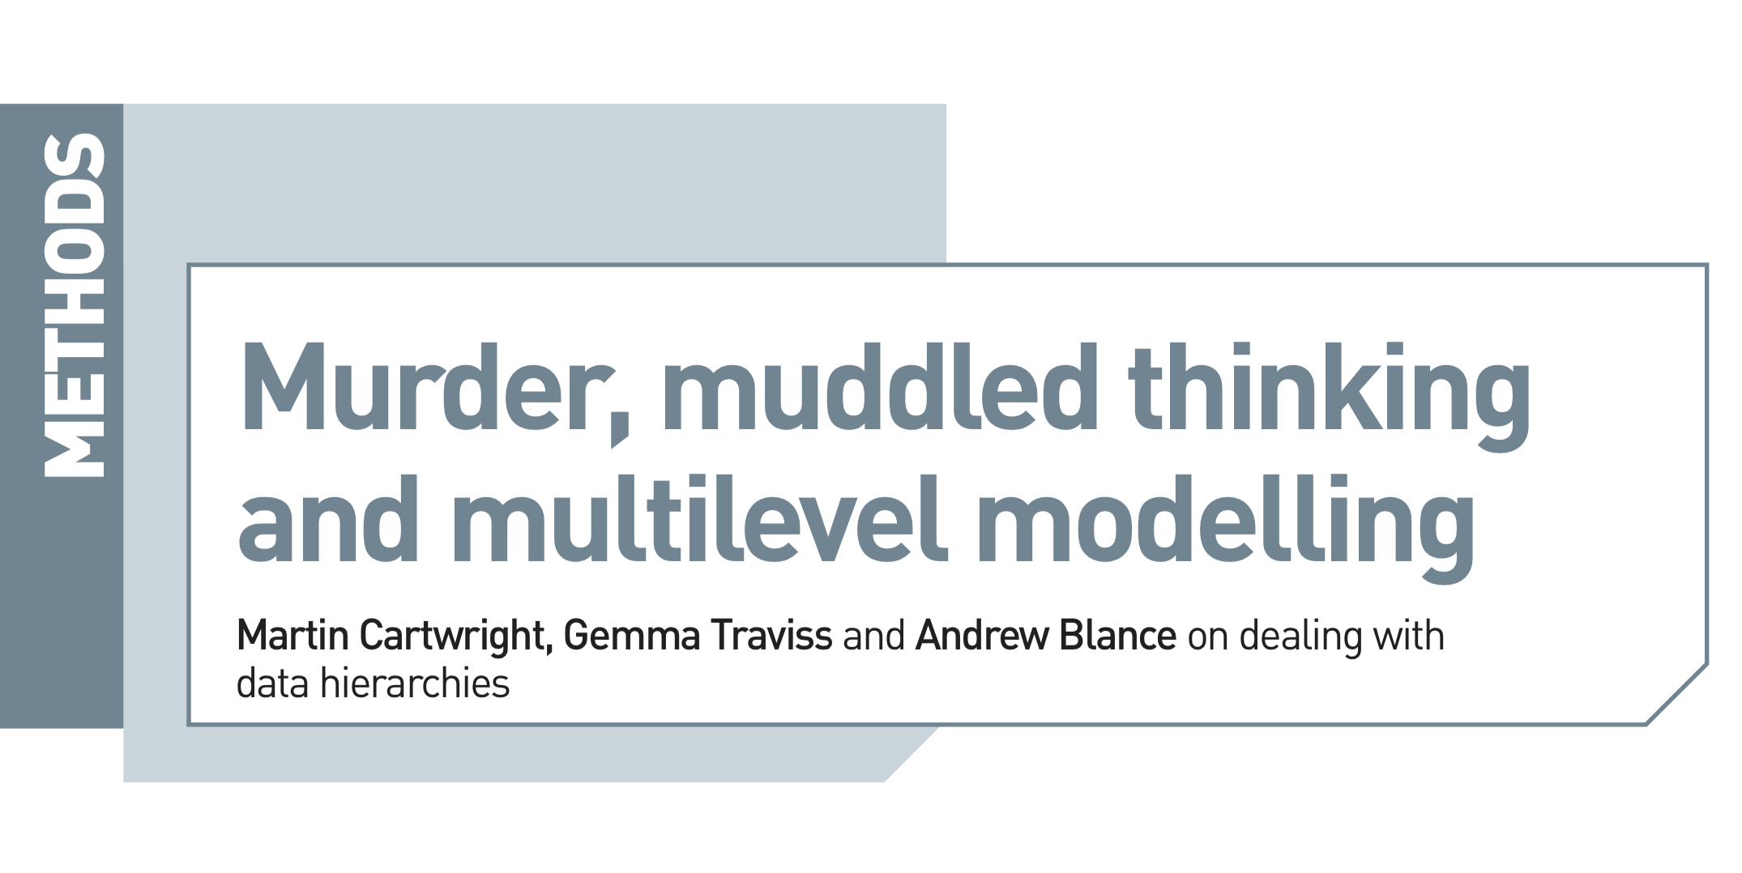
Prereading
Psychologist 25.9 (2012): 690-693.

Slide 5
Key points
In 1999, UK solicitor Sally Clarke was wrongly convicted of killing her two infant sons (who died 13 months apart)
She ultimately served over three years in prison before her conviction was overturned
The defense argued that the probability of two deaths was 1 in 73 million
Based on an estimated probability of Sudden Infant Death for each child of around 1 in 8500
(1/8500 X 1/8500 ~= 1/73000000)

Slide 6
Problem: Incorrectly assumes deaths were independent
“The most fundamental error in Meadow’s testimony was that he treated the two deaths as occurring independently”
Q. Why might the two deaths be dependent?
Notes:
Can you remember from your statistical foundations course, what is the assumption that was violated here?
Independent and identically distributed (i.i.d) – in particular the deaths weren’t independent as the children had shared genetics and environment.

Slide 7
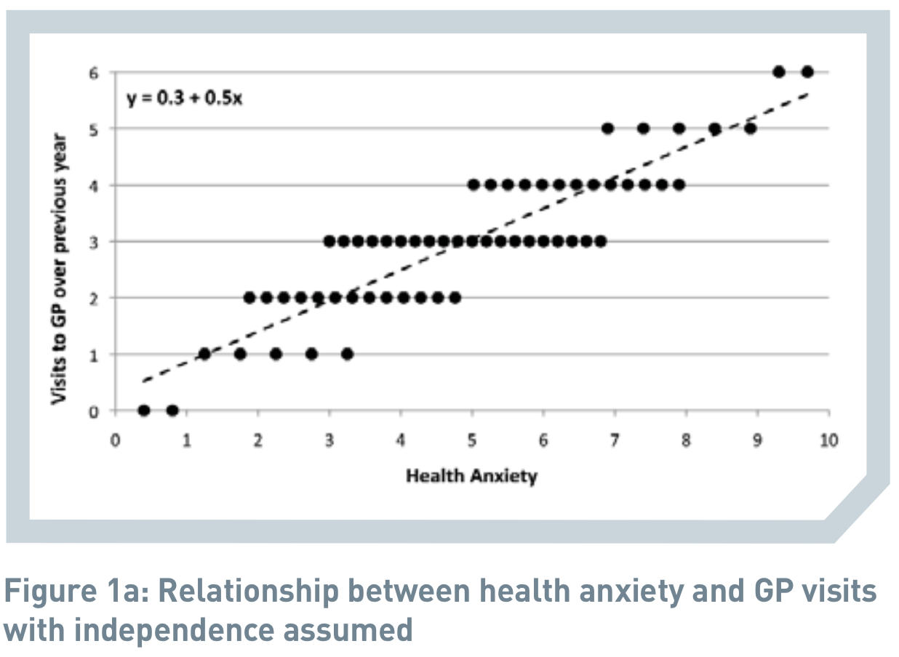
Example: Health Anxiety and GP visits
Assumes 60 independent observations

Slide 8
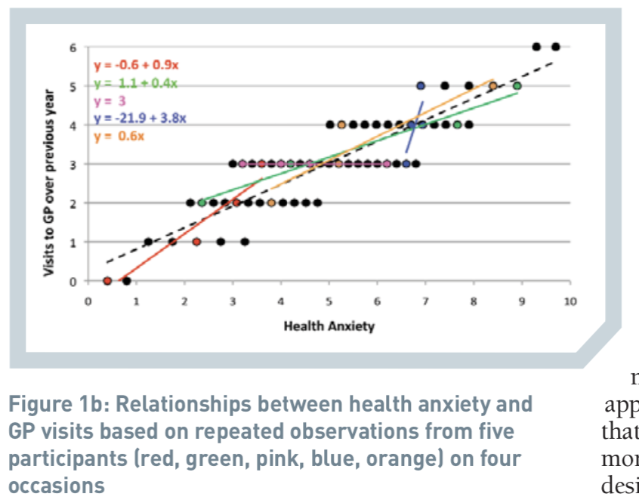
Example: Health Anxiety and GP visits
15 participants contribute data at 4 time points
Notes:
How do we res

Slide 9
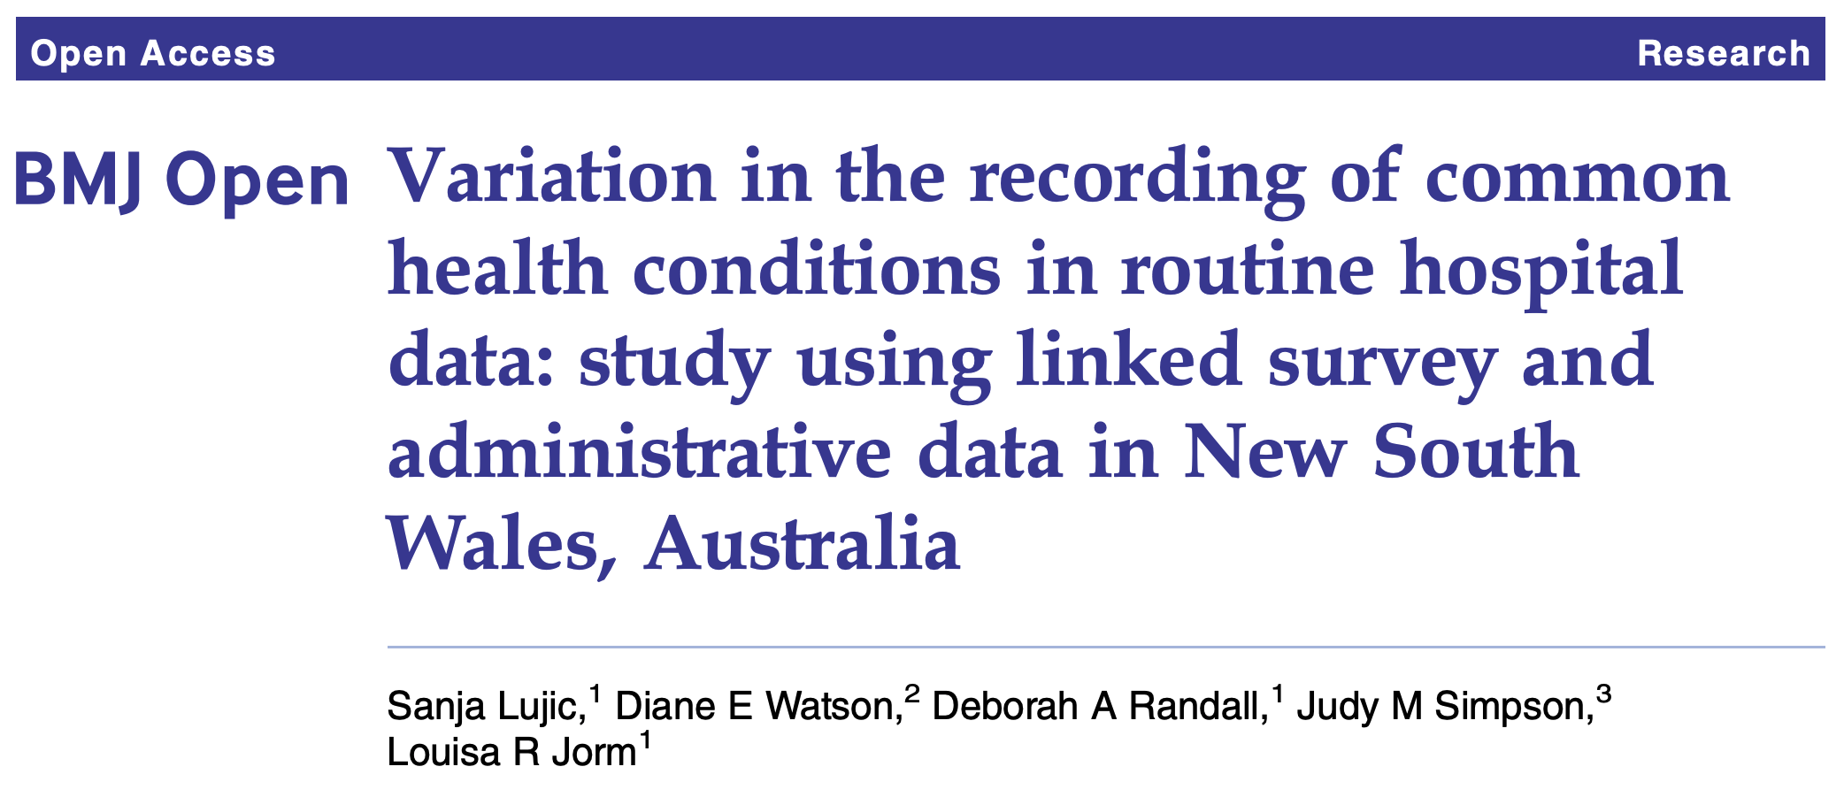
Example closer to home
http://dx.doi.org/10.1136/bmjopen-2014-005768
Three research questions:
Does administrative data under report morbidities? (6 morbidities)
Does this vary by hospital?? (313 hospitals)
What patient and hospital factors predict this?
Notes:
Four health conditions (diabetes, heart disease, hypertension and stroke) and two health risk factors (obesity and smoking)

Slide 10
Data structure for this research – Admitted Patients Data Collection linked to 45 and Up survey data
Hospital ID | Person ID | Diabetes self-report | Diabetes admin | Agree? | Education | Hospital type
A | 101 | 1 | 1 | 1 | Year 10 | Public
A | 102 | 0 | 0 | 1 | Year 12 | Public
A | 103 | 1 | 0 | 0 | Year 12 | Public
B | 201 | 1 | 1 | 1 | Degree | Private
B | 202 | 0 | 1 | 0 | Degree | Private
B | 203 | 1 | 0 | 0 | Year 12 | Private
Notes:
A good example of hierarchical or clustered data – patients clustered within hospitals.

Slide 11
Challenges in this analysis
Usual GLM ignores that patients attending the same hospital have similar characteristics
Can’t add 313 dummy variables for each hospital (RQ2)
Or if we did, we couldn’t also control for hospital-level variables, e.g. hospital type, hospital size.

Slide 12
The solution?
Multilevel models!
- Reflect clustering in the data (=> appropriate standard errors)
- Address more interesting research questions
Does quality of administrative data vary by hospital?
What patient and hospital characteristics predict an outcome?
Do patient and hospital characteristics interact to influence an outcome

Slide 13
Example closer to home
http://dx.doi.org/10.1136/bmjopen-2014-005768
“Significant between-hospital variation was found (ranging from 8% of unexplained variation for diabetes to 22% for heart disease)”
Implications for comparisons involving heart disease based solely on hospital data
Notes:
The results for your interest

Slide 14
When is this relevant? Multilevel contexts

Slide 15
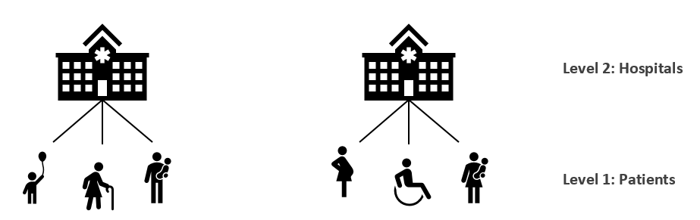
Multilevel contexts
A two-level hierarchy with patient at level 1 and hospital at level 2

Slide 16
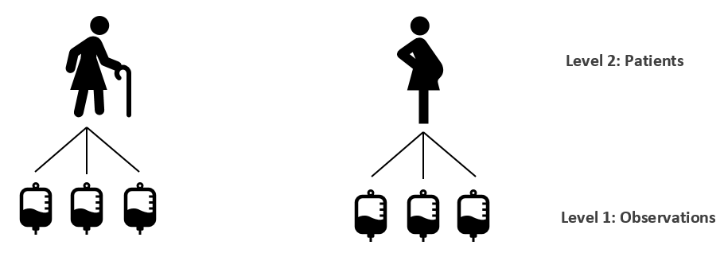
Multilevel contexts
A two-level hierarchy with observations at level 1 clustered within patients at level 2.

Slide 17
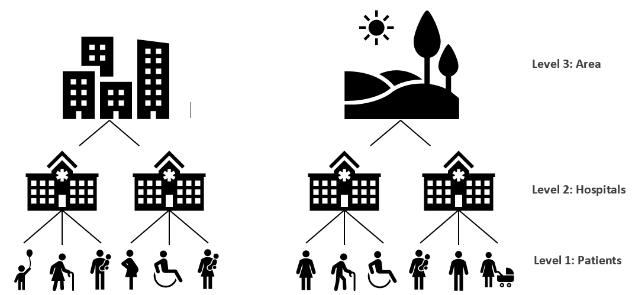
Multilevel contexts
A three-level hierarchy with patient at level 1

Slide 18
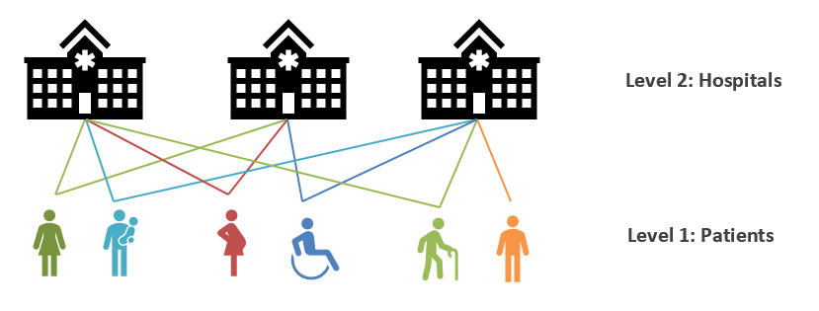
Multilevel contexts
Multiple membership (Patients attend multiple hospitals)

Slide 19
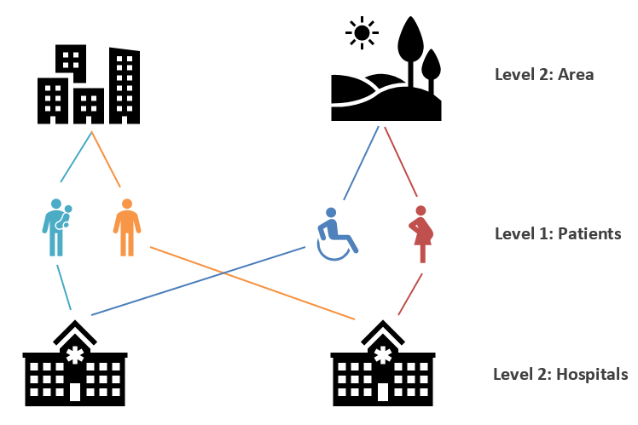
Multilevel contexts
Cross classification

Slide 20
How is a multilevel model operationalised? It’s all about the residuals

Slide 21
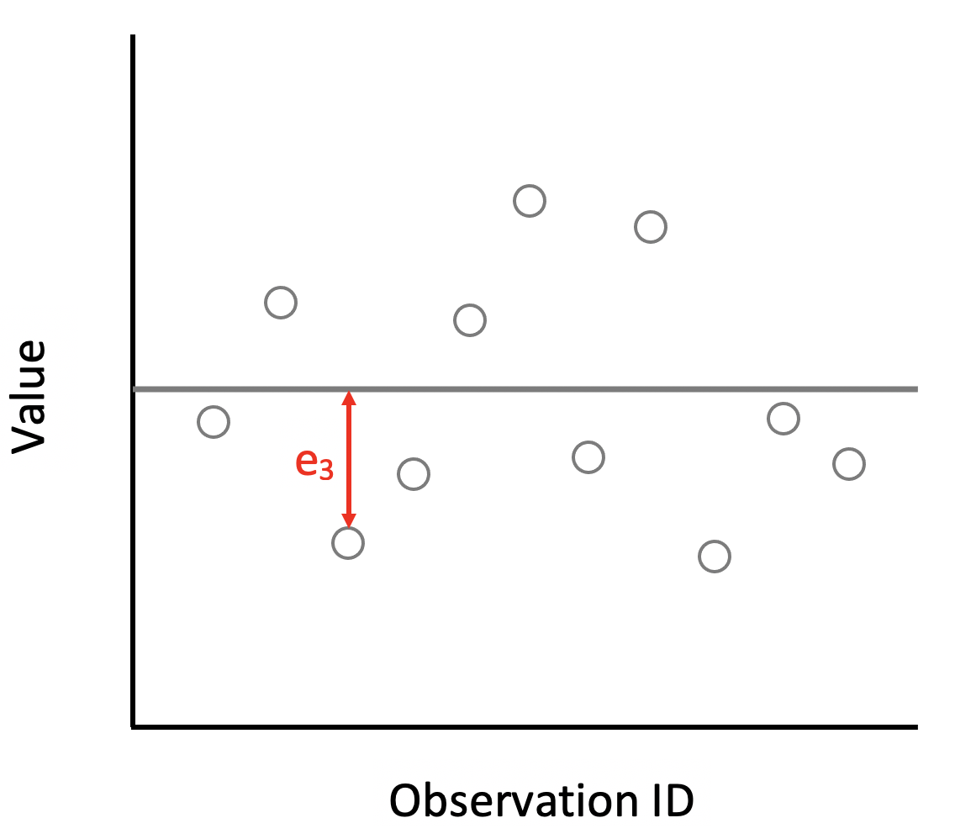
Residuals
Single-level residuals

Slide 22
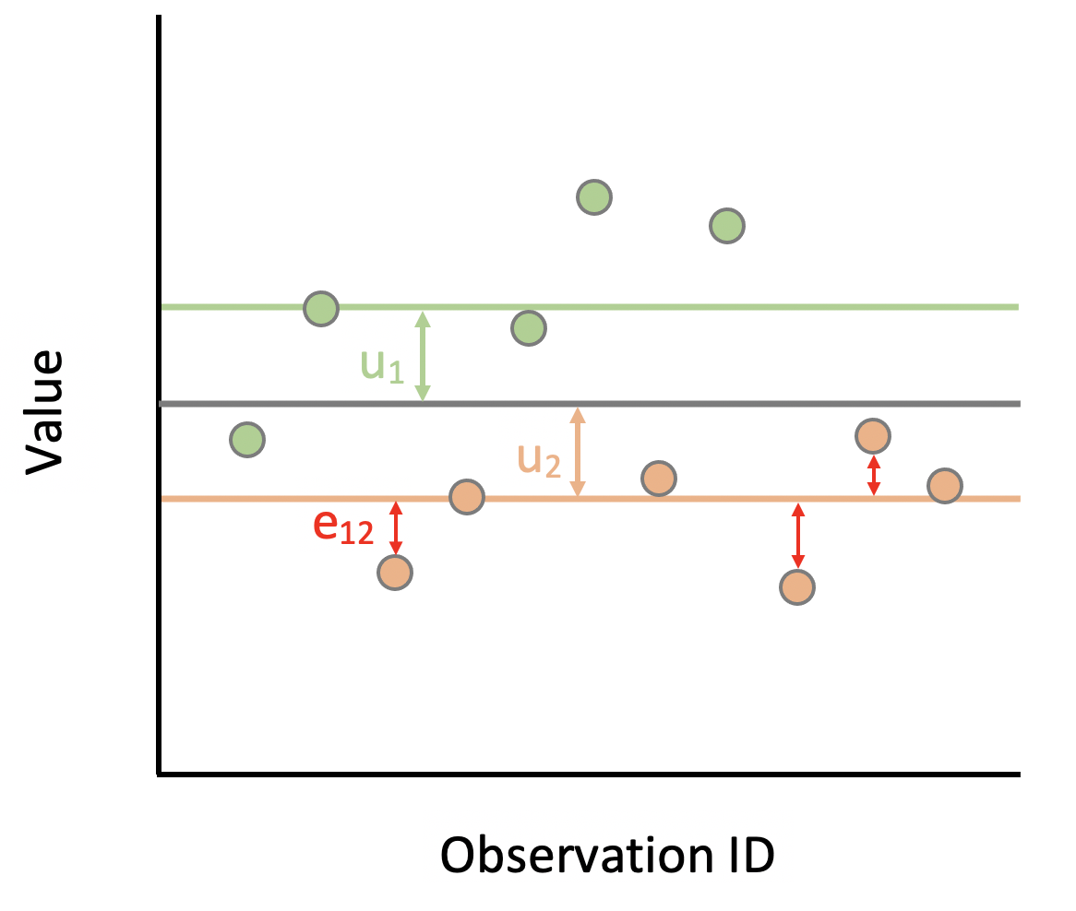
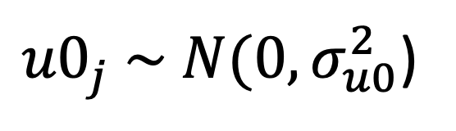
Residuals
Decompose into group-level residuals & within-group residuals
e₃ = u₂ + e₁₂
e_{i} = u_{i} + e_{ij} _{i = level 1 index} _{j = level 2 index}
${u0}_{j} \sim N(0, σ_{u0}^{2}$)
Notes:
Note the notation is simplified here compared to the learnr tutorial where I use u0 rather than u (because I want to distinguish from a different type of residual labelled u1).

Slide 23
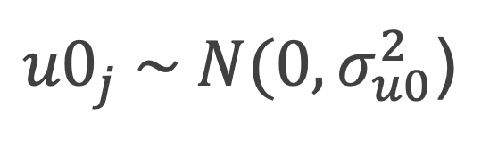
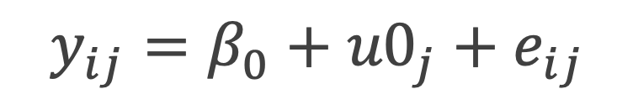
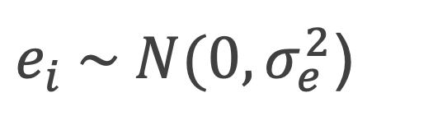
Variance components model
An empty two-level multilevel model
$$y_{ij}=β_{0}+{u0}_{j}+e_{ij}$$
${u0}_{j} \sim N(0, σ_{u0}^{2}$)
Normally distributed level 2 residuals
$e_{i} \sim N(0, σ_{e}^{2}$)
Normally distributed level 1 residuals

Slide 24
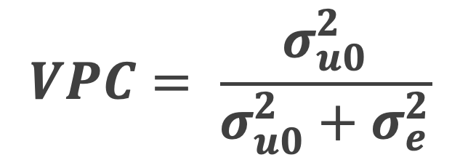
The Variance Partition Coefficient (VPC)
The proportion of variance at level 2
$$VPC= \frac{σ_{u0}^{2}}{σ_{u0}^{2}+σ_{e}^{2}}$$

Slide 25
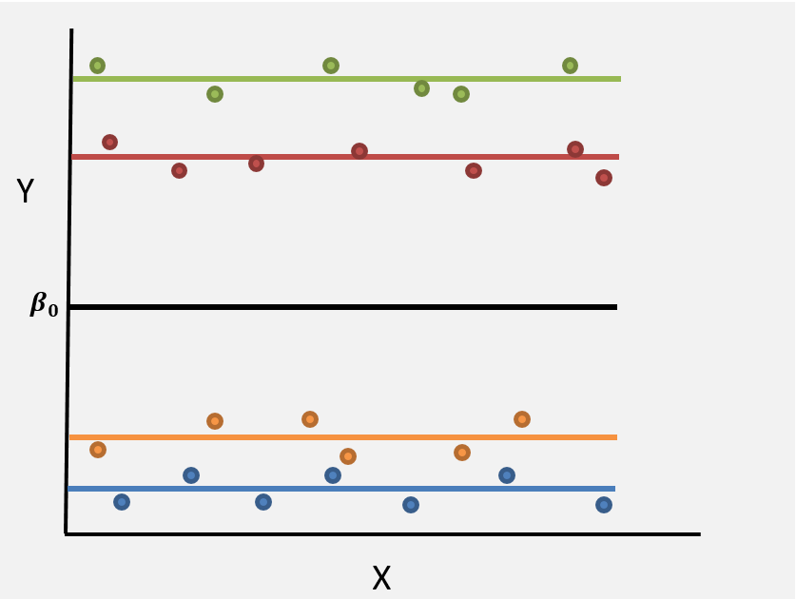
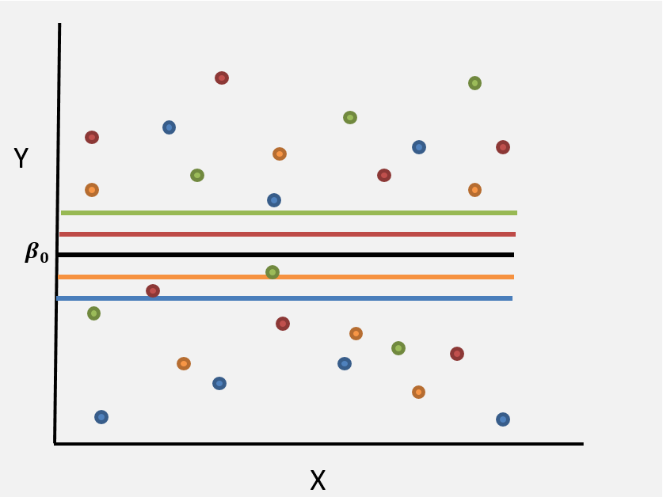
Interpreting the VPC
A.
B.
Which plot shows higher VPC, A or B?

Slide 26
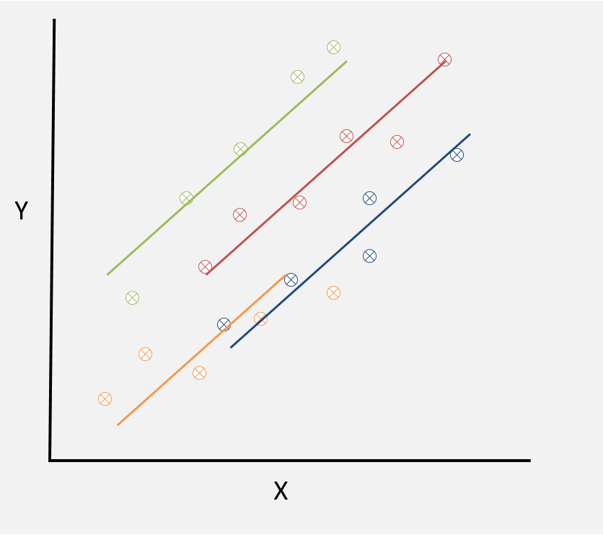
Random intercept model
Notes:
Group level lines are constrained to be parallel

Slide 27
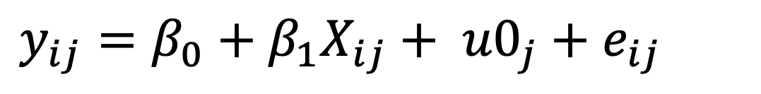
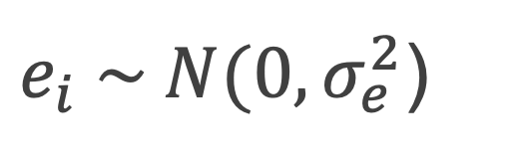

Random intercept model
$$y_{ij}=β_{0}+β_{1}X_{ij}+ {u0}_{j}+e_{ij}$$
${u0}_{j} \sim N(0, σ_{u0}^{2}$)
$e_{i} \sim N(0, σ_{e}^{2}$)
One or more covariates X
Covariates can be at level 1, level 2 or even an interaction between level 1 and level 2.
Group level lines are parallel
Notes:
One or more X variables.
Covariates can be at level 1, level 2 or even an interaction between level 1 and level 2.

Slide 28
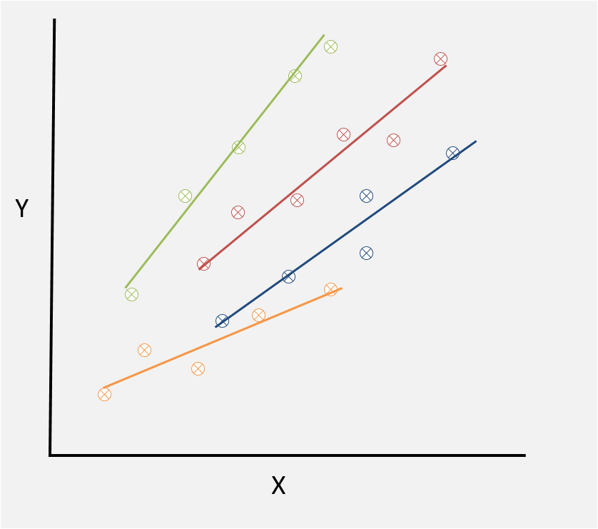
Random intercept-random slope model
Notes:
Group level lines are no longer constrained to be parallel

Slide 29
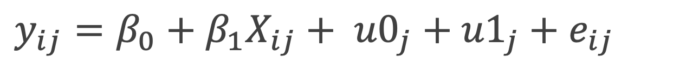
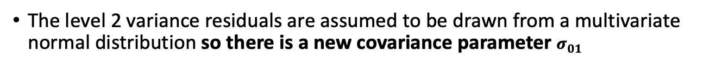
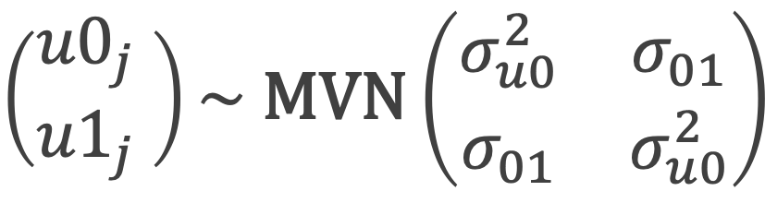

Random intercept-random slope model
$$y_{ij}=β_{0}+β_{1}X_{ij}+ {u0}_{j}+{u1}_{j}+e_{ij}$$
$$\left(\begin{matrix}{u0}_{j} \\ {u1}_{j}\end{matrix} \right)\sim \text{MVN}\left(\begin{matrix}σ_{u0}^{2} & σ_{01} \\ σ_{01} & σ_{u0}^{2}\end{matrix}\right)$$
$e_{i} \sim N(0, σ_{e}^{2}$)
The level 2 variance residuals are assumed to be drawn from a multivariate normal distribution so there is a new covariance parameter $σ_{01}$

Slide 30
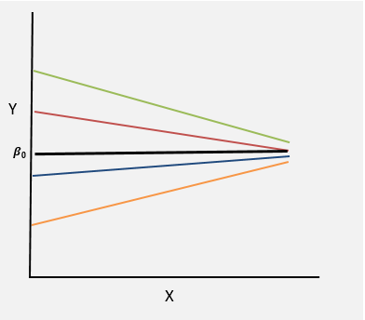
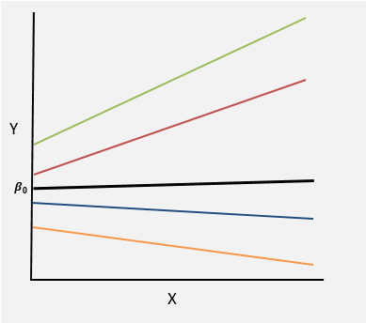
Interpreting the covariance parameter
A.
B.
Which plot shows positive covariance $σ_{01}$, A or B?

Slide 31
Summary (make sure you are comfortable with these ideas!)
Motivation
Appropriate standard errors
Answer questions related to different levels
Multilevel hierarchies
Patients nested within hospitals
Observations nested within patients
Residuals
Decomposed into (i) group-level residuals and (ii) within-group residuals
Basic models
Random intercept model
Random slope model

Slide 32
Visual example: Estimating faculty salaries, where the faculty work in different departments.
http://mfviz.com/hierarchical-models/

Slide 33
App: visualising multilevel models
Online: https://cbdrh.shinyapps.io/mlm1/
Rstudio: hdat9700tutorials::run('mlm-1')

