Slide 1
HDAT 9700
Multilevel modelling III – Growth Curve Models
Online tutorial

Slide 2
Housekeeping
Assessments 1a currently being marked
Assessment 1b released
Cameras on
Record

Slide 3
Outline
Motivating example
Special features of growth curve models
R practical

Slide 4
Motivating example: Incontinence dataset
Men with prostate cancer commonly experience urinary incontinence following treatment with either surgery or radiotherapy
Outcome = the extent to which urinary incontinence caused difficulty in completing activities of daily living (range 0 – 10)
Measured at 4 time points
Baseline (after treatment)
6 months post-treatment
12 months post-treatment
18 months post-treatment
Research questions
Improvement over time?
Difference by surgery or radiotherapy?
Do outcomes vary much for different patients?

Slide 5
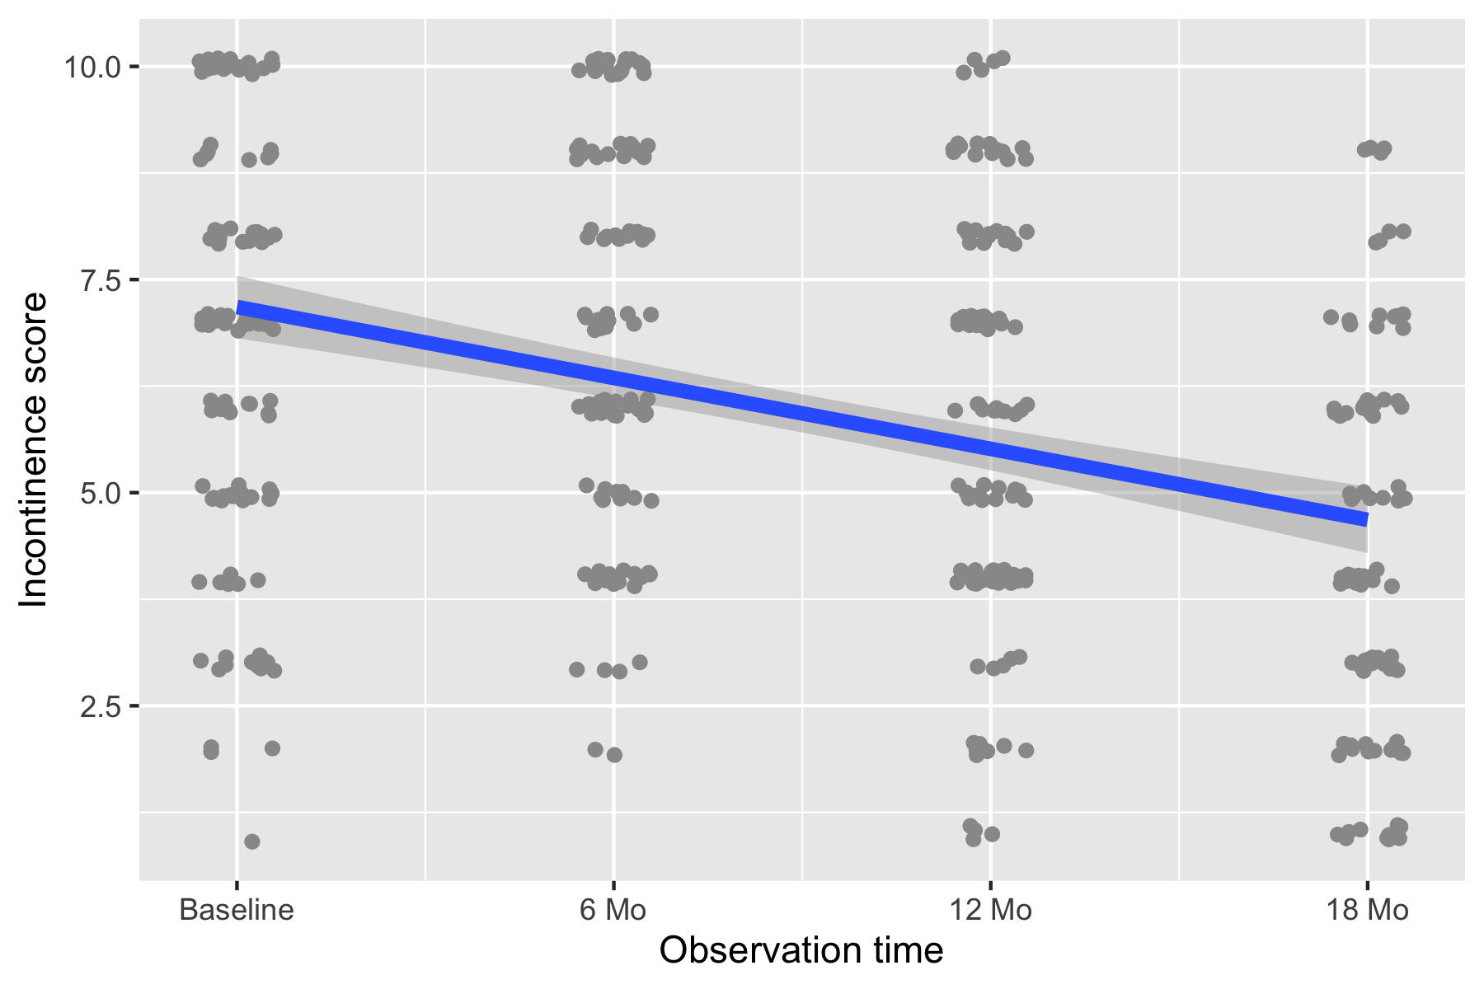
We can fit a single regression line to this data…

Slide 6
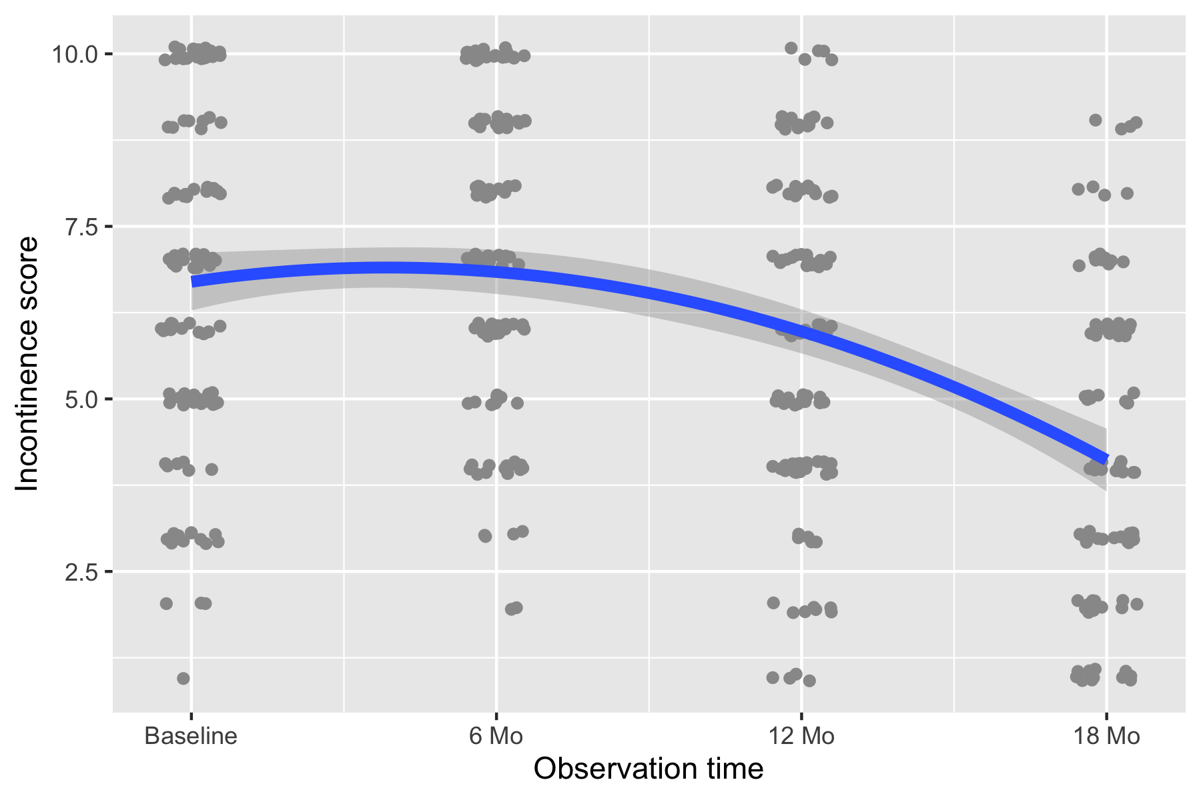
Or we could fit a curve…
Notes:
How would we do this?
In this example, would the quadratic term be positive or negative

Slide 7
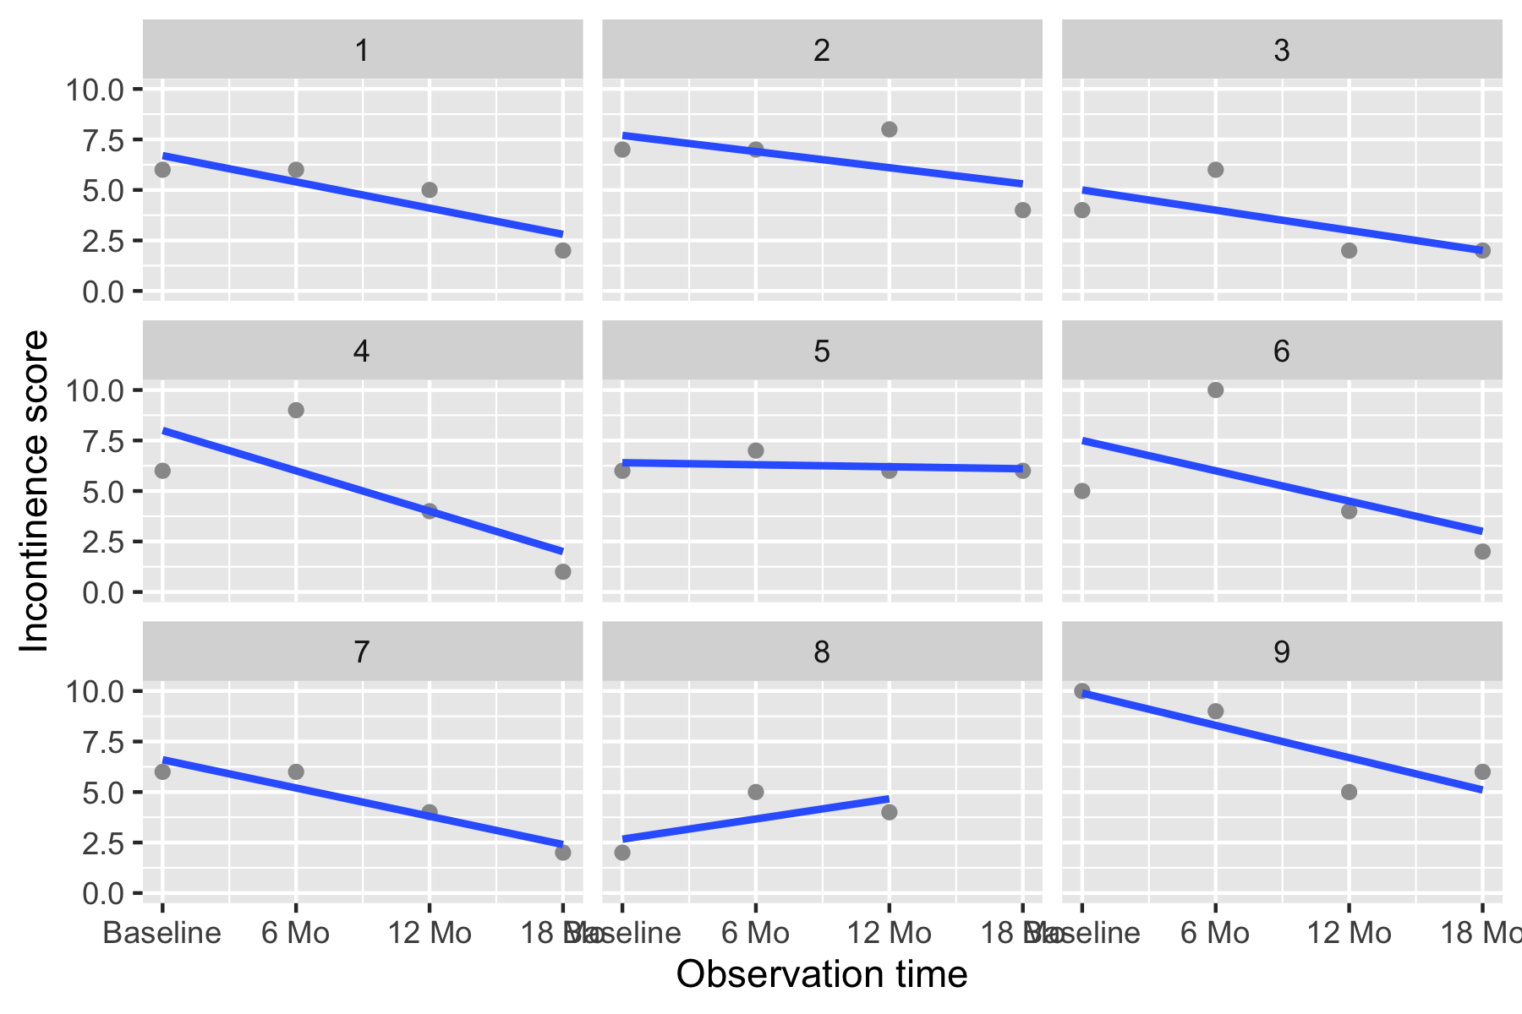
We might separate lines for each patient
Notes:
Note the missing data – in general MLMs can tolerate a small amount of missing data
What kind of multilevel model would be implied by these lines? (Random intercept/random intercept-random slope?)

Slide 8
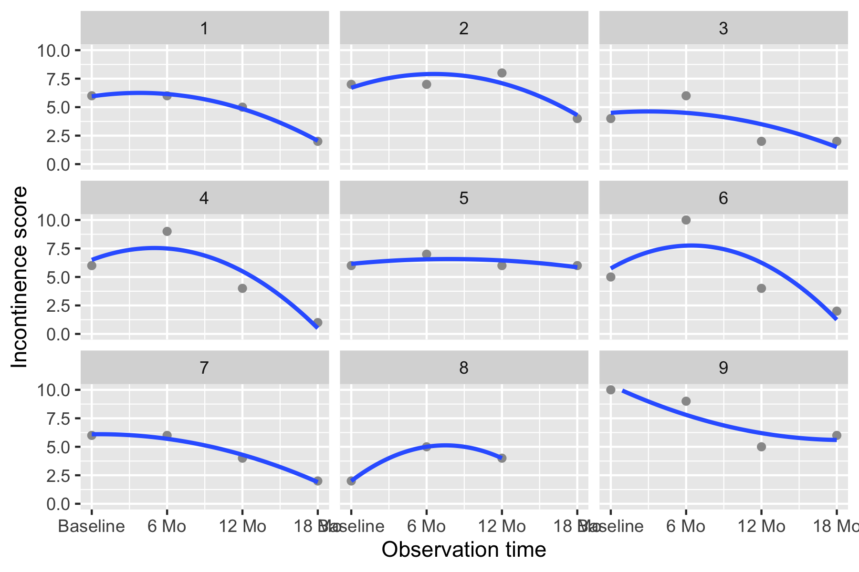
Or indeed separate curves…

Slide 9
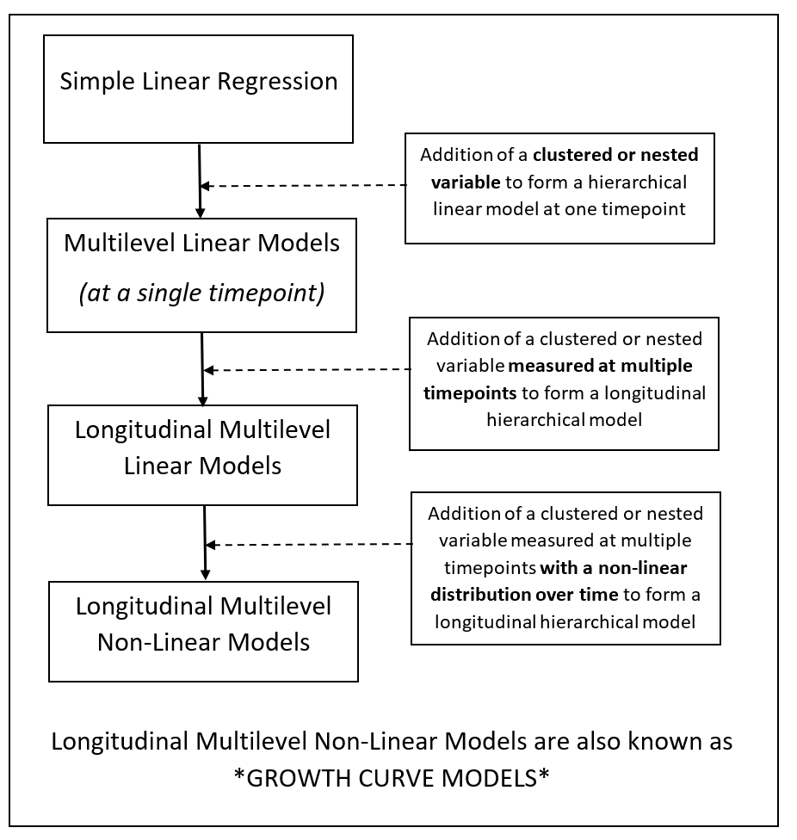
What are growth curve models?
A special type of multilevel model!

Slide 10
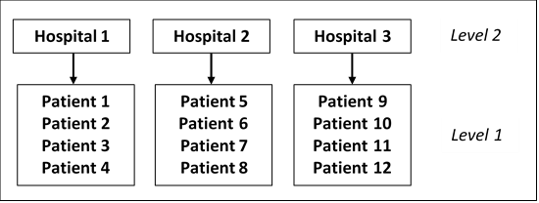
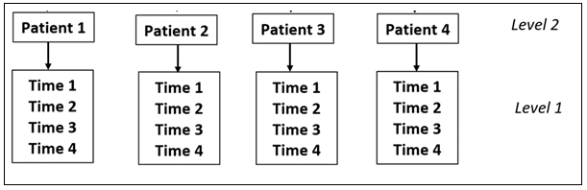
Repeated measures data hierarchy
So far, we have mostly conceptualized patient at level 1.
With repeated measures data we have patient at level 2

Slide 11
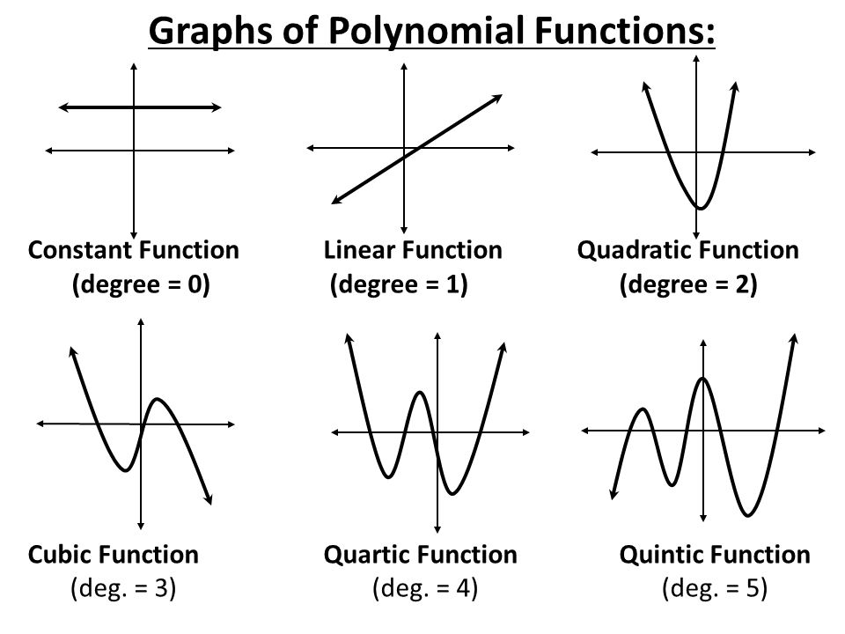
How do we parameterise time?
Polynomials
Splines
Notes:
Note that the possible degrees of the polynomial are always 1 – n where n is the number of observation time points
e.g. if there are 4 observation time points, the highest order polynomial would be a cubic
In practice, degrees above a cubic are rarely clinically meaningful

Slide 12
Data format for repeated measures analysis
Wide format: Often easier for humans entering data!
Patient ID | Time 1 | Time 2 | Time 3 | Time 4
101 | 8 | 9 | 7 | 6
102 | 8 | 10 | 7 | 5
103 | 6 | 7 | 3 | 3

Slide 13
Data format for repeated measures analysis
Long format: This is what we need to analyse longitudinal data in R
Patient ID | Time | Score
101 | 1 | 8
101 | 2 | 9
101 | 3 | 7
101 | 4 | 6
102 | 1 | 8
102 | 2 | 10
102 | 3 | 7
102 | 4 | 5
Notes:
In the R tidyverse this format is also referred to as “tidy data”: every column is a variable; every row is an observation; every cell is a single value

Slide 14

Covariance structure
We always assume level 1 errors are “white noise”
$e_{i} \sim N(0, σ_{e}^{2}$)

Slide 15

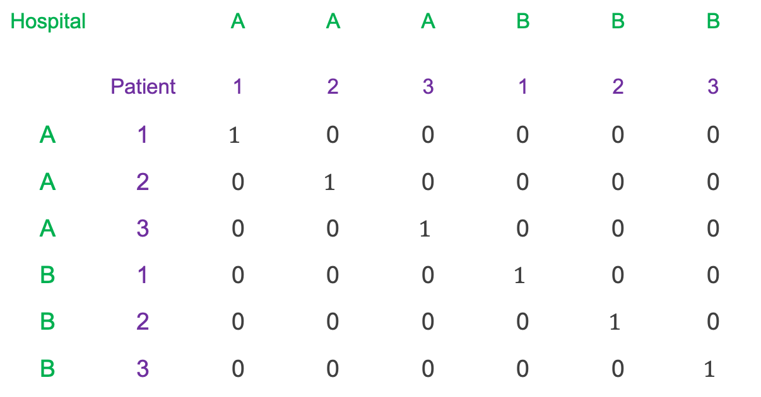
Covariance structure
This makes sense with patients nested within hospitals
e.g. the errors for patient 1 and patient 2 in hospital A are independent
Hospital |  | A | A | A | B | B | B
 | Patient | 1 | 2 | 3 | 1 | 2 | 3
A | 1 | $$1$$ | 0 | 0 | 0 | 0 | 0
A | 2 | 0 | $$1$$ | 0 | 0 | 0 | 0
A | 3 | 0 | 0 | $$1$$ | 0 | 0 | 0
B | 1 | 0 | 0 | 0 | $$1$$ | 0 | 0
B | 2 | 0 | 0 | 0 | 0 | $$1$$ | 0
B | 3 | 0 | 0 | 0 | 0 | 0 | $$1$$
$σ_{e}^{2}$ $×$

Slide 16
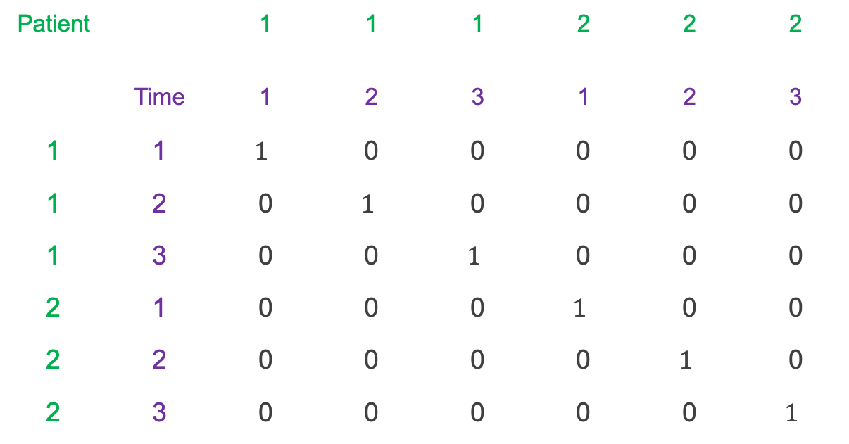
Covariance structure
But it may be different with repeat measures data, where observations at time 1 may be correlated with observations at time 2
Patient |  | 1 | 1 | 1 | 2 | 2 | 2
 | Time | 1 | 2 | 3 | 1 | 2 | 3
1 | 1 | $$1$$ | 0 | 0 | 0 | 0 | 0
1 | 2 | 0 | $$1$$ | 0 | 0 | 0 | 0
1 | 3 | 0 | 0 | $$1$$ | 0 | 0 | 0
2 | 1 | 0 | 0 | 0 | $$1$$ | 0 | 0
2 | 2 | 0 | 0 | 0 | 0 | $$1$$ | 0
2 | 3 | 0 | 0 | 0 | 0 | 0 | $$1$$
$σ_{e}^{2}$ $×$
Should these still be 0?

Slide 17
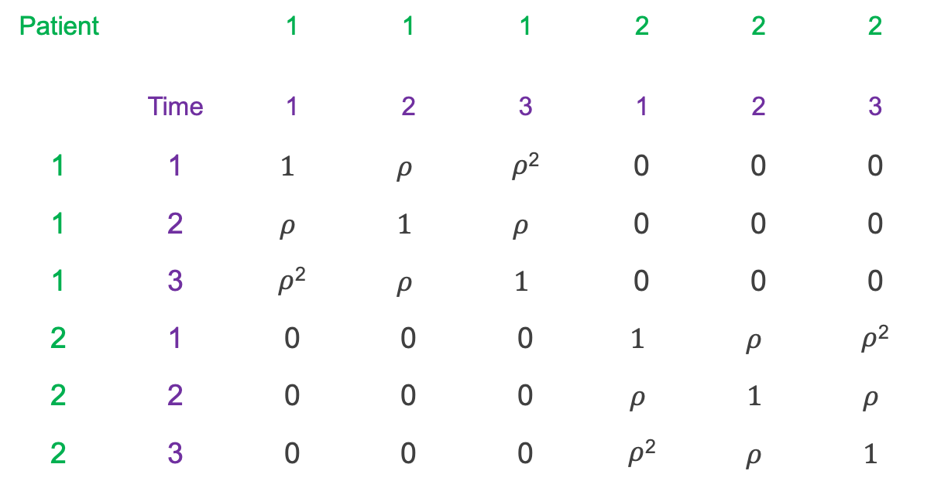
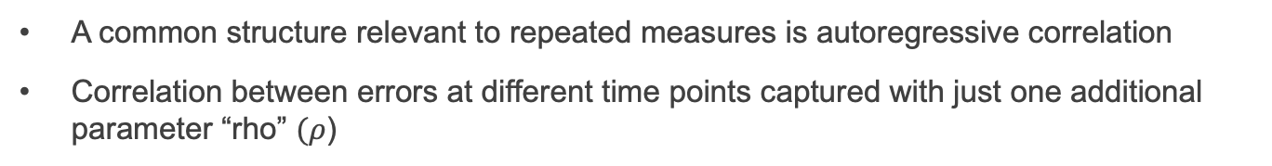
Covariance structure
A common structure relevant to repeated measures is autoregressive correlation
Correlation between errors at different time points captured with just one additional parameter “rho” $(ρ$)
Patient |  | 1 | 1 | 1 | 2 | 2 | 2
 | Time | 1 | 2 | 3 | 1 | 2 | 3
1 | 1 | $$1$$ | $$ρ$$ | $ρ$² | 0 | 0 | 0
1 | 2 | $$ρ$$ | $$1$$ | $$ρ$$ | 0 | 0 | 0
1 | 3 | $ρ$² | $$ρ$$ | $$1$$ | 0 | 0 | 0
2 | 1 | 0 | 0 | 0 | $$1$$ | $$ρ$$ | $ρ$²
2 | 2 | 0 | 0 | 0 | $$ρ$$ | $$1$$ | $$ρ$$
2 | 3 | 0 | 0 | 0 | $ρ$² | $$ρ$$ | $$1$$
$σ_{e}^{2}$ $×$

Slide 18
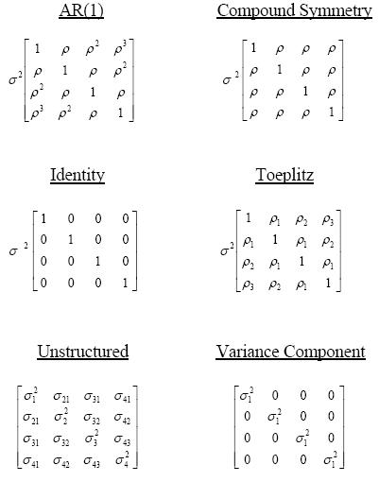
Covariance structure
Many different structures are possible
We can explore different structures and compare models

Slide 19
Fitting Growth Curve Models in R
lme4 package
Advantage
Faster. Can fit more model types.
Syntax
lmer(fixed = y ~ x + (1 | group), data=df )
nlme package
Advantage
Allows for complex variance structures
Syntax
lme(fixed = y ~ x, random = ~ 1 | group, data=df )

Slide 20
Summary of key points
Growth curve models are a special type of multilevel model
Applies to repeated measures data
Choice of parameterization for time (linear/polynomial/splines)
Flexible error covariance structure to capture correlation between errors at different time points
Use nlme package in R

