Slide 1
HDAT 9700
Directed Acyclic Graphs (DAGs)
Online tutorial

Slide 2
Outline today
Part 1: Motivation – when to use DAGs
Part 2: DAG basics (rules, terminology, basic causal structures)
Part 3: Using DAGs to inform variable selection

Slide 3
Know your purpose
Shmueli (2010) To Explain or to Predict?
“Conflation between explanation and prediction is common, yet the distinction must be understood for progressing scientific knowledge”
Hernán et al (2019) A Second Chance to Get Causal Inference Right: A Classification of Data Science Tasks “A failure to grasp the different role of expert knowledge in prediction and causal inference is a common source of confusion in data science”
Description | Prediction | Causal inference (Explanation)
A quantitative summary e.g. proportions, means, regression, data visualisation, clustering | Map inputs to outputs e.g. regression, random forests, neural networks | Effect of treatment/ exposure/program versus something else e.g. comparison of means, regression, matching, g-methods

Slide 4

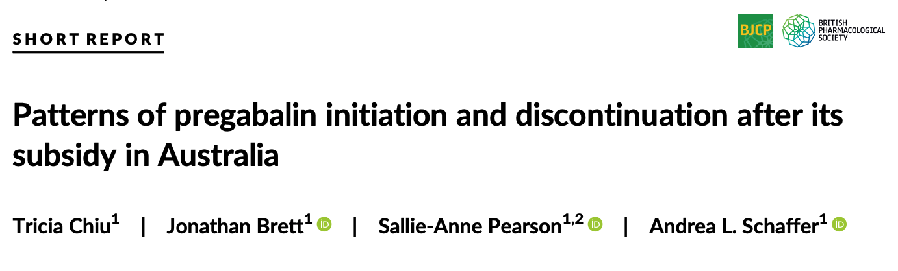
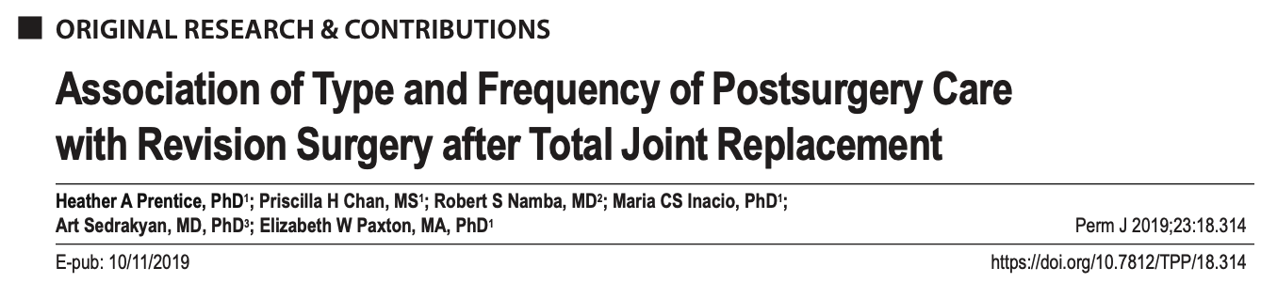
What is the data science task?
Welberry et al (2020)
Objective: To assess the impact of home care on length-of-stay within residential care.
Chiu et al (2019)
Objective: to quantify initiation, discontinuation and dispensing of other analgesics before and after initiation [of pregabalin]
Prentice et al (2019)
Objective: To evaluate whether intensity of post-surgery care is associated with revision risk after total joint arthroplasty
Notes:
One paper focuses on description, one focuses on prediction. and one focuses on explanation or causal inference. What order do you think it is? (Ans: explanation, description, prediction)

Slide 5
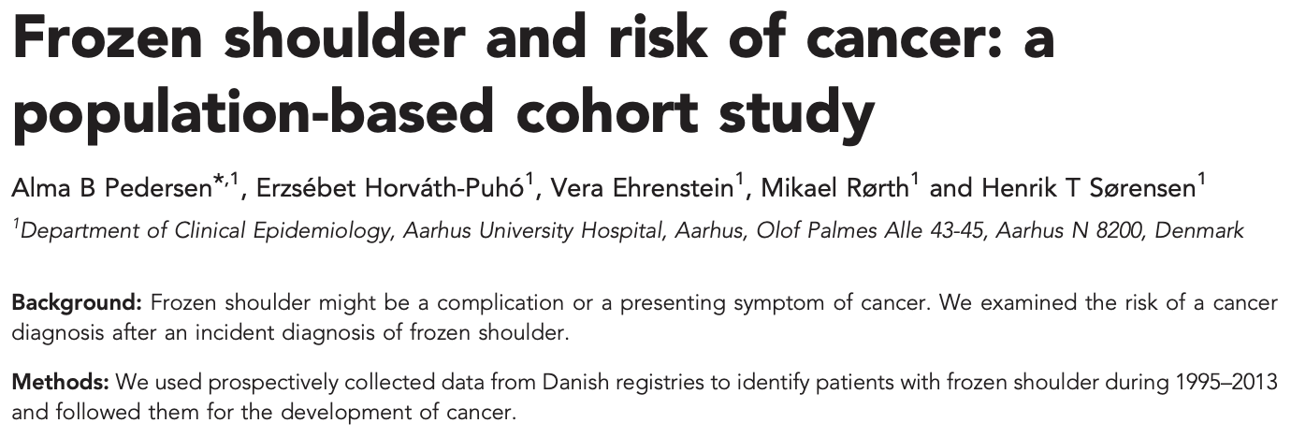
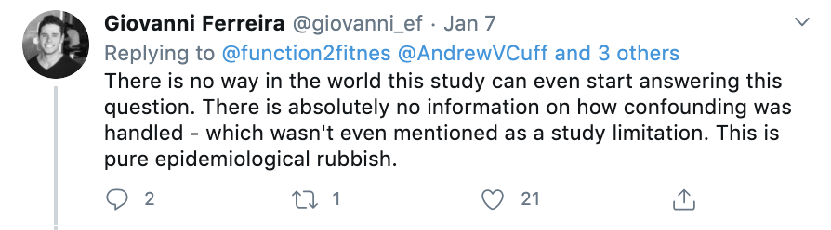
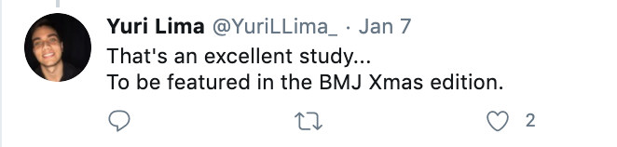

Pre-reading Tweetorial from @EpiEllie

Slide 6
Pre-reading Tweetorial from @EpiEllie
Discussion
What was the study really trying to say?
What were the criticisms?
What was Dr Murray’s (@EpiEllie) argument?

Slide 7


Pre-reading Tweetorial from @EpiEllie
“Does frozen shoulder cause cancer?”
“Can shoulder problems be used as an early warning sign for cancer risk?”
Controlling for “confounders” could lead to the wrong answer!
Build a prediction model
Test a cancer screening program that focuses on shoulder patients

Slide 8

The role of available variables changes depending on the modelling task
1. Description (e.g. @EppieEli’s tweetorial)
e.g. “How do cancer rates differ between two subpopulations
Covariates define subpopulations or time
2. Prediction (HDAT9500)
“e.g. Can we predict outcome from baseline variables?”
Predictors
3. Causal inference (HDAT9700)
“Does treatment A increase the probability of a good outcome?”
Confounders, mediators, colliders, competing exposures

Slide 9
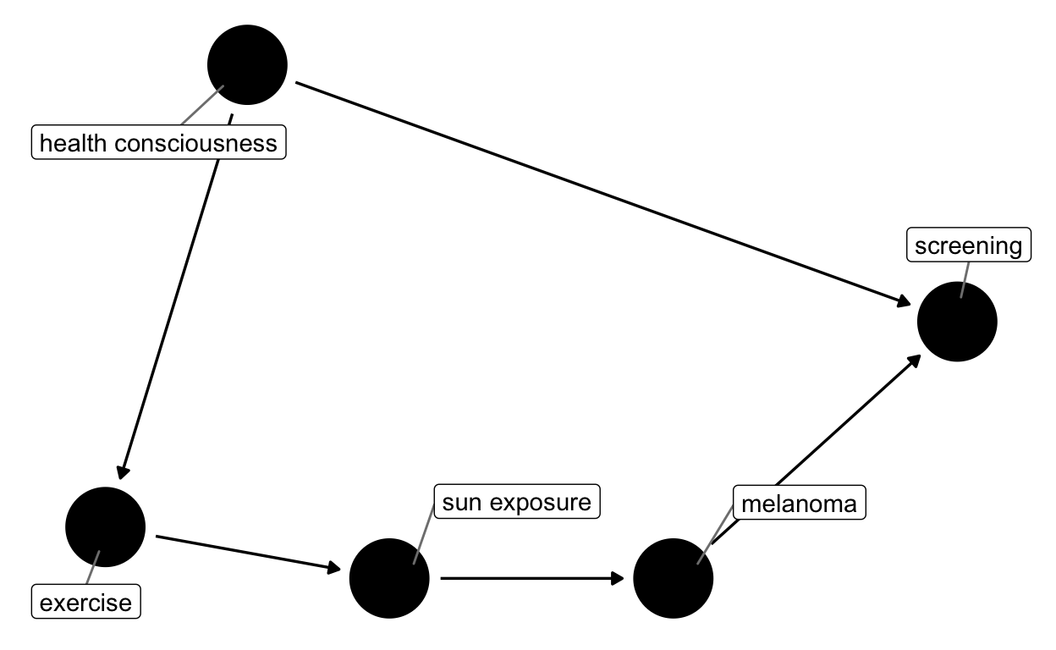
Part 2: Directed Acyclic Graphs
Help us formalise expert knowledge
Clarify and discuss our assumptions
Inform variable selection
Rules
Directed
Acyclic
Includes all common causes
Can (should!) include observed and unobserved variables
Causal DAG representing the relationship between exercise and melanoma

Slide 10
Confounder
Socio-economic status
Z
X
Y
Maternal age
Birth weight

Slide 11
Mediator
Sleep quality
Z
X
Y
Exercise
Mood
This DAG represents the assumption that all the effect of exercise on mood is mediated through sleep quality

Slide 12
Collider
ED admission
Z
X
Y
Respiratory infection
Asthma

Slide 13
Exercise
Draw a labelled DAG to give an example of:
Confounding
Mediation
Collider

Slide 14
Exercise
Test your knowledge of DAG terminology and covariate roles using these applets:
DAG terminology: http://www.dagitty.net/learn/graphs/index.html
Covariate roles: http://www.dagitty.net/learn/graphs/roles.html

Slide 15
Exercise
Draw a labelled DAG to communicate @EpiEllie’s tweetorial. Include the following:
Frozen shoulder
Cancer
A confounder
A collider

Slide 16
Part 3 Using DAGs to inform variable selection
Backdoor path criterion (informally)
To estimate the causal effect of X on Y we must close all backdoor paths between X and Y
What is a backdoor path?
When is a path closed?

Slide 17
1. What is a backdoor path
Socio-economic status
A backdoor path between X and Y is any path from X to Y which starts with an arrow pointing towards X
Z
X
Y
Age
Birth weight
For example, the path Age ← SES→ Birth weight is a backdoor path between Age and Birth weight

Slide 18
1. What is a backdoor path
What are the backdoor paths between exercise and mood?

Slide 19
2. When is a path closed?
Effect of controlling for Z
X
Z
Y
Closes path
X
Z
Y
Closes path
X
Z
Y
Opens path
Controlling for any confounding or mediating variable on a pathway is enough to close that pathway
Controlling = ‘include in analysis” e.g. include Z in regression, stratify on Z, match on Z

Slide 20
Putting it into practice
What would we have to control for to estimate the total effect of exercise on mood?

Slide 21
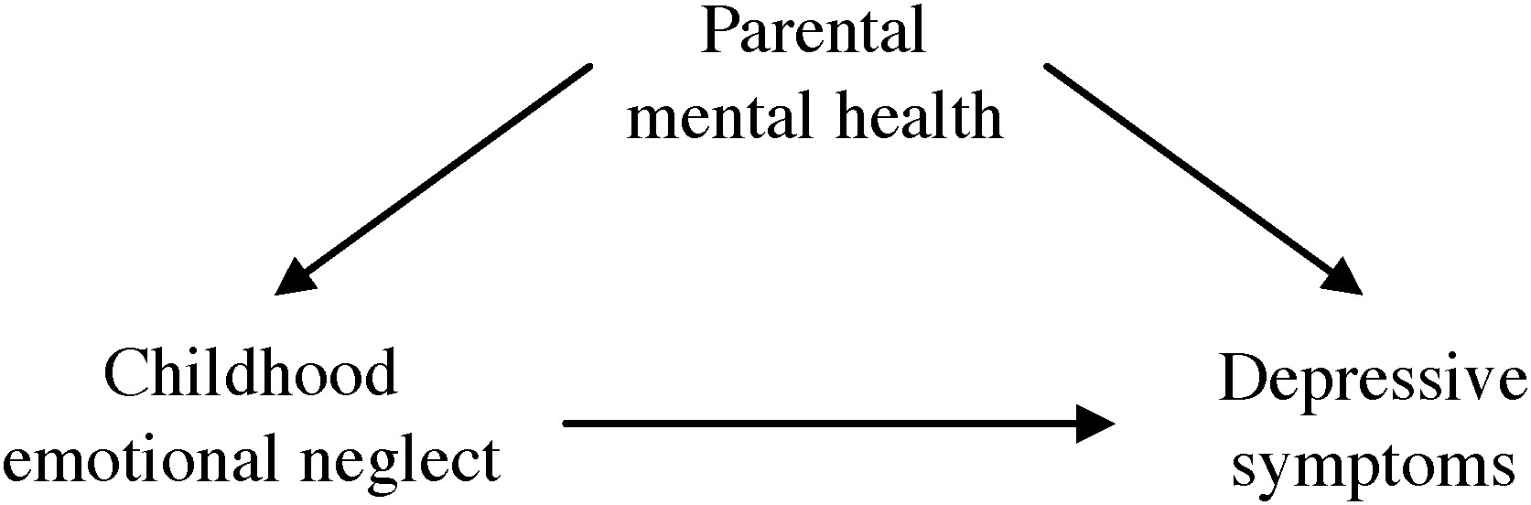
Applied examples: Confounding bias
See Figure 2 in Austin et al 2019 (assigned reading)
Notes:
Exposure is childhood emotional neglect
Outcome is depressive sypmtoms
Confounder is parental mental health

Slide 22
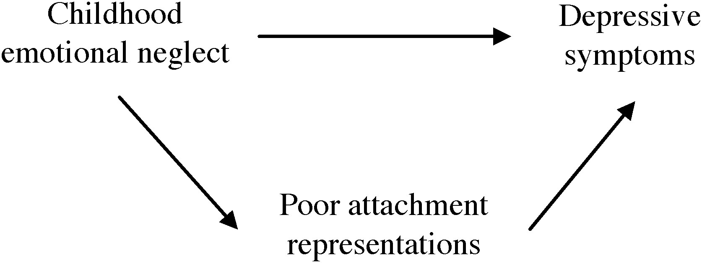
Applied examples: Mediator
See Figure 3 in Austin et al 2019 (assigned reading)
Notes:
Fluorquinolones = X | Epilepsy = Y
Fluorquinolone is a broad-spectrum antibiotic

Slide 23
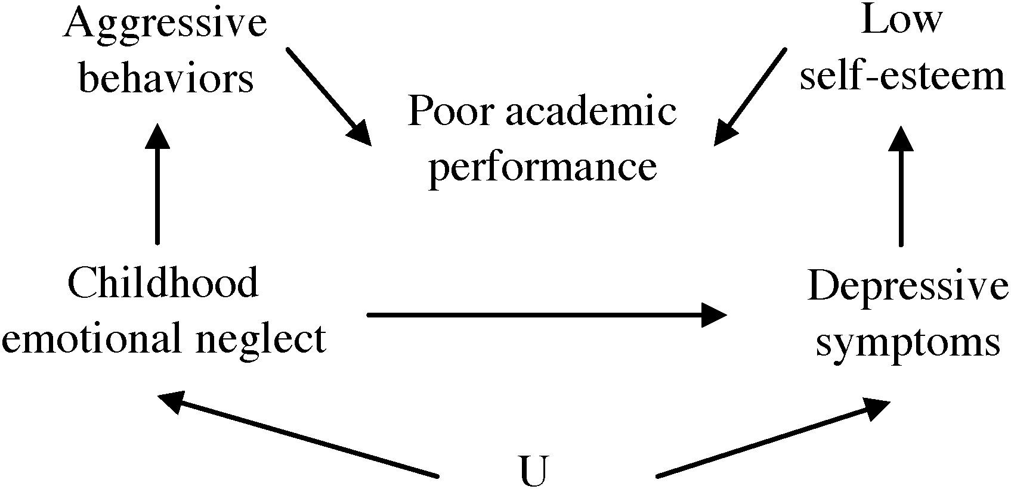
Applied examples: Collider bias
See Figure 4 in Austin et al 2019 (assigned reading)
Notes:
Fluorquinolones = X | Epilepsy = Y
Fluorquinolone is a broad-spectrum antibiotic

Slide 24
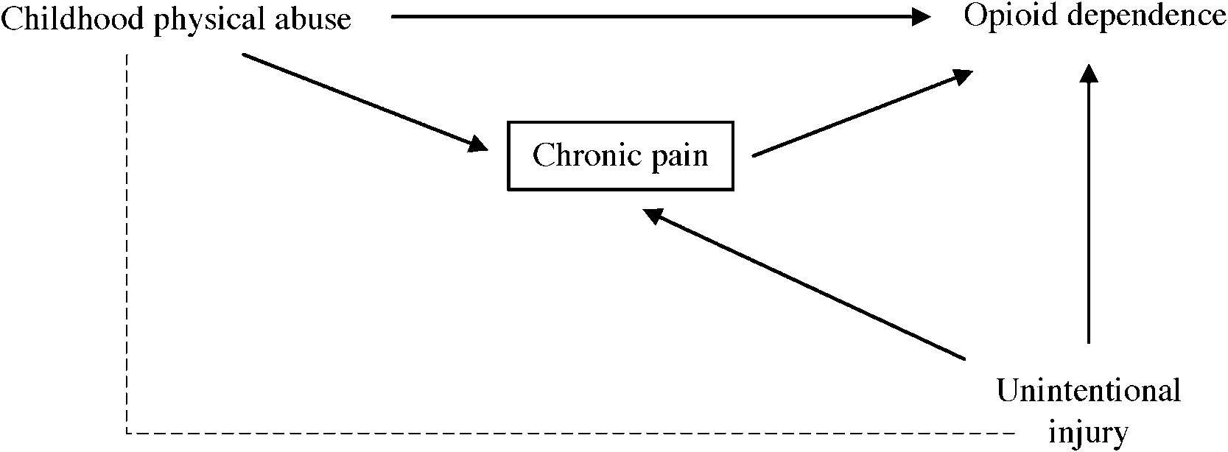
Applied examples: A confounded mediator
See Figure 6 in Austin et al 2019 (assigned reading)
Notes:
Fluorquinolones = X | Epilepsy = Y
Fluorquinolone is a broad-spectrum antibiotic

Slide 25
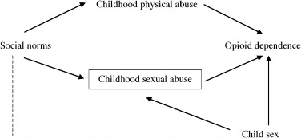
Applied examples: Collider bias
See Figure 7 in Austin et al 2019 (assigned reading)
Notes:
Fluorquinolones = X | Epilepsy = Y
Fluorquinolone is a broad-spectrum antibiotic

Slide 26
Exercise: practice closing backdoor paths using the shiny app
https://cbdrh.shinyapps.io/daggle/
You can also run an older version of this Shiny app in R by entering the following command at the console:
hdat9700tutorials::run(‘backdoor-paths’)
Note the app can optionally ask for total effect or direct effect, refer to the learnR tutorial for the distinction

Slide 27
Summary
There are three tasks of data science: description, prediction and causal inference
When performing causal inference, variable selection must be informed by an understanding of the underlying causal data-generation process
DAGs help us to formalise and communicate our assumptions about causal processes
DAGs also help inform variable selection, through the backdoor path criterion.

