Slide 1
HDAT 9700
Multilevel modelling II
Online tutorial

Slide 2
Housekeeping
Assessment 1A due on Monday 27 Jun
Assessment 1B – will release tomorrow
Cameras on
Record

Slide 3
Outline today
Part 1. Recap of last week: four key pictures
Part 2. Model building, model comparison and models for binary outcomes
Part 3. Example of multilevel modelling in practice
Variation in incentive effects across neighbourhoods (pre-reading)
Part 4. Practical in RStudio

Slide 4

Part 1: Recap from last week: 4 key pictures

Slide 5
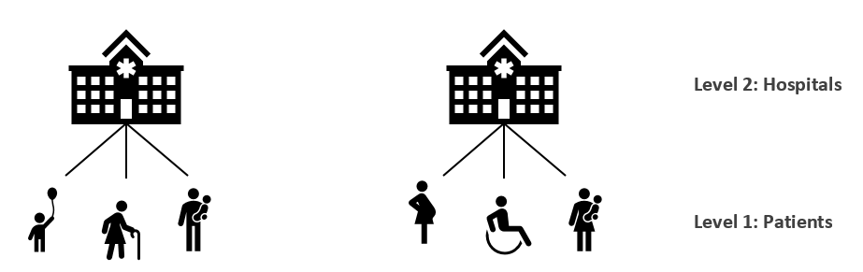
1. Health data often has structure that introduces dependency in the data

Slide 6
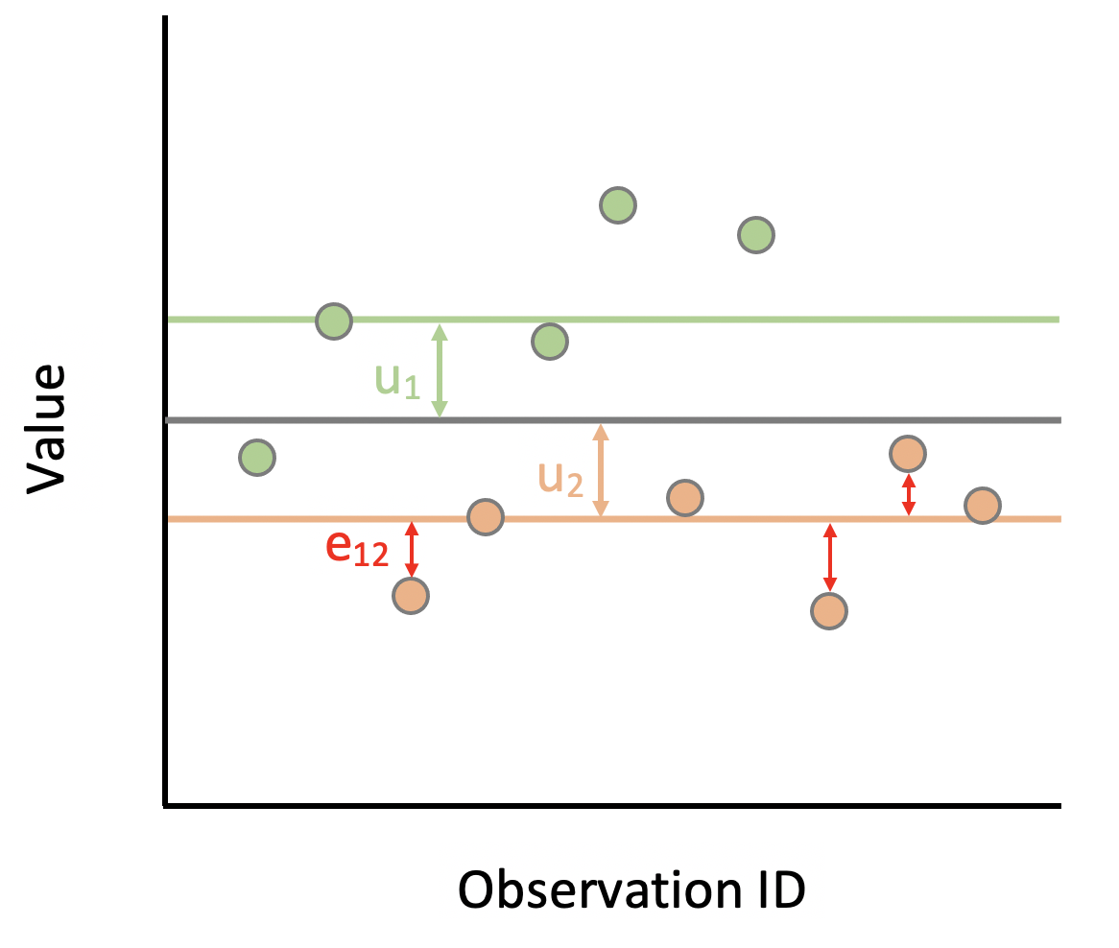
2. A multilevel model decomposes the residual variance into between and within group

Slide 7
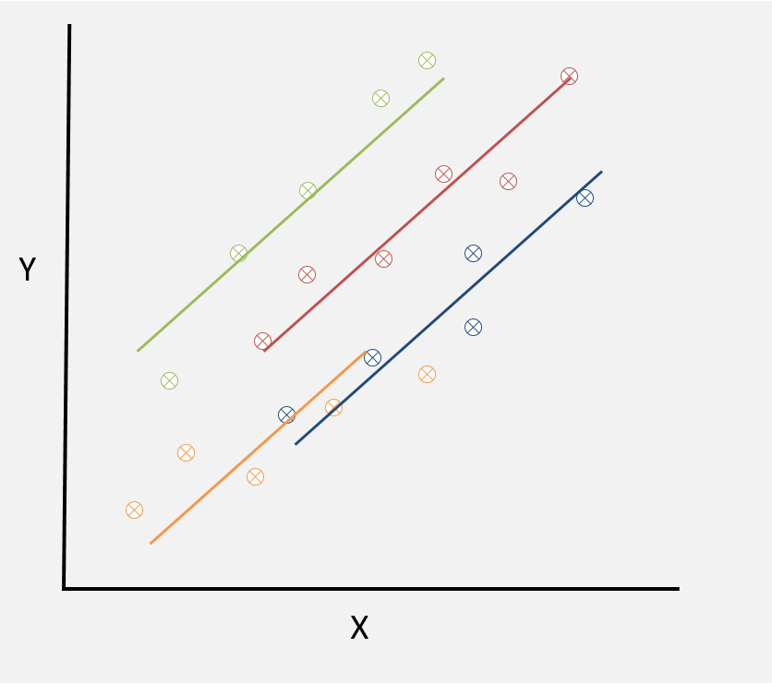
3. A random intercept model allows the intercept to vary across level 2 units

Slide 8
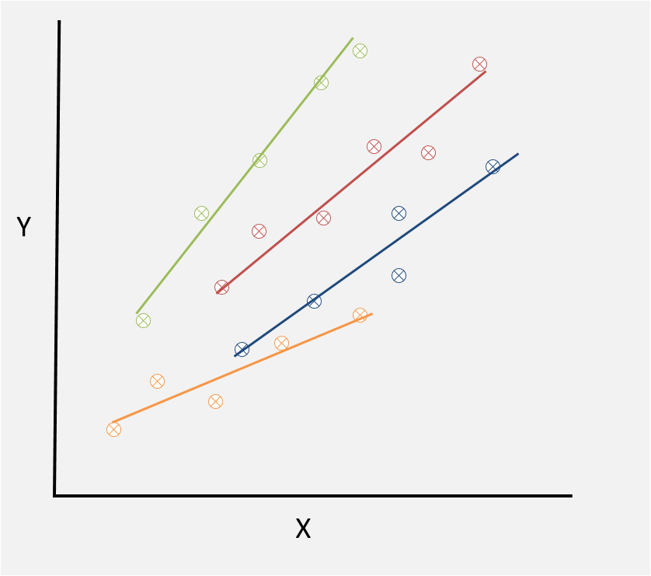
4. A random slope model allows the slope to vary across level 2 units

Slide 9
Part 2: Model building, model comparison and models for binary outcomes

Slide 10
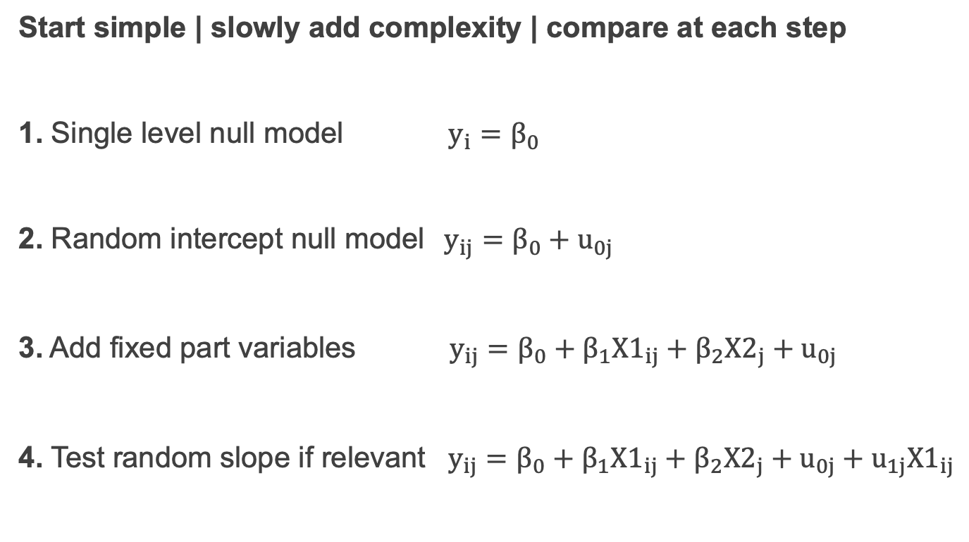
Model building
Start simple | slowly add complexity | compare at each step
1. Single level null model $y_{i}=β_{0}$
2. Random intercept null model$y_{ij}=β_{0}+u_{0j}$
3. Add fixed part variables $y_{ij}=β_{0}+β_{1}{X1}_{ij}+β_{2}{X2}_{j}+u_{0j}$
4. Test random slope if relevant $y_{ij}=β_{0}+β_{1}{X1}_{ij}+β_{2}{X2}_{j}+u_{0j}+u_{1j}{X1}_{ij}$
Notes:
General approach Start simple, build in complexity, compare at each step

Slide 11
Model comparison
Check variance partition coefficient to assess if multilevel model is suitable
Check model parameter estimates
Model comparison statistics
Likelihood ratio test (nested models)
AIC (penalises for more parameters)
BIC (penalizes more for more parameters)

Slide 12

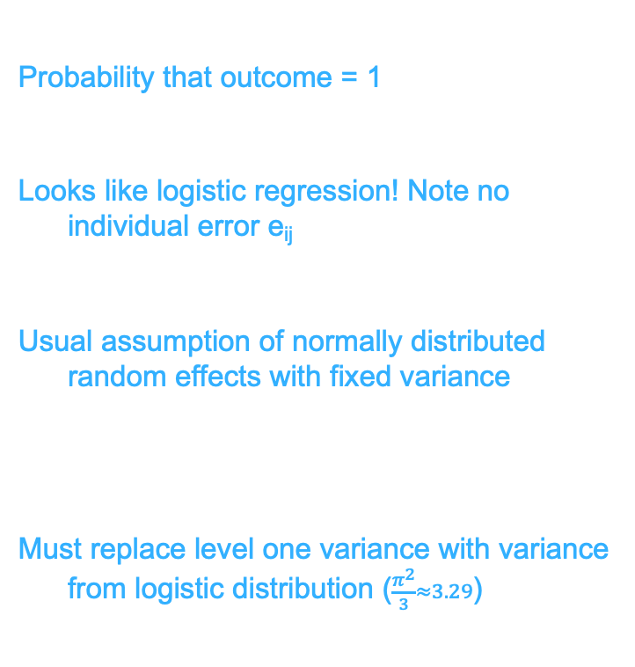
Analysis of binary outcomes
Probability that outcome = 1
Looks like logistic regression! Note no individual error e_{ij}
Usual assumption of normally distributed random effects with fixed variance
Must replace level one variance with variance from logistic distribution ($\frac{π^{2}}{3}≈3.29$)
$$\operatorname{Pr}\left(y_{ij}=1\right)=π_{ij}$$
$$log\left(\frac{π_{ij}}{1−π_{ij}}\right)\sim β_{0}+β_{1}X_{ij}+u_{0j}$$
$$u_{0j} \sim N(0, σ_{u0}^{2})$$
$$VPC= \frac{σ_{u0}^{2}}{σ_{u0}^{2}+σ_{e}^{2}}$$

Slide 13
Model predictions
Model diagnostics
Model fits the data
Random effects are normally distributed
Visualise and communicate the model
Predict out-of-sample
In R
predict() for level 1 predictions
ranef() for random effect predictions

Slide 14
Part 3: Example of multilevel modelling in practice

Slide 15
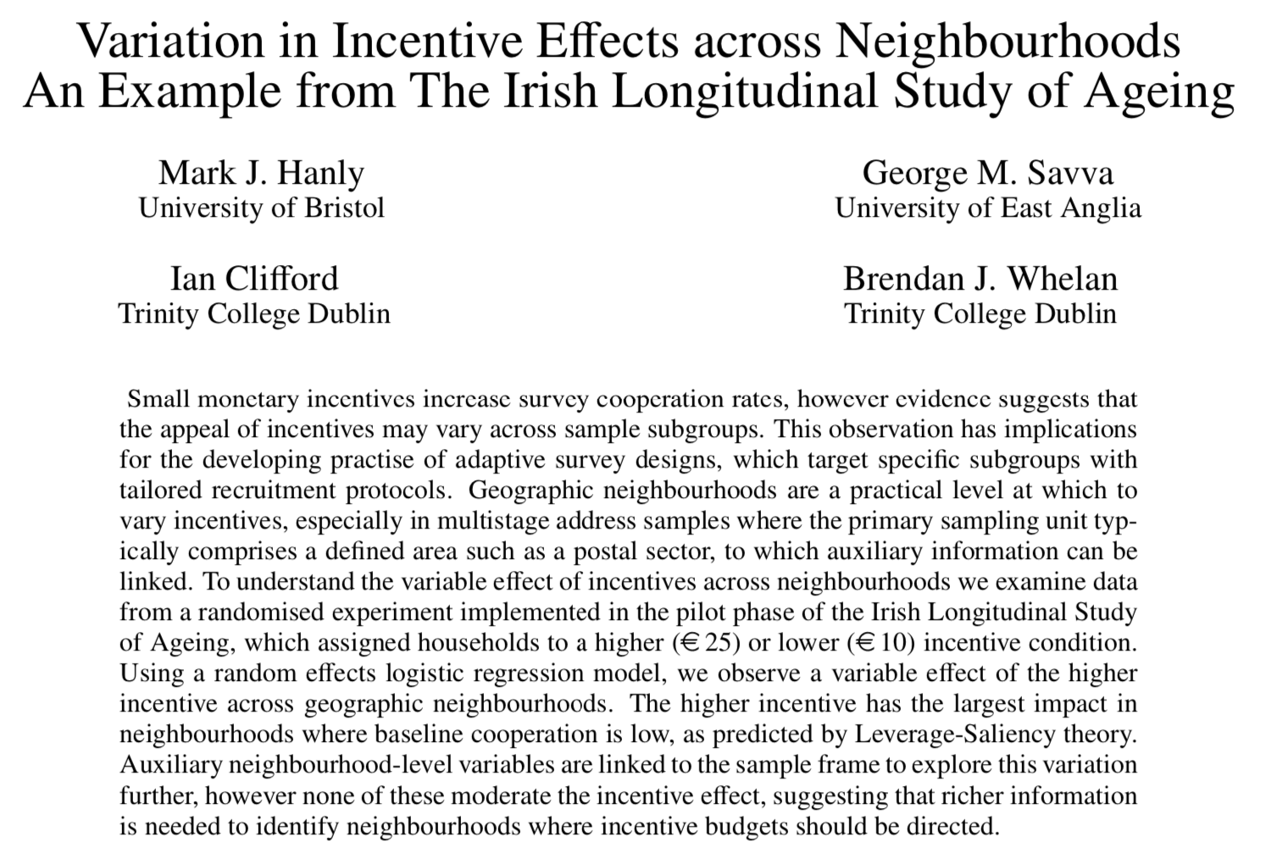
Prereading
Survey Research Methods (2014): 8(1) 19-30
Notes:
Wave one of a longitudinal household survey. Known that incentives will increase response, but not sure what to offer. Ran incentive experiment to compare two incentive levels 10 euro versus 25 euro.

Slide 16
The incentive experiment
The Irish Longitudinal Study of Ageing (TILDA)
Wave 1 Household survey
Recruitment by interviewers on doorstep
Two stage sample:
20 neighbourhoods
60 households per neighbourhood
1200 households
Random assignment to €10 or €25 incentive
€10 group: 35% response rate
€25 group: 61% response rate

Slide 17
Further analysis of incentive data
Research Questions:
Did participation vary by area?
Does the effect of the incentive vary by area?
What characteristics of an area explained where the incentive was most effective?
Discussion for the class:
What is the multilevel structure here?
What type of multilevel model would help answer (1) and (2) above?
Can you write down the model?

Slide 18
Can you write down the model?
Notes:
pi_ij = P(Y_ij = 1) log(pi_ij/(1-pi_ij)) = B0 + B1_ijIncentive + BX_ij + u0_ij + u1_ijIncentive

Slide 19
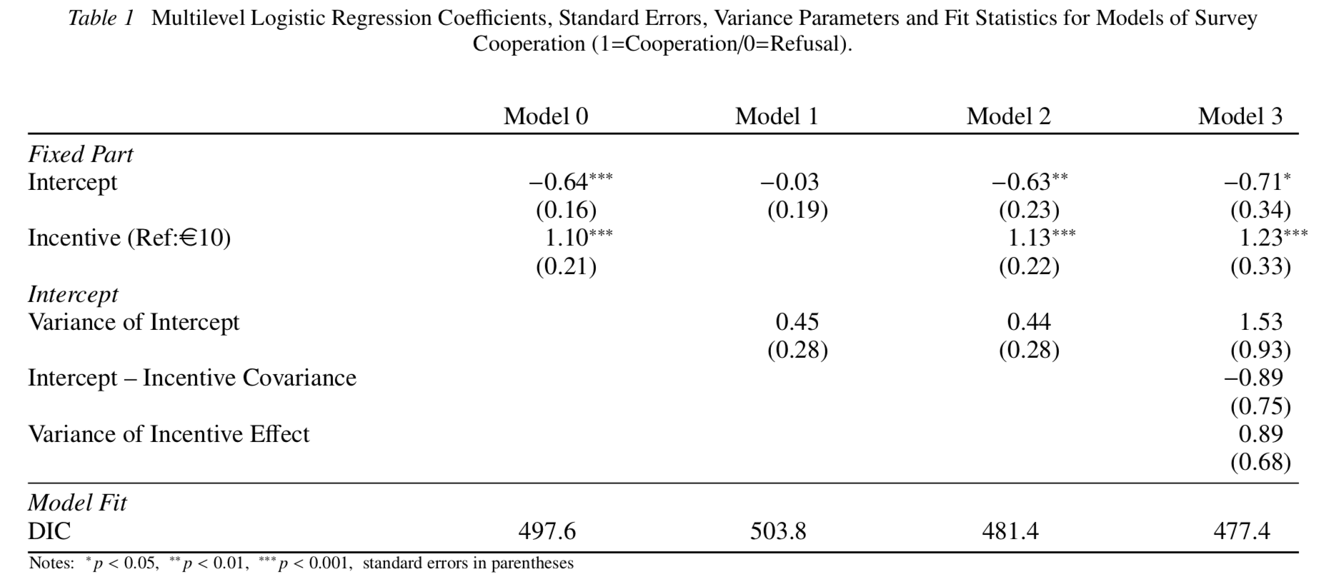
Model building and comparison: Example from the prereading
Notes:
Start with simple model then get progressively more complex, testing at each step

Slide 20
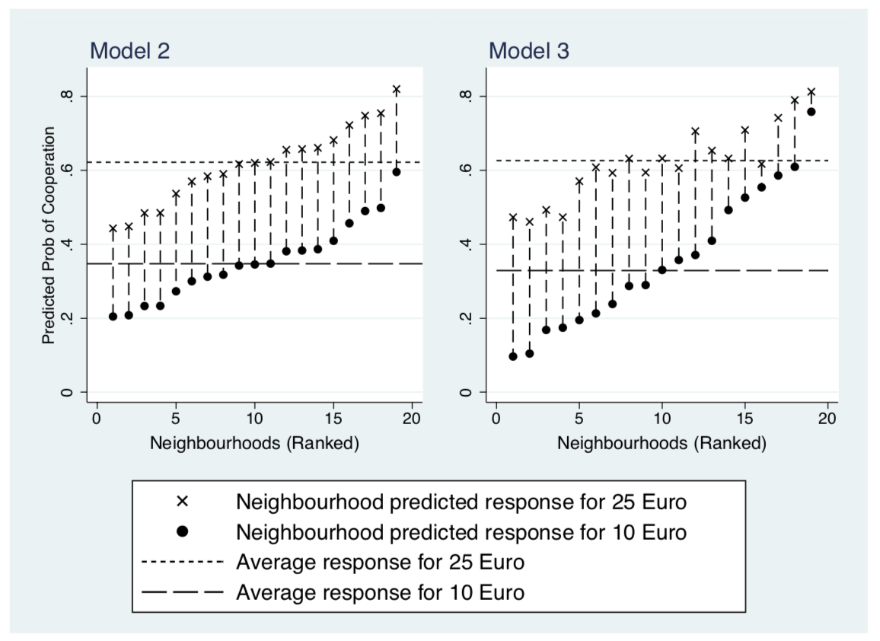
Model predictions: Example from the pre-reading
Notes:
Note for model 2 the incentive effect is the same for each neighbourhood
For model 3 the incentive effect can vary by neighbourhood

Slide 21
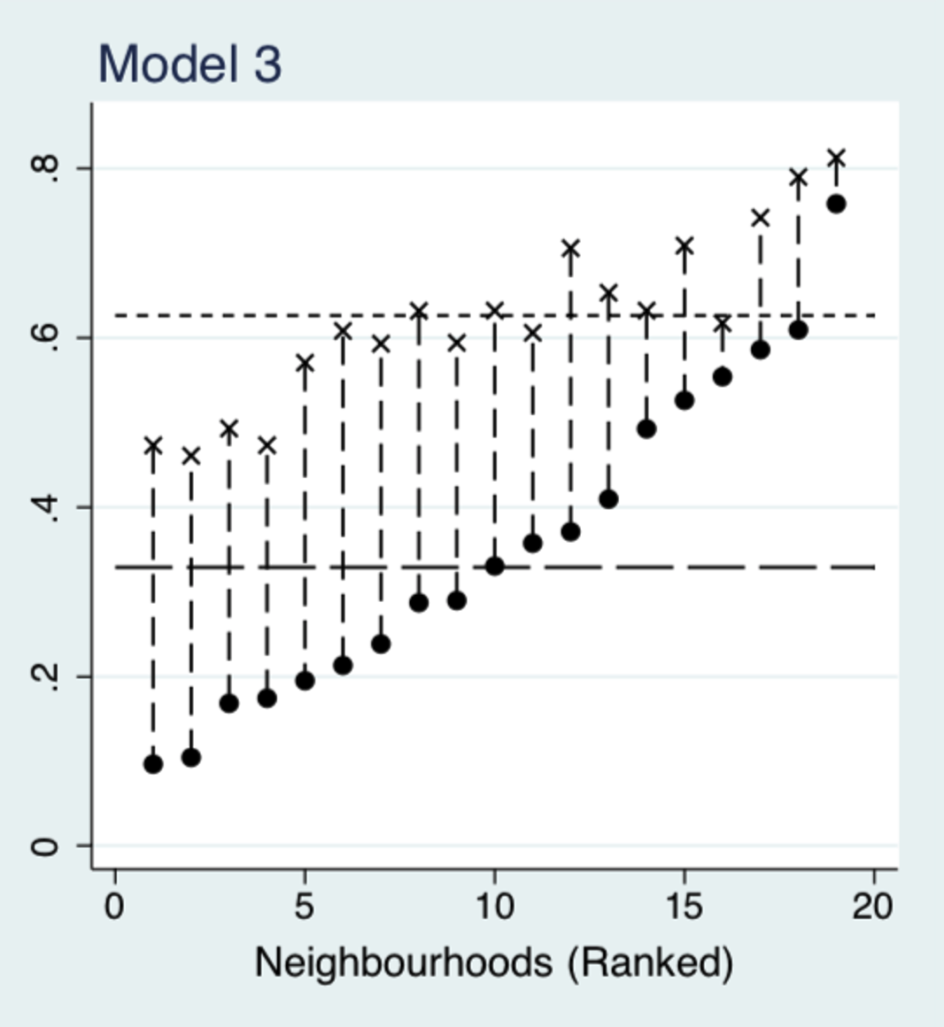
Thinking about the level 2 covariance
Predicted probability of cooperation by incentive level
Random slope u_{1j}
Below average
Above average
Random intercept u_{0j}
Below average
Above average

Slide 22
Conclusions
Incentive effect did vary across areas
Incentive most effective where baseline response was low
Couldn’t identify neighbourhood characteristics that explained the variation
Tested population density, proportion of children, proportion volunteering, deprivation index, proportion aged >65

Slide 23
Summary
Model comparison
Likelihood ratio test (Nested), AIC or DIC
Model building
Start small | Build in complexity | Compare after each step
Predictions
Model diagnostics, visualisation and communication
Level 1 using predict() | Random effects using ranef()
Binary outcome
Analogous to logistic regression | no level 1 error

