Slide 1
HDAT 9700
Matching for causal inference
Online tutorial

Slide 2
Housekeeping
Assessment 1a released
https://cbdrh-hdat9700.github.io/#assessment
Due Mon 27 Jun
Small update to learnr tutorial (re cobalt package)
Camera on, if possible, please
Record

Slide 3
Big picture
Still thinking about causal inference from observational data
Research questions like which drug works better to reduce blood pressure, A or B?
Datasets like survey data, linked administrative data
Last week DAGs help us to identify important control variables
This week How do we control for those variables?
What assumptions need to be met for this to be valid?

Slide 4
Outline today
Part 1: Theoretical background
Part 2: Matching
Part 3: Matching in R

Slide 5



Counterfactual outcomes
Two potential outcomes
Should I enrol in an MSc?
Enrol Don’t enrol
Will I learn much?
Will I get a good job?
Will I have a better salary?
Notes:
There are two sets of potential outcomes, but we only get to view one. This is is the fundamental problem of casual inference!

Slide 6
Counterfactual outcomes
Will I have a better salary?
Hernán: Y_{a=x} Effect = Y_{a=enrol} – Y_{a=don’t enrol}
Pearl: Y | do(X=x) Effect = Y | do(X=enrol) – Y | do(X=don’t enrol)
$110,000
$90,000
Notes:
Ideally you would want to know whats in each box!

Slide 7
Counterfactual outcomes
Person | Enrol? (A) | Salary in 2 years if enrols (Y_{a=1}) | Salary in 2 years if doesn’t enrol (Y_{a=0})
101 | No | 70,000 | 70,000
102 | Yes | 90,000 | 95,000
103 | Yes | 80,000 | 90,000
104 | No | 80,000 | 75,000
105 | Yes | 60,000 | 70,000
106 | No | 50,000 | 65,000
107 | No | 70,000 | 75,000
We don’t observe the counterfactual outcome
Counterfactual = counter to fact
Notes:
The counterfactual outcome is the outcome you would have ended up with under the alternative treatment

Slide 8
Association versus causation
A=1
Y_{a=1}
Vs
Y_{a=0}
Causation
Population
A=0
Association
Vs
Y|A=0
Y|A=1
(Adapted from Causal Inference (2018, Ch1) by Hernán and Robins)
Notes:
Causation is comparing counterfactual outcomes.
Association is comparing outcomes conditional on actual treatment received
Relates to question on holding a variable constant versus conditioning on that variable

Slide 9
Identifiability assumptions
1) Positivity
Everyone has the chance to get the treatment
2) Exchangeability
Background characteristics are balanced in treated and control groups
3) Consistency
There is a single well-defined version of the treatment
See learnR tutorial and video for more detail
Notes:
It is still possible to make causal claims from observational data, under certain assumptions. Because these assumptions allow us to identify causal effects they are referred to as identifiability assumptions.
For discussion: how does these assumptions stand up in an RCT?
How about observational data

Slide 10
Positivity
Everyone has the chance to get the treatment
18-29 years
Female
Male
Urban
Rural
Urban
Rural
30-64 years
Female
Male
Urban
Rural
Urban
Rural
64+ years
Female
Male
Urban
Rural
Urban
Rural

Slide 11


Exchangeability
Background characteristics are balanced in treated and control groups
Treated
Control

Slide 12
How does this tie in with DAGs?
If we are interested in the causal effect X → Y
Backdoor paths?
X ← Z₁ → Y
X ← Z₂ → Y
Z₁
Z₂
The set of variables that close the backdoor paths are the ones that we need to be exchangeable on
X
Y

Slide 13





Consistency
There is a single well-defined version of the treatment
X
Y
$Obesity (BMI ≥ 30$)
$$Death$$
See Hernán and Taubman (Int J of Obesity, 2008) Does Obesity Shorten Life?

Slide 14
So how do we “control” for Z?
Stratify
e.g. stratify by age group:
Z = 18-29y | Z = 30-49y | Z = 50+y
Y ~ X | Age = 18-29 | Y ~ X | Age = 30-49 | Y ~ X | Age = 50+
lm(Y ~ X, data = dt[between(dt$age,18,29)] | lm(Y ~ X, data = dt[between(dt$age,30,49)] | lm(Y ~ X, data = dt[dt$age >= 50]
Y = 3.1 + 2.1X | Y = 3.2 + 1.8X | Y = 3.0 + 0.5X
Useful if effect of X changes for different values of Z (effect modification)
Impractical when a lot of categories or several Z variables

Slide 15
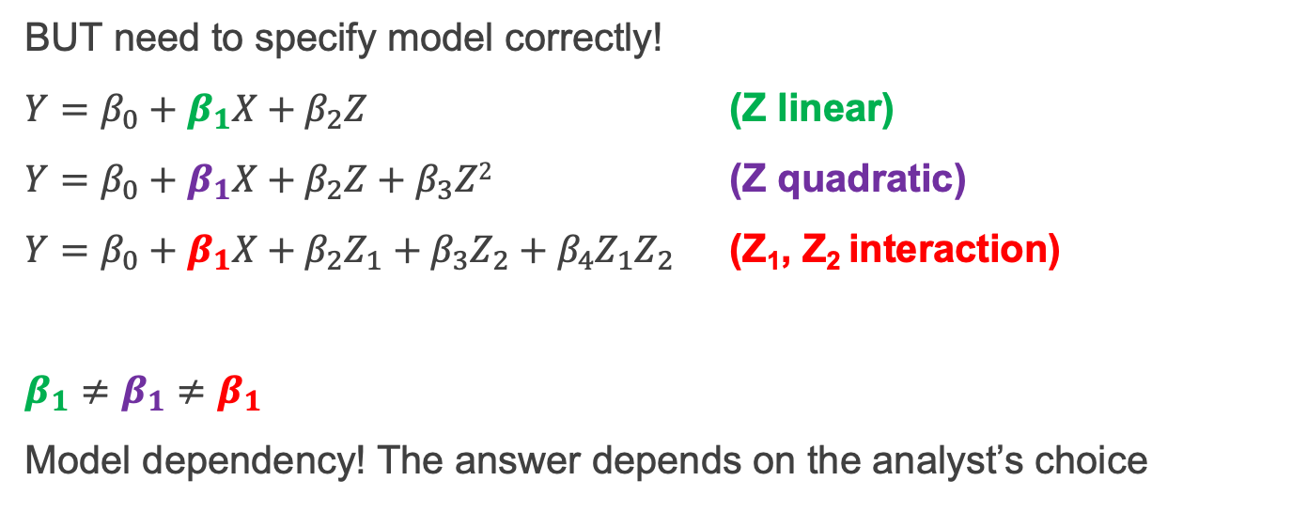
So how do we “control” for Z?
Add to regression
Convenient, versatile, easy to communicate, widely understood
Y ~ X + Z
lm(Y ~ X + Z, data = dt)
Y = 3.1 + 1.8X - 0.4Z
BUT need to specify model correctly!
$Y=β_{0}+β_{1}X+β_{2}Z$ (Z linear)
$Y=β_{0}+β_{1}X+β_{2}Z+β_{3}Z2$ (Z quadratic)
$Y=β_{0}+β_{1}X+β_{2}Z_{1}+β_{3}Z_{2}+β_{4}Z_{1}Z_{2}$ (Z₁, Z₂ interaction)
$β_{1}≠β_{1}$ $≠β_{1}$
Model dependency! The answer depends on the analyst’s choice
Notes:
If one estimate is significant and the other two are not, which do you think the analyst (us!) will choose?

Slide 16
So how do we “control” for Z?
Matching
We want Y_{Mark(a=1)} and Y_{Mark(a=0)}
Find Y_{Adam(a=0)} instead, where Z_{Mark} = Z_{Adam}
Aim is to balance Z variables in exposed/unexposed (treated/control)
Emulates randomization
A preprocessing technique (match first then analyse)
Removes model dependency and researcher discretion!
Notes:
“Finding randomized experiments hidden in observational data” – Gary King

Slide 17
Types of matching
Exact Matching
Coarsened exact matching
Distanced-based matching
Mahalanobis distance
Propensity score

Slide 18

Exact matching
For each treated individual, find an exact match in the data
Pros
Simple, easy to communicate
Cons
Hard to find exact matches, especially as number of variables grows

Slide 19
Exact matching
Treated
Control
Sex | Age | Education (years)
M | 34 | 12
F | 42 | 16
F | 63 | 14
Sex | Age | Education (years)
F | 42 | 16
M | 40 | 16
F | 47 | 14
M | 34 | 12
F | 67 | 12
M | 30 | 11
M | 28 | 12
F | 44 | 17
Notes:
One-to-one exact matching is the simplest and most intuitive form of matching. With this approach, each treated individual is matched to a control individual with identical background characteristics. SO for example…
This approach is very intuitive because it parallels a randomized experiment where we find similar individuals and assign one to be treated and one to be the control. But in many situations this approach isn’t practical because it is impossible to find exact matches on all control variables, leading some individuals to be excluded.

Slide 20
Coarsened exact matching
Coarsen data
Match within strata
Drop strata with no treatment or control
Weight remaining observations to balance treated and controls within strata

Slide 21
Coarsened exact matching
Treated
Control
Sex | Age | AgeGr | Educ (years) | Educ level
M | 34 |  | 12
F | 42 |  | 16
F | 53 |  | 14
Sex | Age | AgeGr | Educ (years) | Educ level
F | 42 | 40s | 16 | PhD
M | 40 | 40s | 16 | PhD
F | 47 | 40s | 14 | MSc
M | 34 | 30s | 12 | HS
F | 57 | 50s | 13 | MSc
M | 30 | 30s | 11 | HS
M | 28 | 20s | 12 | HS
F | 44 | 40s | 17 | PhD
Notes:
An alternative is coarsened exact matching. With coarsened exact matching, we take the variables we want to match on and temporarily coarsen them. So age might become age group, and education in years might become education level. Then next step is to assign all the observations to strata based on the coarsened variables. So here we would have one stratum with males in their 30s with high school education; females in their forties with a PhD and Females in their fifties with an MSc. And strata that do not have a at least one treated and one control unit are dropped.
The remaining data are weighted so that the number of control units match the number of treated units.

Slide 22
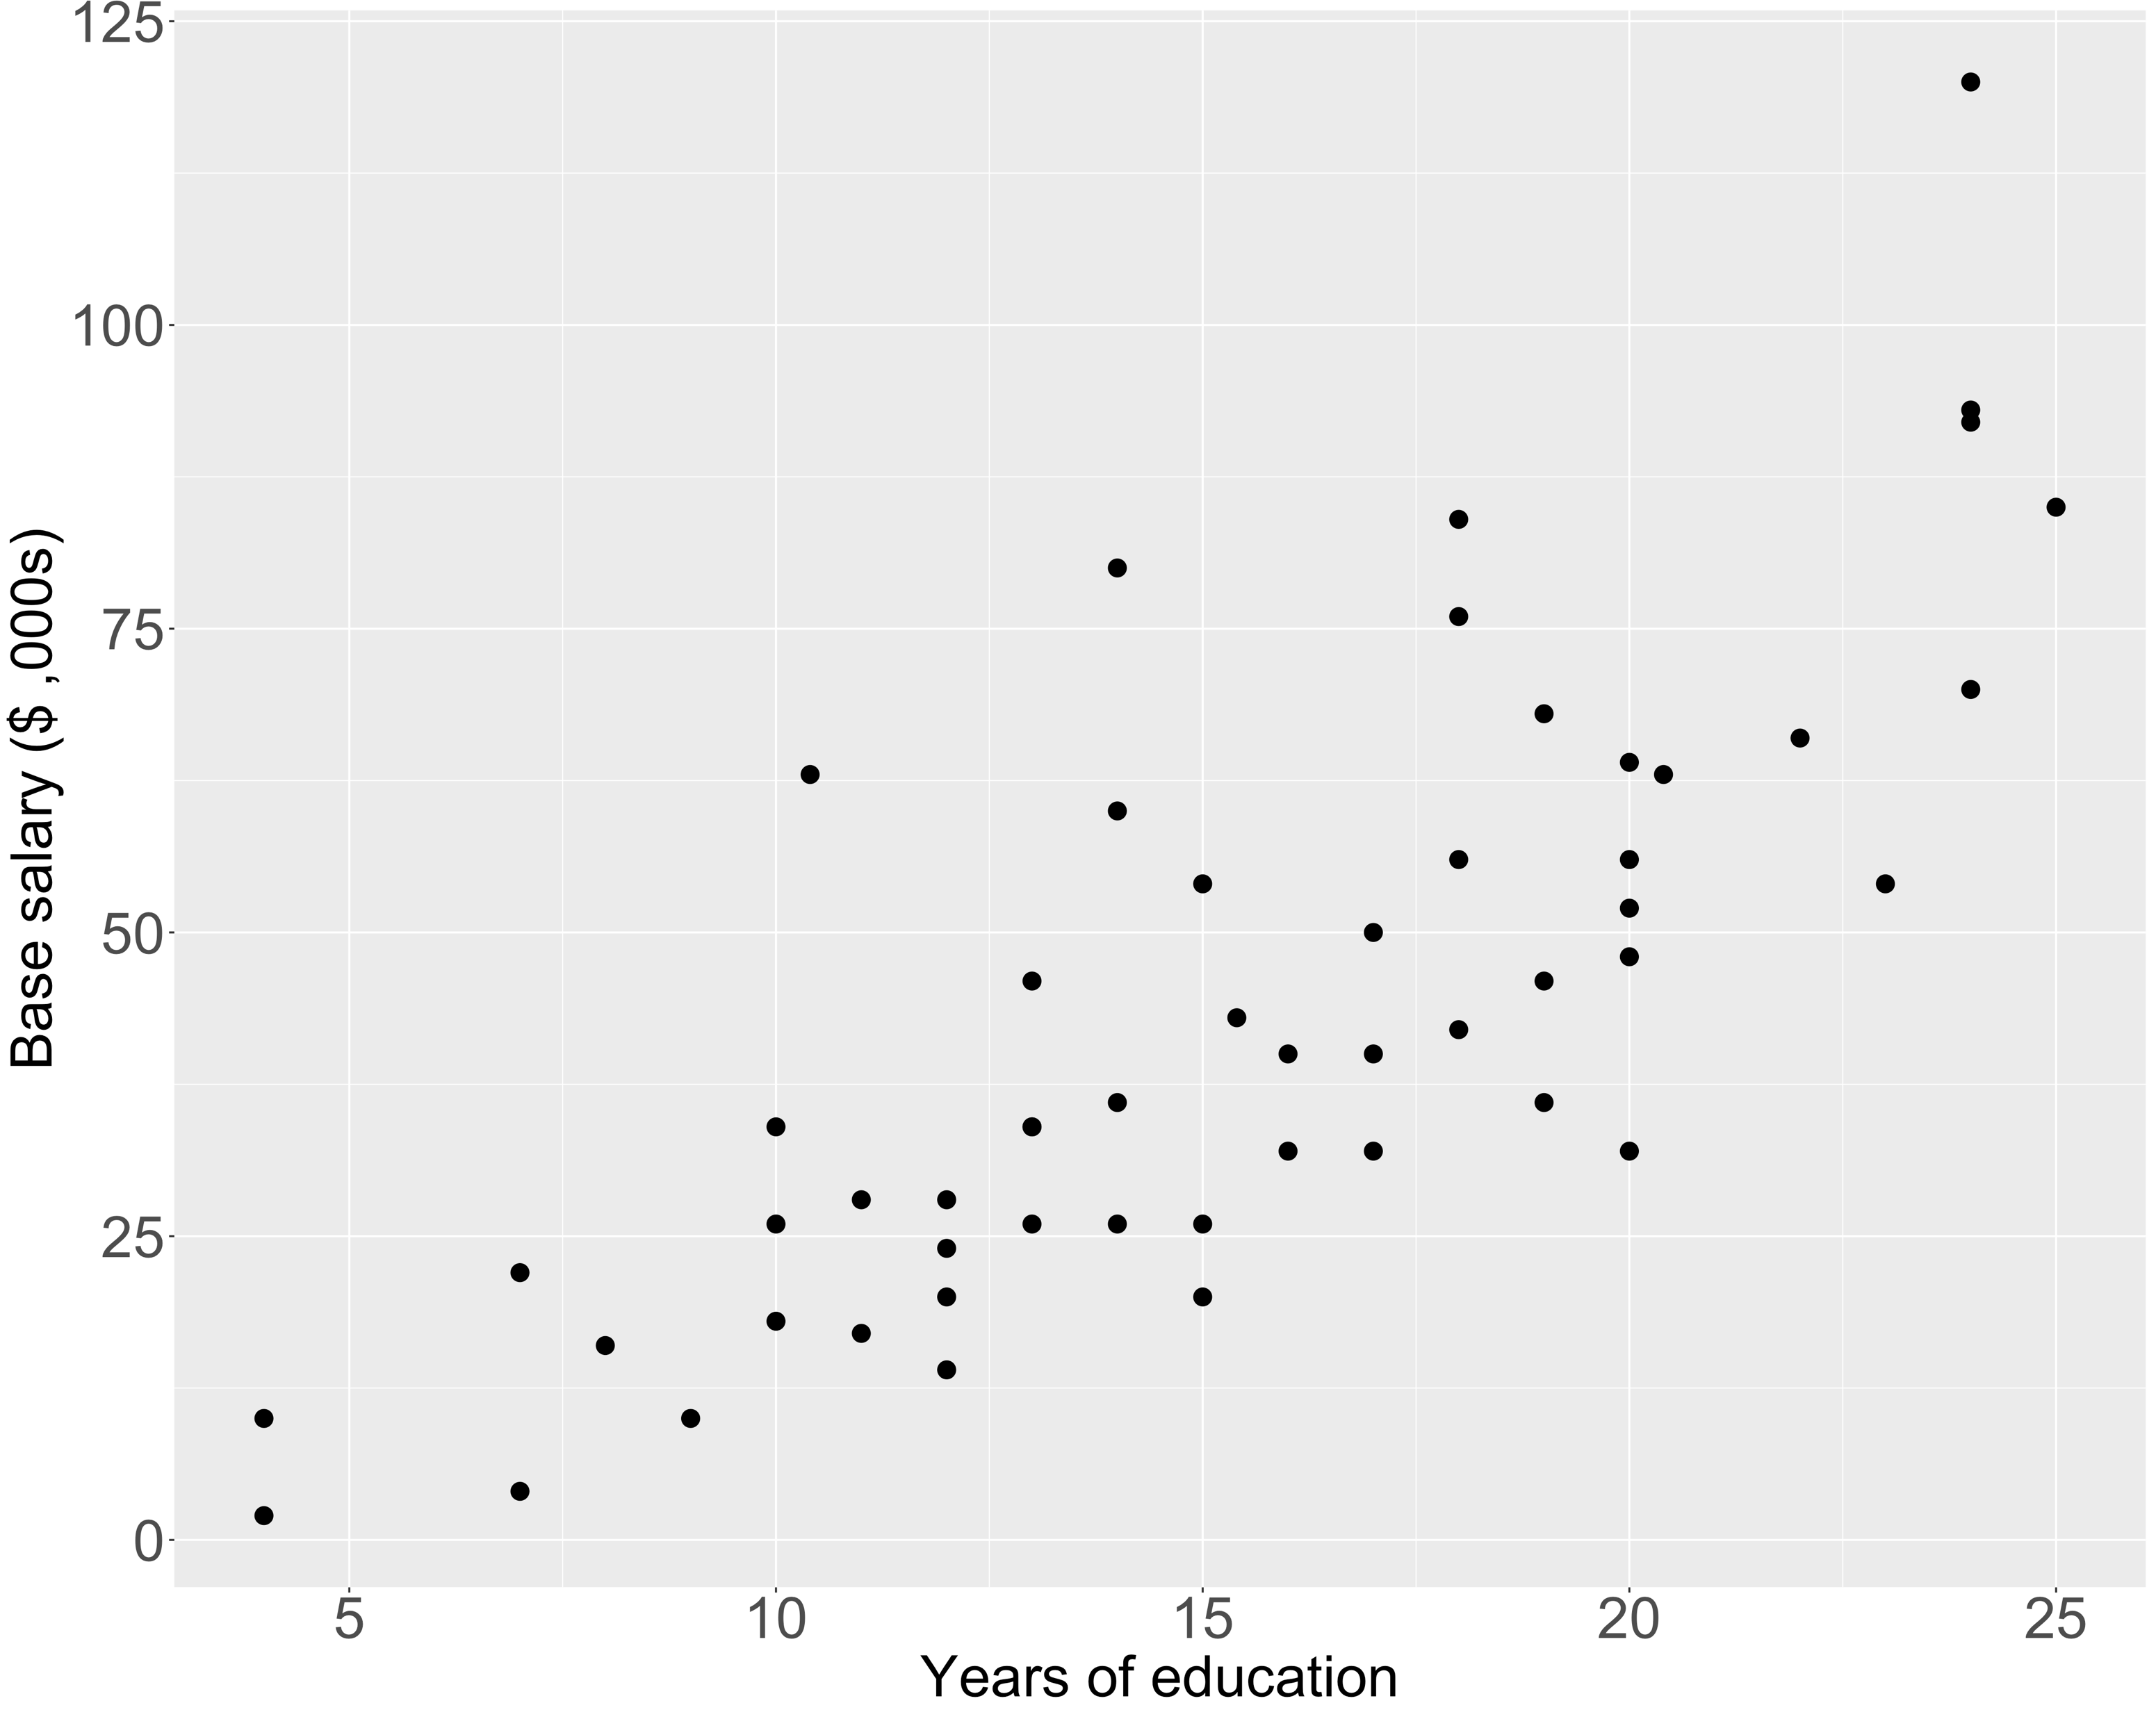
Distance-based matching
Use the distance between two individuals to match
Ratio (1:N matching)
Calipers
Mahalanobis distance
Propensity score distance
Notes:
In general terms, distance-based approaches to matching use some measure of the distance between individuals to pair up people with similar background characteristics.
For each treated individual, we could calculate this distance to all of the control individuals and match to the the person who is nearest.
The graph shows datapoints for two potential background characteristics we would like to match on. If we had a person here who was treated we could calculate these distances and then match to the
Matches can be made at a ratio of one to one, or you can optionally match at a higher ratio, say 1 to 2 or 2 to 3. And you might want to do this to preserve your sample size
Another option is to apply a calipers when looking for matches. The calipers is a cutoff point, that determines the minimum distance for matches to be considered. Within the caliper distance, matches are chosen at random. In this slide, I am just using the straight line or Euclidean distance, but there are many different ways to measure distance, and with multivariate data the Euclidean distance is not necessarily the best way.

Slide 23
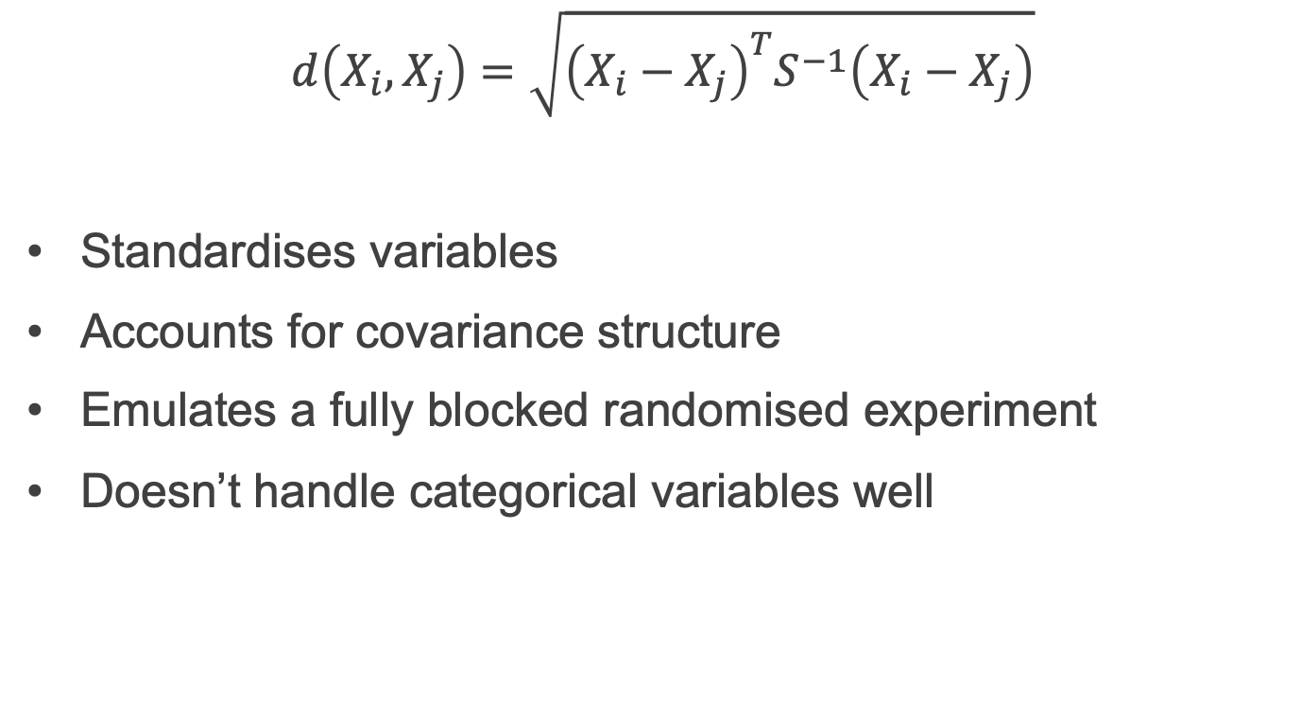
Mahalanobis distance
$$d\left(X_{i},X_{j}\right)=\sqrt{{\left(X_{i}−X_{j}\right)}^{T}S^{−1}\left(X_{i}−X_{j}\right)}$$
Standardises variables
Accounts for covariance structure
Emulates a fully blocked randomised experiment
Doesn’t handle categorical variables well

Slide 24
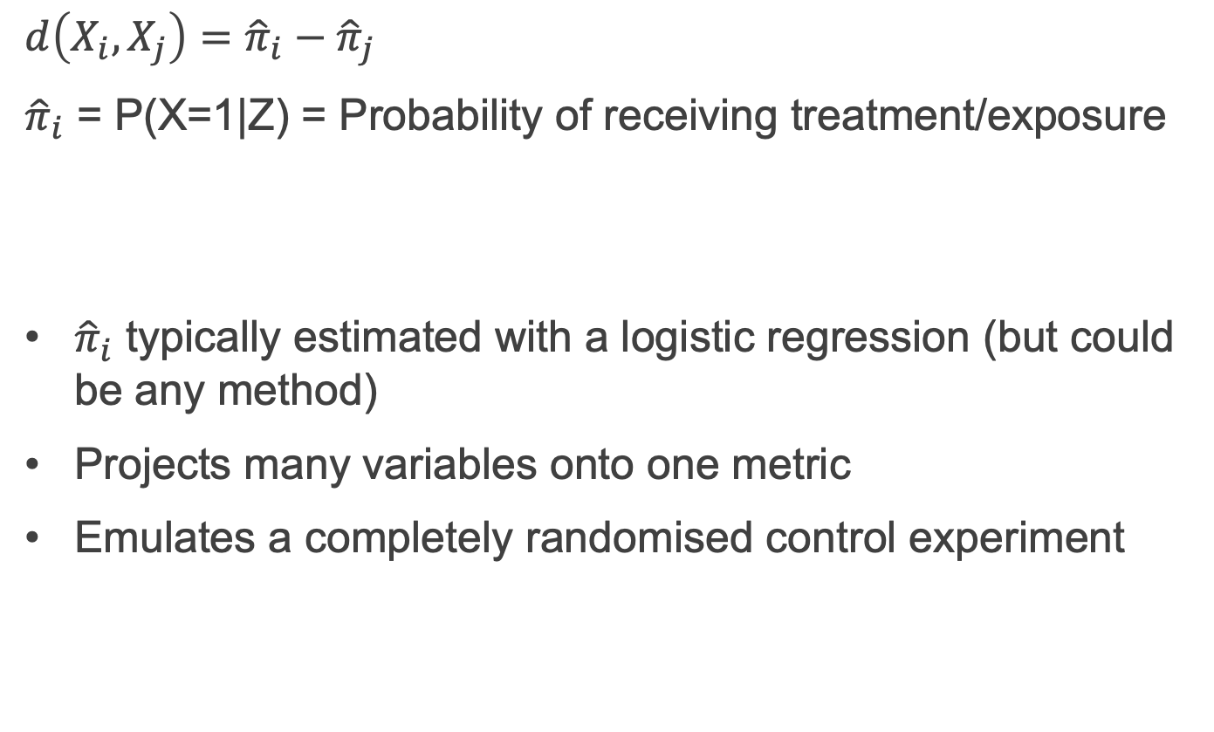
Propensity score distance
$$d\left(X_{i},X_{j}\right)={\hat{π}}_{i}−{\hat{π}}_{j}$$
${\hat{π}}_{i}$ = P(X=1|Z) = Probability of receiving treatment/exposure
${\hat{π}}_{i}$ typically estimated with a logistic regression (but could be any method)
Projects many variables onto one metric
Emulates a completely randomised control experiment

Slide 25
Matching workflow
Assess balance in raw data
Match
Assess balance in matched data
Estimate treatment effect in matched data
Ok to try different matching approaches to improve balance
But avoid temptation to peek at the outcome!

Slide 26
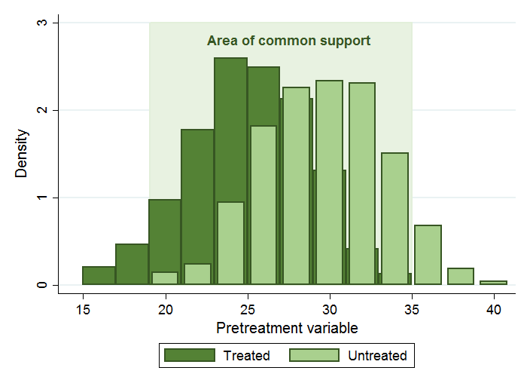
Diagnostics
Common support

Slide 27
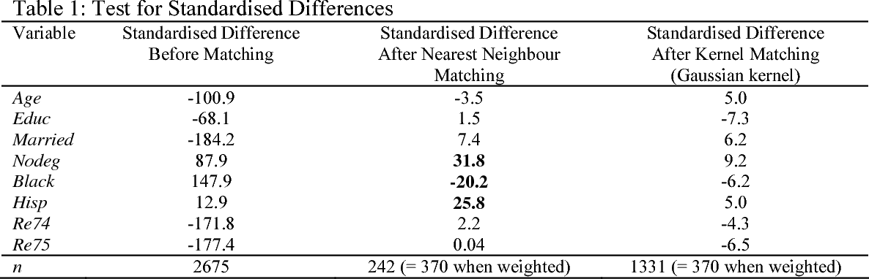
Diagnostics
Covariate balance: compare standardised differences
Lee WS, Propensity score matching and variations on the balance test. Emp Econ 2013, 44

Slide 28
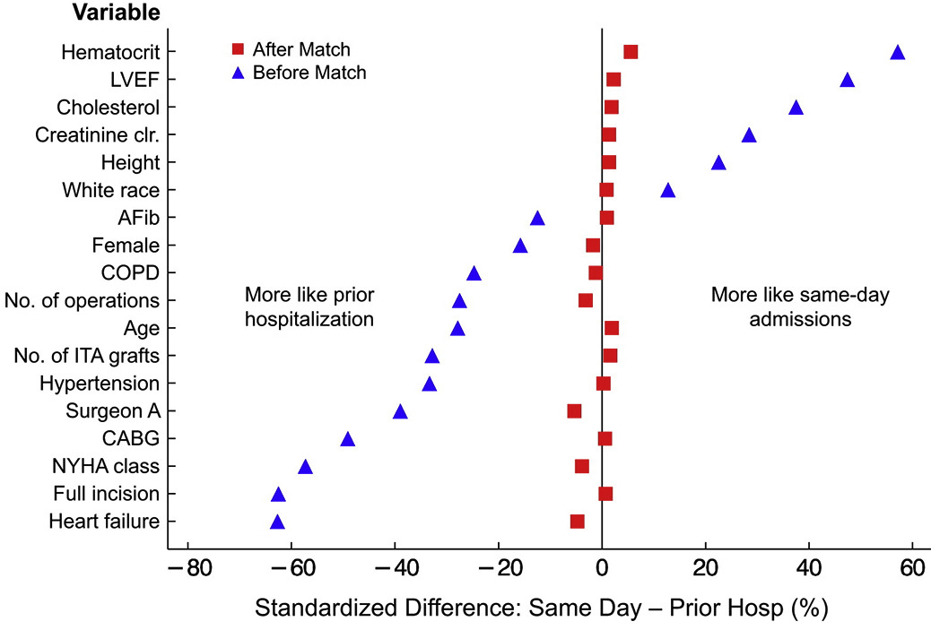
Diagnostics
Covariate balance: visualize standardised differences
Winger et al Propensity-score analysis in thoracic surgery: When, why, and an introduction to how. JTCS 2016 151(6)

Slide 29
Summary
To make causal claims we ideally want to compare observed outcome to counterfactual outcome
Three identifiability conditions allow us to make causal claims from observational data
Positivity
Exchangeability
Consistency
Matching balances data before modelling, removing model dependency
Propensity score matching emulates a simple randomised control trial
Other types of matching emulate a fully blocked randomised trial
Check common support (positivity assumption) and covariate balance (exchangeability assumption)

