Slide 1
Presentation
Mark Hanly

Slide 2
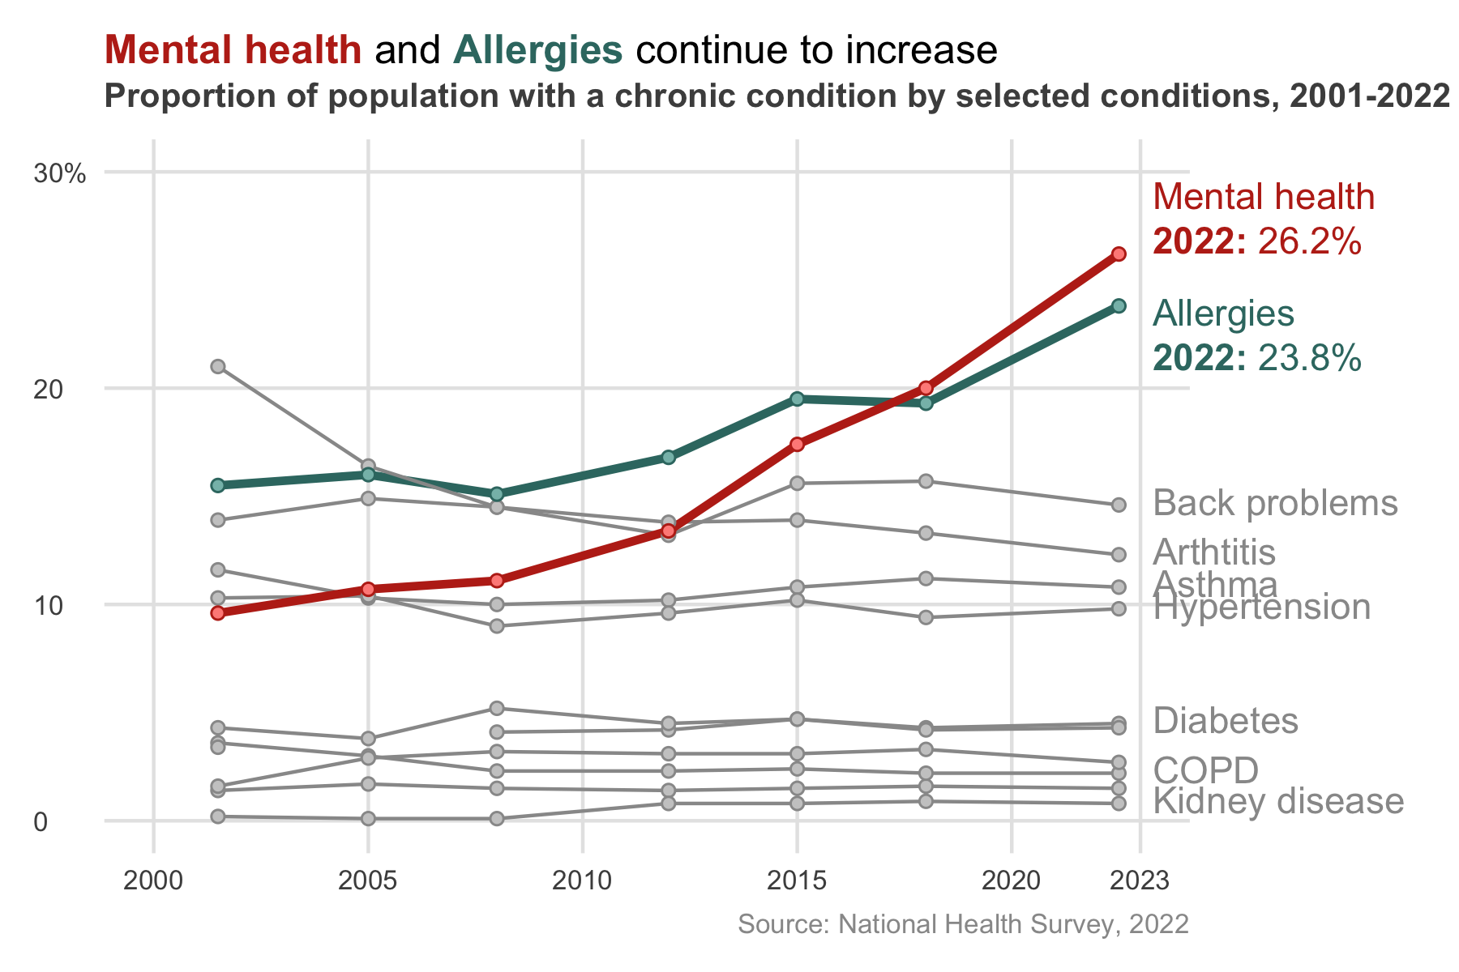
Chronic conditions

Slide 3
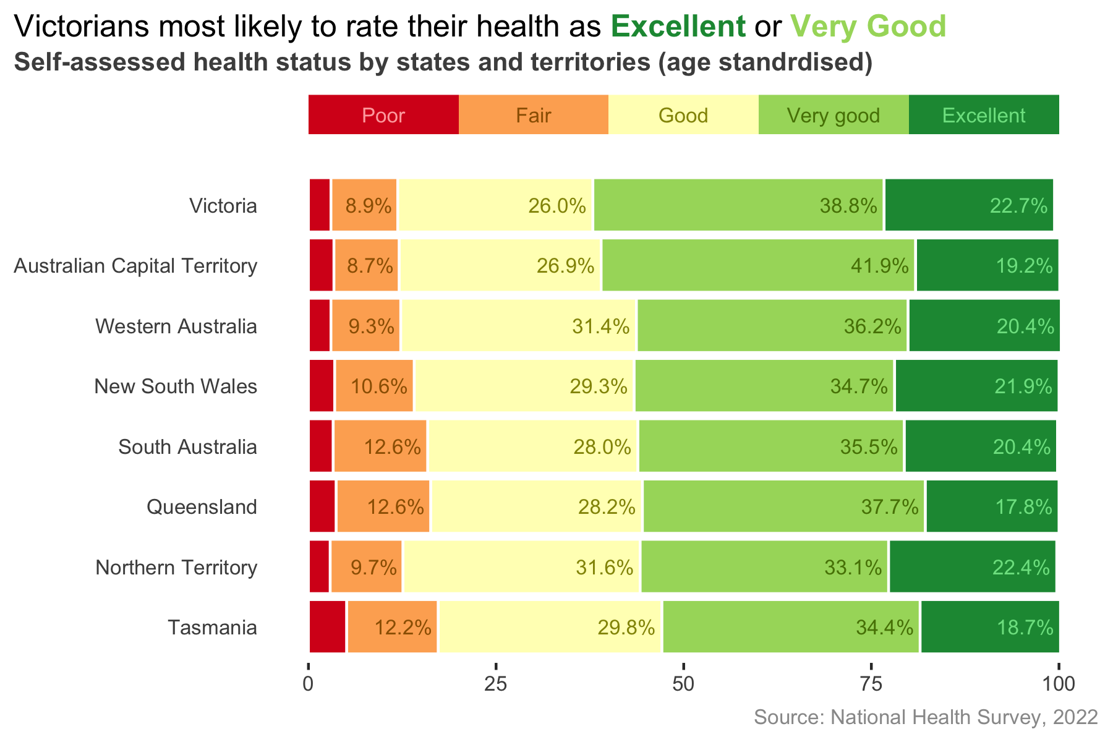
Self assessed health

