Slide 1
Python programming workshop
CBF@liverpool.ac.uk
cbf.liverpool.ac.uk
www

Slide 2
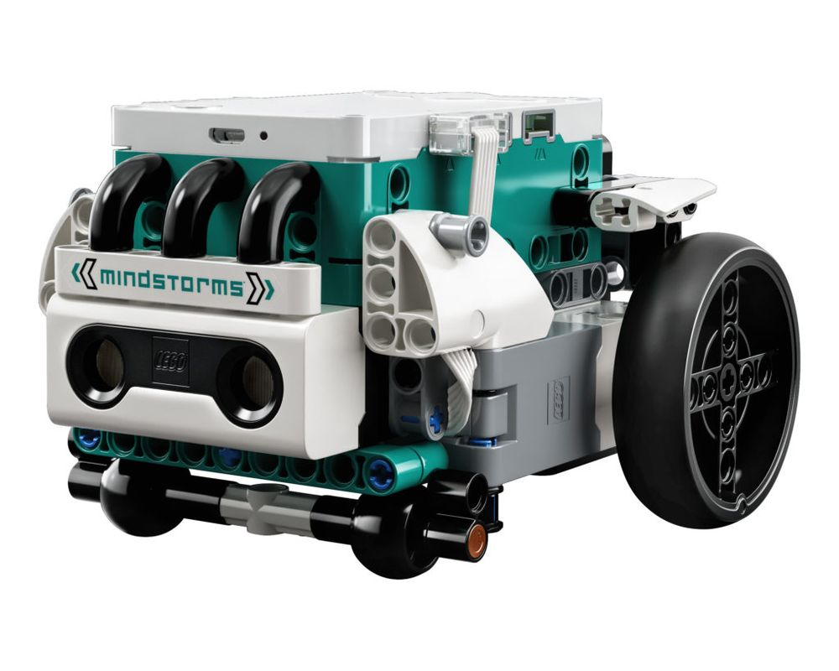

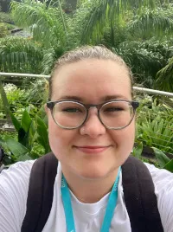
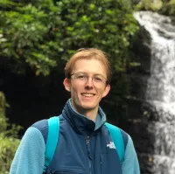
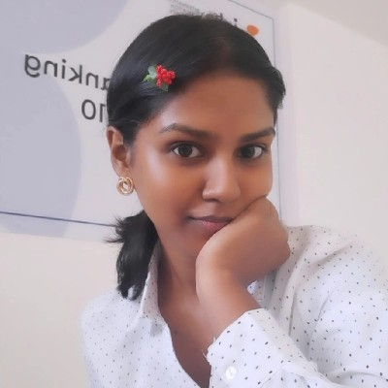


Introduction

Slide 3
Guidance
You will be working through the booklet in front of you
Take turns with your partner being the one to type and the one to direct the other through the materials.
Put your hand up if you need help! The teachers are here to support you!
If you encounter an error don’t worry, this is totally normal in programming, usually it is a typo
These blocks will be used to indicate you should type the code below, copy very carefully! Pay attention to commas, underscores and spaces
These blocks will contain tips with extra information that might help you complete the exercises.
These blocks will contain exercises for you to attempt yourselves with the concepts you’ve learned

Slide 4
Complete sections 1-3 (pages 1-7) 10 minutes
Notes:
After 10 minutes we will work through the answers to the exercises on screen in the SPIKE Prime app

Slide 5
Complete section 4 (pages 8-11) 14 minutes
Notes:
After 12 minutes we will work through the answers to the exercises on screen in the SPIKE Prime app

Slide 6
Complete sections 5 (pages 11-15) 12 minutes
Notes:
After 12 minutes we will work through the answers to the exercises on screen in the SPIKE Prime app

Slide 7

Timed challenge 1
Make traffic lights:
Can you make the robot act like a traffic light, showing red, yellow and green on its centre light button, in this order, three times?
Notes:
Give them 2 minutes to start thinking about it

Slide 8
Timed challenge 1
Hint: Use the time and colour modules along with two for loops – Tips 4 and 6.
Notes:
Another 3 minutes

Slide 9
Timed challenge 1
Use two for loops. E.g:
colours = [color.RED, color.YELLOW, color.GREEN] # create a list of colours
# use first for loop to repeat 3 times
for each_lap in range(3):
# use second loop to loop through each colour
for each_colour in colours:
Notes:
After 5 mins total give them half the solution?

Slide 10
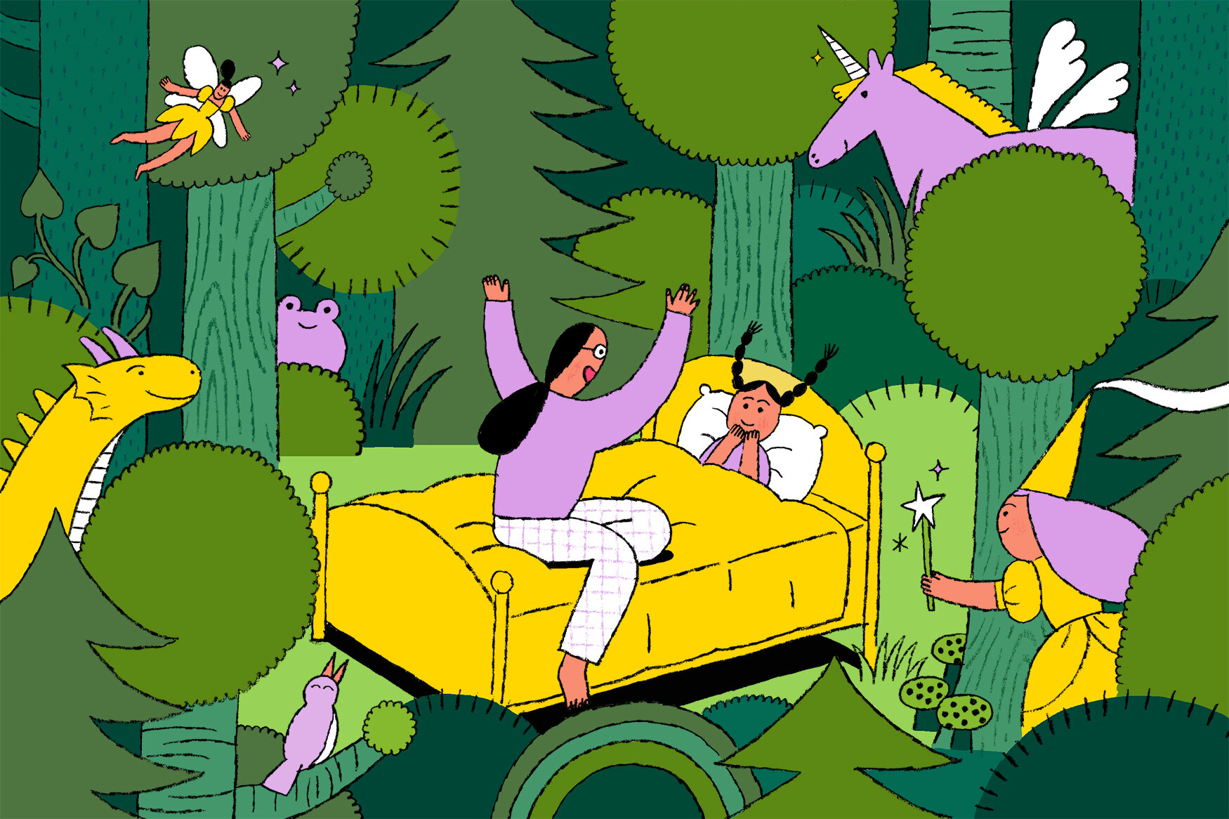
Timed challenge 2
Tell a story:
For example:
Display "I am READY"
Drive forward with a happy face
Spin with a silly face
Come back with a sad face
Display "THE END" at the end.
Notes:
After 5 mins total give them half the solution?

Slide 11
Timed challenge 2
Hint:
Use light_matrix, port, light, color, motor_pair and runloop modules.
Put all the steps inside async def main() and run it with runloop.run(main())
Notes:
After 5 mins total give them half the solution?

Slide 12
Timed challenge 2
Define the main function using async
Pair the motors
Display the text using await and .write() from light_matrix module
Show a happy face using .show_image(light_matrix.IMAGE_) from light_matrix module.
Make the robot move using await and .move_for_degrees() from motor_pair module.
Notes:
After 5 mins total give them half the solution?

Slide 13


Thanks! Any Questions?
Contact
www
cbf.liverpool.ac.uk
CBF@liverpool.ac.uk
computational-biology-facility-livuni
@cbflivuni.bsky.social
Notes:
So that brings us to the end of this lecture. Thank you all for your attention. The key takehome here is that functional enrichment is incredibly powerful but only when done correctly. The handouts you’re about to do will give you some worked examples, and remind you of some of these caveats we’ve discussed.
Any questions?

