Slide 1
Meeting with Eva and Anthony
18/01/24

Slide 2

HUMAN
PHOSPHOPROTEOME
129 proteomic mass spec datasets
Extract,
Convert to .tsv,
Calculate FDR and threshold,
Recalibrate
> 2,000,000 peptides with PTMs
1) Filter to only include peptides with phosphorylated S, T, or Y
2) Generate non-strict peptidoform IDs and aggregate the data
1) Filtering: IDs in 3+ datasets
with 90+ peptide-spectrum matches (PSMs)
2) Fit Gaussian Mixture Models (GMMs) with 1, 2, or 3 components for the calibrated mass errors of each peptidoform
3) Pick best model based on BIC score (lowest = best)
Peptidoforms assigned to m/z bins based on GMM distributions
1,747,947
peptidoform IDs
Notes:
Peptide atlas claims build contains 365 experiments, we have received 254 from Eric, are some of them missing?
The number of peptidoform IDs we have after aggregating the data seems high – close to the total number of distinct modified peptides (2,326,743)
- could be because distinct modified peptides only takes into account peptide sequence and not the type of modification so we have multiple peptidoforoms for some peptides
- still it’s more than double the sum of phosphorylated SITES:
PhosphoProteome Summary # of Phosphorylated Sites in Modified Peptides Singly Phosphorylated 478498 Doubly Phosphorylated 178533 Over 2 Phosphorylated 55958
TOTAL = 478498 + 178533 + 55958 = 712,989
SITES -> are two overlapping peptides (that result in separate peptidoform IDs) counted as the SAME site?

Slide 3
Peptidoform ID format (non-strict)
Peptide amino acid sequence
PTM1_count
nEQSPPPPLQTSSGAEVMDVGSGGDGQSELPAEDPFNFYGASLLSK_M147_1_n230_1_S167_1
non-strict = PTM position does not matter
PTM3_count
nEQSPPPPLQTSSGAEVMDVGSGGDGQSELPAEDPFNFYGASLLSK_n230_1_S167_1
m/z Bins
PTM2_count
3 different bin sizes:
wide (0.008), medium (0.006), narrow (0.005)
Data collected across 30 bins (10 of each width)
spanning ~ m/z -0.03 to m/z 0.03
Notes:
Can this be in some way prone to the same peptidoform being split in more than one ID?

Slide 4
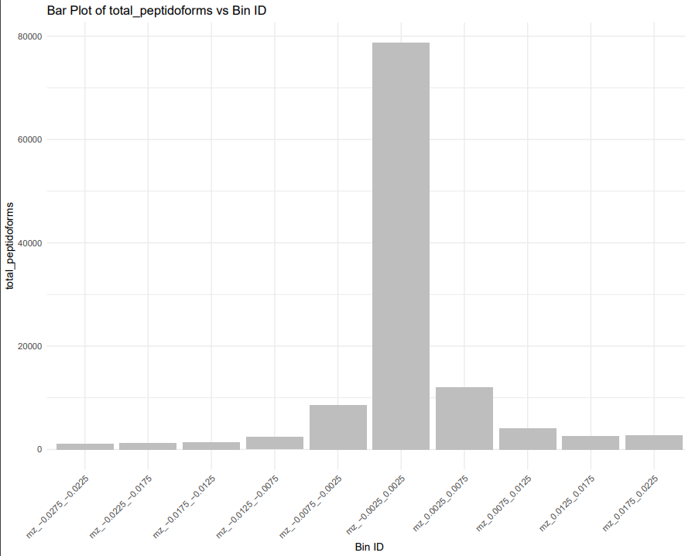
Data bins based on calibrated m/z
Calibrated m/z distribution of Sulfo miss-ID as Phospho
to centre around –m/z 0.01
DECOY bin with similar number of peptidoforms to use for enrichment analysis
Collect the data for ALL bins to serve as background for enrichment analyses

Slide 5
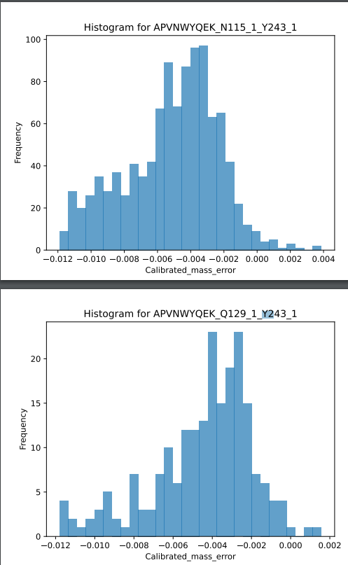
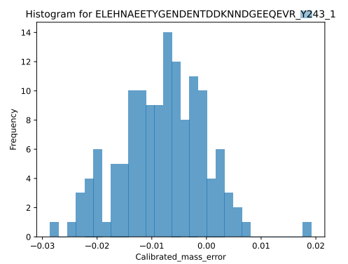
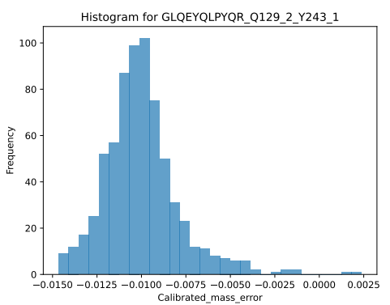
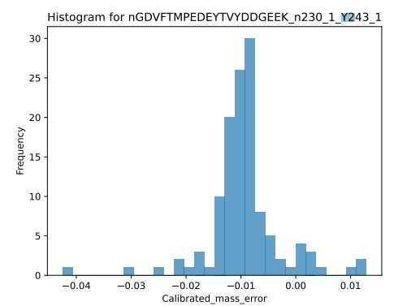
Interesting hits in mz 0.01 bin (histograms of calibrated m/z)

Slide 6
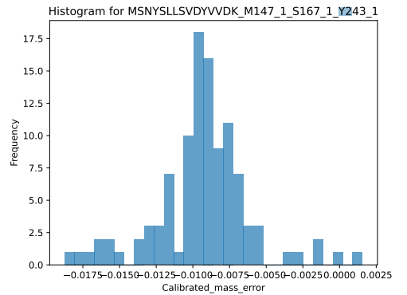
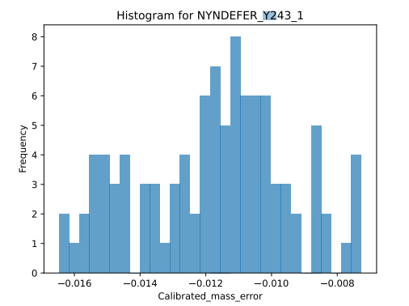
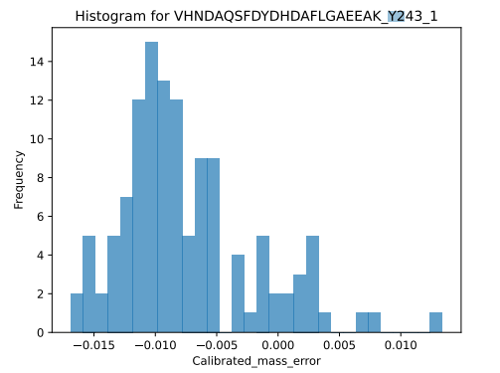
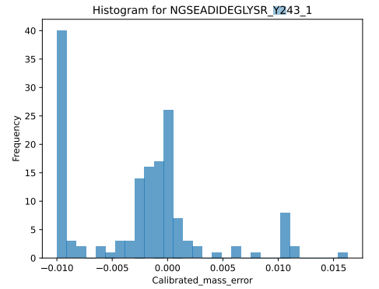
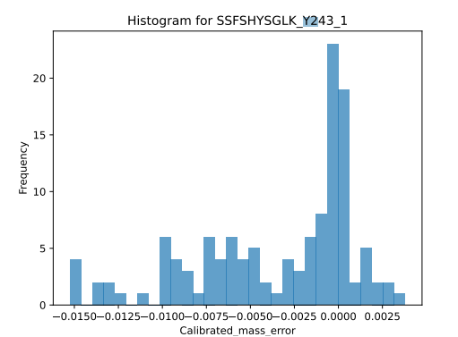
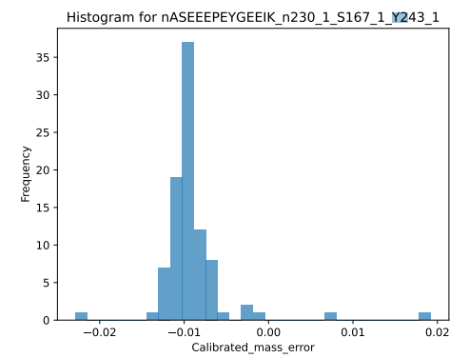
Interesting hits in mz 0.01 bin (histograms of calibrated m/z)

Slide 7
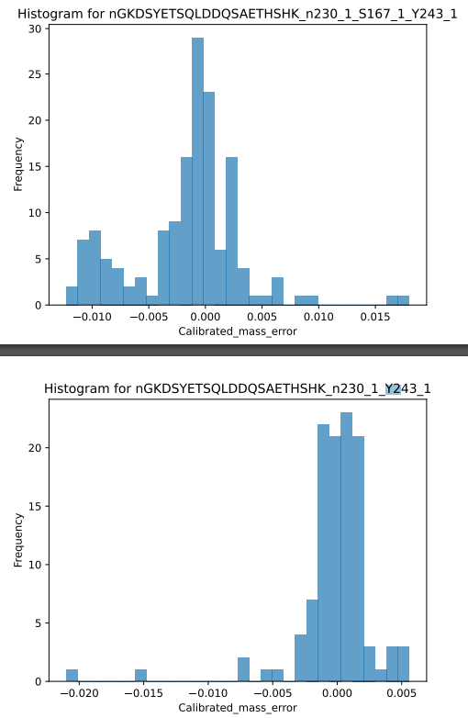
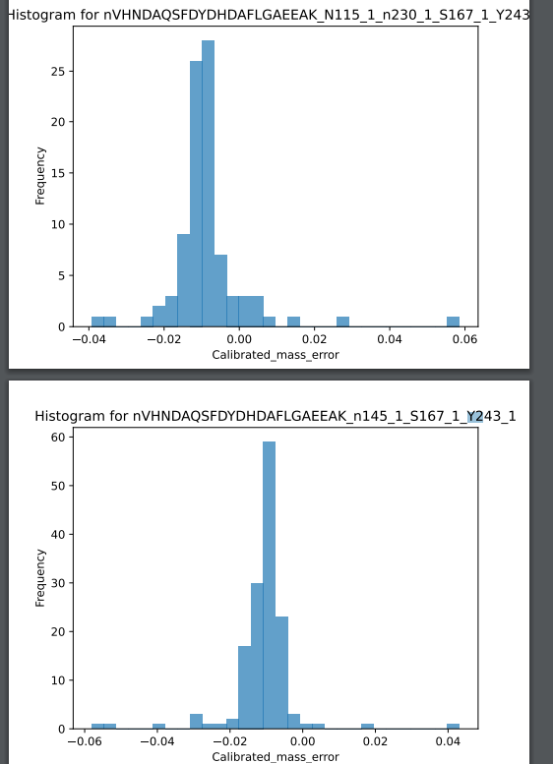
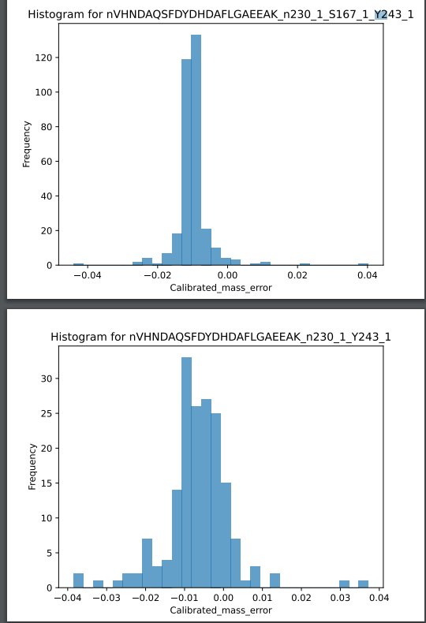
Interesting hits in mz 0.01 bin (histograms of calibrated m/z)

Slide 8
But also plenty of false positive hits and peptides that don’t even contain tYrosine…

Slide 9
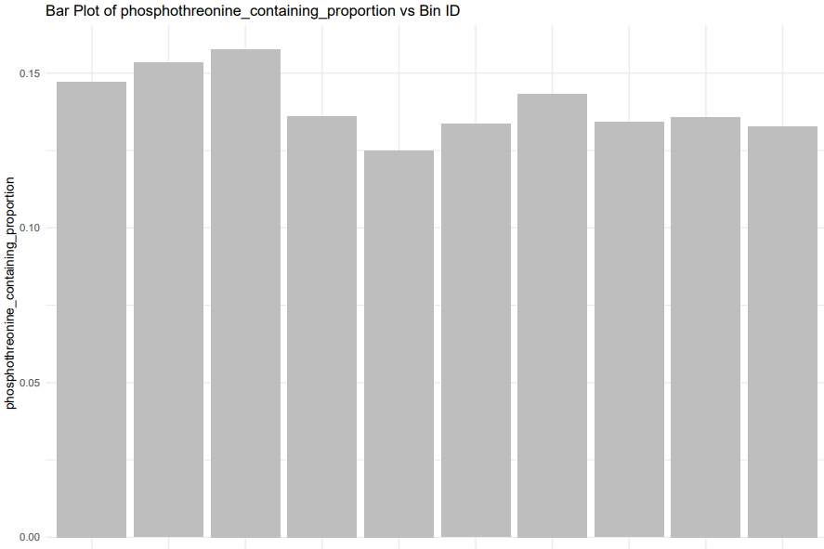
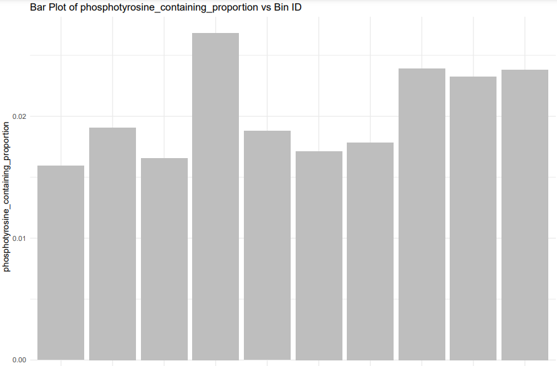
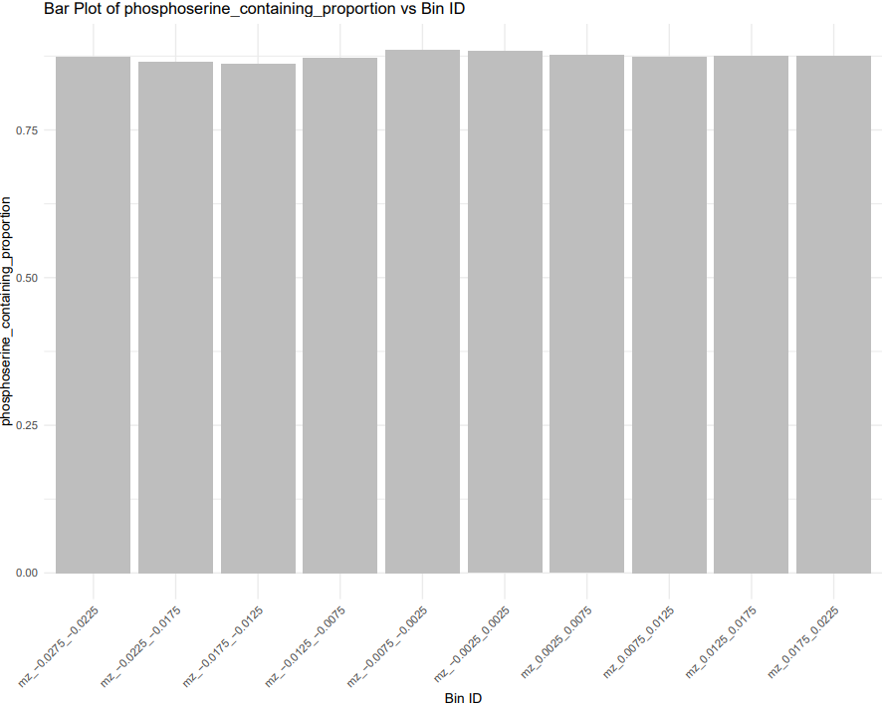
pT/total n peptidoforms
Bin is enriched in phosphotyrosine-containing peptidoforms
but not in phosphothreonine- or phosphoserine-containing peptidoforms; However pY much less common in general, so could just be random? (need to do some stats test here? Chi-squared?)
pY/total n peptidoforms
pS/total n peptidoforms

Slide 10
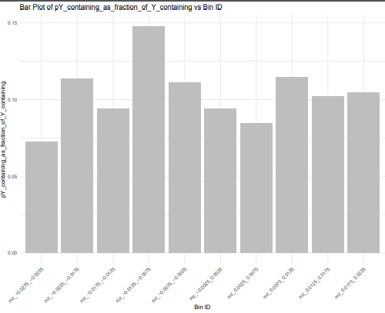
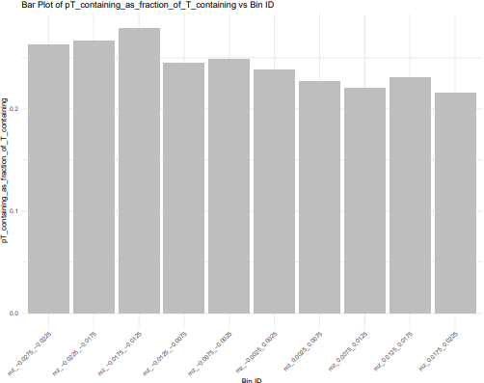
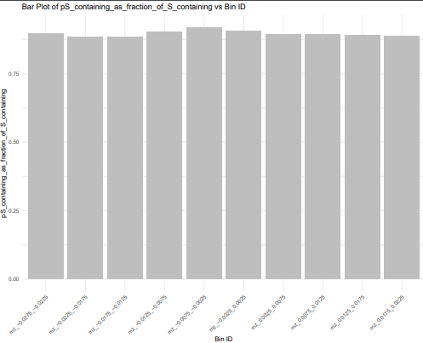
Bin also has higher proportion of phosphorylated tyrosine within the subpopulation of peptidoforms that contain a tyrosine (NB: different y ranges)
pY-containing/Y-containing peptidoforms
pT-containing/T-containing peptidoforms
pS-containing/S-containing peptidoforms

Slide 11
Enrichment analysis: Filtering
Tyrosine-containing phosphorylated peptidoforms
(not pY): some PTMs might be mis-assigned to incorrect amino acid and we’ve not done FDR thresholding on this (don’t fully understand assignment but it’s based on PTM prophet; Andy advised to go with Y-containing )
Foreground:
Y-containing in
Bin of interest
DECOY Foreground:
Y-containing in
DECOY Bin
Background:
Y-containing in
all bins
Only include peptidoforms with assigned protein IDs that are part of SwissProt (reviewed human proteome, ~20,000 proteins)
We have ~ 6500 of these in our background

Slide 12
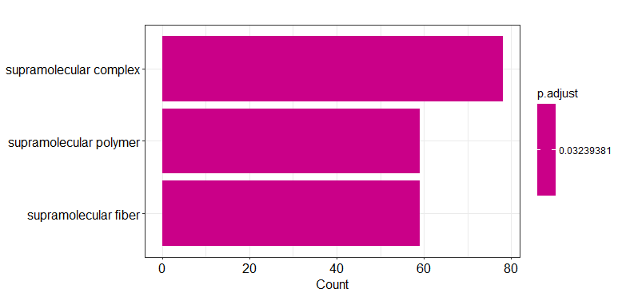
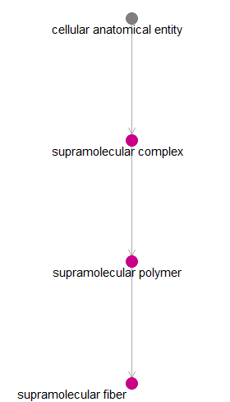
Enrichment analysis: Cellular Component GO terms
The Tyrosine Sulfate Domain of Fibromodulin Binds Collagen and Enhances Fibril Formation
https://www.sciencedirect.com/science/article/pii/S0021925820356519
No significant CC hits in DECOY bin
To look into: set significance thrreshodl to 1 and manually look at the terms that are most significant,
Even if it’s not above the 0.05 threshold?

Slide 13
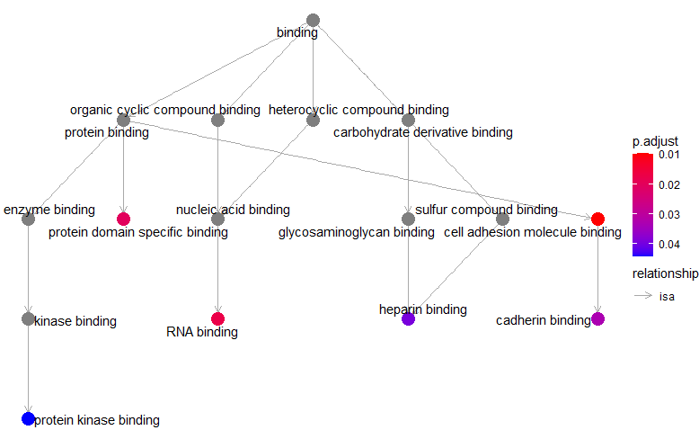
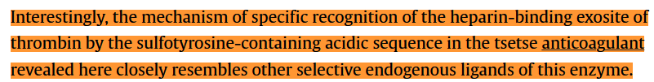
Enrichment analysis: Molecular Function GO terms
In general – binding:
sY is important in increasing binding affinity
https://www.jbc.org/article/S0021-9258(22)00674-3/fulltext#secsectitle0030
e.g. peptide hormone–receptor pairs
(which could be why we’re seeing protein kinase binding come up)
But also, protein kinases are activated by phosphorylation: what does the BINDING GO term entail? (is there a separate one for activation?)
Why is sulfur compound binging not significant? Check p value and q value.
So is the Tyrosine Sulfated before being phosphorylated? Or does this mean we’re not really enriching for Sulfation
p62 Association with RNA Is Regulated by Tyrosine Phosphorylation
https://www.sciencedirect.com/science/article/pii/S0021925819479519#:~:text=The%20ability%20of%20p62%20to,of%20tyrosine%20kinase%20signaling%20pathways.
https://www.sciencedirect.com/science/article/pii/S2451945620303810

Slide 14
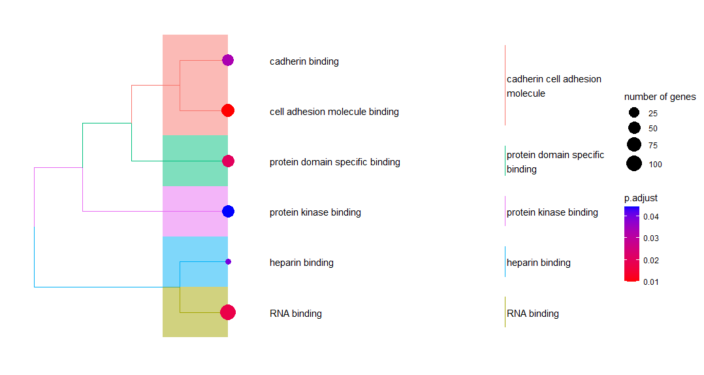
Enrichment analysis: Molecular Function GO terms
Cell Adhesion and RNA binding are the TOP HITs for our bin of interest

Slide 15
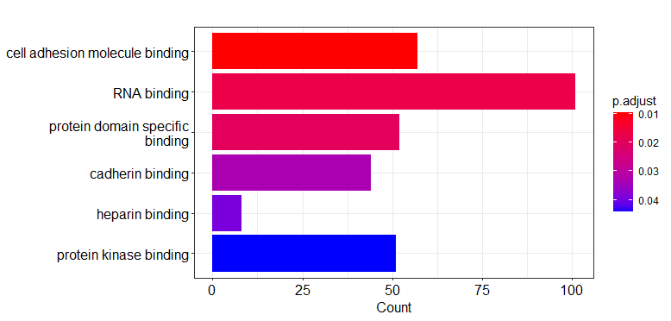
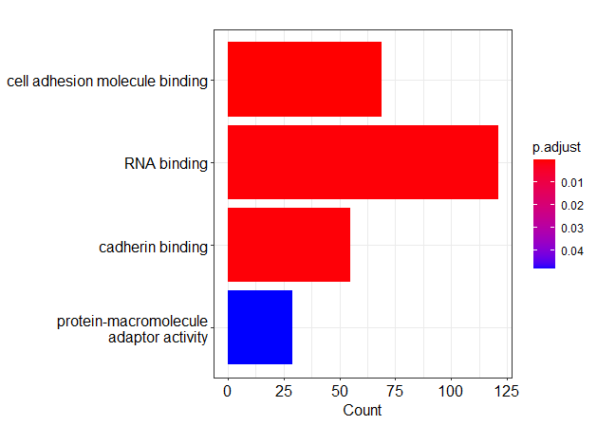
Enrichment analysis: Molecular Function GO terms
But also in the DECOY bin!
To look into: What specific proteins representing these GO terms are in each bin?
Can this be explained by sulfo vs phospho tryrosine involvement in these processes?
Bin of interest
DECOY Bin

Slide 16
Enrichment analysis: Biological Processes GO terms
No significant results for both bin of interest and DECOY bin
To look into: set significance thrreshodl to 1 and manually look at the terms that are most significant,
Even if it’s not above the 0.05 threshold?

Slide 17
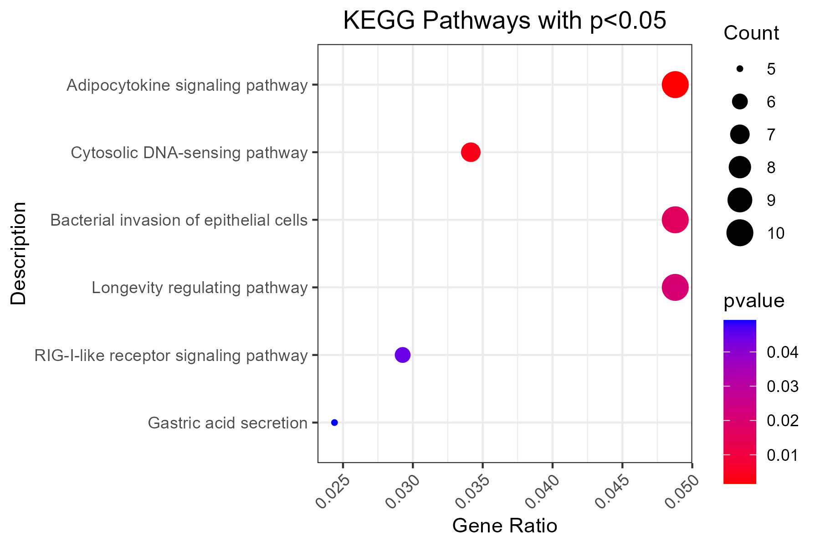
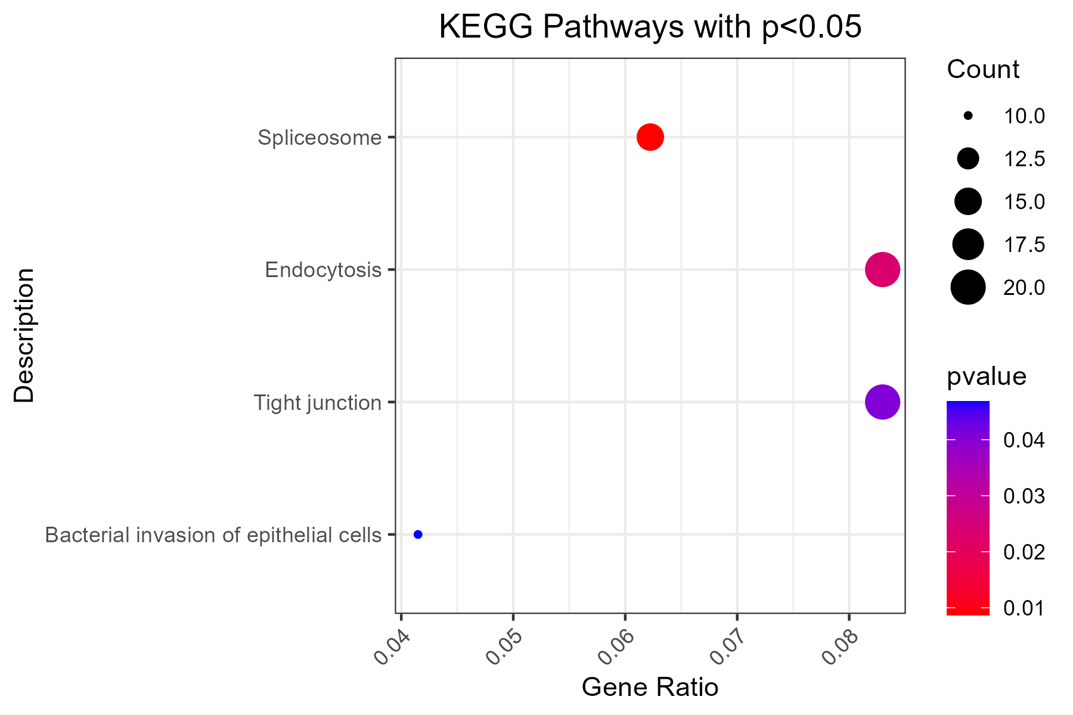
Enrichment analysis: KEGG
(no FDR-corrected significant hits but some significant p values)
Bin of interest
DECOY Bin
no remotely significant results post-FDR
(q value ~0.99 for all)
ADIPOCYTOKINES – good, secreted; need to look into rest – however, no significant results post-FDR
(q value ~ 0.3-0.4 for top 2 hits here;
>0.95 for rest)

Slide 18
Next steps
Motif enrichment analysis with code from Kerry
Potential next steps?
What if we looked at phosphotyrosines-containing only?
Different DECOY bin?
What if we looked at only more modern and mass-sensitive datasets?
Reactome – why am I getting 0 hits even with pvalue cutoff at 1?

