Slide 1
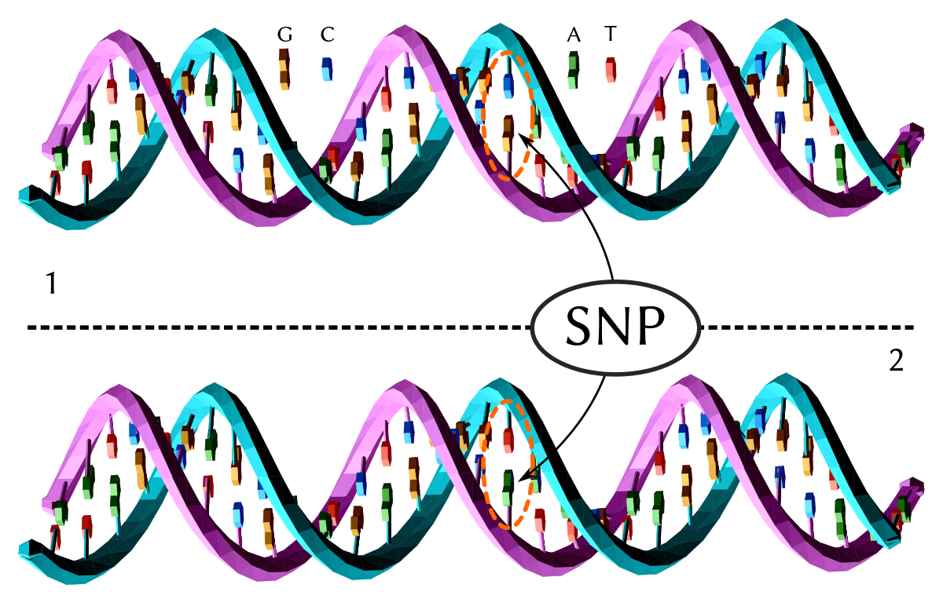
SNPs, genes, genomes: using assembled genomes for answering evolutionary questions
Jacob Landis, Haley Carter, Suzy Strickler, Meghan Myles, Gabriel Barrett, Jill Wegrzyn
June 16, 8 am EST - 5 pm EST

Slide 2
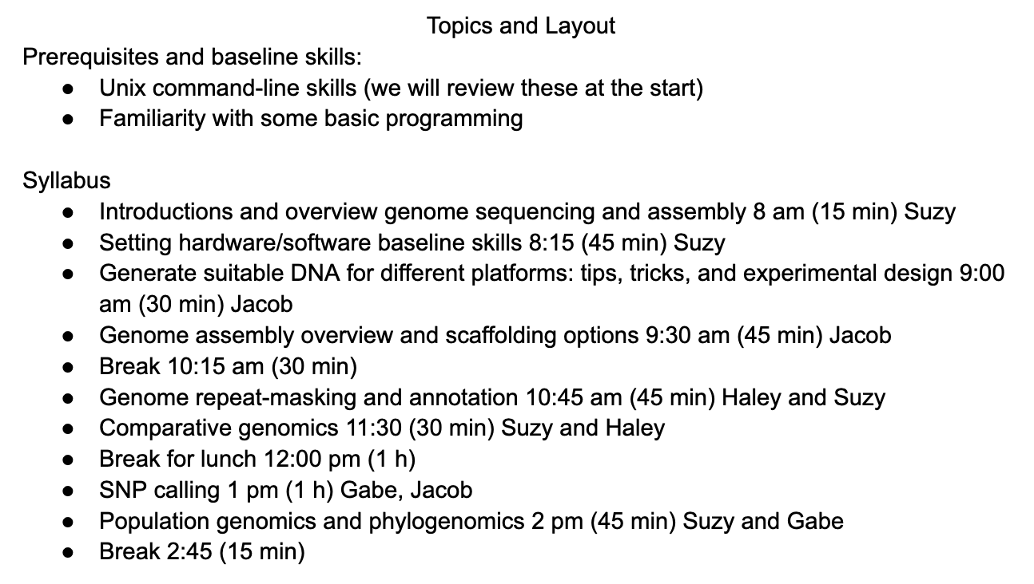
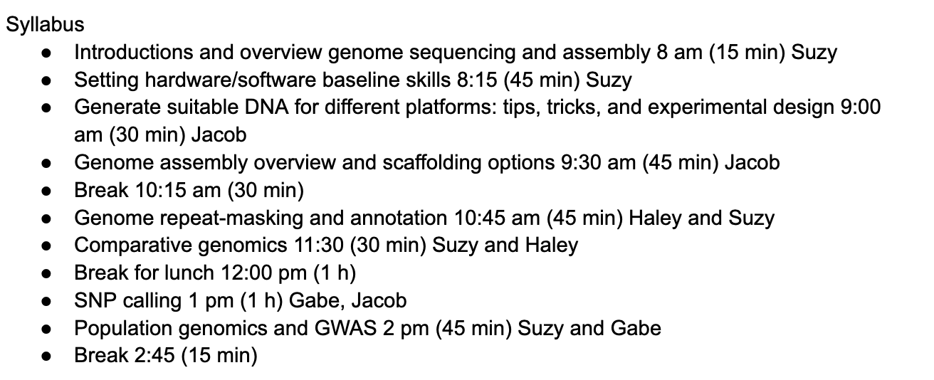
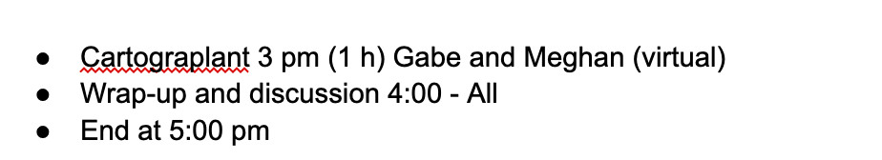
Schedule for Today

Slide 3
Procedural Things
Google folder: https://drive.google.com/drive/folders/1ZDIFmEqQhhqgexKIl7JCvHavLBm7ix-T?usp=sharing
GitHub repo:
https://github.com/CBG-Conservation-Genomics/BotanyWorkshop2024/tree/main

Slide 4
Introductions
What are your projects and interests?
Suzy: sstrickler@chicagobotanic.org
Jacob: jbl256@cornell.edu
Haley: haleycarter2020@u.northwestern.edu
Gabe: gabriel.barrett@uconn.edu

