Slide 1
Linux Command Line
Suzy Strickler
Chicago Botanic Garden
Northwestern University

Slide 2
Linux Command Line
Class Content
Introduction to the Virtual Machine
Shells, Terminals, & file system navigation
Anatomy of a UNIX command
Wildcards, shortcuts and special characters
File permissions
Compression UNIX commands
Networking UNIX commands

Slide 3
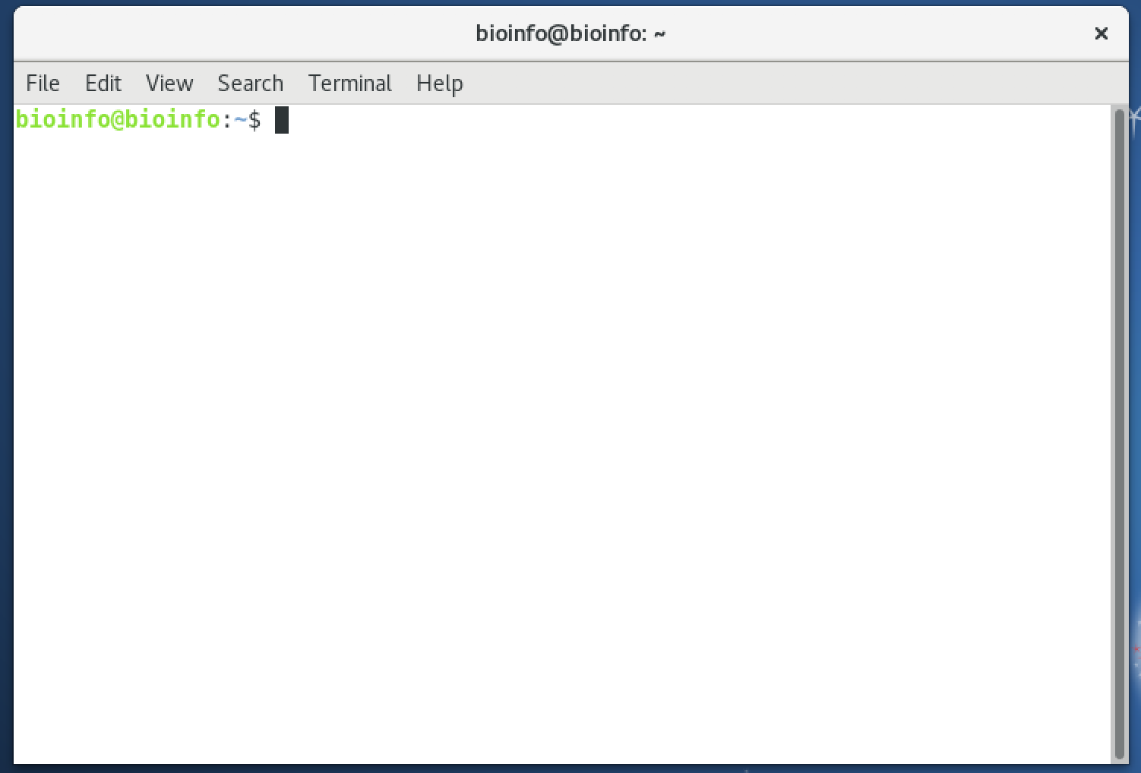
What is a Terminal?
A terminal is a textual interface for interacting with a computer (a shell!)
Using the terminal, one can issue powerful and concise command-line instructions for the computer to follow.
Notes:
- Way Back in the day before GUIs existed, there was only the terminal. You would turn on a computer and all you would have is the command line. Way WAY back in the day before screens were even a thing, the command line was a typewriter and a roll of paper.

Slide 4
Why use the command-line (terminal)?
Most software for biological big data analysis is used through UNIX command-line operations.
Most of the servers for biological data analysis use Linux/Unix as their operating system.
Data analysis on calculation servers are much faster since we can use more CPUs and RAM than in a PC or laptop (e.g. BTI’s “Boyce” server has 64 cores and 1TB RAM).
Large NGS data files can not be opened or loaded in most graphical software and web sites.
App development is often harder and takes longer when using GUIs
Notes:
Command line interfaces allow much more flexibility in input and output than GUIs, which require a lot of pre-programming
For example, processing large data in a .csv file and funneling the info to another program for additional processing is very expensive if you try to do it in excel. The file might take a long time to open, and then it would still be slow to manipulate because of the way excel has to load data
Doing the same task from the command line allows you to move much much faster, and you don’t need to worry about special excel plugins
Programming GUIs takes WAY more effort than programming CLIs. The more pipelines you want to enable, the more work a GUI will take.
Graphical shells are computationally expensive on small machines and are a waste on large machines where there are no graphical apps even installed.

Slide 5
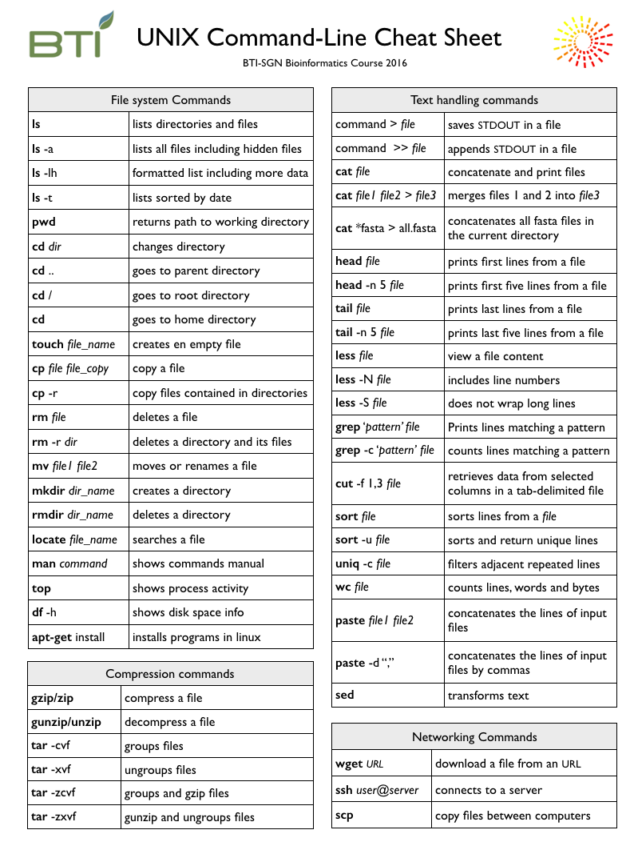
Command-line File System Navigation
The cheat sheet you have been provided contains a list of common commands for navigating the file system.
But what is the file system?

Slide 6
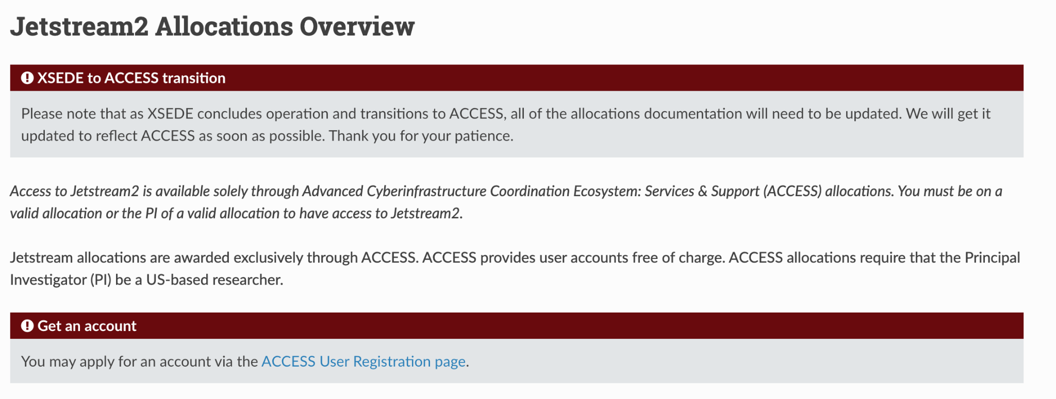

ACCESS and Jetstream2
https://docs.jetstream-cloud.org/alloc/overview/

Slide 7
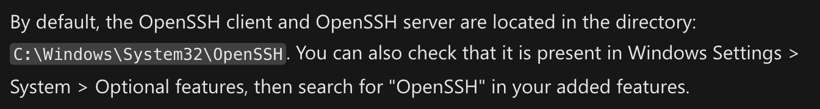
Connect to remote server
Open a terminal and type the following (using your username, ip address, and password emailed to you:
ssh username@ip_address
EX: ssh instructor@149.165.169.242
please note: substitute YOUR credentials for “username” and “ip_address” in the above command

Slide 8
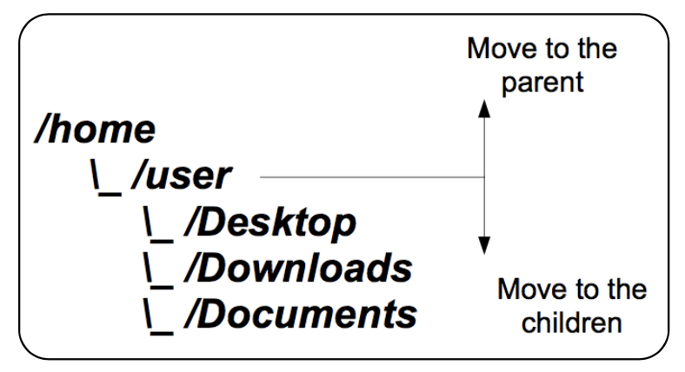
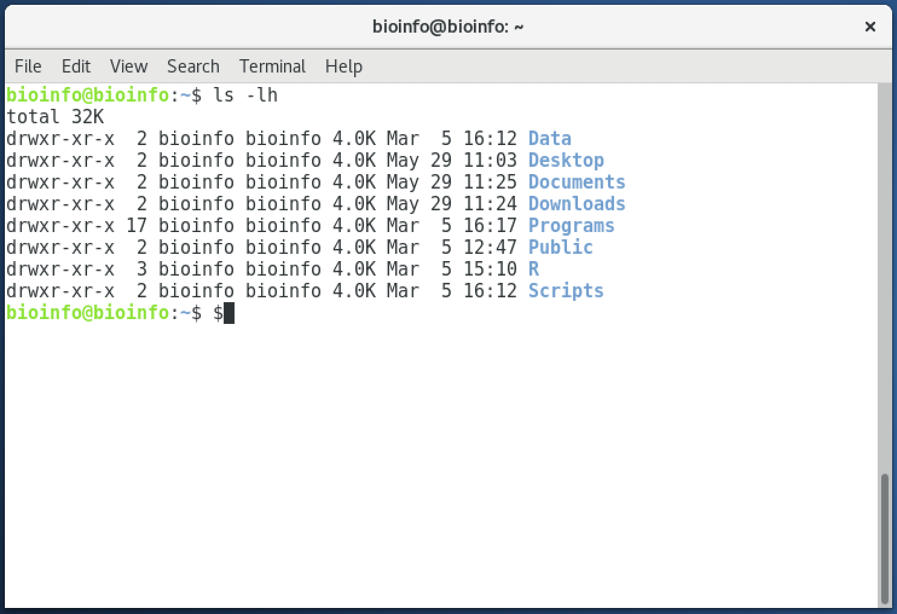
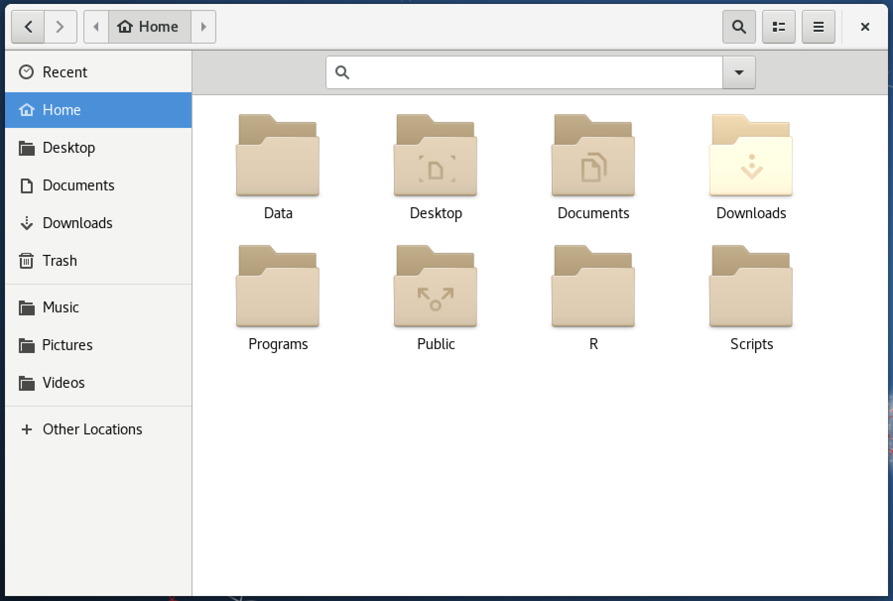
The File System
Exercise:
Type “ls –lh” into the terminal and press enter.
Notes:
The file system is maintained by the computer, but there are multiple ways to view it. You can see it graphically like you are used to, or you can explore it with the command line. It is conceptually the same

Slide 9
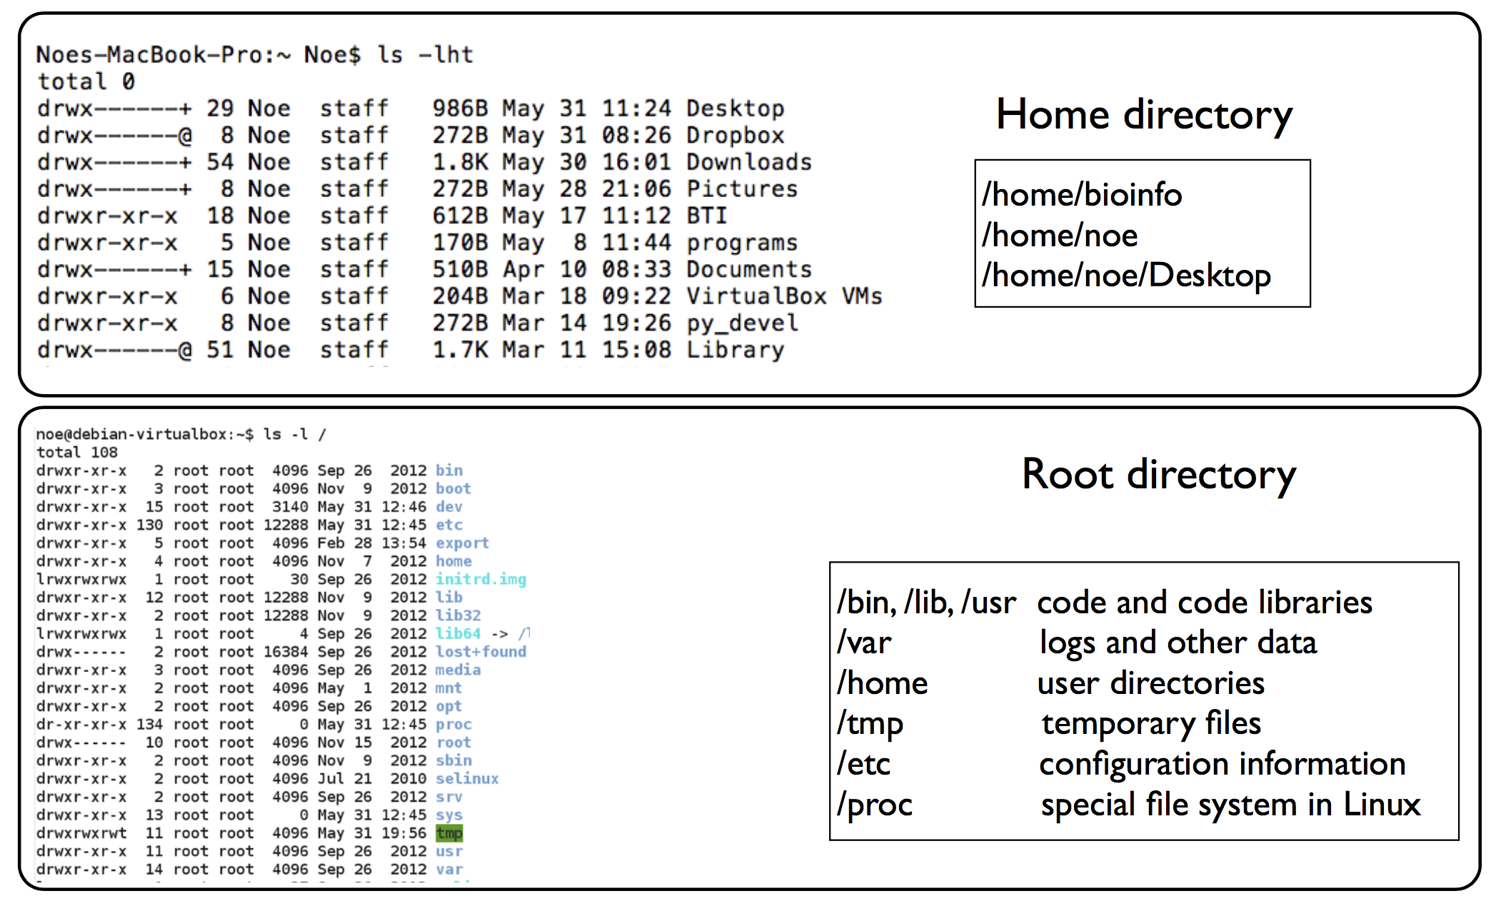
Home and Root Directories
Notes:
All unix machines have a file system where the highest level is root, written as a single forward slash.
Show them cd /
Your “home” directory, similar to C:/Users/YourName on Windows or /Users/YourName on Mac, is /home/YourName
The home directory is always abbreviated to a tilde

Slide 10
Anatomy of a UNIX Command
Every UNIX command is made up of a series of space-separated strings.
The first of these strings is always the command you will run.
The user can also provide options (shown in red) and arguments (shown in blue).
A command can require arguments, as can an option.
In this example, the “-A” option is being given the argument “3” and the command is being given the argument “file.txt”.
grep -c -A 3 --ignore-case file.txt
grep
-c
-A
3
--ignore-case
file.txt
Options often have a short form (starting with “-”) and a long form (starting with “--”).
If an option flag does not have any arguments, then can often be concatenated (e.g. “ls -h -l -a” is equivalent to “ls -hla”).
Notes:
-grep is a text filtering command, very very useful
Note that not all commands you will use have the same grammar as a basic UNIX command! Whenever in doubt, you can try saying command –help, the man command, or google to figure out a command’s specification.

Slide 11
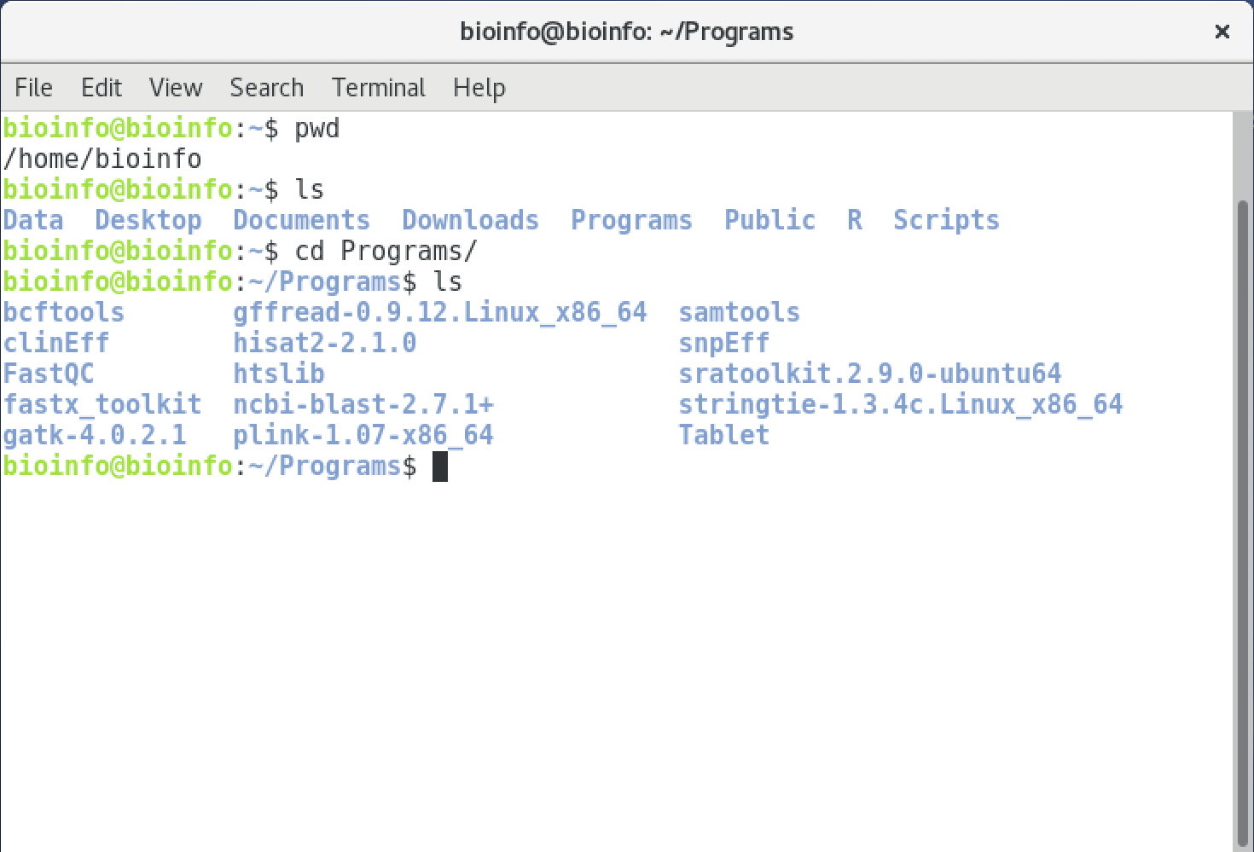
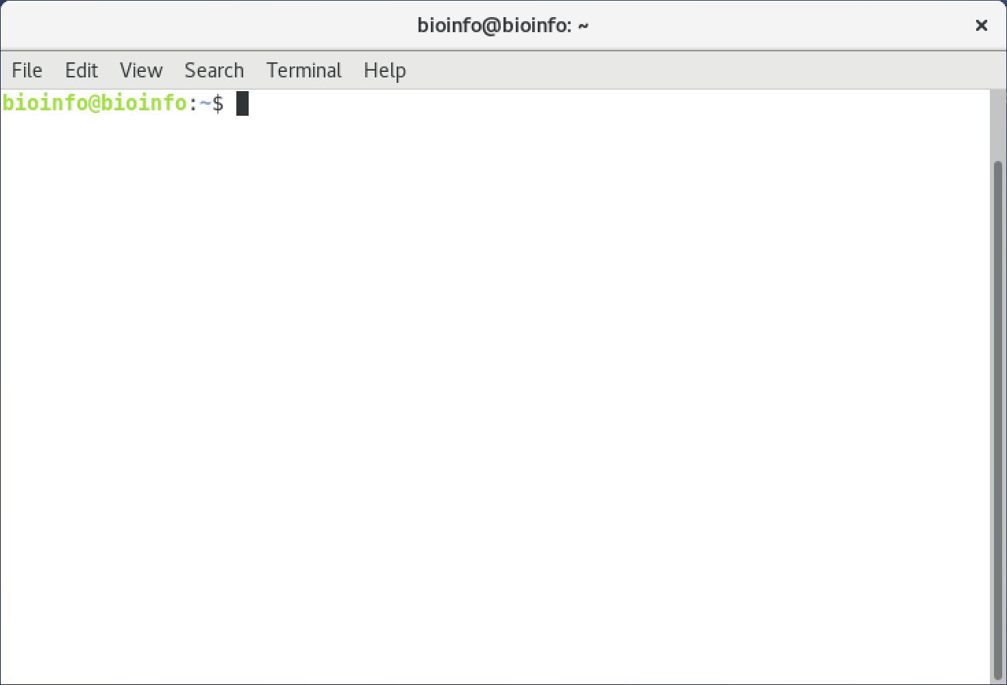
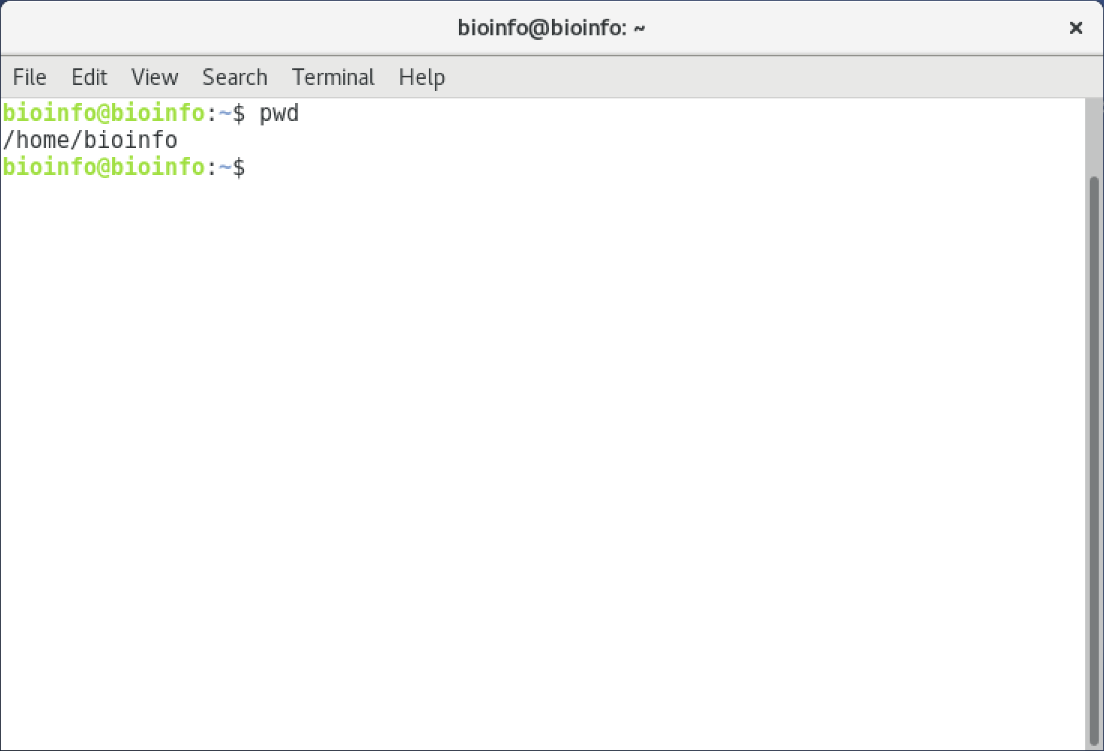
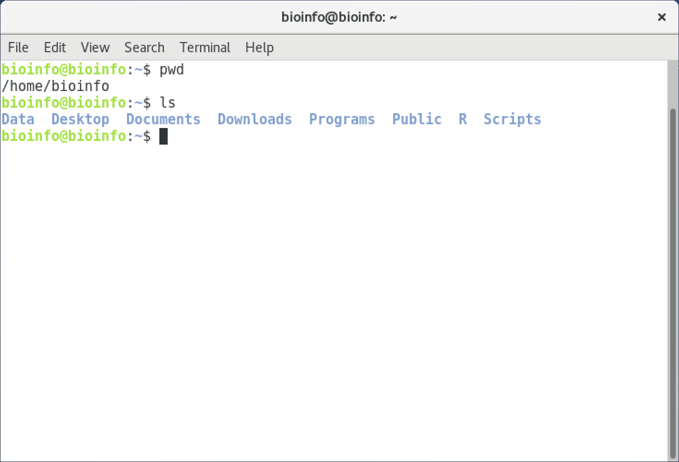
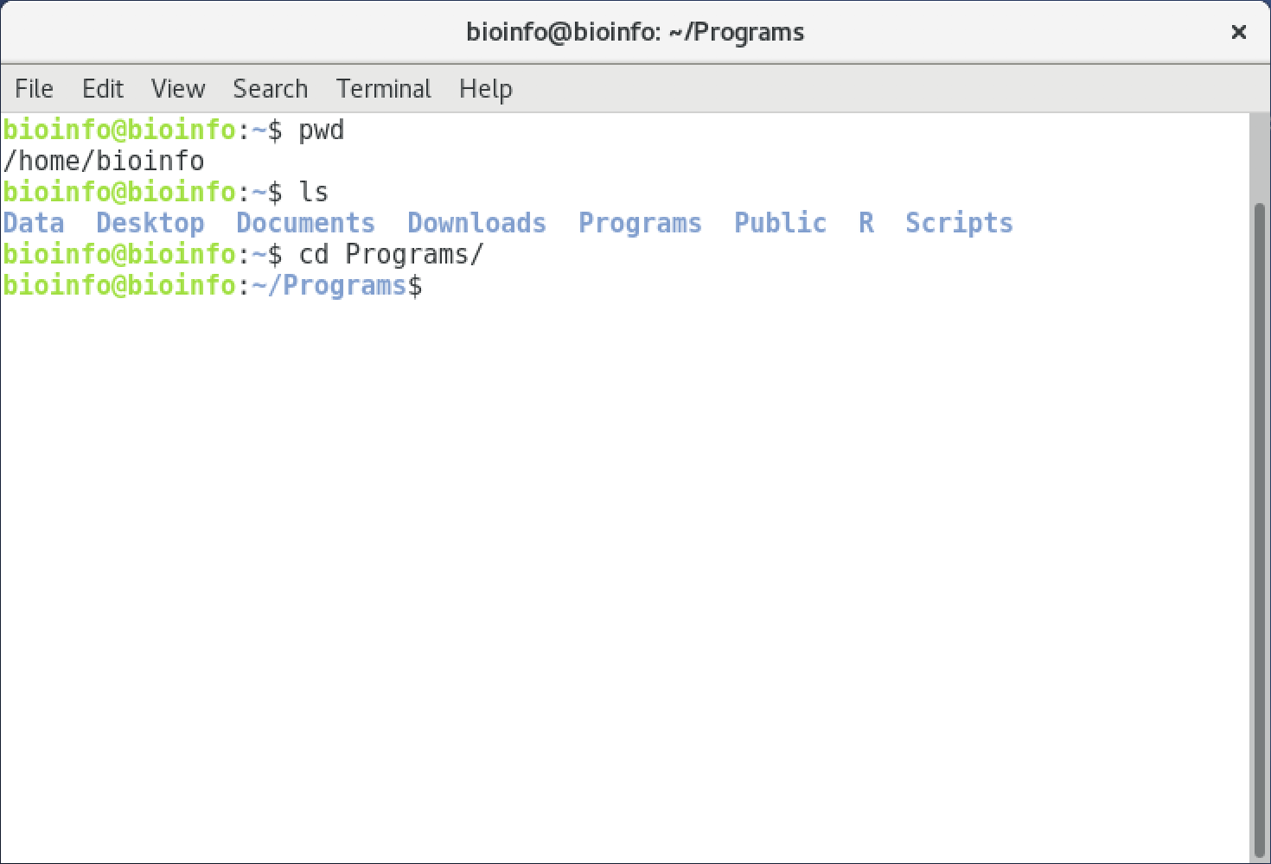
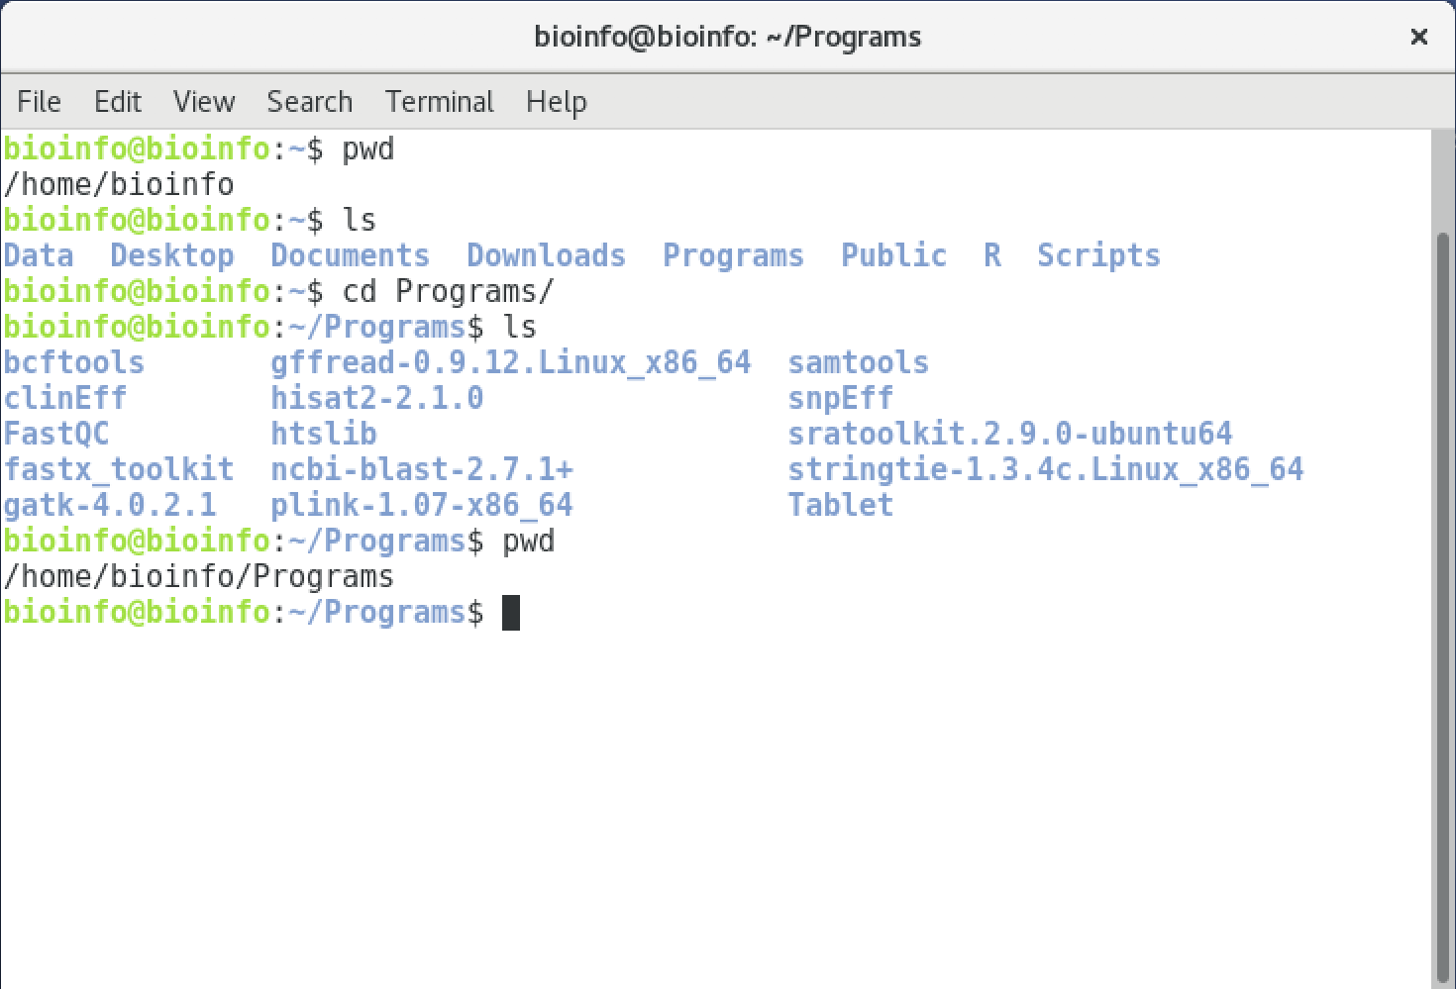
pwd, ls, and cd
pwd — where am I?
ls — what is inside the current directory?
cd — change my current directory.
Exercise:
Change into the “Programs” directory and list the files found there.
Notes:
UNIX commands tend to be short and easy to type, at the expense of seeming esoteric to a new user. You will get used to it.

Slide 12
ls lists files and directories
list directories and files in current directory
ls

Slide 13
ls lists files and directories
list directories and files in current directory
list all directories and files, including hidden files
ls
ls -a
Notes:
Demonstrate this as you do it

Slide 14
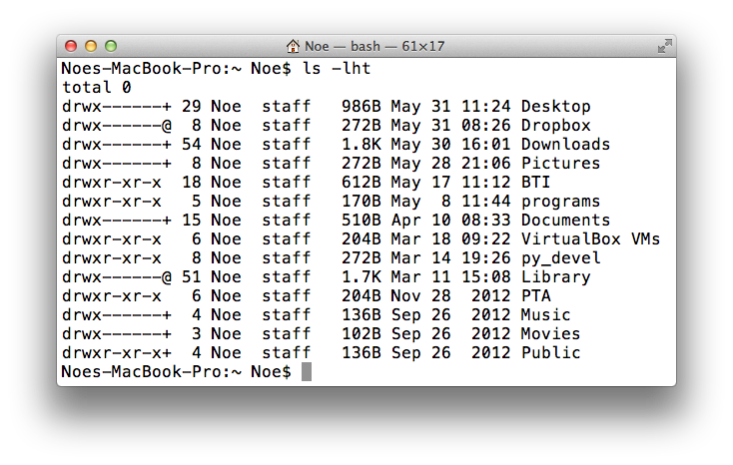
ls lists files and directories
list directories and files in current directory
list all directories and files, including hidden files
ls
ls -a
list in long format
ls
-l
-h
human readable
Notes:
The difference in human readable is in the way the numbers are formatted. The long format version makes a vertical table rather than just listing them out horizontally

Slide 15
The ls list output
owner user
owner group
permissions
links #
size
date
File name
group
user
other
d rwx r-x r-x
r readable
w writable
x executable or searchable
- not rwx
d Directory
- Regular file

Slide 16
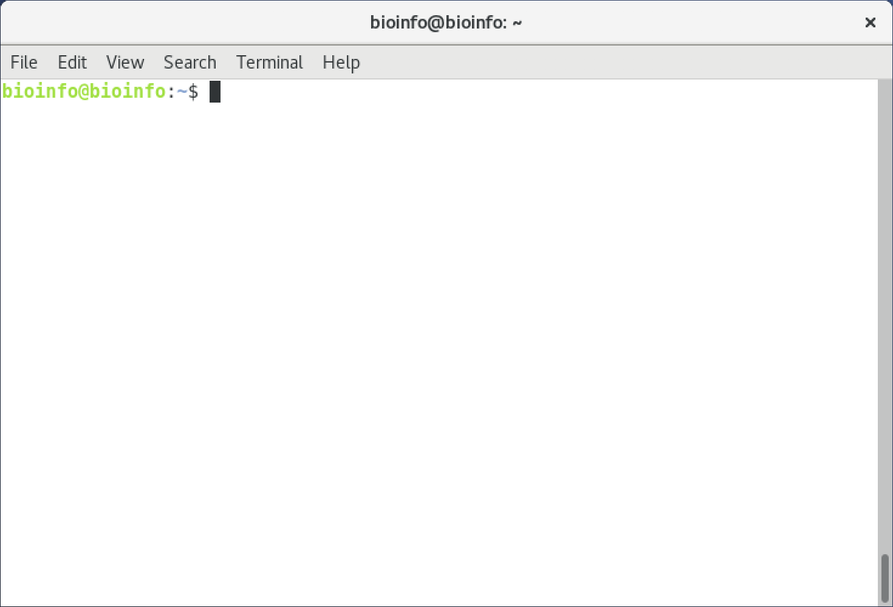
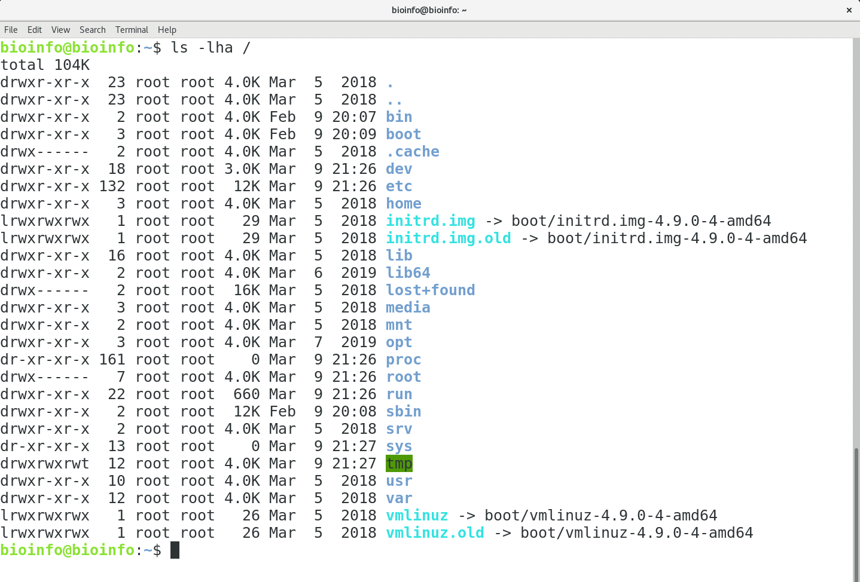
Exercise:
List ALL files present in the root directory (including hidden files)

Slide 17
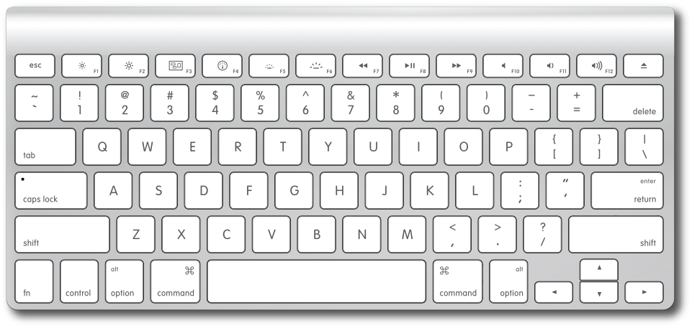
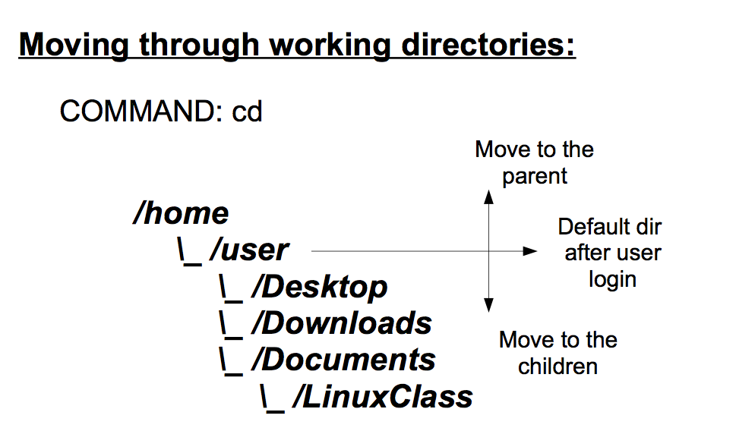
cd changes directory
changes directory to Desktop
Use tab key to autocomplete names
goes to parent directory
cd Desktop
cd ..
cd /
goes to root directory
cd
goes to home directory
cd -
goes to previous directory
Notes:
Cd with no arguments is equivalent to saying cd /home/YourName
This means that cd ~ and cd /home/YourName and cd all do the same thing
You can chain the parent directory symbol, so you can say cd ../../..
The tab autocompletion is great, but it will stop if you have two files or directories with the same name. You can press tab again to see the choices. It will only completely fill in the name if it is unambiguous

Slide 18
Absolute and relative paths
list files in Desktop using an absolute path
ls /home/user/Desktop
ls Desktop/
ls ~/Desktop
list files in Desktop using your home as a reference
list files in Desktop using a relative path (from your home: /home/bioinfo)
Notes:
Whenever you do not explicitly specify the full path starting from root, it will assume that you are starting your path in your current working directory

Slide 19
Absolute and relative paths
Absolute paths do not depend on where you are
ls /home/bioinfo/Desktop
ls ~/Desktop
~/ is equivalent to /home/bioinfo/

Slide 20
Absolute and relative paths
goes to Desktop from when you are in your home (/home/bioinfo)
cd Desktop/
ls ../Documents
list files from Documents when you are in Desktop

Slide 21
Wildcards, Shortcuts, and Command History
ls *txt
list all txt files in current directory
ls d*vv
list files starting with d and ending with v
ctrl-c stop process
ctrl-a go to begin of line
ctrl-e go to end of line
ctrl-r search in command history
Use up and down arrows to navigate the command history
Notes:
Note that ls on dirs. Will list all the contents of each dir matching the wildcard

Slide 22
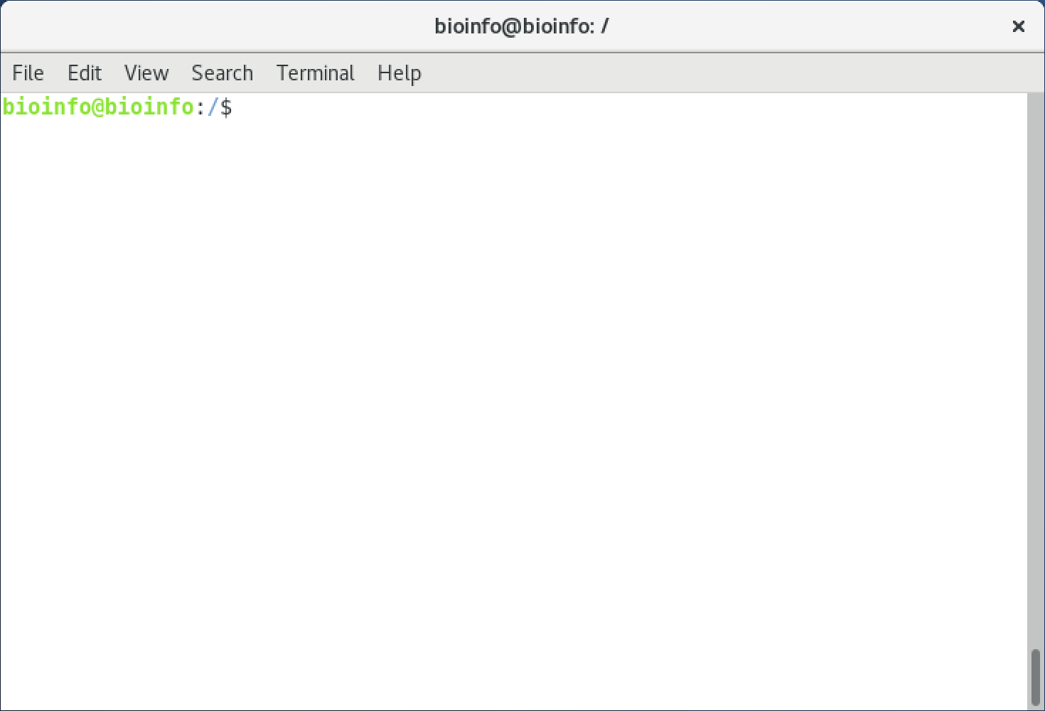
Exercise:
List files in the “/bin” directory that start with “ntfs” (do this once without changing your working directory, and once with changing your working directory).

Slide 23
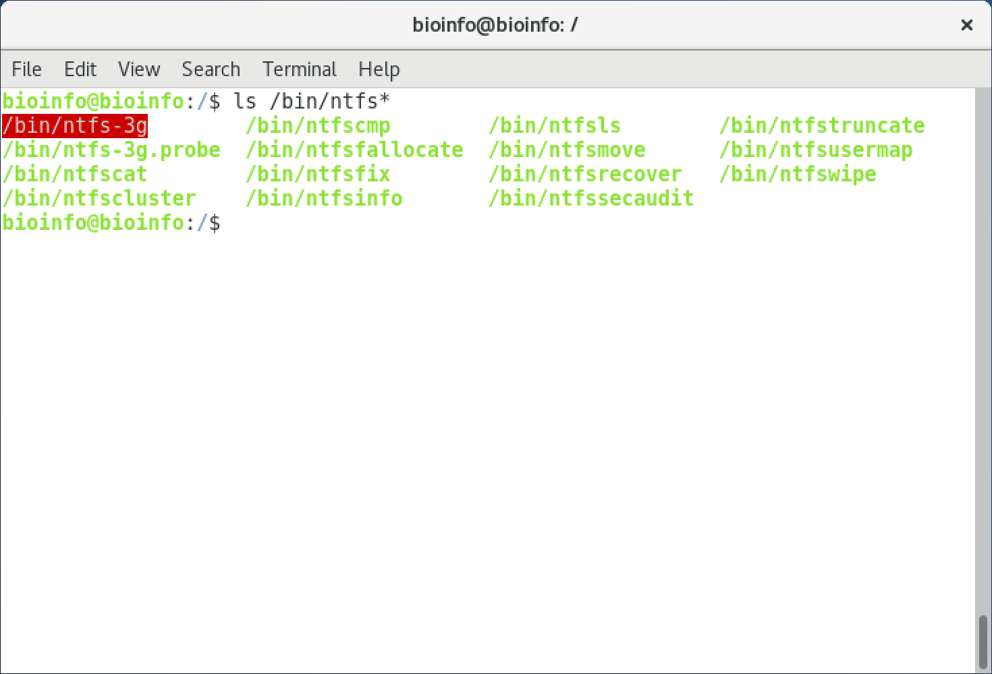
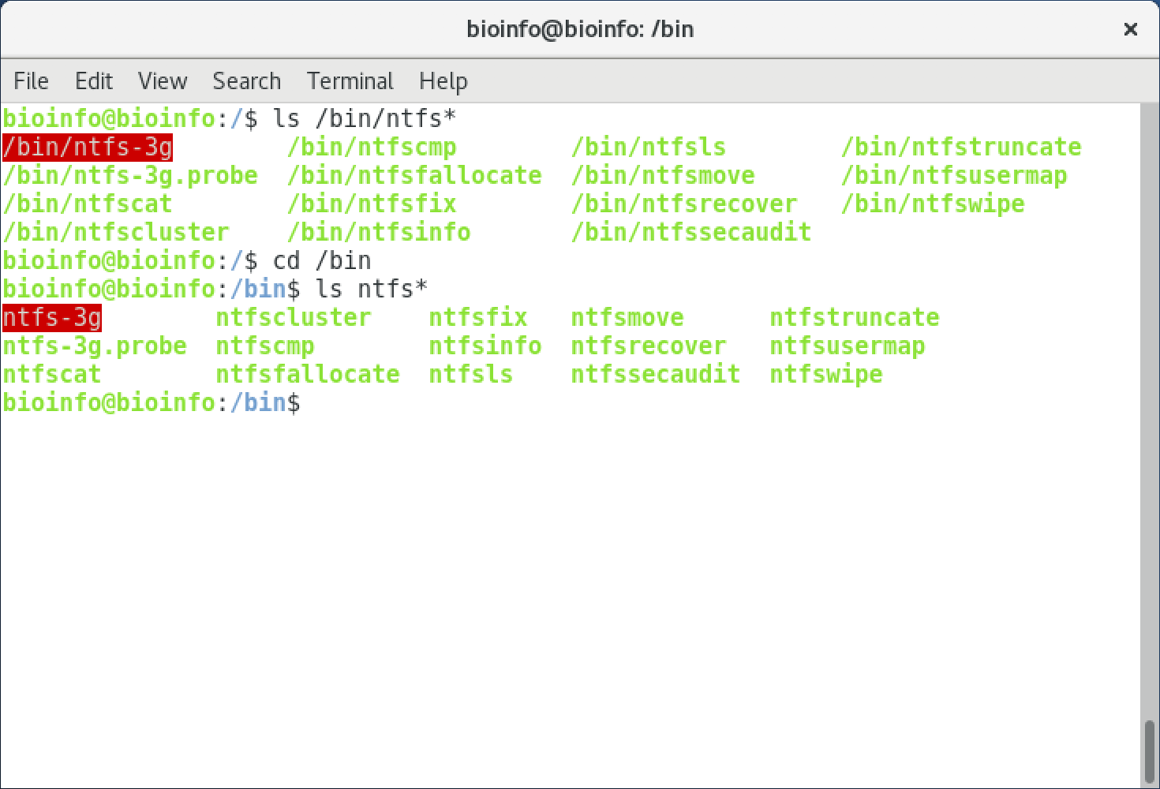
Exercise:
List files in the “/bin” directory that start with “ntfs” (do this once without changing your working directory, and once with changing your working directory).

Slide 24
Escaping special characters
! @ $ ^ & * ~ ? . | / [ ] < > \ ` " ;# ( )
ls my_folder
list a folder
ls my\ folder
list a folder containing a space
Tip: file names in lower case and with underscores instead of spaces
Use tab key to autocomplete names
Notes:
Do file names in undercase because it gets real annoying real fast to be using the shift key. And UNIX is case sensitive
Just avoid ever using special characters. They make things headaches

Slide 25
Create, copy, move and delete files
Tip: name files in lower case and with underscores instead of using spaces
creates an empty file called tmp_file.txt
copies tmp_file.txt in file_copy.txt
touch tmp_file.txt
cp tmp_file.txt file_copy.txt
mv file1.txt file2.txt
moves or renames a file
rm file.txt
deletes file.txt

Slide 26
Locate a file
Locate the path for the file unix_class_file_samples.zip
locate unix_class_file_samples.zip
locate unix_class
Locate the path for all the files containing unix_class
Notes:
Note that this is part of the mlocate utility, and that you cannot use the locate command until you have made the file search database. If you build your own system, make sure to create the database before trying to search for files!
A similar tool is called ack, which allows you to search for strings within files in a file hierarchy. Very useful if you are trying to find the place in a bunch of files a particular piece of text occurs

Slide 27

Create, copy and delete directories
creates an empty directory called dir_name
deletes dir_name directory if it is empty
mkdir dir_name
rmdir dir_name
rm -r dir_name
delete dir_name and its files
cp -r dir_name dir_copy
copy dir_name and its files in a new folder
Notes:
-r stands for “recursive” and needs to be specified for directories (even if they are empty)
Go to /home/bioinfo/desktop and delete unix_data folder

Slide 28
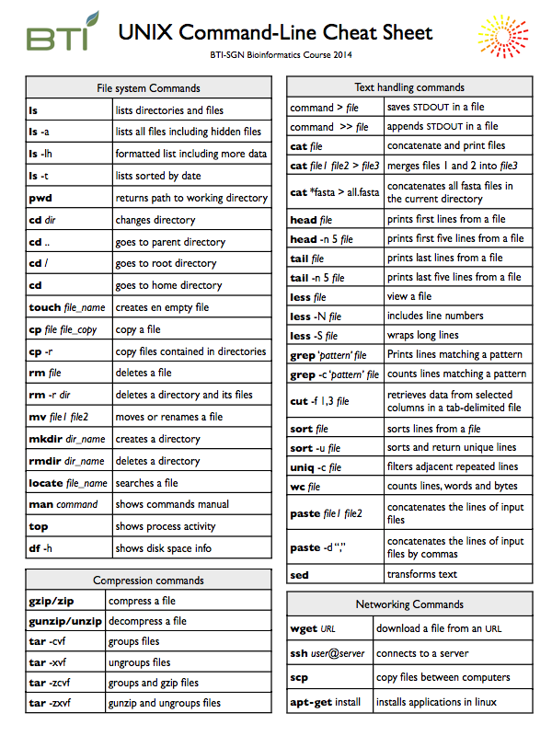




Compression commands

Slide 29
Compression commands
group and compress files
tar -zcvf file.tar.gz f1 f2
tar -zxvf file.tar.gz
decompress and ungroup a tar.gz file
files, directories or wildcards

Slide 30
Compression commands
compress file f1.txt in f1.txt.gz
compress files f1 and f2 in file.zip
gzip f1.txt
zip file.zip f1 f2
unzip file.zip
gunzip file.gz
decompress file.zip
decompress file.gz
Notes:
Gzip and zip use different algorithms, which is why you see the two different file extensions and why you cannot use the two interchangeably. You will get an error message
You will often see files like .tar.gz. The tar command allows multiple files to be bunched together into a single file, and the gzip command will compress it. Large batches of files are often distributed as a .tar.gz

Slide 31


Networking Commands
Networking commands

Slide 32
Networking Commands
connects your terminal to your account in a server
Downloads the BCBC logo!
ssh user_name@server_address
wget https://btiscience.org/wp-content/uploads/BCBClogo.png
scp afp@boyce.sgn.cornell.edu:/home/afp/file.txt .
copy file.txt from your home in the server to the current directory in your computer
Tip: use the command pwd to get the path for cp and scp
Notes:
If you ever get annoyed having to write the same ssh server name over and over again, you can make a config file in ~/.ssh that will let you make shortcuts

Slide 33
Other useful commands
gdown - for downloading google drive files/folders
https://github.com/wkentaro/gdown
git clone - for downloading github repos
EX:
git clone https://github.com/CBG-Conservation-Genomics/BotanyWorkshop2024.git

Slide 34
Useful commands in the server
df -h
shows disk space information
top
display and update sorted information about processes

Slide 35
Exercise:
Download the seqids file to your VM
pip install gdown
emacs ~/.bashrc
*add export PATH="/home/sstrickler1/.local/bin:$PATH"
source ~/.bashrc
gdown –fuzzy https://drive.google.com/file/d/1Qdkb-YxWjS0uhIW78TyKrT-vuEwRyoya/view?usp=drive_link
Notes:
The wget command is very useful for getting your hands on files that you need to download off github or other websites with GUIs. You can use your host machine to figure out what the URL is, and then in the server you can use wget

Slide 36
“Man” pages
Man pages are the documentation for UNIX commands
$ man <command>
$ man ls
Searching man pages
Use the apropos command
$ apropos “text editor”

Slide 37
Processes
Every running program is treated as a process
Every process has a process ID and an “environment”
Processes are created only from other processes through a fork (parent ID)
First process is init, with process ID 1
Viewing processes: ps , jobs , top, pstree
Terminating processes: kill

Slide 38
Controlling processes
Interrupting, terminating execution
control-Z , control-C
Viewing running jobs (jobs )
Background/foreground jobs (bg , fg, & )
Use sleep 100 to test

Slide 39
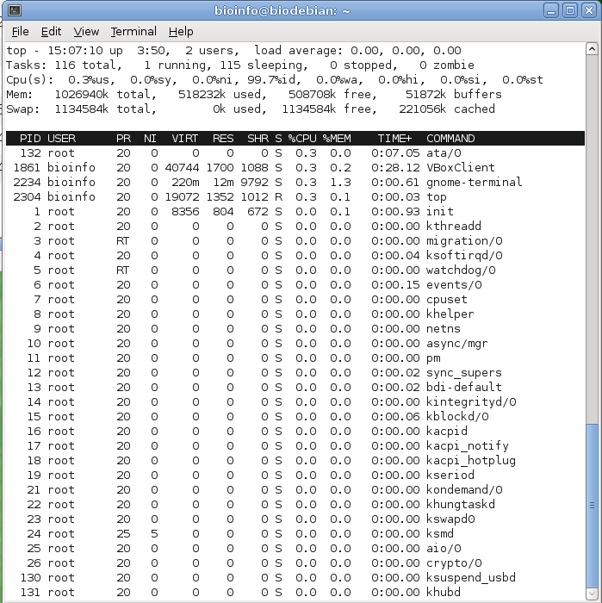
Top displays and updates sorted information about processes
q quit
u user (top -u user)
M sort by memory usage
Notes:
A similar program with more colors is htop
The most important columns are the %CPU and %MEM columns. Beware that %CPU is in percent of a single core, not the whole available CPU power. So 100% means one whole cpu, 1000% means a process is using 10 CPUs

