Slide 1
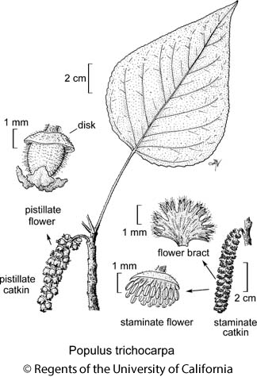
Botany 24: SNPs, genes, genomes: using assembled genomes for answering evolutionary questions Genome Annotation
Presented by
Haley Carter and Suzy Strickler

Slide 2
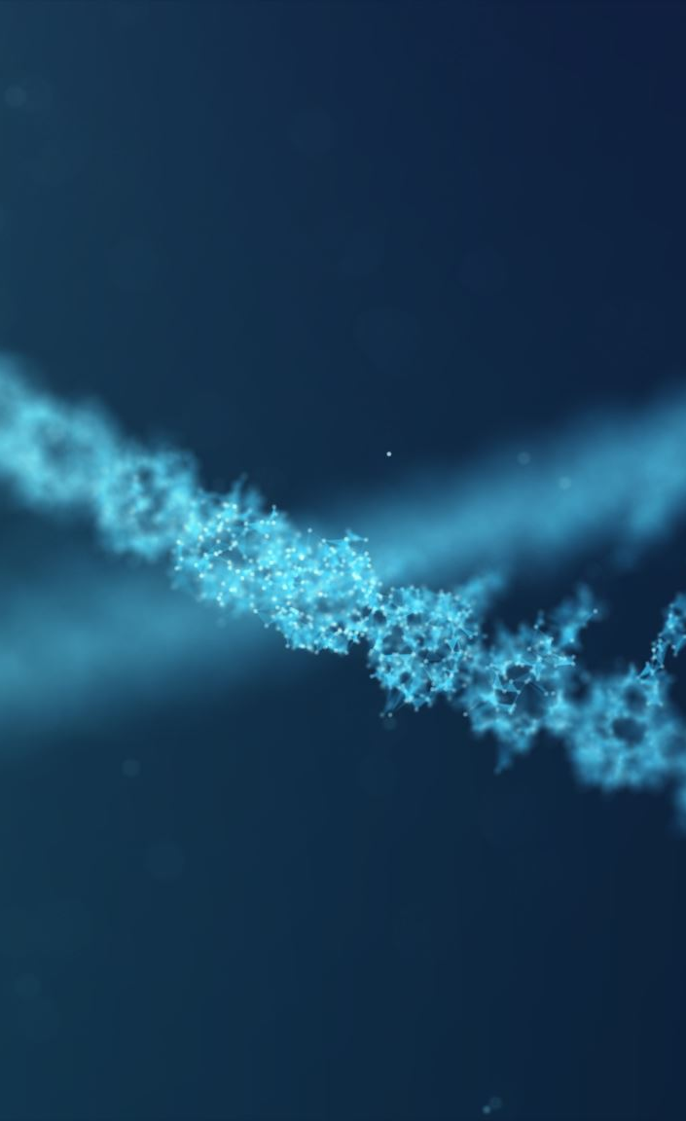
Goals of genome annotation... what is in the genome you just assembled?

Slide 3
Goals of genome annotation
predict, categorize, and mask repetitive elements
determine gene structures as accurately as possible
predict possible functions of predicted genes
associate GO terms, domains, etc for downstream analysis

Slide 4
Goals for this workshop
demonstrate and understand the steps involved in genome annotation
demonstrate the types of data and tools that can be used
give you some hands on practice with these tools

Slide 5
Genome annotation steps
0. Is this genome worth annotating? Pre-annotation QC
Prepare genome - Mask repetitive regions
Prepare RNA data - Trim adaptors, map to genome
Structural annotation - create gene models
Functional annotation
Annotation QC

Slide 6
Start things running...
earlGrey \
-g HiC/yahs/output_examples/yahs_pass6_scaffolds_final.fa \
-o ./earlGreyOutputs \
-s populusTrichocarpa \
-d yes \
-t 60

Slide 7
Start things running...
nextflow run -hub gitlab PlantGenomicsLab/easel \
-c /home/hsc945/nextflow.conf \
--genome annotation/earlGreyOutputs/oenotheraHarringtonii_EarlGrey/oenotheraHarringtonii_summaryFiles/populusTrichocarpa.softmasked.fasta \
--user_reads annotation/rna-seq/*{1,2}.fastq.gz \
--busco_lineage embryophyta \
--order Viridiplantae \
--taxon null \
--training_set plant \
--outdir annotation/easel/
--with-report --with-trace

Slide 8
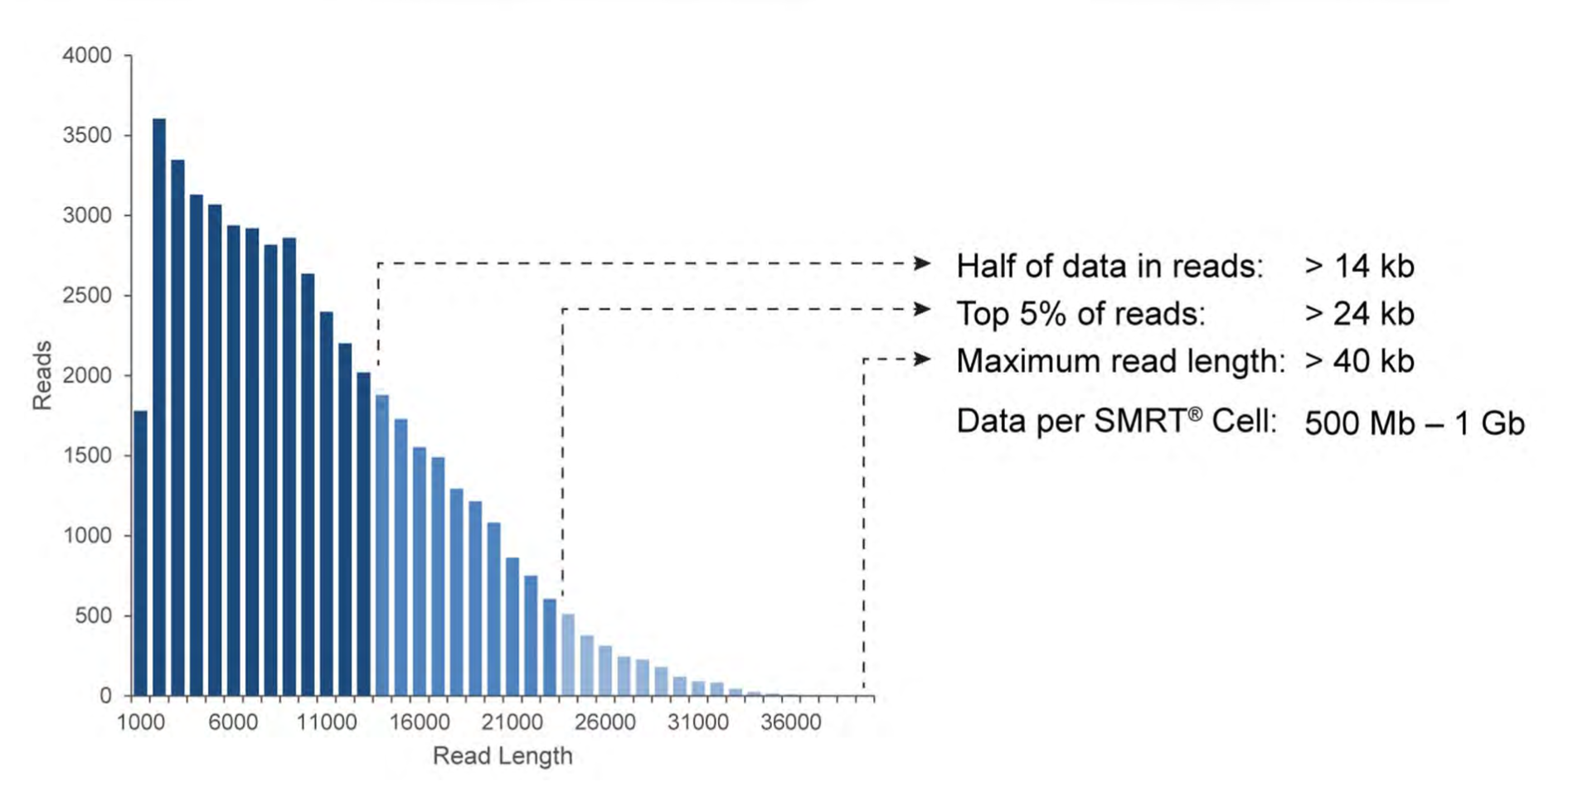
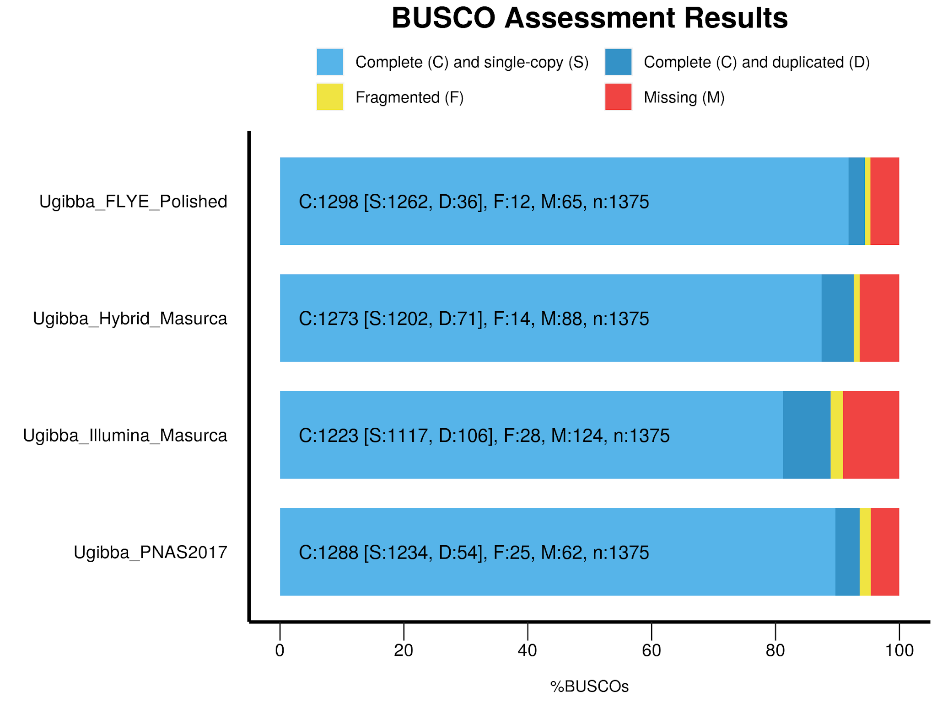
0. Pre-annotation QC
assembly quality (total length, N50, ...)
bbtools stats.sh
errors - correction
BUSCO metrics

Slide 9
1. Prepare genome - Mask repetitive regions
Genomes contain repetitive non-coding regions that can throw off the generation of gene models
Transposable elements, long tandem repeats
Annotate these regions first, and then mask them from our gene annotation
To annotate, compare against a repeat library, this can be custom built for your species

Slide 10
1. Prepare genome - Mask repetitive regions
RepeatMasker - screens DNA sequences for interspersed repeats and low complexity sequences
outputs: detailed annotation of the repeats that are present, masked version of the query sequence
uses curated libraries: Dfam (profile HMM library derived from Repbase sequences), Repbase (service of the Genetic Information Research Institute)
RepeatModeler2 can be used to create library from your own genome draft

Slide 11

1. Prepare genome - Mask repetitive regions
EarlGrey “Earl Grey is a full-automated transposable element (TE) annotation pipeline, leveraging the most widely-used tools and combining these with a consensus elongation process to better define de novo consensus sequences when annotating new genome assemblies.”

Slide 12
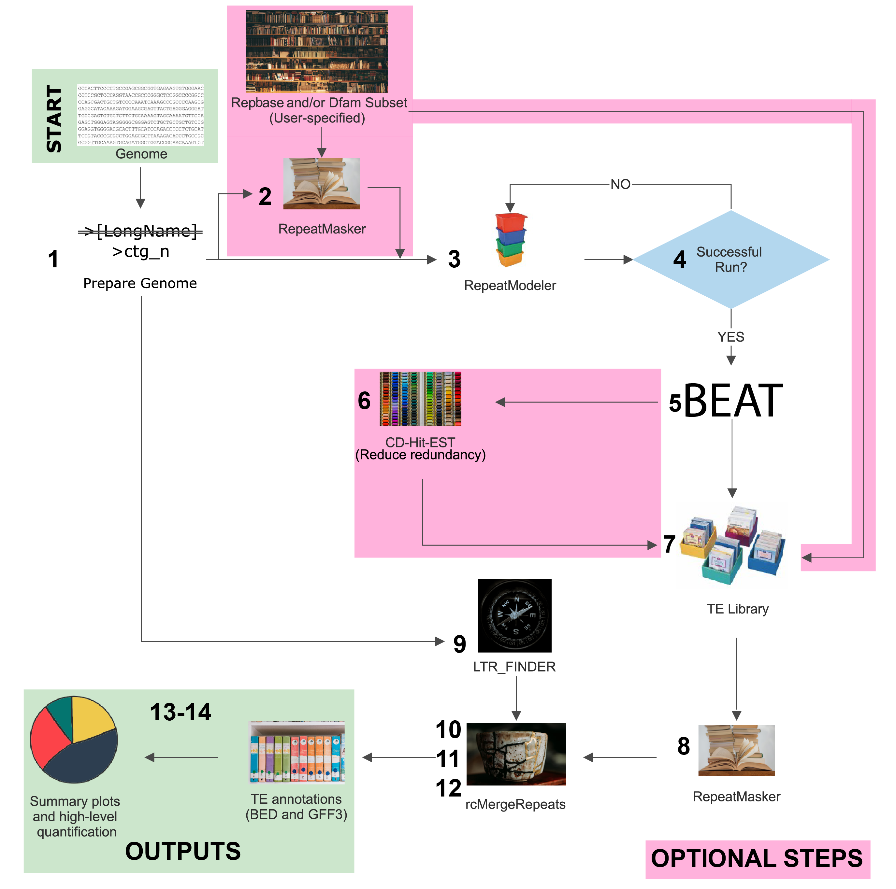

Slide 13
initial masking step against pre-curated library
model TEs from genome to add to library
mask those as well
generate annotations and soft masked genome

Slide 14
2. Prepare RNA data - trim adaptors, map to genome
Just like we had to prepare our genome to be annotated, we also have to prepare our evidence
What provides good evidence of genes?
RNA-seq
Protein sequences

Slide 15
2. Prepare RNA data - trim adaptors, map to genome
fastp “A tool designed to provide fast all-in-one preprocessing for FastQ files. This tool is developed in C++ with multithreading supported to afford high performance.”
HISAT2 “graph-based alignment of next generation sequencing reads to a population of genomes”
But if you’re using EASEL, this is part of the pipeline!

Slide 16
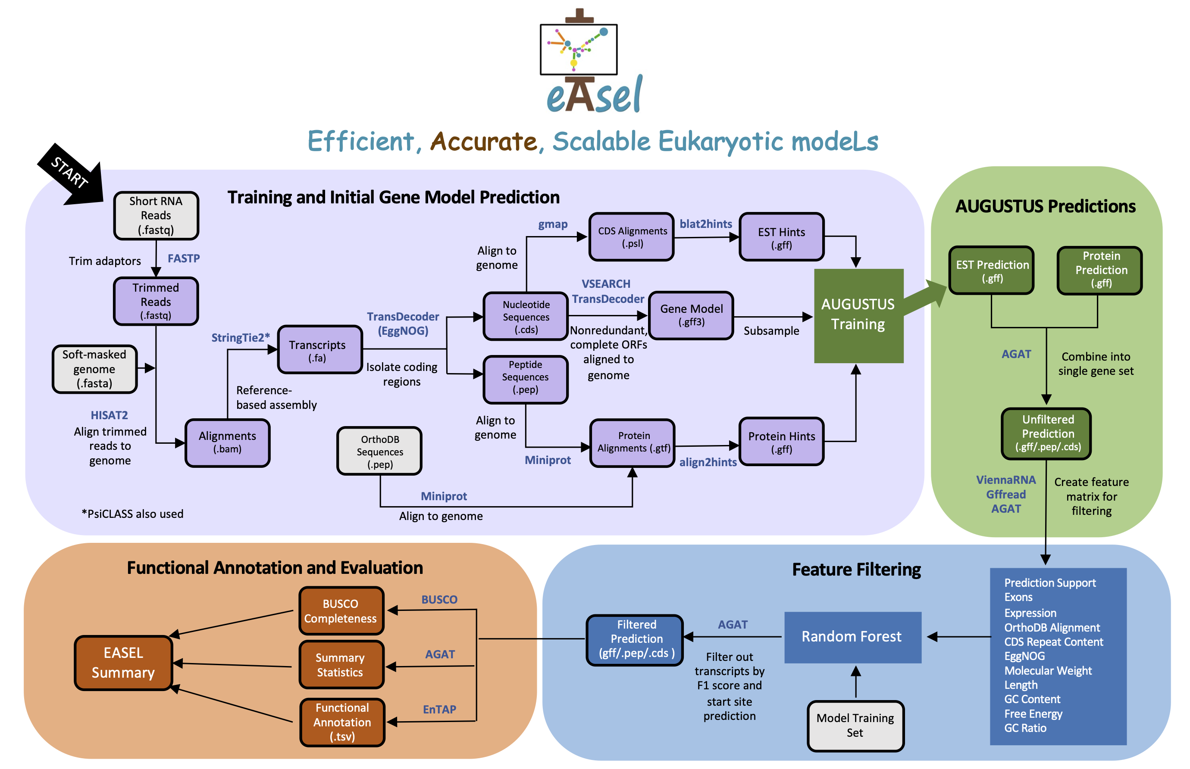
3 + 4. Structural and functional annotation

Slide 17
3. Structural annotation
structural annotation starts “ab initio” with training statistical models
“ab initio gene predictors use organism-specific genomic traits such as codon frequencies and distribution of intron-exon lengths, to distinguish genes from intergenic regions and to determine intron-exon structures” Yandell and Ence 2012
Tools:
Snap - easy to train
Gmap - difficult to train
Genemark

Slide 18
3. Structural annotation
structural annotation also includes aligning gene evidence such as RNA and protein sequences to the genome
output is generally gff, bam, or vcf files
Tools:
Hisat2 - align RNA-seq
Gmap - align mRNA
StringTie2 - transcriptome assembly

Slide 19
3. Structural annotation
structural annotation also includes aligning gene evidence such as RNA and protein sequences to the genome
output is generally gff, bam, or vcf files
Tools:
Hisat2 - align RNA-seq
Gmap - align mRNA
StringTie2 - transcriptome assembly

Slide 20
3. Structural annotation: pipelines
combines different tools into a pipeline to include both ab initio and evidence-based annotation
Tools:
BRAKER - https://github.com/Gaius-Augustus/BRAKER
EASEL - https://gitlab.com/PlantGenomicsLab/easel

Slide 21
3 + 4. Structural (and functional!) annotation
EASEL is written as a nextflow pipeline to run the entire annotation process instead of working step-by-step
includes pre-processing of RNA data, alignment to the genome, as well as structural and functional annotations
requires the install of Nextflow and Docker/Singularity as well as GNU utilities
uses AUGUSTUS to predict gene models
https://gitlab.com/PlantGenomicsLab/easel#what-is-easel

Slide 22
3 + 4. Structural and functional annotation

Slide 23

4. Functional annotation
generally includes similarity search against known gene databases, protein domain assignment, orthologous gene family assessment, Gene Ontology term assignment, and KEGG pathway annotation (predicted assignment to known metabolic pathways)
Tools:
EnTAP - for non-model organisms https://entap.readthedocs.io/en/latest/Getting_Started/introduction.html
EASEL (includes EnTAP)

Slide 24
Tools for structural annotation
EDTA - the Extensive de novo TE Annotator
Protexcluder
RepeatModeler
Repeatmasker
Braker
Augustus
Snap
Maker
Apollo
BUSCO

Slide 25
Tools for functional annotation
BLAST
Diamond
InterProScan
Mercator
Databases: Swiss-prot, Trembl, nr, InterPro

Slide 26
Annotation pipeline 1: Braker
1. Repeat masking
2. RNA and protein evidence
3. RNA-seq cleanup
4. BRAKER3
5. Quality assessment
6. Training Augustus

Slide 27

Annotation pipeline 2: EASEL
Efficient, Accurate, Scalable Eukaryotic modeLs
https://gitlab.com/PlantGenomicsLab/easel

