Slide 1
Transitioning from the
90i to the NI-E
8/17/2021
Notes:
1
hh

Slide 2
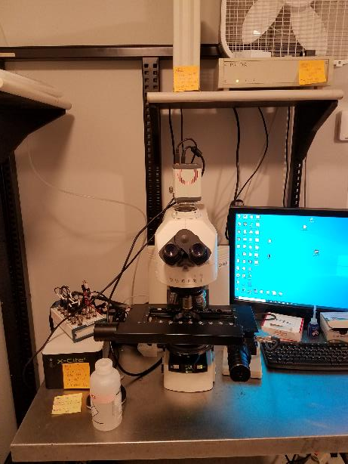
90i Microscope Overview
There are 4 total power buttons
The 90i itself
The Prior Stage
The X-Cite Light Source
The Hamamatsu Camera
All power buttons should always remain on, do not turn anything off when you are finished using the system.
*The only exception is the X-Cite light source, if the excitation intensity out of the objective seems low or dim (while the dial shows 100% power) you can turn the X-Cite off and after a 30 second cool down period back on again. The intensity out of the objective should increase notably.

Slide 3
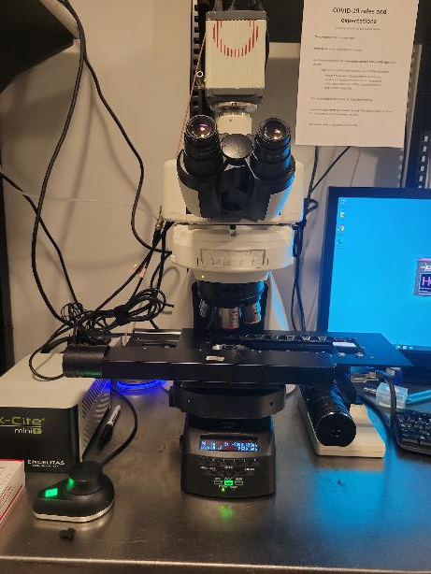
Ni-E Microscope Overview
There are 4 total power buttons
The Ni-E Power Supply
The Prior Stage
The X-Cite Light Source
The Hamamatsu Camera
Most of the components are the same while the stand itself has changed to a newer model.
The controls are slightly different but essentially will not impact normal workflow on the system.

Slide 4
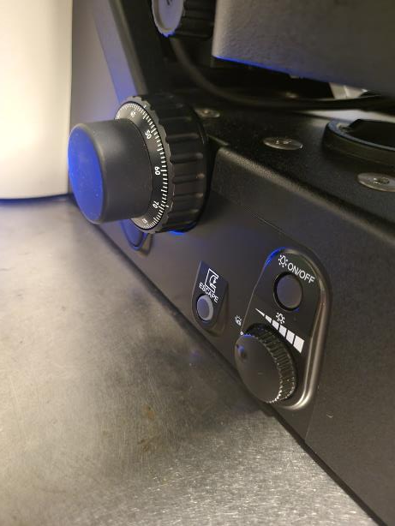
Manual Controls
On the Microscope
Many of the manual controls are located similarly to where they were on the 90i.
One major update is that some of the previously “manual only” controls have been updated and can be controlled in the software.
On the left side of the stand, you still have a focus knob and escape button to raise and lower the stage.

Slide 5
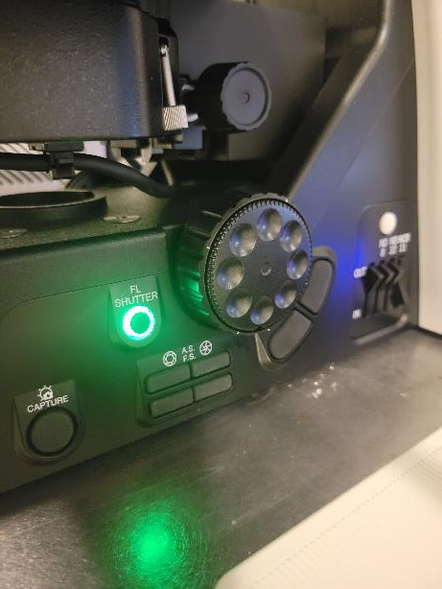
Manual Controls
On the Microscope
The right side of the stand also has a focus knob as well as controls to open and close the aperture, field stop, and fluorescence shutter.
You can also manually rotate the position of the filter wheel and toggle ND filters in the brightfield light path.

Slide 6
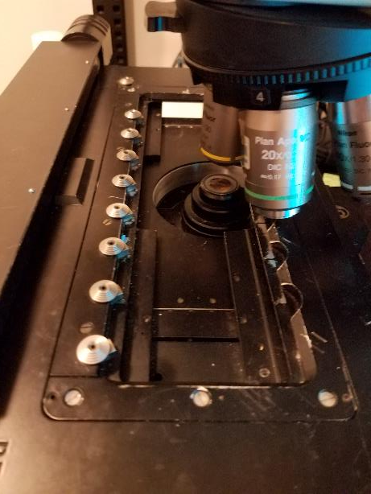
Stage and Objective Nosepiece
The stage is the same one that was previously on the 90i.
The objective turret has been updated and can now be controlled in the software.
etc. etc.

Slide 7
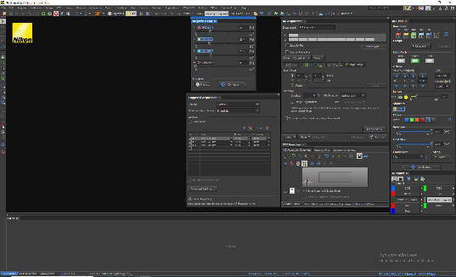
Working in NIS Elements
Overview
Interacting with the software in order to operate the microscope is essentially the same, but the name of some controls may have changed and the control pad will be oriented slightly differently.
For the most part, the use of optical configurations for each channel should help if you aren’t sure where a button has moved such as the epi shutter or light path.

Slide 8
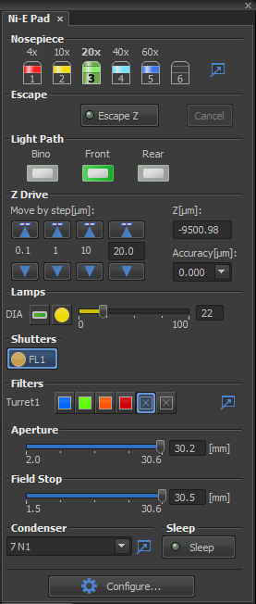
The Ni-E Pad
The Ni-E pad takes the place of the 90i pad and controls the microscope stand.
The Nosepiece is now automated, clicking an objective will escape the stage and rotate that objective into position.
The light path toggles between the Bino (eye piece) or the Front (the camera).
The FL1 Shutter button opens and closes the epi shutter.
Below you can see the filter cube turret position as well as the aperture and field stop settings, and finally the condenser position.

Slide 9
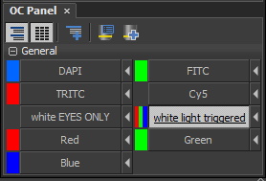
OC Panel
Normal workflow will still utilize optical configurations. Most of the settings for normal imaging conditions should be tied to these settings.
If the OC’s are accidentally changed to an improper setting, normal troubleshooting such as checking a cube position or making sure the proper shutter is open will likely be able to solve the problem.
As always, if you have trouble contact a CBI staff member for assistance.

