Slide 1
CBICA S/W Dev Tutorials 09 – ITK Feature Extraction and a few other things ...
Jimit Doshi

Slide 2
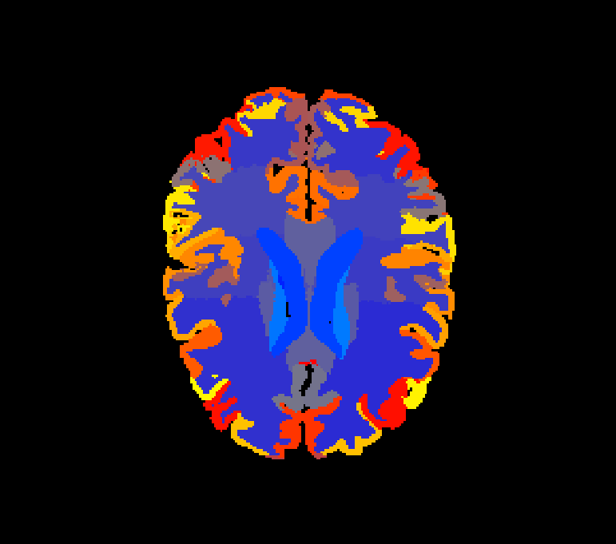
Problem statement
Given a set of ROIs or labels for an image, calculate a set of features that might be of interest to researchers studying different characteristics of a disease or a medical scan in general.
Also…

Slide 3
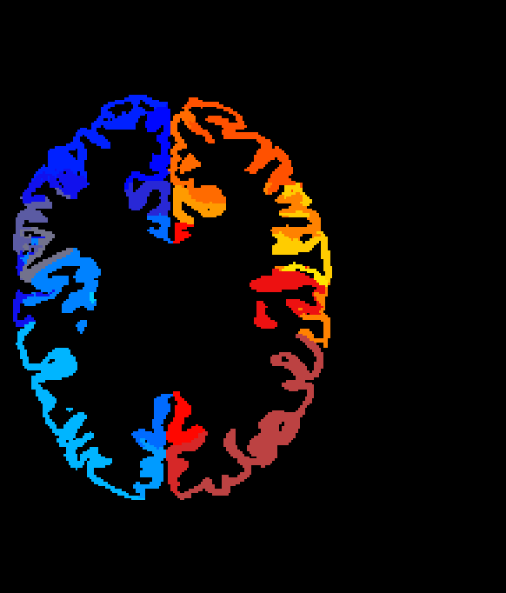
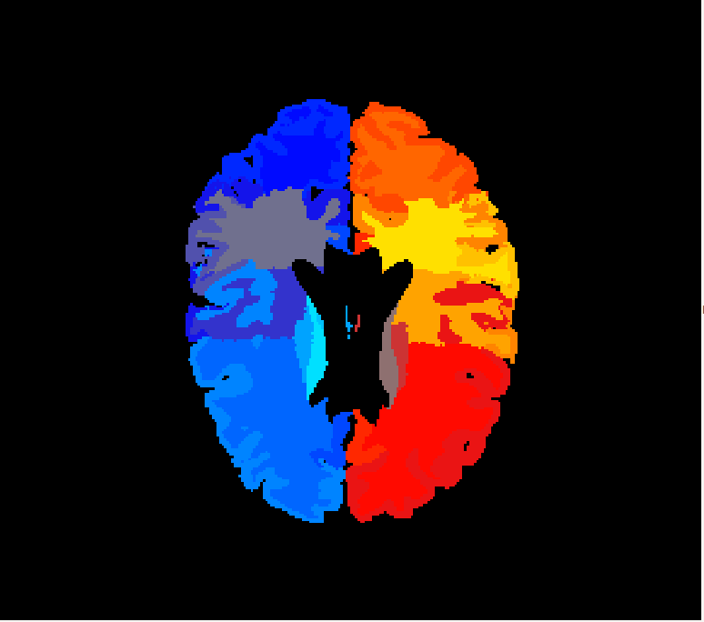
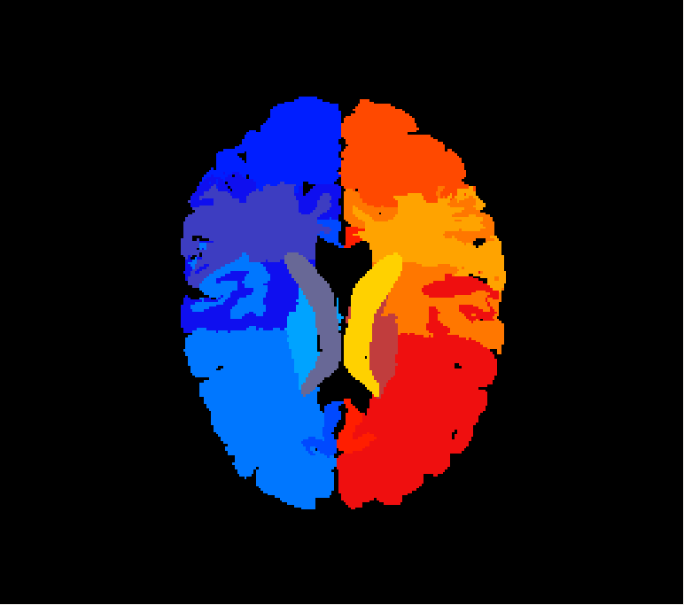
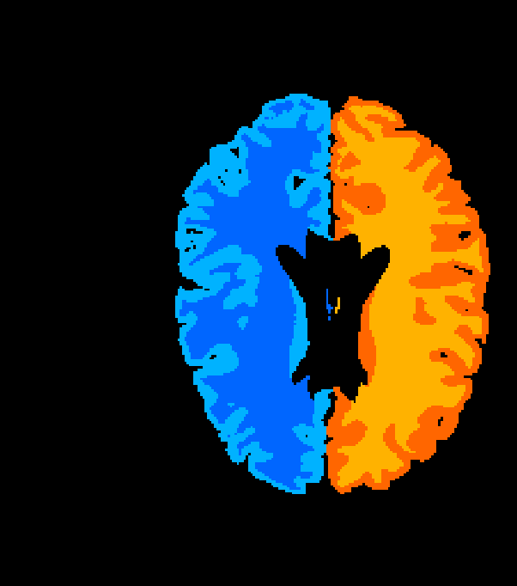
Problem statement
… , if desired, calculate a set of derived ROIs based on a hierarchy (user defined) and then calculate similar features for them.

Slide 4
exe
USAGE: /cbica/home/doshijim/General_Scripts/MUSE_ROI_TOOLS/MUSE_FeatureExtractor/MUSE_FeatureExtractor [options]
OPTIONS:
Required:
-i, --input < path > input intensity image
-l, --label < path > input label image
-s, --sub < id > subject ID
-m, --map < path > map csv file containing derived ROIs and their mapping
-o, --out < path > output csv file to write output data
Optional:
-N, --nonorm do not normalize the input intensity image (default: normalize to [0,100])
-C, --icv < path > calculate attributes for ICV image as well (provide the intensity image)
-V, --size get size information
-S, --shape get shape information
-I, --intensity get intensity information
-T, --texture get texture information (will increase computation time)
-h, --help this help
Examples:
MUSE_FeatureExtractor -i /Intensity/Image -l /Label/Image -c /CSV/ROI/map.csv -s ABC-20150818 -o /Output/CSV/File.csv –V
MUSE_FeatureExtractor -i /Intensity/Image -l /Label/Image -c /CSV/ROI/map.csv -s ABC-20150818 -o /Output/CSV/File.csv –S
MUSE_FeatureExtractor -i /Intensity/Image -l /Label/Image -c /CSV/ROI/map.csv -s ABC-20150818 -o /Output/CSV/File.csv –I
MUSE_FeatureExtractor -i /Intensity/Image -l /Label/Image -c /CSV/ROI/map.csv -s ABC-20150818 -o /Output/CSV/File.csv –T
MUSE_FeatureExtractor -i /Intensity/Image -l /Label/Image -c /CSV/ROI/map.csv -s ABC-20150818 -o /Output/CSV/File.csv -V -S –I
MUSE_FeatureExtractor -i /Intensity/Image -l /Label/Image -c /CSV/ROI/map.csv -s ABC-20150818 -o /Output/CSV/File.csv -V -S -I -T

Slide 5
Output
Size ^{[1]}
Volume
Surface Area
Equivalent Spherical Radius
Shape ^{[1]}
Elongation
Flatness
Roundness
Intensity ^{[1]}
Min
Max
Mean
Median
Std Deviation
Skewness
Kurtosis
Textures ^{[2]}
Energy
Entropy
Homogeneity
Inertia
Cluster Shade
Cluster Prominence

Slide 6
Filters
Classes demonstrated:
itk::LabelImageToStatisticsLabelMapFilter
itk::Statistics::ScalarImageToTextureFeaturesFilter
itk::ChangeLabelImageFilter
itk::ImageFileReader
itk::RescaleIntensityImageFilter
itk::BinaryThresholdImageFilter
itk::BinaryFillholeImageFilter
itk::StatisticsImageFilter
itk::CSVArray2DFileReader
itk::CSVArray2DDataObject

Slide 7
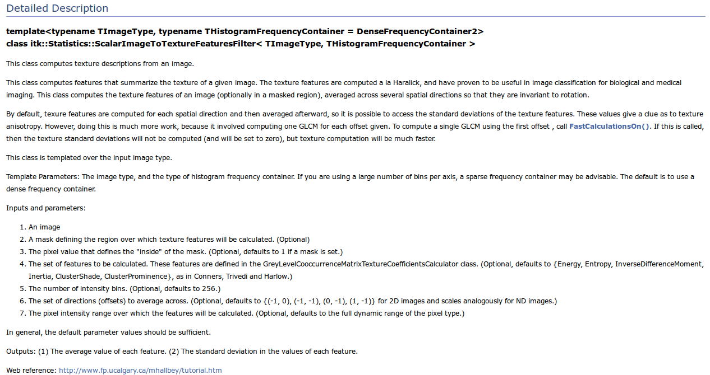
Filters - Statistics::ScalarImageToTextureFeaturesFilter

Slide 8
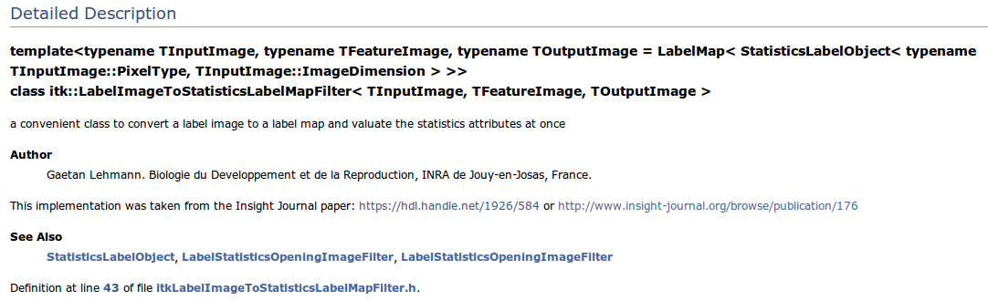
Filters - LabelImageToStatisticsLabelMapFilter

Slide 9
code – read images
typedef itk::Image< LabelPixelType, Dimension > LabelImageType;
typedef itk::ImageFileReader< LabelImageType > LabelReaderType;
LabelReaderType::Pointer labelreader = LabelReaderType::New();
LabelImageType::Pointer labelImage = LabelImageType::New();
LabelImageType::Pointer outlabelImage = LabelImageType::New();
labelreader->SetFileName( labelFile );
try
{
labelreader->Update();
}
catch( itk::ExceptionObject & err )
{
cerr << endl;
cerr << "Exception caught!" << endl;
cerr << err << endl;
return EXIT_FAILURE;
}
labelImage = labelreader->GetOutput();
Define image type
Define reader
Set filename
Update
Get output image

Slide 10
code – read images
typedef itk::Image< ImagePixelType, Dimension > IntensityImageType;
typedef itk::ImageFileReader< IntensityImageType > IntensityReaderType;
IntensityReaderType::Pointer intensityreader = IntensityReaderType::New();
IntensityImageType::Pointer intensityImage = IntensityImageType::New();
intensityreader->SetFileName( imageFile );
try
{
intensityreader->Update();
}
catch( itk::ExceptionObject & err )
{
cerr << endl;
cerr << "Exception caught!" << endl;
cerr << err << endl;
return EXIT_FAILURE;
}
intensityImage = intensityreader->GetOutput();
Define image type
Define reader
Define output image type
Set filename
Update
Get output image

Slide 11
code – rescale intensity image
typedef itk::RescaleIntensityImageFilter< IntensityImageType, IntensityImageType > RescaleFilterType;
RescaleFilterType::Pointer rescaleFilter = RescaleFilterType::New();
IntensityImageType::Pointer rescaledIntensityImage = IntensityImageType::New();
rescaleFilter->SetInput( intensityImage );
rescaleFilter->SetOutputMinimum( 0 );
rescaleFilter->SetOutputMaximum( 100 );
try
{
rescaleFilter->Update();
}
catch( itk::ExceptionObject & err )
{
cerr << endl;
cerr << "Exception caught!" << endl;
cerr << err << endl;
return EXIT_FAILURE;
}
rescaledIntensityImage = rescaleFilter->GetOutput();
Define filter
Set parameters
Update
Get output image

Slide 12
code – get image min-max (if needed)
typedef itk::StatisticsImageFilter< IntensityImageType > StatsFilterType;
StatsFilterType::Pointer statsFilter = StatsFilterType::New();
statsFilter->SetInput( intensityImage );
try
{
statsFilter->Update();
}
catch( itk::ExceptionObject & err )
{
cerr << endl;
cerr << "Exception caught!" << endl;
cerr << err << endl;
return EXIT_FAILURE;
}
float minVal = statsFilter->GetMinimum();
float maxVal = statsFilter->GetMaximum();
Define filter
Set parameters
Update
Get output values

Slide 13
code – binarize intensity image (for ICV)
typedef itk::BinaryThresholdImageFilter< IntensityImageType, IntensityImageType > BinaryThresholdFilterType;
BinaryThresholdFilterType::Pointer thresholdFilter = BinaryThresholdFilterType::New();
thresholdFilter->SetInput( ICVrescaledImage );
thresholdFilter->SetLowerThreshold( itk::NumericTraits< ImagePixelType >::epsilon() );
thresholdFilter->SetUpperThreshold( itk::NumericTraits< ImagePixelType >::max() );
thresholdFilter->SetInsideValue( 702 );
thresholdFilter->SetOutsideValue( 0 );
try
{
thresholdFilter->Update();
}
catch( itk::ExceptionObject & err )
{
cerr << endl;
cerr << "Exception caught!" << endl;
cerr << err << endl;
return EXIT_FAILURE;
}
Define filter
Set parameters
Update

Slide 14
code – fill holes inside a mask (for ICV)
typedef itk::BinaryFillholeImageFilter< IntensityImageType > BinaryFillholeFilterType;
BinaryFillholeFilterType::Pointer fillHoleFilter = BinaryFillholeFilterType::New();
fillHoleFilter->SetInput( thresholdFilter->GetOutput() );
fillHoleFilter->SetForegroundValue( 702 );
fillHoleFilter->SetFullyConnected( true );
try
{
fillHoleFilter->Update();
}
catch( itk::ExceptionObject & err )
{
cerr << endl;
cerr << "Exception caught!" << endl;
cerr << err << endl;
return EXIT_FAILURE;
}
ICVMaskImage = fillHoleFilter->GetOutput();
Define filter
Set parameters (read image from the output of the previous filter)
Update
Get output image

Slide 15
code – parse CSV map to read derived labels
typedef itk::CSVArray2DFileReader< unsigned int > CSVReaderType;
typedef itk::CSVArray2DDataObject< unsigned int > CSVDataObjectType;
typedef CSVDataObjectType::StringVectorType CSVStringVectorType;
typedef CSVDataObjectType::NumericVectorType CSVNumericType;
CSVReaderType::Pointer csvreader = CSVReaderType::New();
CSVDataObjectType::Pointer dfo;
CSVNumericType rois;
csvreader->SetFileName( csvFile );
csvreader->SetFieldDelimiterCharacter( ',' );
csvreader->SetStringDelimiterCharacter( '"' );
csvreader->HasColumnHeadersOff();
csvreader->HasRowHeadersOff();
csvreader->UseStringDelimiterCharacterOff();
Define filter
Set parameters

Slide 16
code – parse CSV map to read derived labels
try
{
csvreader->Update();
}
catch( itk::ExceptionObject & err )
{
cerr << endl;
cerr << "Exception caught!" << endl;
cerr << err << endl;
return EXIT_FAILURE;
}
dfo = csvreader->GetOutput();
rois = dfo->GetColumn( 0 );
Update
Get output object

Slide 17
code – replace labels in an image
typedef itk::ChangeLabelImageFilter< LabelImageType, LabelImageType > ChangeLabelImageFilterType;
typedef ChangeLabelImageFilterType::ChangeMapType ChangeLabelImageFilterMapType;
ChangeLabelImageFilterType::Pointer changeLabelImageFilter = ChangeLabelImageFilterType::New();
ChangeLabelImageFilterMapType iroimap;
ChangeLabelImageFilterMapType droimap;
changeLabelImageFilter->SetInput( labelImage );
changeLabelImageFilter->SetChangeMap( droimap );
try
{
changeLabelImageFilter->Update();
}
catch( itk::ExceptionObject & err )
{
cerr << endl;
cerr << "Exception caught!" << endl;
cerr << err << endl;
return EXIT_FAILURE;
}
outlabelImage = changeLabelImageFilter->GetOutput();
Define filter
Set parameters
Update
Get output image

Slide 18
code – get label statistics, finally!
typedef itk::StatisticsLabelObject< LabelPixelType, Dimension > StatsLabelObjectType;
typedef itk::LabelMap< StatsLabelObjectType > LabelMapType;
typedef LabelMapType::LabelVectorType LabelMapVectorType;
typedef itk::LabelImageToStatisticsLabelMapFilter< LabelImageType, IntensityImageType, LabelMapType > LabelImageToStatsLabelFilterType;
LabelImageToStatsLabelFilterType::Pointer derivedlabelImageToStatsLabelFilter = LabelImageToStatsLabelFilterType::New();
LabelMapType::Pointer statsLabelMap = LabelMapType::New();
LabelMapVectorType labels;
StatsLabelObjectType *labelObject;
derivedlabelImageToStatsLabelFilter->SetComputeFeretDiameter( false );
derivedlabelImageToStatsLabelFilter->SetComputePerimeter( true );
derivedlabelImageToStatsLabelFilter->SetComputeHistogram( true );
derivedlabelImageToStatsLabelFilter->SetInput2( rescaledIntensityImage );
derivedlabelImageToStatsLabelFilter->SetInput1( outlabelImage );
Define filter
Set parameters (read image from the output of the previous filter)

Slide 19
code – get label statistics, finally!
try
{
derivedlabelImageToStatsLabelFilter->Update();
}
catch( itk::ExceptionObject & err )
{
cerr << endl;
cerr << "Exception caught!" << endl;
cerr << err << endl;
return EXIT_FAILURE;
}
statsLabelMap = derivedlabelImageToStatsLabelFilter->GetOutput();
labels = statsLabelMap->GetLabels();
Update
Get output image
Get labels within the image

Slide 20
code – get texture features, finally!
typedef itk::Statistics::ScalarImageToTextureFeaturesFilter< IntensityImageType > ScalarImageToTextureFeaturesType;
typedef ScalarImageToTextureFeaturesType::FeatureNameVector TextureFeatureNameVectorType;
typedef ScalarImageToTextureFeaturesType::FeatureValueVector TextureFeatureValueVectorType;
ScalarImageToTextureFeaturesType::Pointer scalarImageToTextureFeatures = ScalarImageToTextureFeaturesType::New();
TextureFeatureValueVectorType::Pointer featVals;
scalarImageToTextureFeatures->SetFastCalculations( false );
scalarImageToTextureFeatures->SetPixelValueMinMax( 0,100 );
scalarImageToTextureFeatures->SetInput( rescaledIntensityImage );
scalarImageToTextureFeatures->SetMaskImage( outlabelImage );
scalarImageToTextureFeatures->SetInsidePixelValue( labelValue );
Define filter
Set parameters (read image from the output of the previous filter)

Slide 21
code – get texture features, finally!
try
{
scalarImageToTextureFeatures->Update();
}
catch( itk::ExceptionObject & err )
{
cerr << endl;
cerr << "Exception caught!" << endl;
cerr << err << endl;
return EXIT_FAILURE;
}
featVals = scalarImageToTextureFeatures->GetFeatureMeans();
Update
Get feature mean values

Slide 22
!

