Slide 1
CBICA S/W Dev Tutorials 11 – Error Handling
Sarthak Pati

Slide 2
What is it?

Slide 3
What is it?
It is the process of responding to the occurrence of anomalous or exceptional conditions during computation ^{[1]}

Slide 4
What is it?
It is the process of responding to the occurrence of anomalous or exceptional conditions during computation ^{[1]}
They require special processing, typically to avoid processor or memory related errors

Slide 5
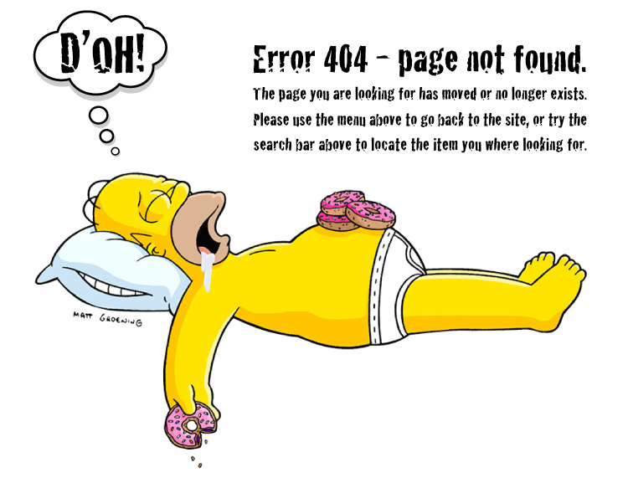
Giving Meaningful Error Messages

Slide 6
Giving Meaningful Error Messages
Required to make sure the user knows what to do next.

Slide 7
Giving Meaningful Error Messages
Required to make sure the user knows what to do next.
Generate comprehensible system logs for developers

Slide 8
Giving Meaningful Error Messages
Required to make sure the user knows what to do next.
Generate comprehensible system logs for developers
Make life easier all around

Slide 9
Assert
#include <iostream>
#include <assert.h>
#include <string>
assert.h is the include required for the “assert” function

Slide 10
Assert
#include <iostream>
#include <assert.h>
#include <string>
// Tests a string to see if it is empty or longer than 2 characters
void analyze_string ( std::string inputString )
{
assert (inputString != ""); // Cannot be empty
assert (inputString.length( ) > 2); // Length must exceed 2
}
asdasfaf
The assert function basically terminates program execution if the condition is not satisfied.
These two assertions can be replaced with just the second.

Slide 11
Assert
#include <iostream>
#include <assert.h>
#include <string>
void analyze_string ( std::string inputString )
{ /*code goes here*/ }
int main ( )
{
std::string test1 = "abc", test3 = "";
std::cout << "Analyzing string '" << test1 << "'\n'";
analyze_string (test1);
std::cout << "Analyzing string '" << test3 << "'\n'";
analyze_string (test3); // assert obtained here
return EXIT_SUCCESS;
}
The assert function basically terminates program execution if the condition is not satisfied.
These two assertions can be replaced with just the second.
Notes:
Basically, assertions are used when you want to completely get out of the program – this is can be invaluable in certain conditions

Slide 12
Exception
#include <iostream>
#include <string>
#include <exception>
int main ( )
{
std::string test1 = "abc", test2 = "d";
try
{
std::cout << "Adding two strings: " << test1 + test2 << "\n";
}
catch (std::exception &e) {
std::cerr << "Exception caught: " << e.what() << "\n";
return EXIT_FAILURE;
}
return EXIT_SUCCESS;
}
std::cout == regular console output
std::cerr == console error output
std::exception is a specialized class
std::exception.what( ) can be customized to give the output the developer wants (using throw ^{[2]}) or a system-generated exception ID (for example, bad_typeid)
itk::ExceptionObject can handle itk-specific exceptions ^{[3]}
Notes:
So exceptions can be used to provide useful debugging information in the event a particular function fails in the program.

Slide 13
Assert v/s Exception

Slide 14
Assert v/s Exception
Asserts are used for critical errors where the program can never recover from and exceptions are used for solid debugging

Slide 15
Assert v/s Exception
Asserts are used for critical errors where the program can never recover from and exceptions are used for solid debugging
Use of exceptions is better during development and make better sense than to see a program crash.

Slide 16
?

