Slide 1
CBICA S/W Dev Tutorials 11 – ITK + Machine Learning
Sarthak Pati

Slide 2
Classes demonstrated
itk::ImageRegionIterator ^{[1]}
This class enables importing image data from the memory buffer.

Slide 3
Notes
The code assumes a list of subject IDs stored in a CSV list file. For an example, see:
/code/data/machine_learning/list.csv

Slide 4
/code/src/cbicaITKSafeImageIO.h
template <class TImageType>
void ReadImage(typename TImageType::Pointer image, const std::string &fName)
{
typedef itk::ImageFileReader< TImageType > ImageReaderType;
typename ImageReaderType::Pointer reader = ImageReaderType::New();
reader->SetFileName( fName );
try
reader->Update();
catch (itk::ExceptionObject& e)
{
std::cerr << "Exception caught: " << e.what() ;
exit( EXIT_FAILURE );
}
image->Graft( reader->GetOutput() );
return;
}
Type safe code to read an image from supplied file name and throw an exception of there is an issue.
Code borrows from the first ITK tutorial where image reading is explained.

Slide 5
/code/src/main.cxx
int main( int argc, char **argv )
{
// command line parsing
std::string csvFile, inputImageCols, saveFile;
parser.getParameterValue("csvFile", csvFile);
parser.getParameterValue("images", inputImageCols);
parser.getParameterValue("saveFile", saveFile);
What are the command line parameters I added to get these?

Slide 6
/code/src/main.cxx
int main( int argc, char **argv )
{
// command line parsing
std::string csvFile, inputImageCols, saveFile;
parser.getParameterValue("csvFile", csvFile);
parser.getParameterValue("images", inputImageCols);
parser.getParameterValue("saveFile", saveFile);
“c”, “csvFile”, …
“i”, “images”, …
“s”, “saveFile”, …

Slide 7
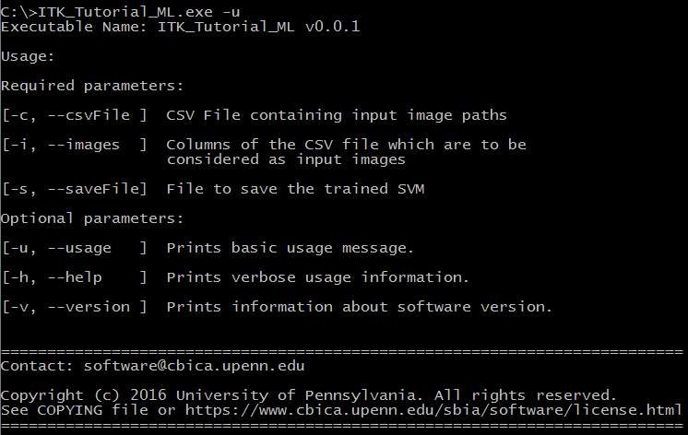
/code/src/main.cxx
int main( int argc, char **argv )
{
// command line parsing
std::string csvFile, inputImageCols, saveFile;
parser.getParameterValue("csvFile", csvFile);
parser.getParameterValue("images", inputImageCols);
parser.getParameterValue("saveFile", saveFile);
Notes:
echoUsage( )

Slide 8
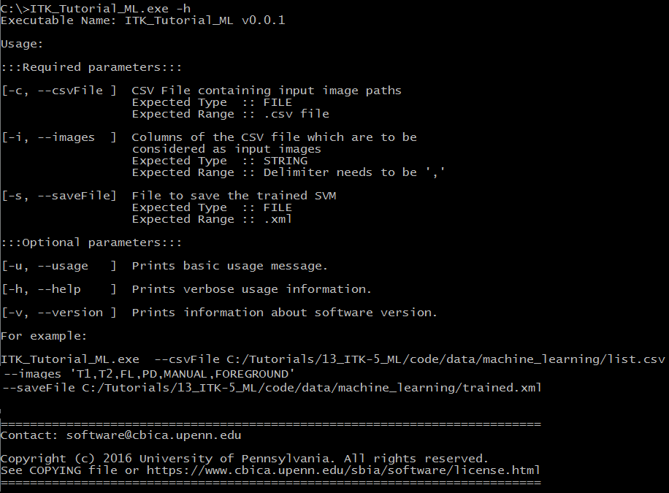
/code/src/main.cxx
int main( int argc, char **argv )
{
// command line parsing
std::string csvFile, inputImageCols, saveFile;
parser.getParameterValue("csvFile", csvFile);
parser.getParameterValue("images", inputImageCols);
parser.getParameterValue("saveFile", saveFile);
Notes:
echoHelp( )

Slide 9
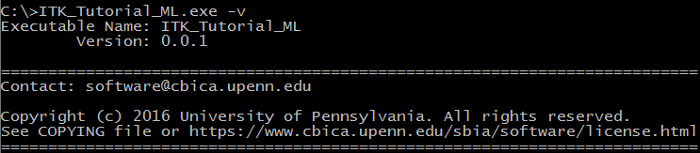
/code/src/main.cxx
int main( int argc, char **argv )
{
// command line parsing
std::string csvFile, inputImageCols, saveFile;
parser.getParameterValue("csvFile", csvFile);
parser.getParameterValue("images", inputImageCols);
parser.getParameterValue("saveFile", saveFile);
Notes:
echoVersion( ) – default version number applied

Slide 10
A more intelligent CSV parser
struct CSVDict
{
//! Contains input image file names
std::vector< std::string > inputImages;
//! Contains Labels that correspond to each file
std::vector< double > inputLabels;};
}
std::vector< CSVDict > parseCSVFile(
const std::string &csvFileName,
const std::string &inputColumns,
const std::string &inputLabels,
const bool checkFile = true,
const std::string &rowsDelimiter = "\n",
const std::string &colsDelimiter = ",",
const std::string &optionsDelimiter = ",");
This is a basic structure which holds the input images and labels per subject (assuming one subject per row).
Labels are always assumed to be per-subject labels.
For multiple subjects, a vector of CSVDict can be initialized .
Notes:
For per-voxel labels (as given in this example), the label image is passed as an inputImageColumn and processing is done based on that.

Slide 11
A more intelligent CSV parser
struct CSVDict
{
//! Contains input image file names
std::vector< std::string > inputImages;
//! Contains Labels that correspond to each file
std::vector< double > inputLabels;};
}
std::vector< CSVDict > parseCSVFile(
const std::string &csvFileName,
const std::string &inputColumns,
const std::string &inputLabels,
const bool checkFile = true,
const std::string &rowsDelimiter = "\n",
const std::string &colsDelimiter = ",",
const std::string &optionsDelimiter = ",");
csvFileName – input file
inputColumns – Columns in above file which are to be considered as “images”, i.e., are populated in CSVDict::inputImages.
inputLabels – Columns in above file which are to be considered as “labels”, i.e., are populated in CSVDict::inputLabels
The Default delimiter for both is “,” but can be changed using the optionsDelimiter input.
Notes:
Multiple labels can be assigned per subject. For this example (/code/data/machine_learning/list.csv), both AGE and NORMAL can be passed as labels.

Slide 12
/code/src/main.cxx
int main( int argc, char **argv )
{
// command line parsing
std::string csvFile, inputImageCols, saveFile;
parser.getParameterValue("csvFile", csvFile);
parser.getParameterValue("images", inputImageCols);
parser.getParameterValue("saveFile", saveFile);
std::vector< CSVDict > sortedSubjectsAndFiles = cbica::parseCSVFile(
csvFile,
inputImageCols,
"");
In this case, the csvFile and inputImageCols are passed. The command line parameters used are:
--csvFile C:/Tutorials/13_ITK-5_ML/code/data/machine_learning/list.csv
--images “T1,T2,FL,PD,MANUAL,FOREGROUND”
Labels are blank because they are defined on a per-voxel basis rather than a per-subject basis.

Slide 13
/code/src/main.cxx
std::vector< std::string > inputImageCols_vector = cbica::stringSplit( inputImageCols, ",");
size_t maskLocation, lesionLocation;
for (size_t i = 0; i < inputImageCols_vector.size(); i++)
{
std::string tempString = inputImageCols_vector[i];
std::transform(tempString.begin(), tempString.end(), tempString.begin(), ::tolower);
if (tempString == "manual")
{
maskLocation = i;
}
else if (tempString == "foreground")
{
lesionLocation = i;
}
}
I am splitting the input image columns into a vector of strings so that I can parse the mask and labels locations in the CSV file.

Slide 14
/code/src/main.cxx
std::vector< std::string > inputImageCols_vector = cbica::stringSplit( inputImageCols, ",");
size_t maskLocation, lesionLocation;
for (size_t i = 0; i < inputImageCols_vector.size(); i++)
{
std::string tempString = inputImageCols_vector[ i ];
std::transform(tempString.begin(), tempString.end(), tempString.begin(), ::tolower);
if (tempString == "manual")
{
maskLocation = i;
}
else if (tempString == "foreground")
{
lesionLocation = i;
}
}
Converting each column to lower case so that the check can be made on a single string rather than all possible UppErCasE combinations.

Slide 15
/code/src/main.cxx
std::vector< std::string > inputImageCols_vector = cbica::stringSplit( inputImageCols, ",");
size_t maskLocation, lesionLocation;
for (size_t i = 0; i < inputImageCols_vector.size(); i++)
{
std::string tempString = inputImageCols_vector[ i ];
std::transform(tempString.begin(), tempString.end(), tempString.begin(), ::tolower);
if (tempString == "manual")
{
maskLocation = i;
}
else if (tempString == "foreground")
{
lesionLocation = i;
}
}
If the string matches “manual”, it is assumed to be the mask and the location is stored.
If it matches “foreground”, it is the lesion image location in the CSV file (image from which labels are to be taken).
These strings can be obtained from the command line to make it EVEN more generic.

Slide 16
/code/src/main.cxx
std::vector< std::string > inputImageCols_vector = cbica::stringSplit( inputImageCols, ",");
size_t maskLocation, lesionLocation;
for (size_t i = 0; i < inputImageCols_vector.size(); i++)
{
std::string tempString = inputImageCols_vector[ i ];
std::transform(tempString.begin(), tempString.end(), tempString.begin(), ::tolower);
if (tempString == "manual")
{
maskLocation = i;
}
else if (tempString == "foreground")
{
lesionLocation = i;
}
}
If the string matches “manual”, it is assumed to be the mask and the location is stored.
If it matches “foreground”, it is the lesion image location in the CSV file (image from which labels are to be taken).
These strings can be obtained from the command line to make it EVEN more generic.

Slide 17
/code/src/main.cxx
// helpful typedefs to make code reading easier
typedef itk::Image< float, 3 > FloatImageType;
typedef FloatImageType::Pointer ImagePointerType;
typedef itk::ImageRegionConstIterator< FloatImageType > IteratorType;

Slide 18
/code/src/main.cxx
for (size_t i = 0; i < sortedSubjectsAndFiles.size(); i++)
{
std::vector< ImagePointerType > inputImagePointers;
std::vector< IteratorType > inputImageIterators;
inputImagePointers.resize( sortedSubjectsAndFiles[i].inputImages.size() – 2 );
inputImageIterators.resize( sortedSubjectsAndFiles[i].inputImages.size() – 2 );
Initialize input image pointers and their respective iterators for all images that make up the training data.
Pre-allocate size for easier parsing.
Notes:
sortedSubjectsAndFiles is the output of cbica::parseCSV( )

Slide 19
/code/src/main.cxx
for (size_t i = 0; i < sortedSubjectsAndFiles.size(); i++)
{
std::vector< ImagePointerType > inputImagePointers;
std::vector< IteratorType > inputImageIterators;
inputImagePointers.resize( sortedSubjectsAndFiles[i].inputImages.size() – 2 );
inputImageIterators.resize( sortedSubjectsAndFiles[i].inputImages.size() – 2 );
for (size_t j = 0; j < sortedSubjectsAndFiles[i].inputImages.size(); j++)
{
if ((j != maskLocation) && (j != lesionLocation))
{
inputImagePointers[j] = FloatImageType::New();
inputImagePointers[j] = cbica::ReadImage< FloatImageType >( sortedSubjectsAndFiles[i].inputImages[j] );
inputImageIterators[j] = IteratorType( inputImagePointers[j], inputImagePointers[j]->GetBufferedRegion( ) );
}
}
}
Iterate over every image defined per subject.

Slide 20
/code/src/main.cxx
for (size_t i = 0; i < sortedSubjectsAndFiles.size(); i++)
{
std::vector< ImagePointerType > inputImagePointers;
std::vector< IteratorType > inputImageIterators;
inputImagePointers.resize( sortedSubjectsAndFiles[i].inputImages.size() – 2 );
inputImageIterators.resize( sortedSubjectsAndFiles[i].inputImages.size() – 2 );
for (size_t j = 0; j < sortedSubjectsAndFiles[i].inputImages.size(); j++)
{
if ((j != maskLocation) && (j != lesionLocation))
{
inputImagePointers[j] = FloatImageType::New();
inputImagePointers[j] = cbica::ReadImage< FloatImageType >( sortedSubjectsAndFiles[i].inputImages[j] );
inputImageIterators[j] = IteratorType( inputImagePointers[j], inputImagePointers[j]->GetBufferedRegion( ) );
}
}
}
As long as the image is not the mask or lesion, go in and start populating inputImagePointers and inputImageIterators.

Slide 21
/code/src/main.cxx
ImagePointerType maskImage = FloatImageType::New( ), lesionImage = FloatImageType::New( );
maskImage = cbica::ReadImage< FloatImageType >( sortedSubjectsAndFiles[i].inputImages[maskLocation]);
lesionImage = cbica::ReadImage< FloatImageType >( sortedSubjectsAndFiles[i].inputImages[lesionLocation]);
IteratorType maskIt( maskImage,
maskImage->GetBufferedRegion( )),
lesionIt( lesionImage,
lesionImage->GetBufferedRegion( ));
cv::Mat training_data, labels;
Initialize the mask and lesion images and their respective iterators.

Slide 22
/code/src/main.cxx
ImagePointerType maskImage = FloatImageType::New( ), lesionImage = FloatImageType::New( );
maskImage = cbica::ReadImage< FloatImageType >( sortedSubjectsAndFiles[i].inputImages[maskLocation]);
lesionImage = cbica::ReadImage< FloatImageType >( sortedSubjectsAndFiles[i].inputImages[lesionLocation]);
IteratorType maskIt( maskImage,
maskImage->GetBufferedRegion( )),
lesionIt( lesionImage,
lesionImage->GetBufferedRegion( ));
cv::Mat training_data, labels;
Initialize the training and label matrices.

Slide 23
/code/src/main.cxx
for (maskIt.GoToBegin( ); !maskIt.IsAtEnd( ); ++maskIt)
{
cv::Mat tempMat;
if (maskIt.Get( ) != static_cast< PixelType >(0))
{
lesionIt.SetIndex( maskIt.GetIndex( ) );
labels.push_back( lesionIt.Get( ) );
tempMat = cv::Mat( );
for (size_t j = 0; j < inputImageIterators.size( ); j++)
{
inputImageIterators[j].SetIndex( maskIt.GetIndex( ) );
tempMat.push_back( inputImageIterators[j].Get( ) );
}
}
if (tempMat.cols > 0)
{
training_data.push_back( tempMat.t( ) );
}
}
Iterating over the entire mask

Slide 24
/code/src/main.cxx
for (maskIt.GoToBegin( ); !maskIt.IsAtEnd( ); ++maskIt)
{
cv::Mat tempMat;
if (maskIt.Get( ) != static_cast< PixelType >(0))
{
lesionIt.SetIndex( maskIt.GetIndex( ) );
labels.push_back( lesionIt.Get( ) );
tempMat = cv::Mat( );
for (size_t j = 0; j < inputImageIterators.size( ); j++)
{
inputImageIterators[j].SetIndex( maskIt.GetIndex( ) );
tempMat.push_back( inputImageIterators[j].Get( ) );
}
}
if (tempMat.cols > 0)
{
training_data.push_back( tempMat.t( ) );
}
}
Initialize a tempMat to store the image intensities from input images every time the value of the mask is not zero.

Slide 25
/code/src/main.cxx
for (maskIt.GoToBegin( ); !maskIt.IsAtEnd( ); ++maskIt)
{
cv::Mat tempMat;
if (maskIt.Get( ) != static_cast< PixelType >(0))
{
lesionIt.SetIndex( maskIt.GetIndex( ) );
labels.push_back( lesionIt.Get( ) );
tempMat = cv::Mat( );
for (size_t j = 0; j < inputImageIterators.size( ); j++)
{
inputImageIterators[j].SetIndex( maskIt.GetIndex( ) );
tempMat.push_back( inputImageIterators[j].Get( ) );
}
}
if (tempMat.cols > 0)
{
training_data.push_back( tempMat.t( ) );
}
}
For each non-zero mask value, store the lesion voxel value as label and populate tempMat

Slide 26
/code/src/main.cxx
for (maskIt.GoToBegin( ); !maskIt.IsAtEnd( ); ++maskIt)
{
cv::Mat tempMat;
if (maskIt.Get( ) != static_cast< PixelType >(0))
{
lesionIt.SetIndex( maskIt.GetIndex( ) );
labels.push_back( lesionIt.Get( ) );
tempMat = cv::Mat( );
for (size_t j = 0; j < inputImageIterators.size( ); j++)
{
inputImageIterators[j].SetIndex( maskIt.GetIndex( ) );
tempMat.push_back( inputImageIterators[j].Get( ) );
}
}
if (tempMat.cols > 0)
{
training_data.push_back( tempMat.t( ) );
}
}
Every time tempMat has some value, push it back to the training_data.
Transpose is taken because OpenCV defaults to row-major and we need the different modality intensities arranged over the columns.

Slide 27
/code/src/main.cxx
cv::Ptr<cv::ml::SVM> svm = cv::ml::SVM::create();
svm->setType(cv::ml::SVM::C_SVC);
svm->setKernel(cv::ml::SVM::LINEAR);
svm->setTermCriteria( cv::TermCriteria(cv::TermCriteria::MAX_ITER,
100,
1e-6)
);
svm->setClassWeights(cv::Mat());
Create a new instance of cv::ml::SVM ^{[4]}

Slide 28
/code/src/main.cxx
cv::Ptr<cv::ml::SVM> svm = cv::ml::SVM::create();
svm->setType(cv::ml::SVM::C_SVC);
svm->setKernel(cv::ml::SVM::LINEAR);
svm->setTermCriteria( cv::TermCriteria(cv::TermCriteria::MAX_ITER,
100,
1e-6)
);
svm->setClassWeights(cv::Mat());
Set up different parameters of the SVM ^{[5]}.
Type of SVM and kernel.

Slide 29
/code/src/main.cxx
cv::Ptr<cv::ml::SVM> svm = cv::ml::SVM::create();
svm->setType(cv::ml::SVM::C_SVC);
svm->setKernel(cv::ml::SVM::LINEAR);
svm->setTermCriteria( cv::TermCriteria(
cv::TermCriteria::MAX_ITER,
100,
1e-6)
);
svm->setClassWeights(cv::Mat());
Termination criteria:
Max iterations (100) reached, or when accuracy (1e-6) achieved.

Slide 30
/code/src/main.cxx
cv::Ptr<cv::ml::SVM> svm = cv::ml::SVM::create();
svm->setType(cv::ml::SVM::C_SVC);
svm->setKernel(cv::ml::SVM::LINEAR);
svm->setTermCriteria( cv::TermCriteria(cv::TermCriteria::MAX_ITER,
100,
1e-6)
);
svm->setClassWeights(cv::Mat());
We are assuming the classes to be equally distributed so no weights are assigned.

Slide 31
/code/src/main.cxx
svm->train(training_data,
cv::ml::ROW_SAMPLE,
labels
);
svm->save(saveFile);
Train the SVM using the constructed training data, telling the class that it is distributed as a row-major fashion and provide the labels.

Slide 32
/code/src/main.cxx
svm->train(training_data,
cv::ml::ROW_SAMPLE,
labels
);
svm->save(saveFile);
// do awesome stuff with SVM
Save the trained SVM for future use.

Slide 33
OpenCV Documentation
Machine Learning:
http://docs.opencv.org/3.1.0/dd/ded/group__ml.html
GPU:
http://docs.opencv.org/3.1.0/d1/d1e/group__cuda.html

Slide 34
?

