Slide 1
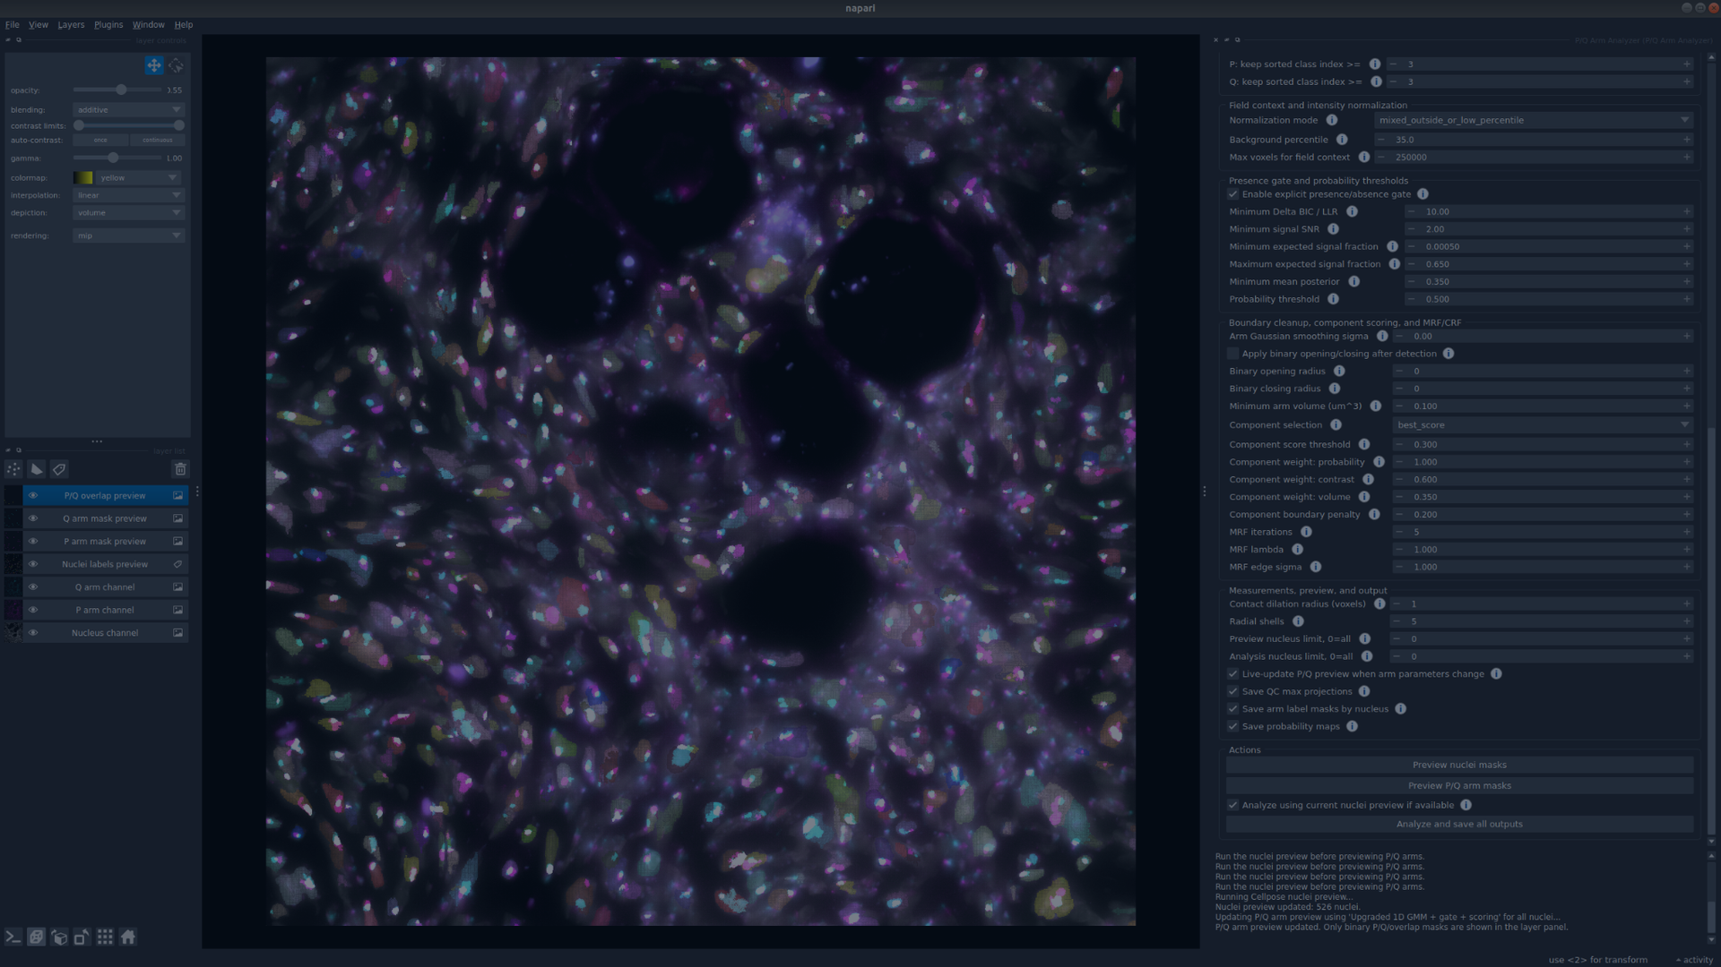
P/Q Arm Analyzer
Comprehensive plugin tutorial, backend formulas, parameter tuning, and result interpretation
napari plugin for 3D nuclei, P-arm, Q-arm, overlap, contact, shape, and radial measurements
Author and repository owner: Adib Keikhosravi
P/Q Arm Analyzer v0.3.7
1

Slide 2
OVERVIEW
What this presentation covers
Use this deck for a live demo, user training, and explaining the math behind the plugin.
1. How to use the plugin
2. How the backend works
3. What the outputs mean
Loading images, choosing scenes, selecting channels, previewing nuclei, previewing P/Q masks, saving configurations, and running single-scene or batch analysis.
Cellpose nuclei detection, per-nucleus GMM intensity modeling, field normalization, presence gating, MRF/CRF refinement, and component selection.
Masks, label images, CSV measurements, population summaries, plots, QC projections, and configuration files.
4. How to tune parameters
Practical rules for false positives, missed signal, merged nuclei, fragmented arm masks, over-smoothing, noisy boundaries, and slow analysis.
P/Q Arm Analyzer v0.3.7
2

Slide 3
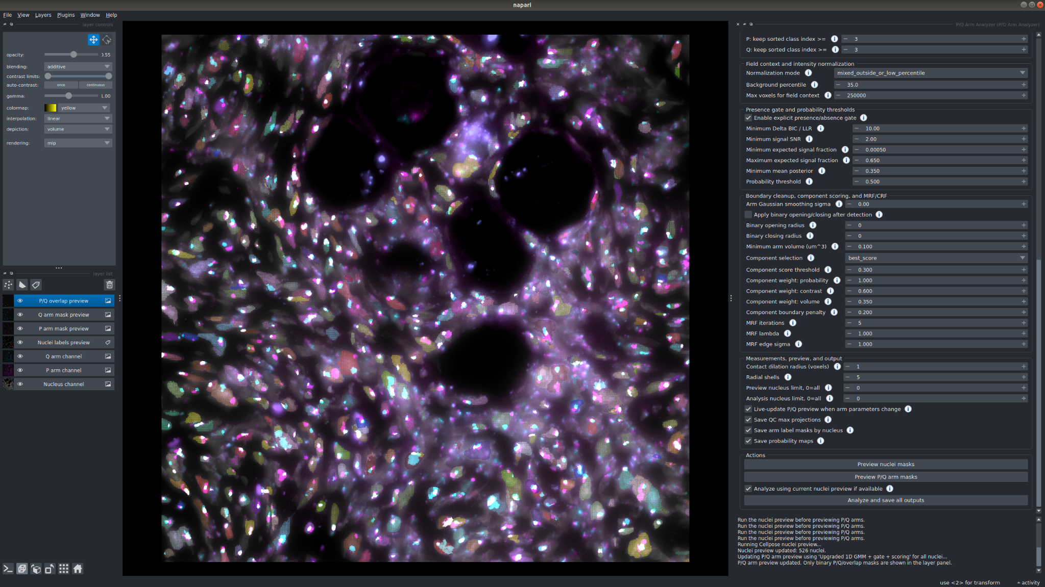
ANALYSIS TARGET
Conceptual task: segment nuclei, P arms, Q arms, and their spatial relationships
• Nucleus segmentation defines the 3D compartment where all downstream measurements are made.
• P and Q arm detection is performed independently inside each nucleus, using the selected P and Q channels.
• The plugin then measures volumes, fractions, FISH signal counts, centroids, overlap, contact, edge distances, shape descriptors, radial positions, and summary plots.
• The live napari preview is used to tune parameters before saving a full result set.
Raw channels
Nuclei labels
P/Q masks
Measurements
Plots + CSVs
P/Q Arm Analyzer v0.3.7
3

Slide 4
WORKFLOW
Recommended live-demo workflow
The order matters: tune nuclei first, then tune P/Q arms, then run final analysis.
Step | Action | What to inspect
1 | Load image | Confirm scenes, channels, CZYX shape, voxel spacing
2 | Load one preview scene | Choose a representative field for parameter tuning
3 | Set channels | Nucleus, P-arm, and Q-arm raw layers should be correct
4 | Preview nuclei | Nuclei should not be merged, split, or missing
5 | Preview P/Q masks | Masks should match signal and reject noise
6 | Save configuration | Store reusable parameter set as JSON
7 | Check scenes and analyze | Run one scene or batch of selected scenes
Demo tip: keep “Live-update P/Q preview” off while changing several parameters, then click “Preview P/Q arm masks” manually.
P/Q Arm Analyzer v0.3.7
4

Slide 5

IMAGE LOADING
Inputs: multi-channel 3D microscopy images and scene metadata
• The plugin loads common microscopy formats: LIF, CZI, ND2, IMS, OME-TIFF, TIFF, LSM, and Zarr when reader packages are available.
• Many files contain multiple scenes, positions, series, fields, or tiles; the plugin exposes them in a preview dropdown and a batch checkbox list.
• Data are internally handled as CZYX: channel, z-slice, y, x.
• Physical voxel spacing Δz, Δy, and Δx is used for volumes, surface areas, distances, equivalent diameters, and radial measurements.
Scene loaded in the example result set
Scene: 7: Series006 Shape CZYX: [4, 57, 2048, 2048] Spacing ZYX: (0.1788, 0.1032, 0.1032) µm
Why spacing matters
A voxel count is not a physical measurement until it is multiplied by voxel size. The same binary mask can represent different physical volumes if the pixel size is different.
P/Q Arm Analyzer v0.3.7
5

Slide 6
GUI TOUR
The napari interface: visualization on the left, controls on the right
Layer list and color controls
Raw channels + masks overlay
Parameter groups + actions
P/Q Arm Analyzer v0.3.7
6

Slide 7
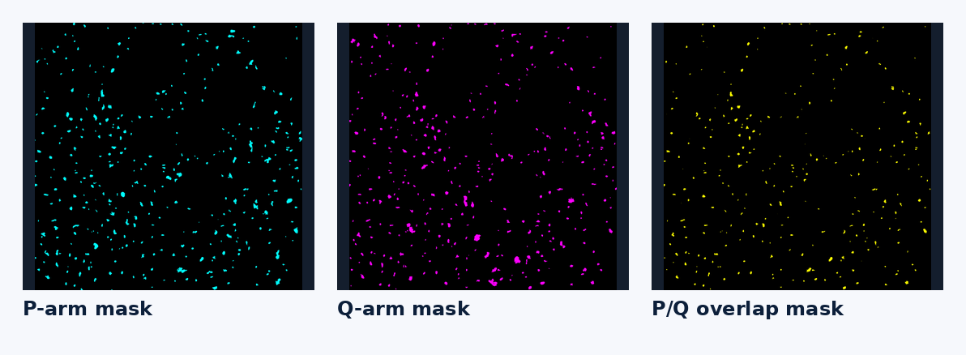
VISUALIZATION
What appears in the layer panel
This streamlined version only shows layers needed for interpretation and presentation.
Layer | Type | Purpose
Nucleus channel | Image | Raw nuclear signal used by Cellpose
P arm channel | Image | Raw P-arm signal used for P mask detection
Q arm channel | Image | Raw Q-arm signal used for Q mask detection
Nuclei labels preview | Labels | Each nucleus has a distinct integer ID
P arm mask preview | Image | Binary P-arm segmentation shown with adjustable colormap
Q arm mask preview | Image | Binary Q-arm segmentation shown with adjustable colormap
P/Q overlap preview | Image | Voxels where final P and Q masks overlap
Mask previews are Image layers so napari colormap/color changes work like raw channels.
P/Q Arm Analyzer v0.3.7
7

Slide 8
REPRODUCIBILITY
Configuration files and batch scene analysis
Save configuration…
Load configuration…
Stores the current GUI parameter values, selected image, selected preview scene, checked scenes, and output settings into a reusable JSON file.
Restores a previously tuned parameter set. This lets users repeat an analysis later without manually re-entering settings.
Checked scenes
Automatic provenance
After tuning on one scene, check any scenes that should be analyzed with the same parameters. Each checked scene gets its own result subfolder.
Every analysis writes pq_arm_analyzer_configuration.json and analysis_parameters.json. Batch analysis also writes batch_pq_arm_analyzer_configuration.json.
Recommended demo line: “Once we have a good preview, we save the configuration and use exactly the same settings for all selected scenes.”
P/Q Arm Analyzer v0.3.7
8

Slide 9
Backend segmentation logic
From raw channels to nuclei labels, probability maps, final masks, and measurements
Section: Backend
9

Slide 10
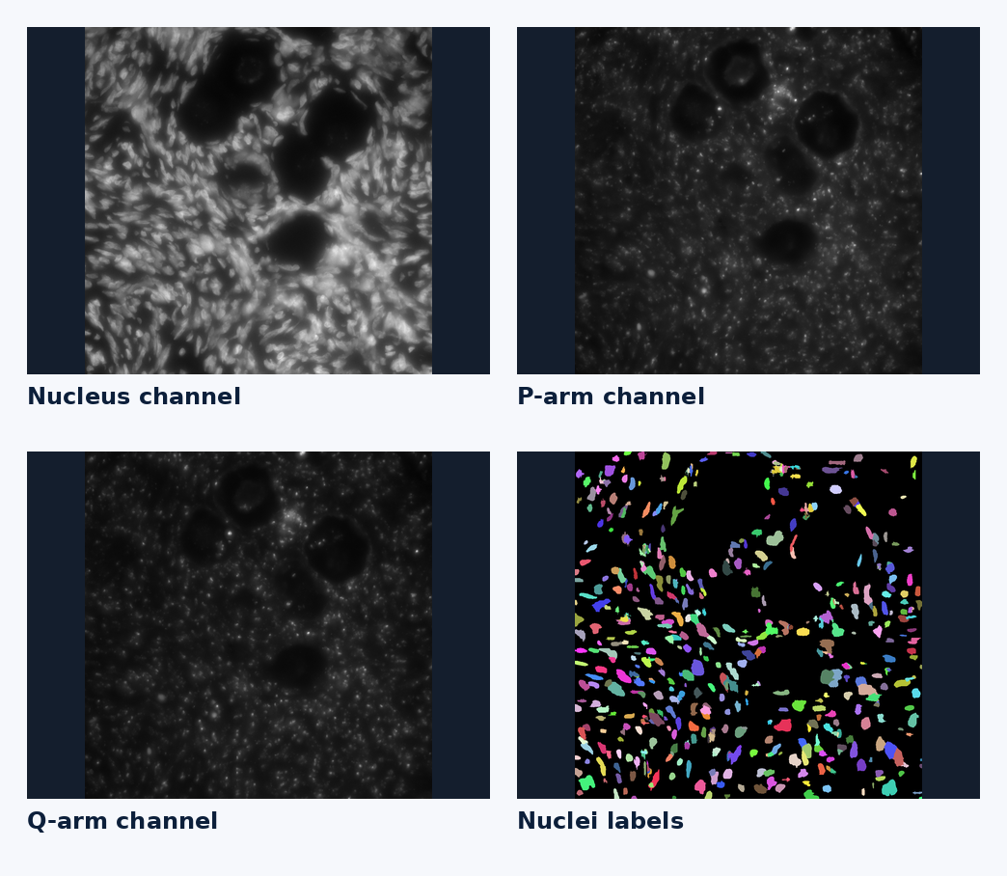
BACKEND
End-to-end computational pipeline
Load CZYX image
Select channels
Cellpose nuclei
Per-nucleus P/Q model
Mask refinement
Measurements
Exports
• Nuclei are segmented first because every P/Q decision is restricted to a parent nucleus.
• P-arm and Q-arm channels are modeled independently but measured jointly for overlap/contact.
• The final masks are not just thresholded raw images; they pass through probability modeling, optional presence gating, and component selection.
• All physical measurements use the voxel spacing read from the input file metadata.
P/Q Arm Analyzer v0.3.7
10

Slide 11

NUCLEI
Nuclei segmentation: Cellpose produces a 3D label image
• Input: selected nucleus channel volume.
• Output: label image L(v), where L(v)=0 is background and L(v)=i means voxel v belongs to nucleus i.
• Small labels below the minimum nucleus volume are removed.
• Final P/Q arm detection is performed inside each label independently.
Cellpose modes
3D whole volume: more 3D-aware but heavier. 2D stack batch + overlap stitch: practical speed/quality starting point. 2D parallel slices + overlap stitch: CPU-parallel 2D path.
Nuclei labels preview: each color is a different nucleus ID
P/Q Arm Analyzer v0.3.7
11

Slide 12
NUCLEI
Nuclei parameter tuning
Tune these before judging any P/Q arm masks.
Parameter | Increase when… | Decrease when…
Cell/nucleus diameter | A nucleus is split into fragments | Neighboring nuclei are merged
XY downsample | Cellpose is slow or memory-limited | Boundaries look blocky or small nuclei are lost
Minimum nucleus volume | Debris or tiny false nuclei remain | Small real nuclei are removed
2D batch size | GPU/CPU has available memory, and batch mode is inefficient | Memory errors occur
2D z-stitch overlap | Objects join incorrectly across Z | Same nucleus breaks into Z fragments
Key rule: if nuclei are wrong, P/Q arm measurements will also be wrong.
P/Q Arm Analyzer v0.3.7
12

Slide 13
PERFORMANCE
Speed strategy for large z-stacks
Preview fast
Use parallel per-nucleus analysis
Prefer threading first
Use a moderate XY downsample and a preview nucleus limit while tuning. Disable live P/Q preview when changing many settings.
Worker count controls CPU parallelism for P/Q segmentation after nuclei are available. “0” means automatic worker selection.
Threading avoids copying large 3D arrays between processes. Process-based backends can be faster for some cases but may use more memory.
• Most expensive steps: Cellpose nuclei segmentation and per-nucleus P/Q modeling on many objects.
• For GPU Cellpose, avoid launching multiple GPU workers; batch 2D or 3D modes are safer.
• After tuning is complete, set Analysis nucleus limit to 0 to run all nuclei.
• If disk space is a problem, probability maps can be disabled after parameter development.
P/Q Arm Analyzer v0.3.7
13

Slide 14

P/Q DETECTION
P/Q arm detection is a per-nucleus voxel classification problem
• For each nucleus Nᵢ, the algorithm extracts P-channel intensities and Q-channel intensities inside the nucleus.
• For one arm channel, each voxel receives a signal probability pᵢ = P(signal | intensity and model).
• The probability map is thresholded, optionally refined, then filtered by connected-component logic.
• P and Q are detected independently, then compared for overlap, contact, and distance.
Why a probability map?
A probability map separates the question “how signal-like is this voxel?” from later decisions about minimum size, component plausibility, and boundary refinement.
Why inside nuclei?
It prevents the algorithm from treating signal outside nuclei as chromosome-arm territory and enables per-nucleus normalization, shape, radial, and overlap metrics.
P/Q Arm Analyzer v0.3.7
14

Slide 15
METHODS
Three P/Q arm detection methods kept in the streamlined plugin
Legacy 1D GMM
Upgraded 1D GMM + gate + scoring
MRF/CRF refinement
Baseline intensity-only method. Fast and useful for comparison, but it can segment noise because it always splits intensities into classes.
Recommended default. Adds field normalization, presence/absence gating, probability thresholding, and connected-component scoring.
Starts from upgraded GMM and adds spatial boundary refinement. Neighboring voxels are encouraged to agree while intensity edges protect boundaries.
Practical default: begin with Upgraded 1D GMM + gate + scoring. Move to MRF/CRF when the mask is approximately right but the boundaries need cleanup.
P/Q Arm Analyzer v0.3.7
15

Slide 16


METHOD 1
1D GMM: intensity-only clustering inside each nucleus
• The model fits K Gaussian intensity classes to the voxel intensity distribution inside one nucleus.
• Classes are sorted by their mean intensity from dimmest to brightest.
• The user chooses the lowest sorted class index to keep. Example: with K=4 and keep ≥3, only the brightest class is kept.
• Limitation: the method has no context telling it that a nucleus may contain no true arm signal.
Use Legacy GMM as a baseline or for very clean signal. Use upgraded GMM when noise/no-signal nuclei are present.
P/Q Arm Analyzer v0.3.7
16

Slide 17
GMM PARAMETERS
GMM controls: how they affect P/Q arm masks
Control | What it does | Effect on masks
Max GMM components | Maximum number of intensity classes | More classes can model dim/medium/bright signal; too many can split noise
Auto-choose by BIC | Chooses number of components using model-selection score | Adapts across nuclei but can be slower
P: keep sorted class index ≥ | P-channel classes kept as signal | Higher = stricter/brighter; lower = more inclusive
Q: keep sorted class index ≥ | Q-channel classes kept as signal | Tune separately because P and Q channels differ
Probability threshold | Converts probability map into binary mask | Higher shrinks/cleans; lower expands/recovers dim signal
Common demo example: for 4 GMM components, “keep sorted class index ≥ 3” keeps only the brightest modeled class.
P/Q Arm Analyzer v0.3.7
17

Slide 18
METHOD 2
Upgraded 1D GMM + gate + scoring: why it is the recommended default
Field normalization
Per-nucleus GMM
Presence gate
Probability threshold
Component scoring
Final mask
Fixes field-to-field intensity variation
Rejects no-signal nuclei
Rejects implausible fragments
Raw intensities are robustly normalized relative to background/context so thresholds behave more consistently.
The presence gate requires enough evidence for real signal before allowing a mask.
Component scoring evaluates connected 3D objects using probability, contrast, volume, and boundary irregularity.
• This method addresses the main weakness of legacy GMM: intensity clustering alone can create false masks from noise.
• It is usually the first method to tune before trying MRF/CRF refinement.
P/Q Arm Analyzer v0.3.7
18

Slide 19

NORMALIZATION
Field context and robust intensity normalization
Normalization mode | Use case
mixed_outside_or_low_percentile | Recommended default; uses outside nuclei if available, otherwise low-percentile fallback
outside_nuclei | Good when outside-nucleus background is representative
nuclear_low_percentile | Good when whole-field background is unreliable
whole_image_low_percentile | Simple fallback for broad field background
none | Only if raw intensities are already comparable
• B is a background/context sample from outside nuclei or low-intensity voxels, depending on normalization mode.
• MAD = median absolute deviation, a robust estimate of spread that is less sensitive to bright outliers.
• After normalization, positive values mean brighter than background-like intensity.
• The background percentile controls which low-intensity voxels contribute to the background estimate.
Increase background percentile carefully: too high can treat dim real signal as background.
P/Q Arm Analyzer v0.3.7
19

Slide 20



PRESENCE GATE
Presence/absence gate: preventing false arms in no-signal nuclei
• Delta BIC/LLR asks whether a multi-component signal model explains the data better than a single noise-like model.
• Signal SNR asks whether bright voxels stand out from the lower-intensity nuclear distribution.
• Expected signal fraction prevents both tiny specks and overly broad masks from being accepted.
• Mean posterior checks that expected signal voxels are sufficiently confident.
If noise is still segmented, make the gate stricter. If true dim signal disappears, relax the gate.
P/Q Arm Analyzer v0.3.7
20

Slide 21
PRESENCE GATE
Presence gate parameters: practical tuning effects
Parameter | Increase to… | Decrease to…
Minimum Delta BIC / LLR | Reject nuclei where intensity classes are not well separated | Keep weak/ambiguous true signal
Minimum signal SNR | Require signal to stand out more strongly | Recover dim or low-contrast signal
Minimum expected signal fraction | Reject tiny specks | Allow very small true territories
Maximum expected signal fraction | Prevent broad over-segmentation | Allow large true territories
Minimum mean posterior | Keep only confident probability maps | Accept weak but plausible probability maps
Probability threshold | Shrink/clean final masks | Expand masks and recover dim boundaries
P/Q Arm Analyzer v0.3.7
21

Slide 22
COMPONENT SELECTION
Connected-component selection: object-level cleanup
• After probability thresholding and optional refinement, the binary mask may contain multiple disconnected 3D objects.
• Component selection decides which 3D objects are plausible arm territories.
• This step does not refine voxel boundaries; it keeps or removes entire connected components.
• Think of it as the final “object plausibility” filter.
Mode | Behavior | When useful
none | Keeps all detected voxels | Debugging raw mask behavior
largest | Keeps largest component only | One compact territory expected
all_after_size_filter | Keeps components above minimum volume | Permissive multi-piece signal
best_score | Keeps highest-scoring object | Default when one main territory expected
all_passing_score | Keeps all objects above score threshold | True signal may be fragmented
MRF/CRF fixes shape. Component selection chooses objects.
P/Q Arm Analyzer v0.3.7
22

Slide 23
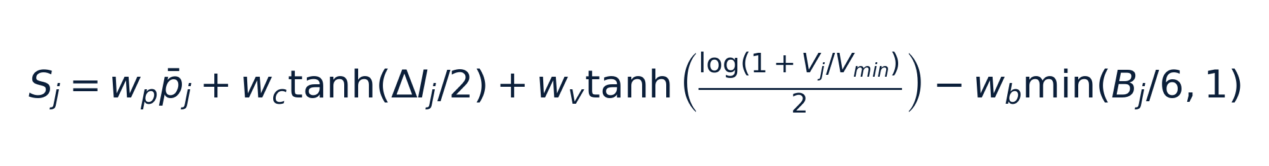
COMPONENT SELECTION
Component score: probability + contrast + volume − boundary penalty
Term | Meaning | Higher weight favors…
wₚ mean probability | Average GMM signal probability inside component | High-confidence components
w꜀ contrast | Component brightness relative to nearby surroundings | Locally distinct signal rather than background gradients
wᵥ volume | Component size relative to minimum allowed volume | Larger coherent territories over specks
wᵦ boundary penalty | Irregularity / jagged boundary-like shape | Smooth plausible components; penalizes speckled pieces
If a false component is kept, increase score threshold, contrast weight, volume weight, or boundary penalty depending on the failure mode.
P/Q Arm Analyzer v0.3.7
23

Slide 24


METHOD 3
MRF/CRF refinement: boundary smoothing with edge protection
• MRF = Markov Random Field: neighboring voxels tend to have similar labels.
• CRF = Conditional Random Field: the amount of smoothing depends on the image; strong intensity edges reduce smoothing.
• The plugin uses this as a deterministic refinement step after GMM probabilities.
• It is best when the upgraded GMM finds the correct region but the boundary is ragged, speckled, or slightly fragmented.
Interpretation
Final voxel decision = GMM probability evidence + neighborhood support − resistance from image edges.
Use MRF/CRF after the intensity model is mostly correct—not as a substitute for correct channels and thresholds.
P/Q Arm Analyzer v0.3.7
24

Slide 25
MRF/CRF
MRF/CRF parameters: how they affect boundaries
Parameter | Higher value does… | Risk if too high
MRF iterations | Repeats neighborhood refinement more times | Over-smoothing, over-expansion, slower analysis
MRF lambda | Increases neighbor agreement strength | Pulls background into the mask or merges nearby objects
MRF edge sigma | Allows smoothing across weaker intensity edges | Leaks across real boundaries if too permissive
Probability threshold | Sets the starting mask before refinement | Too high removes signal before refinement; too low seeds background
• If background is added next to the arm: increase probability threshold; decrease lambda, edge sigma, or iterations.
• If true signal remains fragmented: slightly decrease probability threshold; increase lambda or iterations gently; consider all_passing_score.
• If boundaries look too smooth or too round: decrease lambda or iterations.
P/Q Arm Analyzer v0.3.7
25

Slide 26
BOUNDARY CLEANUP
Optional smoothing and binary morphology: use carefully
Arm Gaussian smoothing sigma
Binary opening radius
Binary closing radius
Smooths raw P/Q intensity before modeling. Helps speckle; can blur true boundaries and merge nearby signal.
Removes small objects and thin protrusions after detection. Good for specks; can delete small true fragments.
Fills small holes and bridges small gaps. Good for fragmented signal; can attach background adjacent to the arm.
• Binary morphology is not intensity-aware: it changes masks based only on shape and adjacency.
• When background is added because it touches the arm, reduce binary closing or turn morphology off.
• Use MRF/CRF when the desired cleanup should respect intensity boundaries.
Practical default: keep morphology off unless a specific defect remains after tuning probability and component selection.
P/Q Arm Analyzer v0.3.7
26

Slide 27
TUNING STRATEGY
Choosing the best method during a live demo
Situation | Method to show | Reason
Clean bright signal; quick baseline | Legacy 1D GMM | Demonstrates intensity-only segmentation
Mixed strong/weak/no-signal nuclei | Upgraded GMM + gate + scoring | Rejects false positives and scores objects
Good approximate masks but rough boundaries | MRF/CRF refinement | Uses neighbor context while respecting intensity edges
Many tiny false dots | Upgraded or MRF + stricter component selection | Object-level filtering removes specks
True arm is split into multiple pieces | all_passing_score component mode | Allows more than one plausible component
P/Q Arm Analyzer v0.3.7
27

Slide 28
Measurements and mathematical definitions
What the CSV columns and plots mean
Section: Measurements
28

Slide 29

MEASUREMENTS
Volume and fraction measurements
• nucleus_volume_um3, p_volume_um3, q_volume_um3, and pq_overlap_volume_um3 are physical volumes.
• p_fraction_of_nucleus = P-arm volume / nucleus volume.
• q_fraction_of_nucleus = Q-arm volume / nucleus volume.
• p_fish_signal_count and q_fish_signal_count report how many final retained 3D P or Q signal compartments are present in that nucleus.
• pq_overlap_fraction_of_p and pq_overlap_fraction_of_q answer different questions when P and Q sizes differ.
Why normalize?
Fractions account for differences in nucleus size and arm-mask size, making cell-to-cell comparisons more interpretable than raw volumes alone.
P/Q Arm Analyzer v0.3.7
29

Slide 30

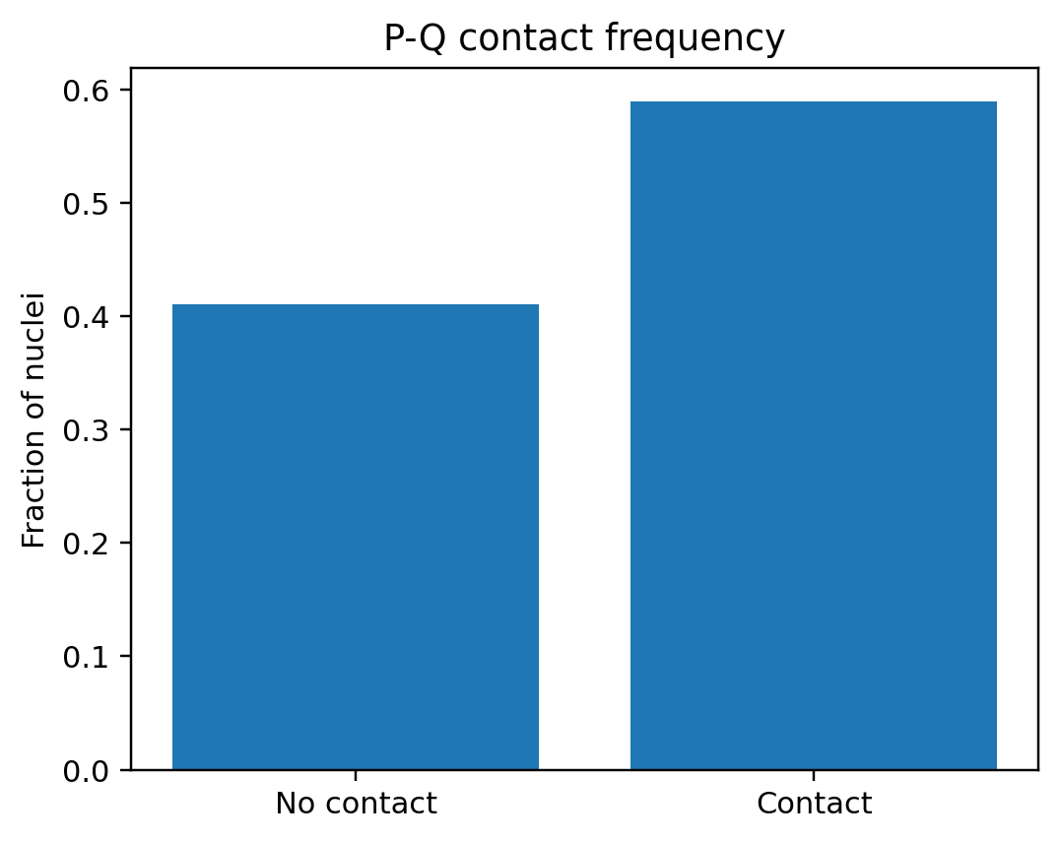
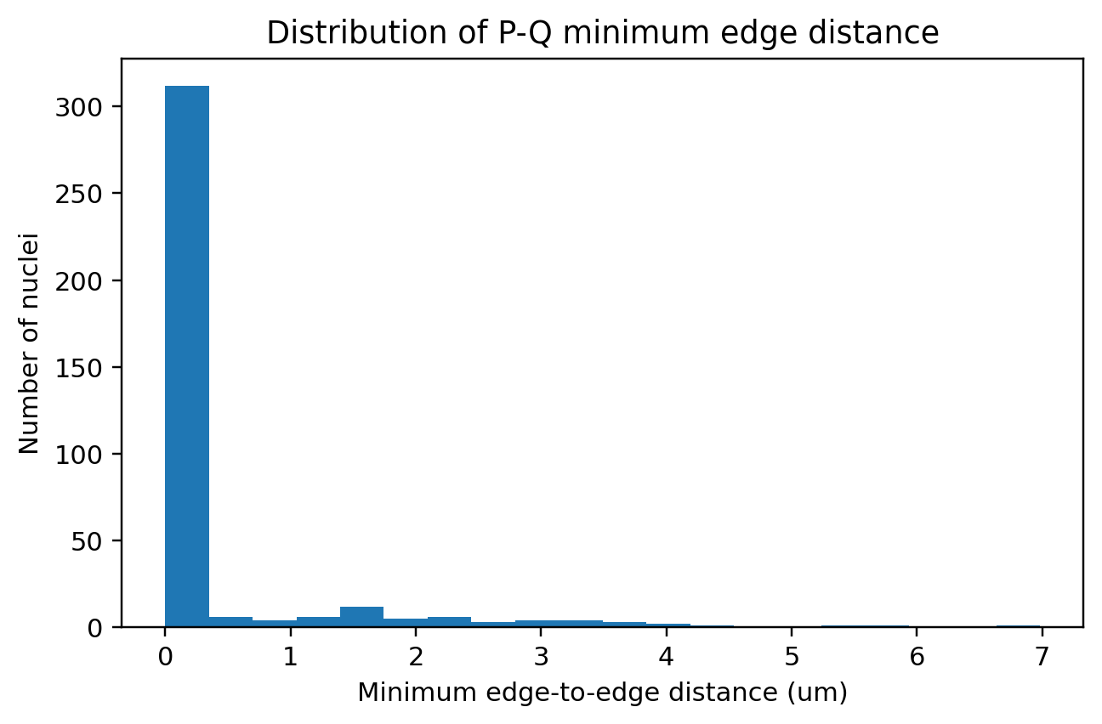
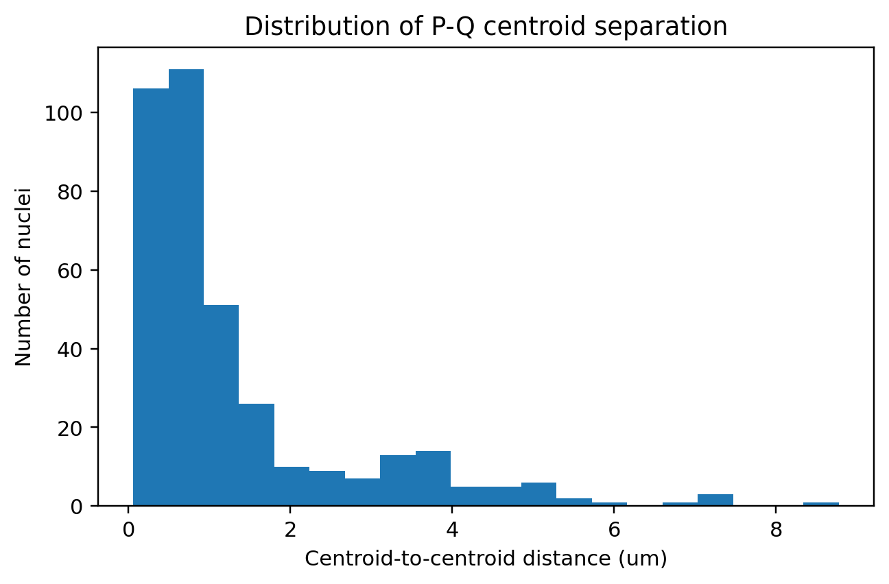
MEASUREMENTS
P/Q spatial relationship: centroid distance, edge distance, and contact
• Centroid distance uses the physical 3D centers of P and Q masks.
• Minimum edge distance is the shortest physical distance between P and Q boundary voxels.
• Contact is binary: 1 if P and Q touch/overlap after the chosen contact dilation radius; 0 otherwise.
• Contact frequency is the mean of pq_contact across nuclei.
P/Q Arm Analyzer v0.3.7
30

Slide 31


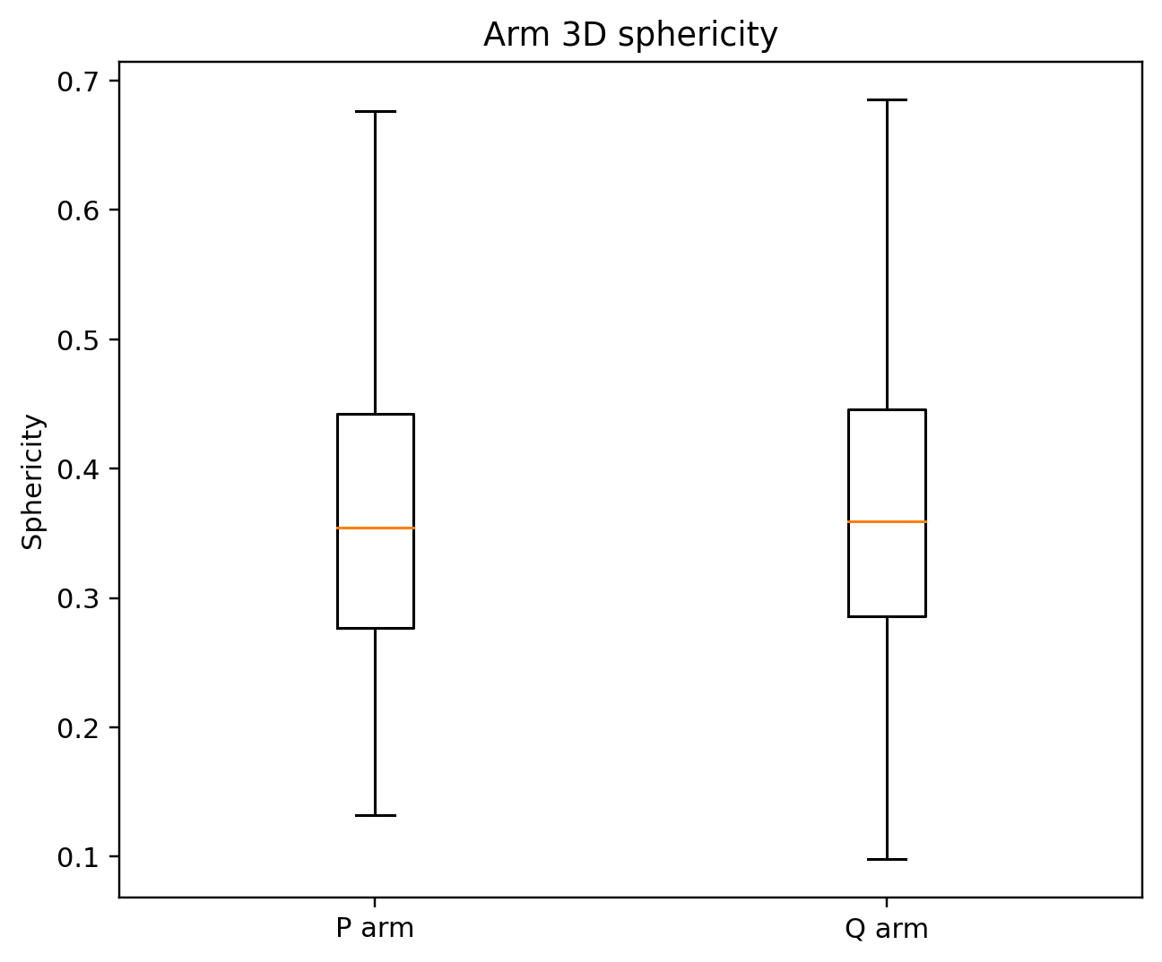
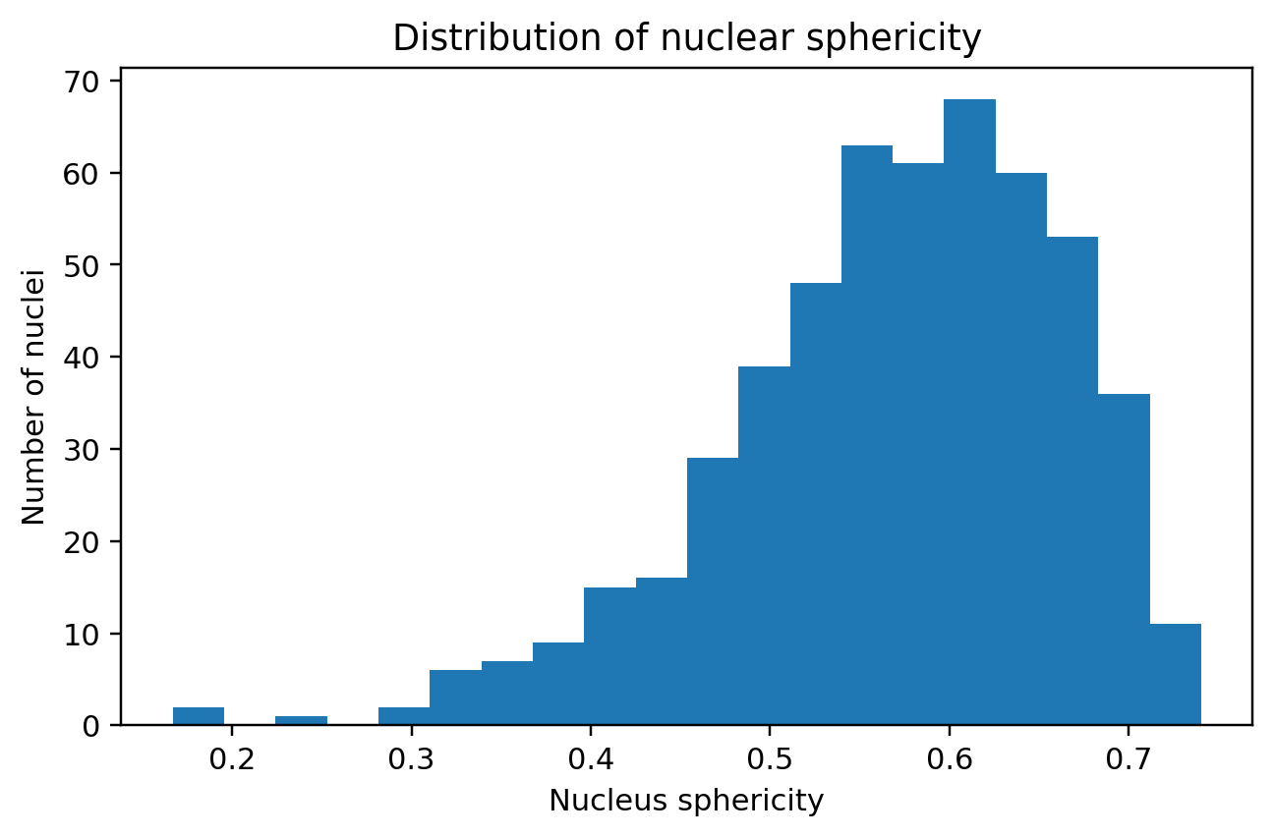
MEASUREMENTS
3D shape metrics: volume, surface area, sphericity, compactness, axes
• Surface area estimates how much boundary area the object has.
• Sphericity compares object surface area to a sphere with the same volume; values closer to 1 are more sphere-like.
• Compactness is another volume-to-surface relationship; low values often indicate rough or fragmented masks.
• PCA major/intermediate/minor axes summarize the 3D spread of the object along its principal directions.
• Elongation and flatness are ratios of these PCA axes.
P/Q Arm Analyzer v0.3.7
31

Slide 32

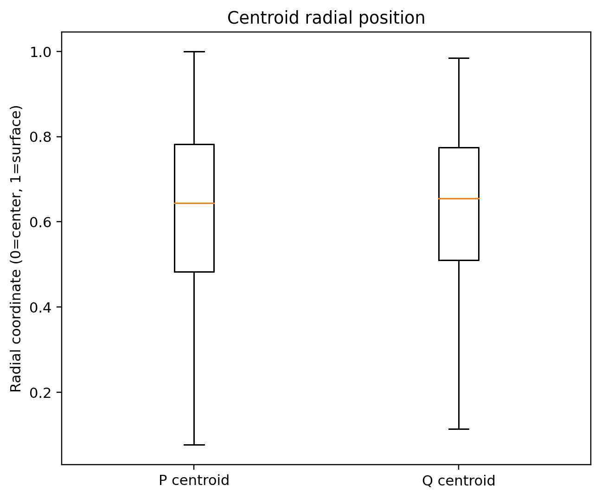
MEASUREMENTS
3D radial position: continuous center-to-surface coordinate
• D(v) is the 3D distance-transform value inside the nucleus.
• Dmax is the maximum distance-transform value in that nucleus.
• ρ(v) is close to 0 near the nuclear center and close to 1 near the nuclear boundary.
• For each territory, the plugin reports centroid, min, max, mean, and median radial position.
This extends the HiTIPS 2D distance-transform idea to full 3D nuclei.
P/Q Arm Analyzer v0.3.7
32

Slide 33
MEASUREMENTS
Radial shell fractions: binned 3D distribution inside the nucleus
• The plugin can divide each nucleus into concentric shell bins using distance-transform values.
• For each P or Q mask, the shell fraction is the fraction of that mask lying in a shell.
• Shells are useful for summaries and comparisons; continuous radial coordinates are more precise.
• The public table keeps selected shell fractions while internal/requested removed columns are omitted.
Column example | Meaning
p_shell_2_frac | Fraction of P-arm volume in shell 2
p_shell_5_frac | Fraction of P-arm volume in most central reported shell
q_shell_3_frac | Fraction of Q-arm volume in shell 3
q_shell_5_frac | Fraction of Q-arm volume in most central reported shell
Interpretation
Radial fractions summarize where a mask lies within a nucleus. A more central object has more volume in inner shells; a more peripheral object has more volume near outer shells.
P/Q Arm Analyzer v0.3.7
33

Slide 34
OUTPUTS
Output files created by “Analyze and save all outputs”
File group | Examples | Purpose
Masks | nuclei_labels_3d.tif, p_arm_mask_3d.tif, q_arm_mask_3d.tif, pq_overlap_mask_3d.tif | 3D segmentation outputs
Label masks | p_arm_labels_by_nucleus_3d.tif, q_arm_labels_by_nucleus_3d.tif | Trace mask voxels back to parent nucleus ID
CSVs | series7_chrX_arm_measurements_per_nucleus.csv with p_fish_signal_count/q_fish_signal_count, population_summary.csv | Per-nucleus measurements, including FISH signal counts, and population summaries
QC images | qc_nuc_maxproj.tif, qc_p_maxproj.tif, qc_q_maxproj.tif | Quick visual validation
Configuration/provenance | analysis_parameters.json, pq_arm_analyzer_configuration.json | Reproducibility and audit trail
Plots | plots/*.png including fish_signal_count_distribution.png and plot_summary.txt | Summary figures for presentation/reporting, including FISH signal count distribution
P/Q Arm Analyzer v0.3.7
34

Slide 35
Example result set
Using the supplied test output folder, CSV files, plots, QC projections, and napari screenshot
Section: Example results
35

Slide 36
EXAMPLE RESULTS
Population summary from the supplied result set
Metric | Value
Number of nuclei | 526
Arm detection method | Upgraded 1D GMM + gate + scoring
Mean nucleus volume | 71.50 µm³
Mean P fraction of nucleus | 0.0428
Mean Q fraction of nucleus | 0.0397
Mean overlap / P | 0.3286
Mean overlap / Q | 0.3546
P/Q contact frequency | 0.5894
Mean minimum edge distance | 0.3547 µm
New in v0.3.7: after rerunning analysis, the per-nucleus CSV includes p_fish_signal_count and q_fish_signal_count. The population summary also reports total, mean, and median P/Q signal counts and fractions of nuclei with P, Q, or both signals.
P/Q Arm Analyzer v0.3.7
36

Slide 37
EXAMPLE VISUALIZATION
Example napari visualization after previewing nuclei and P/Q masks
P/Q Arm Analyzer v0.3.7
37

Slide 38
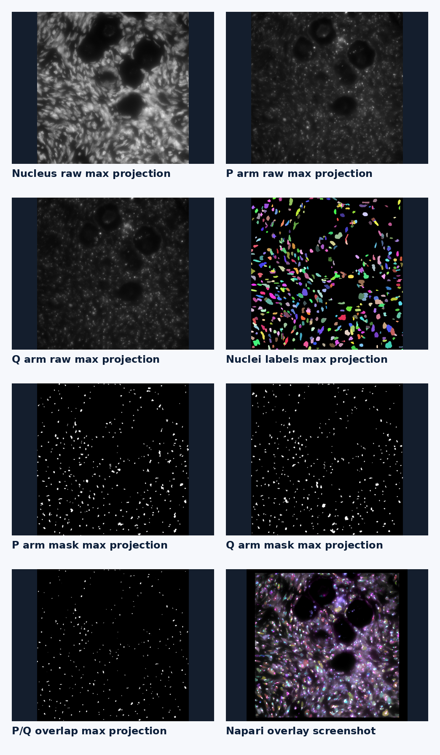
QC OUTPUTS
Saved QC projections and mask projections
These files help confirm that saved outputs match the napari preview.
• QC projections summarize 3D stacks into quick 2D review images.
• Nuclei labels can be inspected for over-splitting, merging, or missing objects.
• P/Q/overlap mask projections confirm where the saved masks appear in the field.
• For final validation, also scroll through the 3D masks in napari or another 3D viewer.
P/Q Arm Analyzer v0.3.7
38

Slide 39
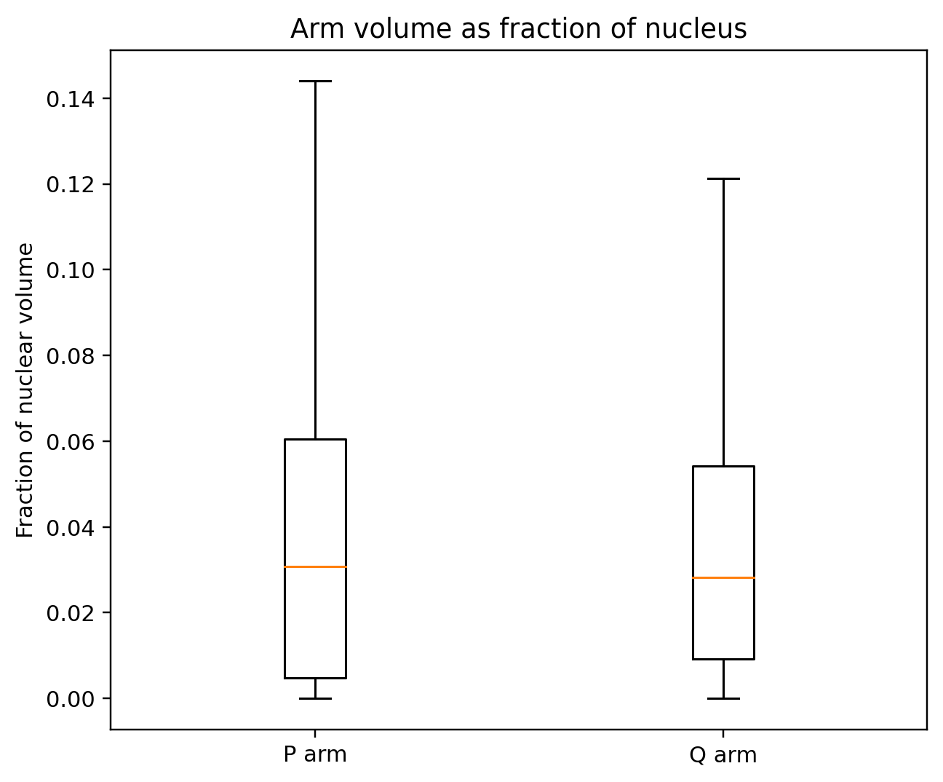
RESULT PLOTS
Plot: P and Q arm volumes as fractions of nuclear volume
• Each nucleus contributes P volume / nucleus volume and Q volume / nucleus volume.
• Boxplots summarize the population distribution while suppressing individual outlier points.
• This plot is useful for comparing how much of the nuclear volume each arm mask occupies.
• If values are unexpectedly high, inspect probability threshold, maximum signal fraction, and component selection.
P/Q Arm Analyzer v0.3.7
39

Slide 40
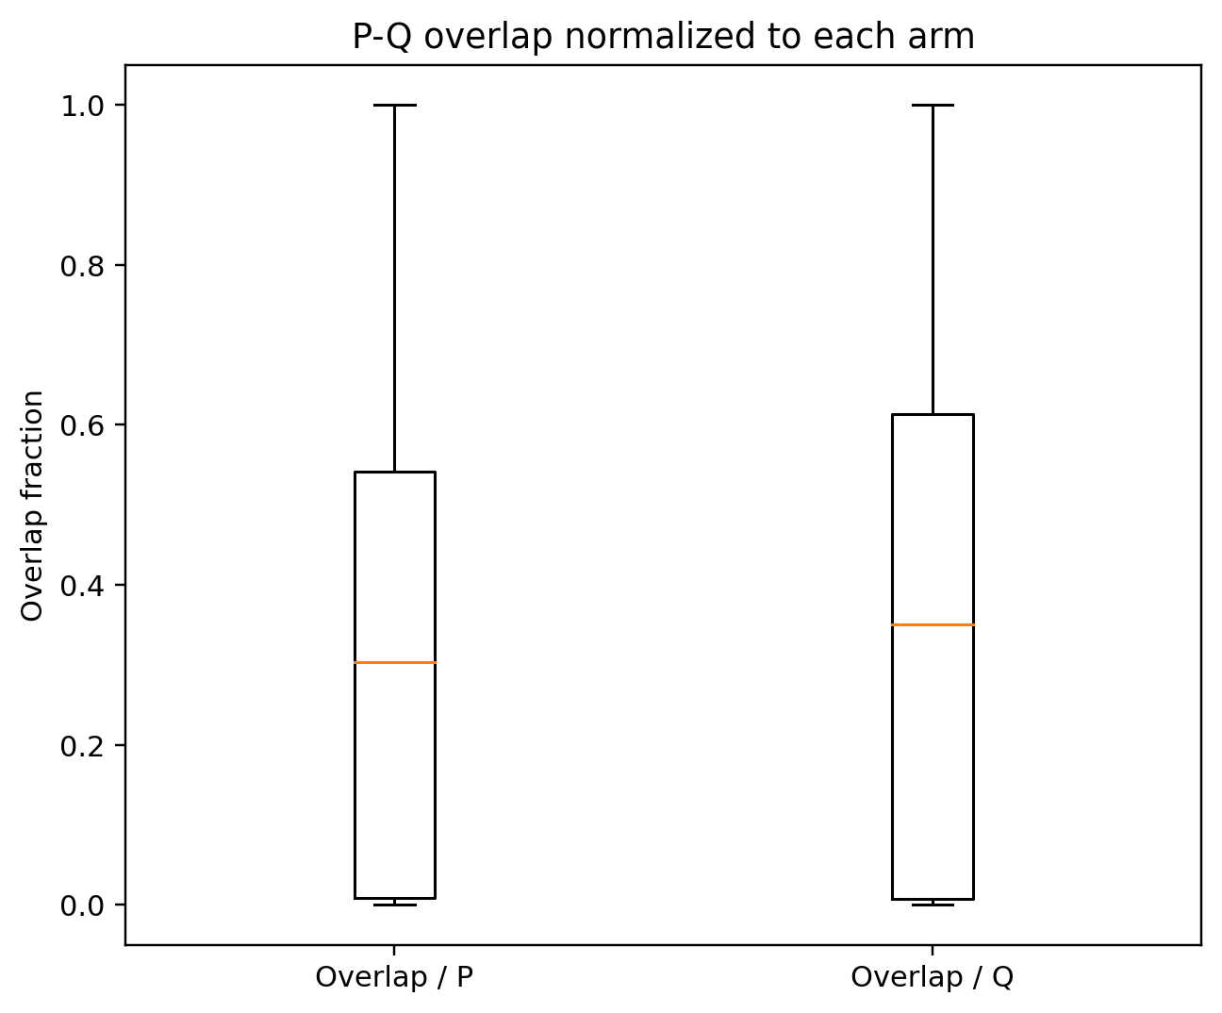
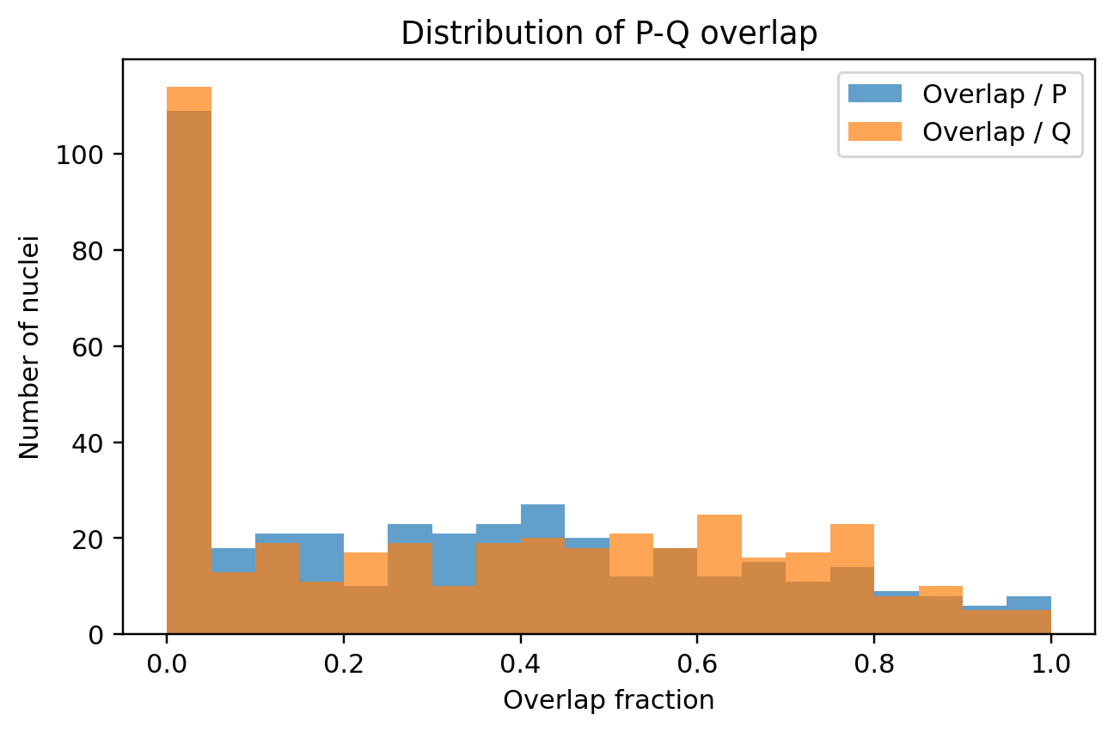
RESULT PLOTS
Plots: P/Q overlap normalized to each arm
• Overlap/P and Overlap/Q are different when P and Q volumes differ.
• Histogram shape shows whether the population is concentrated or heterogeneous.
• High overlap values may reflect true colocalization or over-inclusive segmentation; validate with overlays.
P/Q Arm Analyzer v0.3.7
40

Slide 41
RESULT PLOTS
Plots: contact frequency and P/Q separation
• Contact is a binary call per nucleus; contact frequency is the population mean.
• Minimum edge distance is zero when masks overlap/touch; positive when separated.
• Centroid separation measures territory-center distance, not boundary distance.
• Use edge distance and centroid distance together because they capture different spatial relationships.
P/Q Arm Analyzer v0.3.7
41

Slide 42
RESULT PLOTS
Plots: shape and radial position summaries
• Sphericity/compactness help identify fragmented, rough, or over-smoothed masks.
• Radial centroid values summarize center-to-surface position on a 0-to-1 scale.
• Use these plots as QC as well as biological/structural summaries.
P/Q Arm Analyzer v0.3.7
42

Slide 43
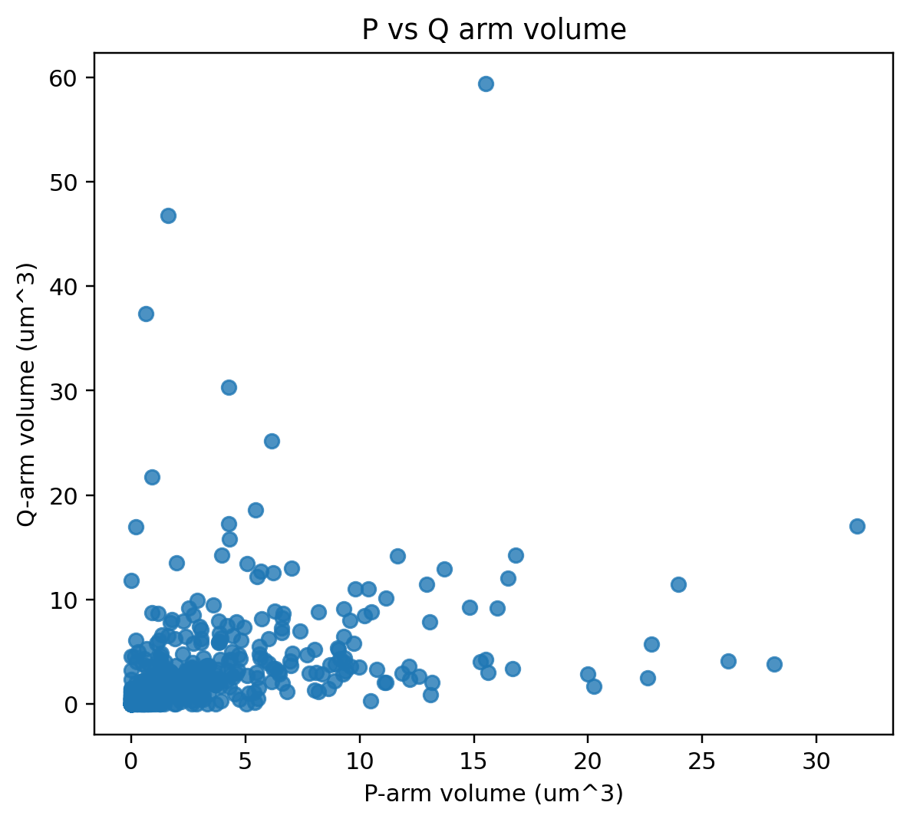
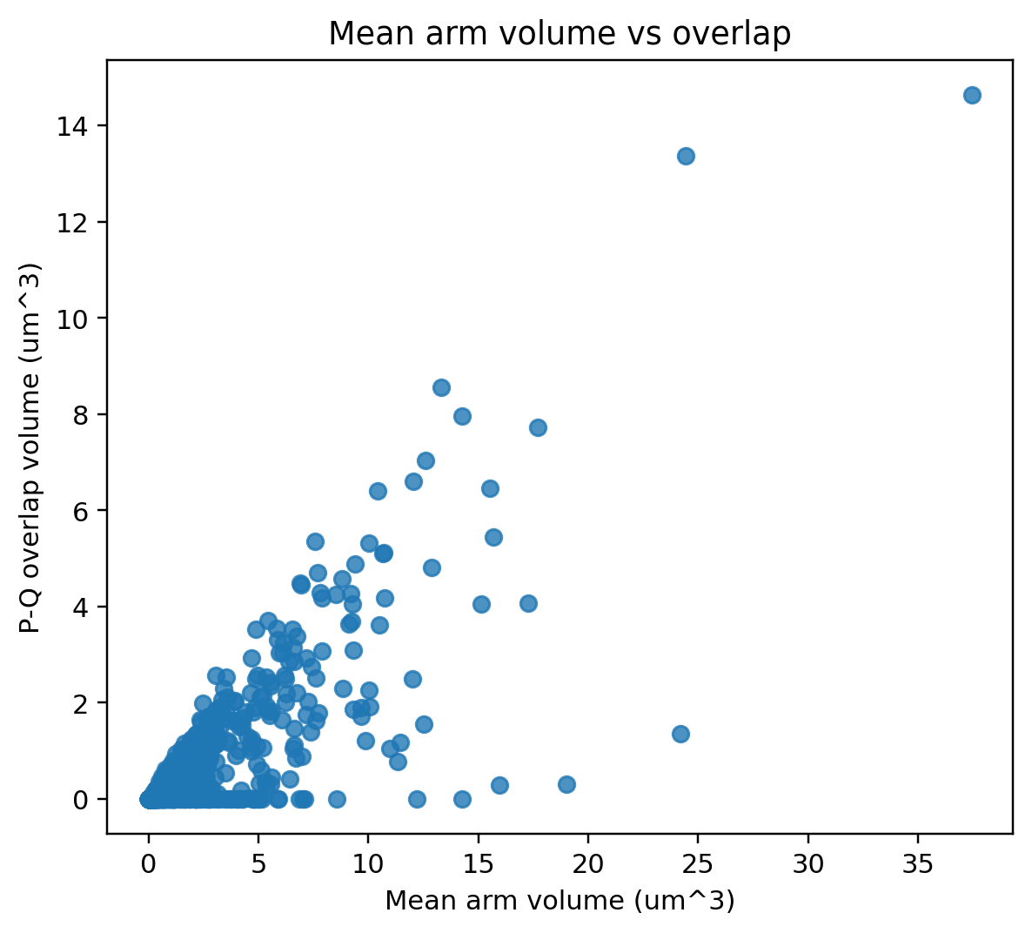
RESULT PLOTS
Plots: relationships between P volume, Q volume, and overlap
• P vs Q volume shows whether large P territories tend to occur with large Q territories.
• Mean arm volume vs overlap helps determine whether overlap increases mainly because arms are larger.
• Outliers should be inspected in the mask layers because they may represent segmentation errors or unusual objects.
P/Q Arm Analyzer v0.3.7
43

Slide 44
Practical parameter tuning guide
Section: Tuning
45

Slide 45
TUNING
Recommended tuning order
Changing parameters out of order can hide the real problem.
Scene + channels
Nuclei
GMM class + threshold
Presence gate
Component selection
MRF/CRF
Save config
1. Confirm the correct scene and raw channels first.
2. Tune nuclei until boundaries are reliable.
3. Tune GMM classes and probability threshold to get the approximate P/Q signal.
4. Tune the presence gate to reject no-signal/noise nuclei.
5. Tune component selection to keep plausible objects.
6. Add MRF/CRF only when boundary quality needs improvement.
7. Save configuration before final/batch analysis.
Most common mistake
Trying to fix a wrong channel, poor nucleus mask, or bad probability threshold using MRF/CRF. MRF/CRF is a refinement step; it cannot recover a fundamentally wrong starting segmentation.
P/Q Arm Analyzer v0.3.7
46

Slide 46
TUNING
Troubleshooting by visual failure mode
Problem in preview | Likely cause | Try these changes
Noisy specks segmented | Gate too permissive; components too small | Increase min SNR, Delta BIC, min arm volume, component score threshold
True signal missed | Threshold/gate too strict | Lower probability threshold, SNR, Delta BIC, min mean posterior
Masks too large | Bright class too inclusive or threshold too low | Increase class index, probability threshold, or lower max signal fraction
Boundary ragged | Voxel-level noise around the correct region | Use MRF/CRF; raise lambda/iterations gently
Background attached near arm | Closing or smoothing too permissive | Turn off closing; lower MRF lambda/edge sigma; raise contrast weight
True arm split into pieces | Component mode too restrictive | Use all_passing_score; lower score threshold/min volume; mild MRF
P/Q Arm Analyzer v0.3.7
47

Slide 47
PRESENTATION SCRIPT
Suggested live-demo script for the user
• Show the raw nucleus/P/Q channels and explain channel selection.
• Run or show nuclei preview; point out labels and object identities.
• Switch to Upgraded GMM + gate + scoring and preview P/Q masks.
• Change one parameter live: probability threshold or P/Q sorted class index; show the mask shrinking/expanding.
• Explain presence gate: it prevents the model from inventing arms in no-signal nuclei.
• Switch to MRF/CRF only if boundaries need smoothing; explain lambda and edge sigma.
• Save configuration, check scenes, run analysis, and show saved plots/CSVs.
One sentence summary
“The plugin lets us tune segmentation interactively in napari, then locks those settings into a reproducible JSON configuration for full 3D measurement and plot generation.”
P/Q Arm Analyzer v0.3.7
48

Slide 48
Appendix: deeper algorithm explanations
Use these slides when a user wants the mathematical details behind the segmentation choices
Appendix
49

Slide 49
APPENDIX
GUI help buttons: built-in explanations for every visible parameter
• Each parameter row has an information button. Hovering gives immediate help; clicking opens a fixed help window.
• Only one help window per parameter should be open. Re-clicking the same information button raises/focuses the existing window.
• The help text explains what the parameter is, how it affects the result, when to increase/decrease it, and practical tuning advice.
• For a full explanation, point users to the DOCX manual in the repository docs/manual folder.
P/Q Arm Analyzer v0.3.7
50

Slide 50
APPENDIX
MRF/CRF deep dive: data term plus smoothness term
Plain-language version
A voxel is more likely to be included if it has high signal probability and if nearby voxels are also included, but smoothing is reduced at strong intensity boundaries.
• xᵢ is the unknown binary label for voxel i: 1 = arm signal, 0 = background.
• Uᵢ(xᵢ) is the unary/data cost derived from the GMM probability map.
• The pairwise term penalizes neighboring voxels that disagree.
• λ controls how much the algorithm trusts neighboring labels relative to voxel-level probability.
• wᵢⱼ reduces smoothing across strong image edges, so boundaries can still be preserved.
Term | Meaning
Data term | Does this voxel look like arm signal?
Smoothness term | Do neighboring voxels agree?
Edge weight | Should a visible edge stop smoothing?
Lambda | How strong is the neighbor effect?
P/Q Arm Analyzer v0.3.7
51

Slide 51
APPENDIX
MRF/CRF update: probability evidence, neighbor support, and edge resistance
Parameter | Direct effect
MRF iterations | How many repeated update passes are applied
MRF lambda | How strongly neighbors influence each voxel
MRF edge sigma | How easily smoothing crosses weak edges
Probability threshold | Starting mask before refinement
• log(pᵢ/(1-pᵢ)) converts the GMM signal probability into evidence for signal versus background.
• rᵢ is the local neighborhood support: high when many neighbors are currently signal.
• eᵢ is the edge-confidence term: high in flat regions where smoothing is allowed, lower at strong edges.
• The voxel becomes signal if the updated score is positive.
• Repeating this update several times creates smoother, more spatially consistent masks.
If MRF/CRF expands into background, reduce lambda, edge sigma, or iterations before changing many other settings.
P/Q Arm Analyzer v0.3.7
52

Slide 52
APPENDIX
What MRF/CRF can and cannot do
Can help with… | How
Isolated noisy voxels | Neighbors do not support them, so they can be removed
Small holes inside real signal | Surrounding signal voxels support filling
Jagged boundaries | Neighbor agreement smooths local label changes
Weak internal gaps | Mild smoothing can reconnect signal
Cannot reliably fix… | Reason
Wrong channel selection | The probability map is based on the wrong raw signal
Bad nuclei labels | Arm detection is restricted to the wrong compartment
Very poor GMM threshold | The starting mask may be too wrong
No true signal | A spatial smoother cannot create real evidence
Use MRF/CRF as a final refinement step after channel, nuclei, GMM class, gate, and probability threshold are reasonable.
P/Q Arm Analyzer v0.3.7
53

Slide 53
APPENDIX
Component selection deep dive: choosing objects after voxel segmentation
• The binary mask is converted into 3D connected components: C₁, C₂, …, Cₙ.
• Tiny components below Minimum arm volume can be removed.
• Size-only modes keep either the largest object or all objects above size.
• Score-based modes evaluate each object by probability, contrast, volume, and boundary regularity.
• This step is especially important when GMM probability maps contain small false-positive fragments.
Mode | Best when
largest | One true territory and it is usually the largest object
best_score | One main territory is expected and noise must be rejected
all_passing_score | Real territory may be split into multiple valid pieces
all_after_size_filter | Only tiny debris should be removed
none | Debugging or inspecting raw thresholded mask
Object selection happens after MRF/CRF; it decides which connected objects survive.
P/Q Arm Analyzer v0.3.7
54

Slide 54
APPENDIX
Component score terms: what each weight changes
Weight | Increase when… | Decrease when…
Probability | Low-confidence fragments are being kept | Dim but real signal is rejected
Contrast | Background patches or broad gradients are kept | True signal is diffuse with weak local boundary
Volume | Tiny speckles are selected as objects | True territories are small
Boundary penalty | Jagged/rim-like/noisy components survive | Real territories are irregular or near the edge
P/Q Arm Analyzer v0.3.7
55

Slide 55
APPENDIX
Measurement formula cheat sheet
• All distances and volumes are physical measurements, not raw voxel counts.
• Overlap normalized to P and overlap normalized to Q are both reported because they answer different size-normalized questions.
• Radial position is continuous and nucleus-specific; it uses the distance transform of each nucleus.
• Shape metrics are useful for both scientific reporting and segmentation quality control. • FISH signal count is a connected-component count: n_P = number of retained 3D P components and n_Q = number of retained 3D Q components.
P/Q Arm Analyzer v0.3.7
56

Slide 56
APPENDIX
How to explain parameter effects live
Question from user | Suggested explanation
Why does threshold matter? | It is the cutoff that converts probability into a mask. Higher keeps only confident voxels; lower includes more dim/uncertain voxels.
Why does GMM class index matter? | The model sorts intensity classes from dim to bright. The class index decides which bright classes count as P/Q signal.
Why do we need a gate? | Without a gate, GMM will still split noise into classes even when no real arm is present. The gate asks whether the signal evidence is strong enough.
Why component scoring? | After voxel thresholding, several pieces may exist. Scoring selects plausible 3D objects instead of keeping every bright speck.
Why MRF/CRF? | It adds local spatial context so masks are not decided voxel-by-voxel only. Neighbors support each other, while intensity edges protect boundaries.
P/Q Arm Analyzer v0.3.7
57

Slide 57
Multi-compartment P/Q arm measurements
How volumes, centroids, overlap, contact, radial position, and shape are calculated when P or Q is split into multiple disconnected compartments.
The rule used by the plugin
Each arm is measured as the union of all retained compartments inside one nucleus. The number of retained compartments is now reported as p_fish_signal_count or q_fish_signal_count; per-component volumes are still not separated in the public table.
P/Q Arm Analyzer | Multi-compartment measurements | 1
Adib Keikhosravi, Ph.D. | MIT License

Slide 58
1. Final arm mask = union of kept compartments
The component-selection step may retain one object or multiple disconnected objects. The measurement table uses the retained union.
Important interpretation
A row in the per-nucleus CSV describes one nucleus. If P has 3 disconnected retained compartments, p_fish_signal_count = 3, while P volume, centroid, overlap, radial, and shape values summarize all 3 compartments together. The same applies to Q.
What is counted?
Every voxel in any retained P compartment contributes to P measurements. Every voxel in any retained Q compartment contributes to Q measurements. The signal-count columns count how many disconnected retained compartments exist.
P compartments
Q compartments
Nucleus
P/Q Arm Analyzer | Multi-compartment measurements | 2
Adib Keikhosravi, Ph.D. | MIT License

Slide 59
2. Volume and fraction measurements are additive
Disconnected compartments are summed by voxel count, then converted to physical units using voxel size.
If one arm is split...
Volume is the total volume of the retained union. A small disconnected compartment adds to the arm volume just like a connected part would.
Population plots
Boxplots and histograms use these per-nucleus totals. They do not separate compartments within one nucleus.
All P voxels across compartments
P/Q Arm Analyzer | Multi-compartment measurements | 3
Adib Keikhosravi, Ph.D. | MIT License

Slide 60
3. Centroids are volume-weighted centers of the union
The centroid summarizes the spatial center of all retained voxels, not the center of one compartment.
Key caveat
When an arm has separated compartments, the centroid may lie between them, even if no signal exists at that point. It is a summary of the overall territory center.
P centroid
Q centroid
P/Q Arm Analyzer | Multi-compartment measurements | 4
Adib Keikhosravi, Ph.D. | MIT License

Slide 61
4. Overlap, contact, and edge distance use all pairwise opportunities
Any retained P compartment can overlap, touch, or approach any retained Q compartment.
possible local pair
Contact
The nucleus is contact-positive if any retained P compartment touches, overlaps, or lies within the selected dilation radius of any retained Q compartment.
Minimum distance
The reported distance is the closest P-Q boundary pair across the whole union. One nearby small piece can make the distance small.
P/Q Arm Analyzer | Multi-compartment measurements | 5
Adib Keikhosravi, Ph.D. | MIT License

Slide 62
5. Radial position is evaluated voxel-by-voxel inside the nucleus
The 3D distance transform converts every nuclear voxel into a center-to-edge radial coordinate.
Interpretation
R near 0 means more central. R near 1 means more peripheral. Values are computed in 3D, not only in the projection.
Multi-compartment behavior
Minimum radial position reports the most central retained arm voxel. Maximum radial position reports the most peripheral retained arm voxel. Mean and median use all arm voxels.
periphery
center
P/Q Arm Analyzer | Multi-compartment measurements | 6
Adib Keikhosravi, Ph.D. | MIT License

Slide 63
6. Shape metrics summarize the full union, so fragmentation matters
Separated pieces usually increase surface area and reduce compactness or sphericity.
Union volume
V is the total voxel volume across all retained compartments.
Union surface area
A includes the surface of each disconnected piece.
PCA axes
Axes are computed from all union voxels and can span gaps between compartments.
Practical interpretation
If P or Q is split into multiple pieces, the volume may still be accurate as total territory size, but shape metrics should be interpreted as union-shape descriptors, not as the shape of a single compact object.
P/Q Arm Analyzer | Multi-compartment measurements | 7
Adib Keikhosravi, Ph.D. | MIT License

Slide 64
Take-home summary for presenting multi-compartment results
Use the union-based outputs for per-nucleus summaries; inspect masks when fragmentation is frequent.
What the current outputs mean
What can be misleading
How to present it clearly
Volume, overlap, centroid, contact, edge distance, radial position, shape, and FISH signal count are calculated from the final retained P or Q mask inside each nucleus. Counts summarize how many disconnected retained signal compartments are present; other measurements summarize the full union mask.
Centroids can fall between separated compartments. Minimum edge distance can be driven by one close pair. Shape metrics can look less spherical because disconnected pieces add surface area and expand the PCA footprint.
State that the plugin reports per-nucleus union measurements plus explicit P and Q FISH signal counts. If multi-compartment patterns are common, show mask examples and consider future per-component outputs such as per-component volume, largest-component fraction, or per-component centroid.
P/Q Arm Analyzer | Multi-compartment measurements | 8
Adib Keikhosravi, Ph.D. | MIT License

Slide 65
SUMMARY
Key takeaways
Reliable nuclei first
Use upgraded GMM by default
Use MRF/CRF as refinement
All arm masks and measurements depend on the nucleus labels.
It adds normalization, no-signal gating, and object scoring beyond intensity clustering.
It improves spatial coherence when the probability map is already approximately correct.
Validate visually and quantitatively
Save configurations
Interpret columns by groups
Use napari overlays, QC projections, CSV summaries, and plots together.
Every tuned parameter set should be saved and archived with final outputs.
Volumes, overlap, contact, shape, radial, and centroids each answer different questions.
P/Q Arm Analyzer v0.3.7
58

Slide 66
REFERENCES
References and source materials
• Plugin: P/Q Arm Analyzer v0.3.7 repository and manual authored by Adib Keikhosravi, Ph.D. MIT License.
• Sample result set: uploaded test_napari_plugin output folder with napari screenshot, CSV files, JSON configuration files, QC projections, summary plots, and v0.3.7 FISH signal-count outputs.
• Reference measurement style: Rosin LF, Nguyen SC, Joyce EF. Condensin II drives large-scale folding and spatial partitioning of interphase chromosomes in Drosophila nuclei. PLoS Genetics, 2018.
• Core computational concepts: Cellpose nuclei segmentation; Gaussian mixture models; robust MAD normalization; connected-component analysis; distance transforms; 3D surface/shape measurements; MRF/CRF-style spatial refinement.
End of presentation
P/Q Arm Analyzer v0.3.7
59

Slide 67
OUTPUTS
New output: per-object FISH signal measurements
The existing per-nucleus CSV remains; v0.3.8 adds one row per final P or Q object.
New file: series7_chrX_arm_measurements_per_object.csv
Each row is one connected 3D component in the final accepted P-arm or Q-arm mask inside one parent nucleus.
The row count equals total retained P-arm objects plus total retained Q-arm objects across all analyzed nuclei.
This table complements the per-nucleus CSV: per-nucleus rows summarize union masks; per-object rows measure each compartment separately.
Example: if one nucleus has two final P-arm compartments and one final Q-arm compartment, the per-object file receives three rows for that nucleus.
P/Q Arm Analyzer v0.3.8 | Per-object output addendum
67

Slide 68
OUTPUTS
How object rows link back to image, scene, and cell
Identifiers are included so users can aggregate object-level data back to nuclei or scenes.
Column group | Purpose
source_image_path, source_image_name | Identify which input file produced the object row.
scene_name, data_shape_c/z/y/x | Identify the scene/series/field and loaded CZYX scene dimensions.
nucleus_id, cell_id | Identify the parent nucleus/cell label in nuclei_labels_3d.tif.
arm, object_type | Specify whether the object is a P-arm or Q-arm FISH signal.
object_global_id | Sequential object ID within the per-object table.
object_index_within_nucleus_arm | Component index within that nucleus and arm.
object_unique_id | Readable ID combining nucleus, arm, and component index.
To recover per-nucleus counts: group by source image, scene, nucleus_id, and arm, then count rows.
P/Q Arm Analyzer v0.3.8 | Per-object output addendum
68

Slide 69
OUTPUTS
What is measured for each individual object?
Shape, centroid, volume, nucleus fraction, and radial position are calculated for the single connected component.
object_volume_um3 = object voxel count × Δz × Δy × Δx
object_fraction_of_nucleus = object_volume_um3 / parent_nucleus_volume_um3
object_centroid_z/y/x_um is the physical centroid of that one component.
object_shape_* columns use the same 3D shape calculations as the per-nucleus table, but on the single object mask.
object_radial_* columns sample the parent nucleus 3D radial coordinate only over that object.
Per-object column examples | Interpretation
object_shape_sphericity, compactness | Sphere-like compactness of the individual FISH signal object.
object_shape_surface_area_um2 | Marching-cubes surface area of the single object.
object_shape_pca_major/intermediate/minor_axis_um | Principal-axis size descriptors of the single object.
object_radial_min/mean/max/centroid | Object location inside the parent nucleus on the 0=center, 1=surface radial coordinate.
The per-nucleus table is still the right file for total P/Q territory measurements; the per-object file is the right file for individual FISH signal size and shape.
P/Q Arm Analyzer v0.3.8 | Per-object output addendum
69

