Slide 1
KNIME workflows for nuclear segmentation , spot tracking and analysis
-- Random Forest version

Slide 2
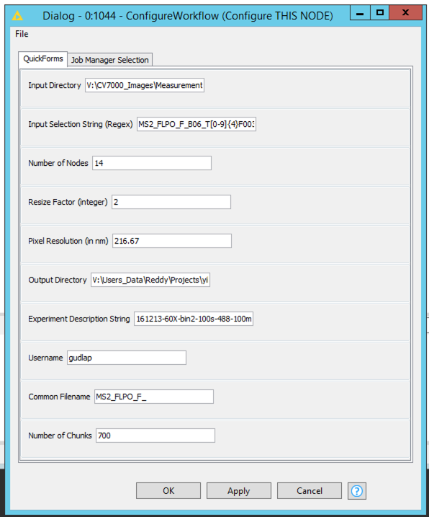
1. NUCLEAR SEGMENTATION TRAINING FROM CV7000 FILES
KNIME WORKFLOW:
knime://knime-server/HiTIF/(User)/GeneTrap/HiTIF_RNAActivationTracking_Segmentation_Training_1Channel_Ch01
Choose the timeseries of a specific well and field of view for training.
For example, the input selection string for choosing well B06 field F001 would be:
‘Plate1_B06_T[0-9]{4}F001L[0-9]{2}A[0-9]{2}Z[0-9]{2}C01.tif’
Pixel Resolution during image acquisition

Slide 3
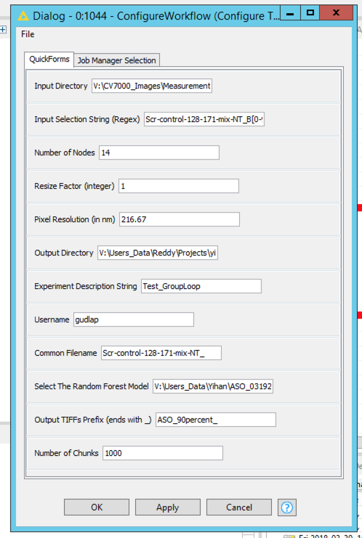
2. NUCLEAR SEGMENTATION FROM CV7000 FILES
KNIME WORKFLOW:
knime://knime-server/HiTIF/(User)/GeneTrap/HiTIF_RNAActivationTracking_CV7000_Segmentation_1Channel_Ch01
RF learner file

Slide 4
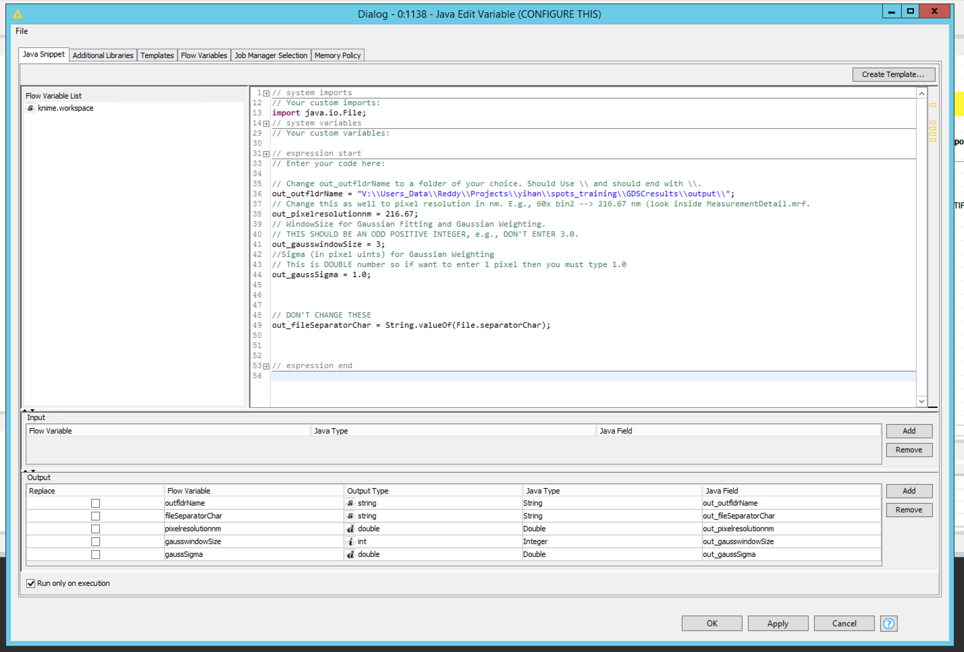
2. SPOT SEGMENTATION TRAINING FROM CV7000 FILES
KNIME WORKFLOW:
knime://knime-server/HiTIF/(User)/GeneTrap/HiTIF_RNAActivation_GenerateRNASpotTraining

Slide 5
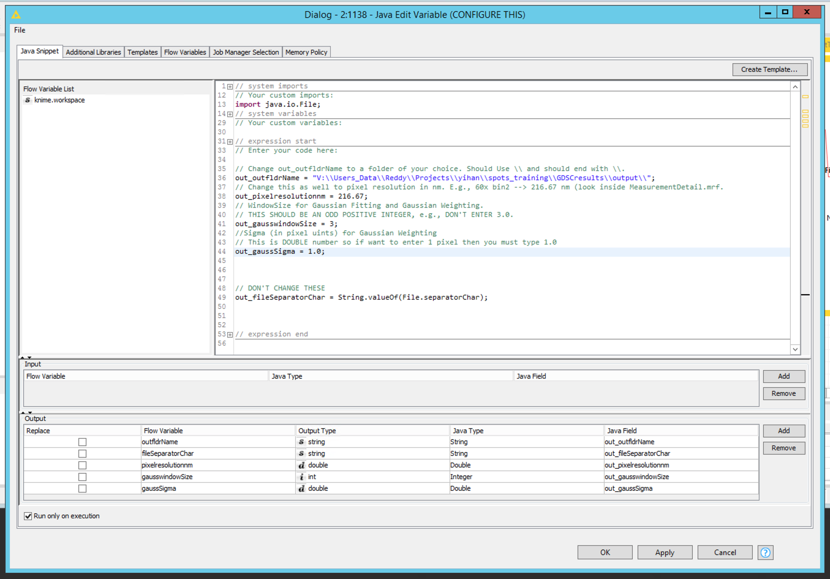
2. MERGE SPOT SEGMENTATION TRAINING FILES
KNIME WORKFLOW:
knime://knime-server/HiTIF/(User)/GeneTrap/HiTIF_RNAActivation_Merge_SpotTrainings
Perform spot training for ~50 time series (t=512 frames) and merge the spot segmentation training files

Slide 6
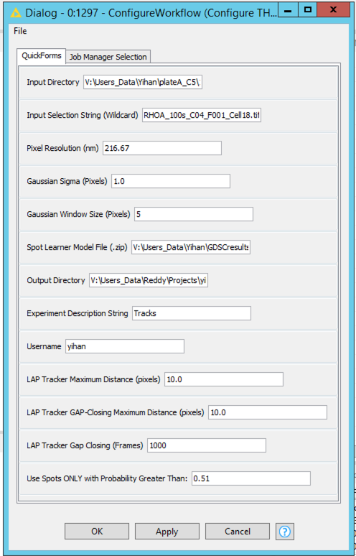
3. SPOT TRACKING WITH RF LEARNING
KNIME WORKFLOW:
knime://knime-server/HiTIF/(User)/GeneTrap/Updates/HiTIF_ImageJ_Python_RNASiteIntensity_Loop
RF learner file
Max distance a spot is expected to travel when visible.
Max distance a spot is expected to travel when it reappears after disappearing.
Set the value to be greater than the timeseries length.
Change the stringency of what is considered a spot.

Slide 7
4. FILTERING GOOD SPOT TRACKS FOR HMM ANALYSIS
KNIME WORKFLOW:
knime://knime-server/HiTIF /(User)/GeneTrap/HiTIF_Interact_withTracks
Categorize tracks as ‘Good’ or ‘Bad’ (or any name of choice) similar to the nuclear segmentation training.
Note this is NOT actually training, as the final tracks were already generated in the previous spot segmentation workflow. This output puts a copy of the ‘RNASpots’ track files in subfolders according to the category labels designated in this workflow. This helps extract the subset of good tracks to be used for HMM analysis.
Also note: Letter case matters… ‘Good’ and ‘good’ will be treated as two different categories.
5. HMM ANALYSIS
KNIME WORKFLOW:
knime://knime-server/HiTIF /(User)/ KNIME35X/HiTIF_RNAActivationTracking_Localize_HMM

Slide 8
KNIME workflows for nuclear segmentation , spot tracking and analysis
-- Deep learning version

Slide 9
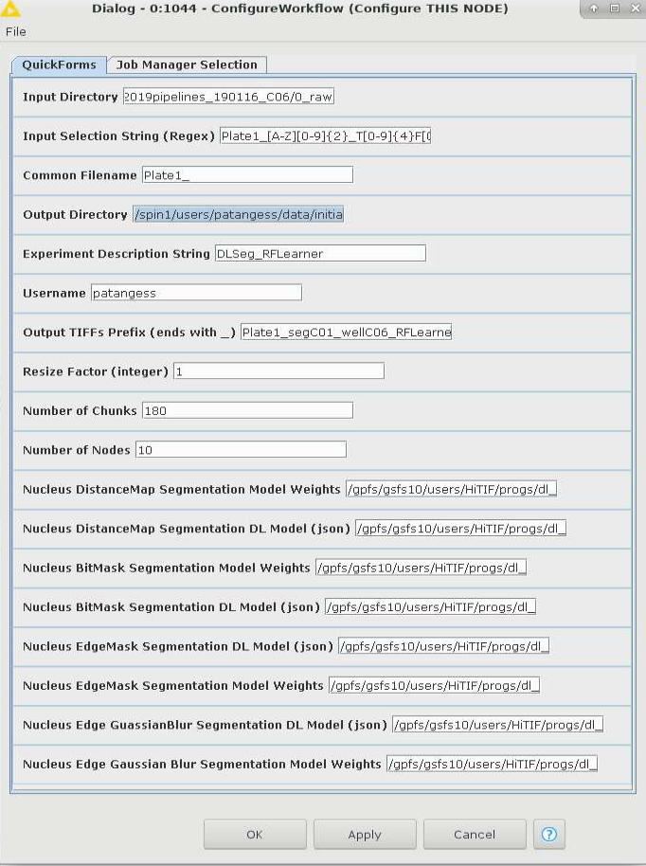
1. NUCLEAR SEGMENTATION TRAINING FROM CV7000 FILES
KNIME WORKFLOW:
//knime-server/HiTIF/(User)/KNIME35X/DeepLearning/HiTIF_CV7000_Segmentation_Tracking_1Channel_Ch01_FullPlate_Offset_DeepLearning_FilteringRFLearner
Takes series of single images in CV7000 format. Time series will be concatenated in KNIME.
Choose the timeseries of a specific well and field of view for training.
For example, the input selection string for choosing well B06 field F001 would be:
‘Plate1_B06_T[0-9]{4}F001L[0-9]{2}A[0-9]{2}Z[0-9]{2}C01.tif’

Slide 10
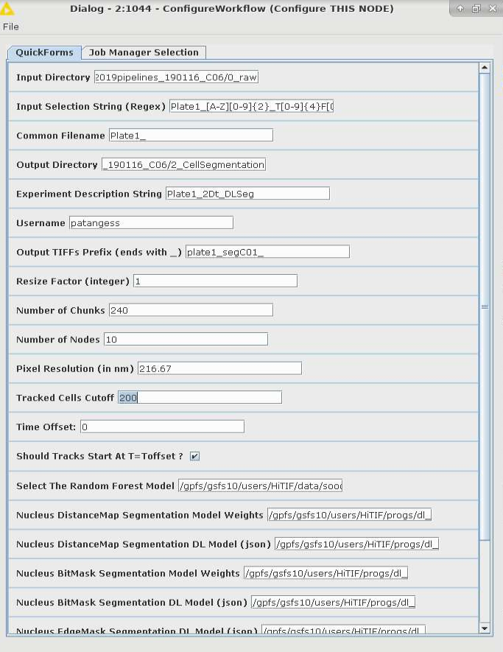
2. NUCLEAR SEGMENTATION FROM CV7000 FILES
KNIME WORKFLOW:
knime://knime-server/HiTIF /(User)/ KNIME35X/DeepLearning/HiTIF_CV7000_Segmentation_Tracking_1Channel_Ch01_FullPlate_Offset_DeepLearning
Indicate the minimum number of frames the tracks will contain (can increase yield by selecting less than the full length of the timeseries), and whether they should start after a particular time and/or be synchronized from a particular frame. Tracks generated will be at least half the indicated cutoff length.
Examples with a 400 frame timeseries…
Example 1: Cutoff= 400/Toffset = 0/Start at Toffset= Yes
Will only include tracks that are the 200 frames or greater starting at T=0.
Example 2: Cutoff= 200/Toffset = 0/Start at Toffset= Yes
Tracks will be a minimum of 100 frames, all starting at T=0.
Example 3: Cutoff= 200/ Toffset = 0/Start at Toffset= No
Tracks will be a minimum of 100 frames, starting anywhere in the timeseries.
Example 4: Cutoff= 200/ Toffset = 50/Start at Toffset= Yes
Tracks will be a minimum of 100 frames, all starting at frame 50.
Example 5: Cutoff= 200/Toffset = 50/Start at Toffset= No
Tracks will be a minimum of 100 frames, starting anywhere at or after frame 50.

Slide 11
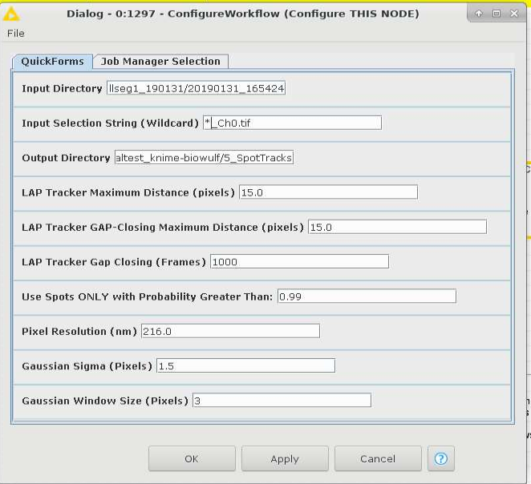
3. SPOT TRACKING WITH DEEP LEARNING
KNIME WORKFLOW:
knime://knime-server/HiTIF /(User)/ KNIME35X/DeepLearning/HiTIF_DLSpotSegmentation_ImageJStackReg_Python_RNASiteIntensity_Loop
Max distance a spot is expected to travel when visible.
Max distance a spot is expected to travel when it reappears after disappearing.
Set the value to be greater than the timeseries length.
Change the stringency of what is considered a spot.

Slide 12
4. FILTERING GOOD SPOT TRACKS FOR HMM ANALYSIS
KNIME WORKFLOW:
knime://knime-server/HiTIF /(User)/ KNIME35X/HiTIF_Interactive_TracksFiltering_Ghost_Bad_Tracks_forDL
Categorize tracks as ‘Good’ or ‘Bad’ (or any name of choice) similar to the nuclear segmentation training.
Note this is NOT actually training, as the final tracks were already generated in the previous spot segmentation workflow. This output puts a copy of the ‘RNASpots’ track files in subfolders according to the category labels designated in this workflow. This helps extract the subset of good tracks to be used for HMM analysis.
Also note: Letter case matters… ‘Good’ and ‘good’ will be treated as two different categories.
5. HMM ANALYSIS
KNIME WORKFLOW:
knime://knime-server/HiTIF /(User)/ KNIME35X/HiTIF_RNAActivationTracking_Localize_HMM

