Slide 1
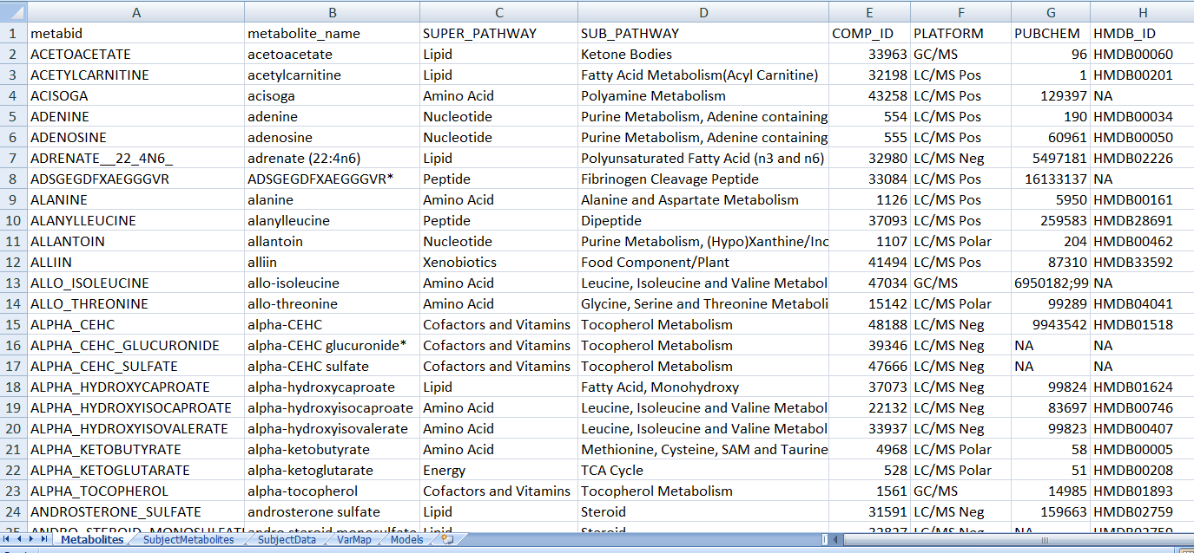
FEATURES:
a. Metabid is initially active where you may use the 3rd party login or your account.
b. Metabolite name click on this tab to register for an account.
c. helpful columns columns C-H are an example of additional metabolite information. If possible, cohorts should include as much metabolite information as possible to help in harmonization especially mass charge, retention time, and HMDB ID.
a
b
c
Users are required to “LOG IN” using an existing Facebook or Google account, or can sign up for a login using the “SIGN UP” button. Your gmail account through your university may be used for authentication.

