Slide 1
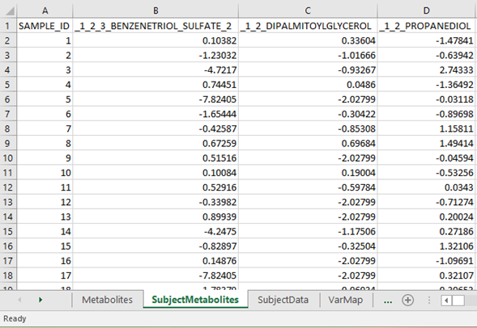
Create input file: subject metabolites
The “SubjectMetabolites” sheet contains the measured metabolite values for the cohort samples.
b
c
a. SubjectMetabolites This sheet in the input file contains the measured metabolite values for each sample.
b. SAMPLE_ID Column A contains the study sample IDs.
c. Column names are contained in row 1 and (except the column named sample_ID) must match the row names under the column “metabid” in sheet “Metabolite”.
d. Row names are required to match the row names in the sheet “SubjectData”.
e. Metabolite values cells contain measured metabolite values. For analyses based on correlations (most early analyses, we anticipate), no rescaling of data or transformations are needed, as Spearman correlations are based on rank.
d
e
a

