Slide 1
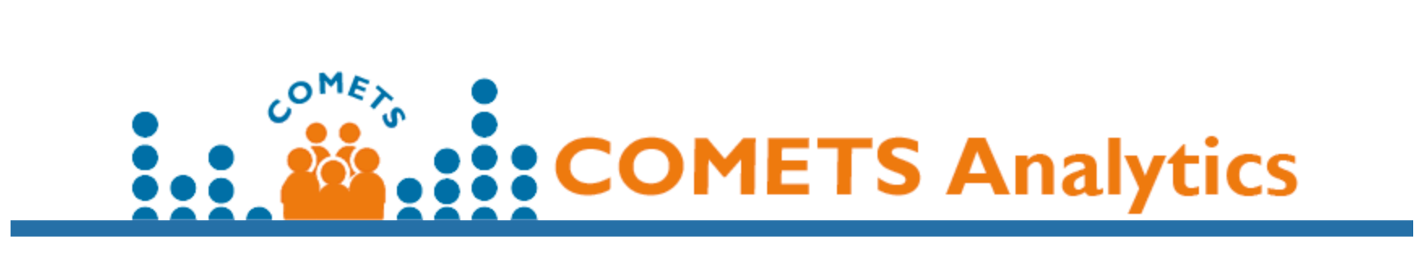
COMETS Analytics 2.0 New Developments 03/04/2022 Ewy Mathé, NCATS/NIH
Reproducibility, usability, input/output consistency

Slide 2
Overview of Using COMETS Analytics
Model_Type
Temprosa, Moore C.S., et al. AJE 2021

Slide 3
COMETS Analytics Access
R Package
Web Interface
Code and Documentation
https://github.com/CBIIT/R-cometsAnalytics/tree/master/RPackageSource
Requires minimal knowledge of R/Rstudio to run. Detailed documentation on how to prepare the input and how to run through an analysis are provided.
comets-analytics.org/
User-friendly, requires no coding
Operates on secure cloud-based servers that delete data after analyses
R package
Code: https://github.com/CBIIT/R-cometsAnalytics/tree/master/RPackageSource
Vignette (for R) : https://cbiit.github.io/R-cometsAnalytics/cometsvignette_v2.0.html
Tutorial: https://cbiit.github.io/R-cometsAnalytics/Tutorial/docs/ (needs updating)

Slide 4
COMETS Analytics – current status
R Package
Web interface
Version 2.0 is stable and supports:
Unadjusted and partial correlation analyses
Generalized linear models
Advanced user-controlled options for model definitions
Outputs are written in Excel
Version 2.1: survival analysis, conditional regression, and pathway analysis (RaMP-DB)
Version 3.0: meta-analysis
Development version (ready for release): Version2.0
Current release is version 1.7 (which included some bug fixes but on the first release, which reflects the first publication)
By design, using the R package and the user interface will produce the same results!
(The GUI uses the R package exclusively)

Slide 5
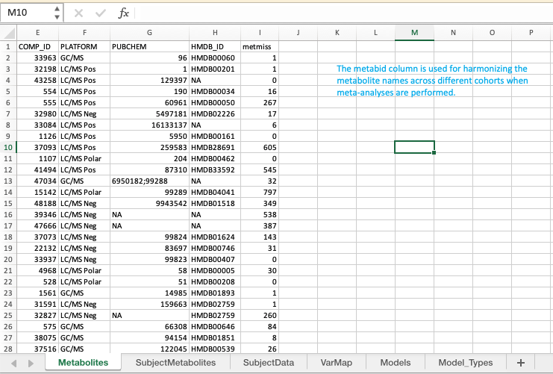
Basics of Input File
Metabolites: annotations
SubjectMetabolites: abundances
SubjectData: covariables
VarMap: renaming of variables
Models: tells software what models you wish to run
Model_Type: provides flexibility for model checks and model parameters

Slide 6
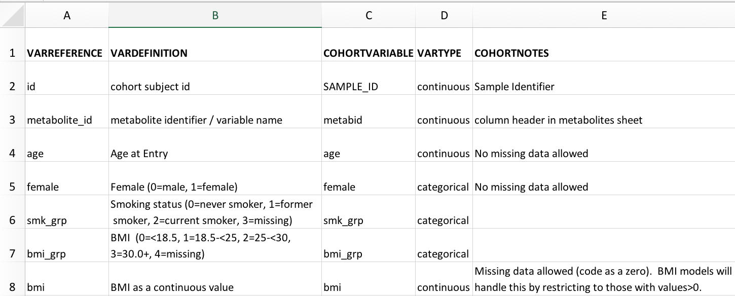
Standardized Input – Lead Analyst Defines Variable names and definitions (VarMap)
Variable Names To be Used Across Cohorts (predefined by organizer(s) of meta-analysis)
Detailed Description of how to code variables (predefined)
User variable name (must match Subject Data sheet) and type
Additional Notes
Notes:
Standardize how you would code – change variable map
Main analyst would set this

Slide 7
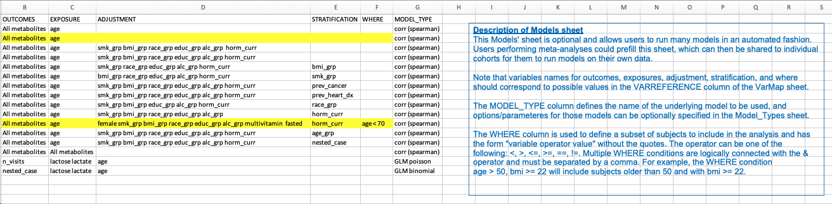
Standardized Input – Lead Analyst Defines Models
All variables must be predefined in the other sheets
All models can be run in one command

Slide 8
Standardized Input – Lead Analyst Defines Models
New ”MODEL_TYPE” column: can create a specific name for the model, allowing users to change parameters for that model specifically
The name in “MODEL_TYPE” column for a model in this sheet then matches the name of “MODEL_TYPE” for rows in the ModelOptions Sheet.

Slide 9
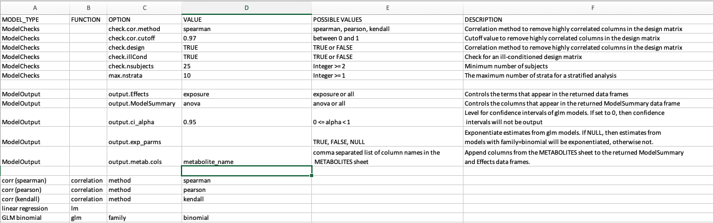
Standardized Input – Lead Analyst Defines Parameters for Each Model Through MODEL_TYPE
New ”MODEL_TYPE” column: can create a specific name for the model, allowing users to change parameters for that model specifically

Slide 10
Model_Types Sheet – ModelChecks and ModelOutput
Rows for ModelChecks and ModelOutput are applied to ALL models
Default options used by the software are provided in the input file
Options can be overridden for a specific model
Note: the term “ModelChecks” and “ModelOutput” are reserved words and should not appear in the MODEL_TYPE column of the Models sheet.

Slide 11
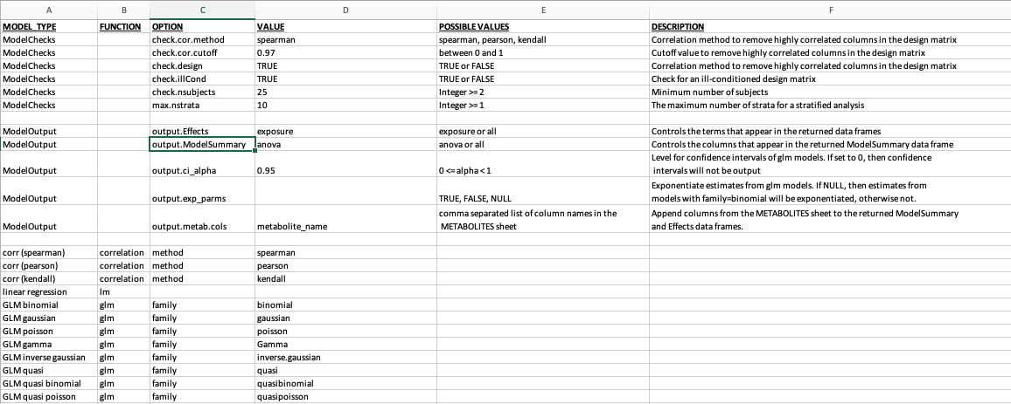
Standardized Input – Lead Analyst Defines Parameters for Each Model Through MODEL_TYPE
MODEL_TYPE
MODELS
Each MODEL_TYPE defines parameters for individual models (named in Models Sheet)
MODELSPEC, FUNCTION, OPTION, and VALUE are required
Possible to override ModelCheckOptions
Possible values for FUNCTION: correlation, lm, glm

Slide 12
Simplified process for running models
Load Data - readCOMETSinput()
Define model – getModelData()
Interactively by specifying exposures and other criteria
By referring to a model pre-defined in the input Excel sheet
Run model – runModel()

Slide 13
Ackowledgements
COMETS Data Infrastructure Group
Steven Moore
Ella Temprosa
Bing Yu
Krista Zanetti
CBIIT web development Team
Kailing Chen
Brian Park
IMS
Dave Ruggieri
Bill Wheeler
Joe Zhu
Funding
EGRP/NCI
Thank you to our Beta Testers~
Contact us at comets.analytics@gmail.com
Users! Thank you for your feedback!

Slide 14
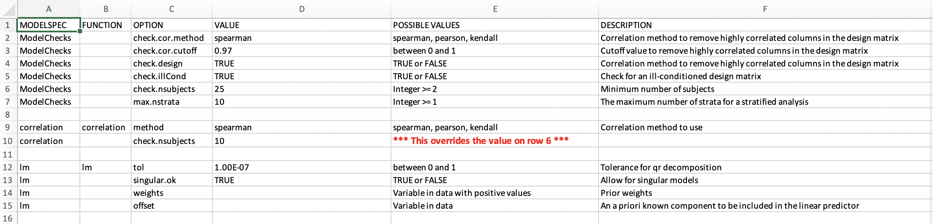
ModelOptions: Other MODELSPEC models
FUNCTION column: Possible values are correlation, glm, and lm.
All columns in this sheet except FUNCTION are case sensitive.
MODELSPEC, FUNCTION, OPTION, and VALUE are required
Possible to override ModelCheckOptions

