Slide 1
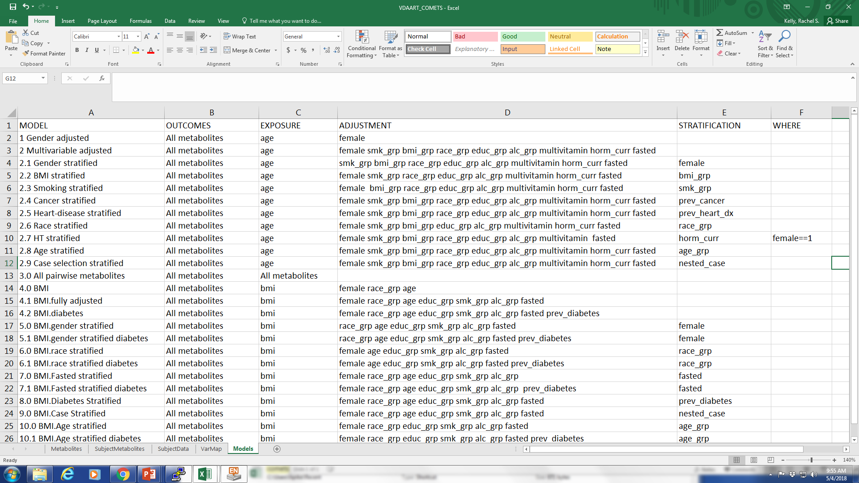
Create input file: Model specification
a. Models is a sheet in the input file that contains the models to be run on the cohort data
b. MODEL contains the model number and the model name. The results files will be named according to the chosen model name
c. OUTCOME specifies which variable(s) will be the dependent variable(s)
d. EXPOSURE specifies the independent variable of interest. The beta coefficient for this variable will be returned in the results
e. ADJUSTMENT specifies the potential confounders to be included in the model (optional)
f. STRATIFICATION for stratified analyses only. Results will be returned for all strata within this variable (optional)
g. WHERE If the analysis is meant to be run on only a subset of the cohort, this column will contain the subset definition (e.g., “female==1” for an analysis stratified by hormone therapy use). (optional)
e.g, Model “2.1” is named “Gender stratified” and the analysis will be run with “age” as the exposure and “All metabolites” as the outcomes while adjusting for smoking status (“smk_grp”), BMI (“bmi_grp”), race (“race_grp”), education (“educ_grp”), alcohol consumption (“alc_grp”), multivitamin use (“multivitamin”), hormonal status (“horm_curr”) and fasting status (“fasted”). This analysis will be stratified by gender using the internal COMETS variable “female”.
Specify the Analytical Models you wish to Run
b
c
d
e
f
g
a

