Slide 1
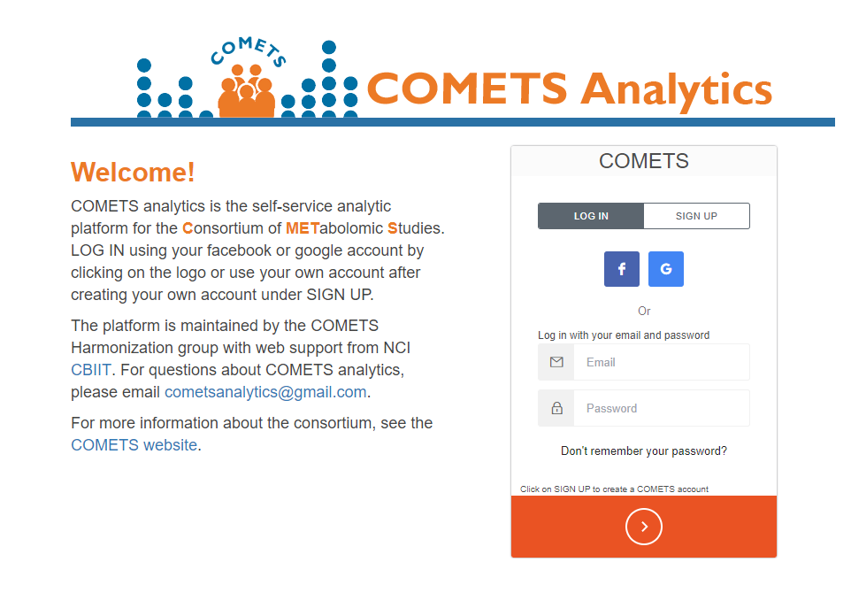
a
b
FEATURES:
A. Log In is initially active where you may use the 3rd party login or your account.
B. Sign Up click on this tab to register for an account.
C. 3rd party log in click on the facebook or google icons to login using your credentials from your account.
D. Forget password to reset your password. You are required to provide the email associated with your account..
E. Proceed to the web app by clicking on the orange button.
c
d
e
Users are required to “LOG IN” using an existing Facebook or Google account, or can sign up for a login using the “SIGN UP” button. Your gmail account through your university may be used for authentication.

