Slide 1
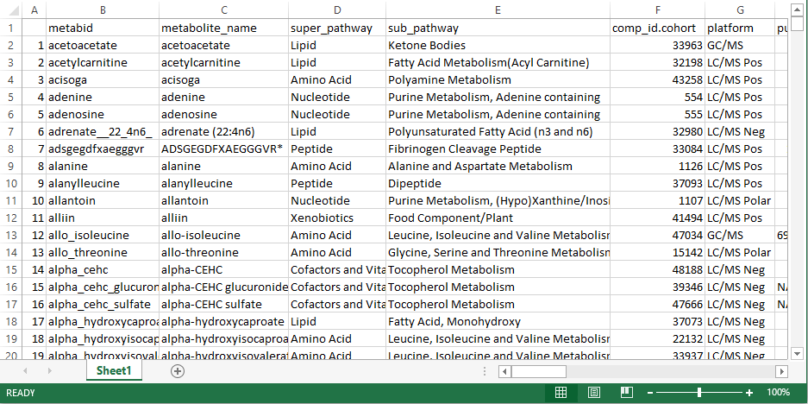
Metabolite Harmonization FILE
The names of metabolites inputted into the software are automatically harmonized to a common name. This important features facilitates comparison of metabolites across different studies that use different platforms and/or naming conventions.
A. metabid (column B) corresponds to metabolite IDs as defined by each individual cohort. The metabolite IDs correspond to the column metabid from the Sheet “Metabolites” of the input file.
B. metabolite_names (column C) corresponds to metabolite names as defined by each individual cohort. The metabolite names correspond to the column metabolite_name from the Sheet “Metabolites” of the input file.
C. Columns (except A and B) correspond to metabolite meta-information that was either already present in the input file or was matched from the internal COMETS database. We highly recommend to add at least on public database identifier (e.g. HMDB ID).
D. Rows correspond to metabolites, with each row containing all available meta-information for one metabolite.
a
b
c
d

