Slide 1
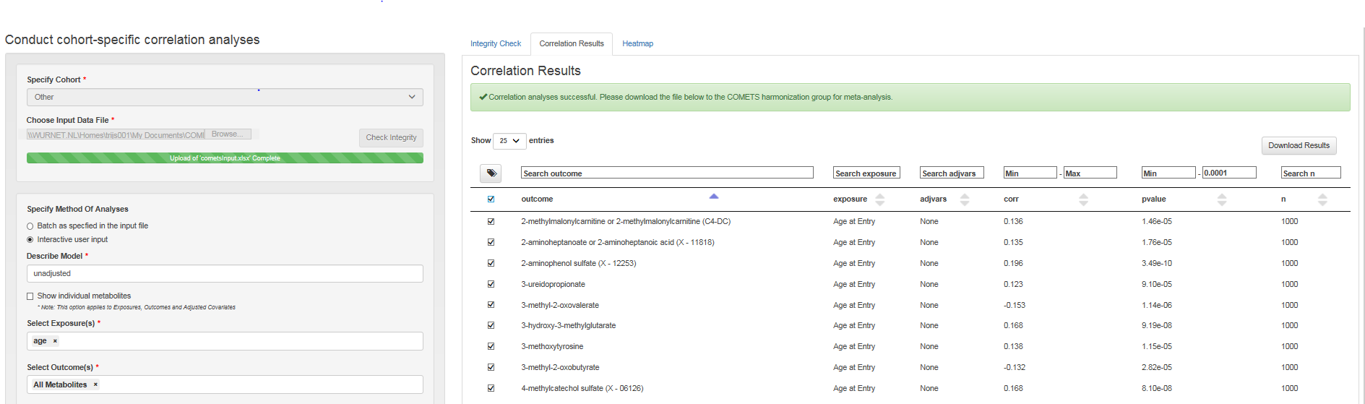
‘TAG’ option in the correlate and heatmap tab
To select and create a subset of metabolites for further analysis based on the correlation results the ‘TAG’ function can be used.
Below an example with age (exposure) and metabolites (outcome) as run in the ‘interactive user input’ correlate tab (see for using the correlate tab slides....).
b
c
a
A. Set level of significance: in this example the level of significance is defined as p<0.00001
B. Select significant metabolites: by ticking the box all significant metabolites are selected
C. TAG metabolites: by ticking the ‘TAG’ box all selected metabolites are automatically marked
.

Slide 2
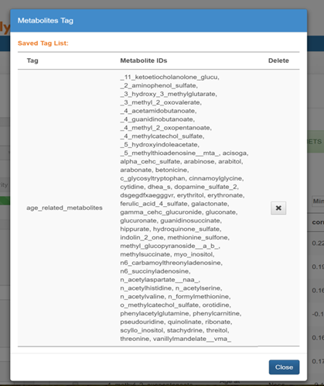
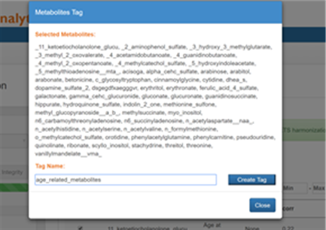
Create subset of ‘Tagged’ metabolites
Once the ‘TAG’ button is clicked a screen will appear
A. Name your ‘TAG’ give the subset of metabolites a name (e.g. “Age_related_metabolites”).
B. Create ‘TAG’ click the button ‘create Tag’ to create the tag.
C. ‘TAG’ is created A new box appears with an overview of your tagged metabolites. Close the newly created ‘TAG’.
.
a
b
c

Slide 3
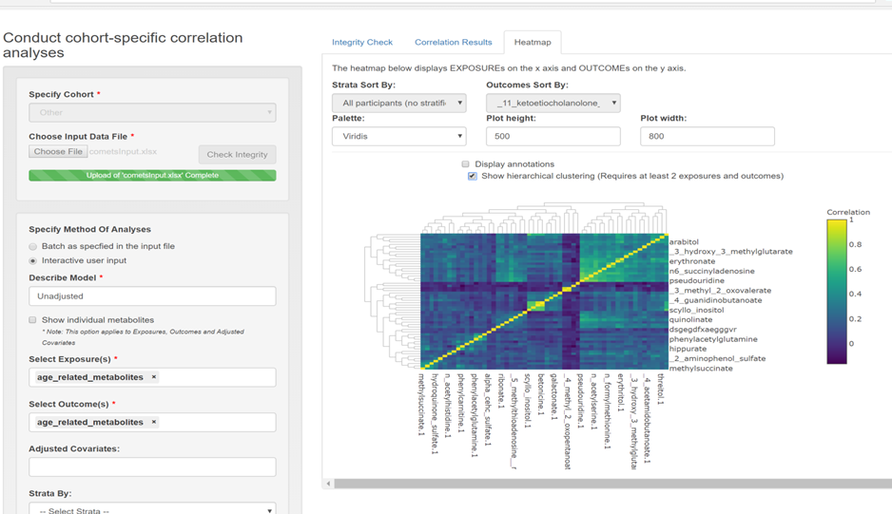
Create A heatmap
Go back to the ‘Interactive user input’ and select your newly created subset, using the ‘TAG’ function
d
A. Select your exposure select the newly created ‘Age_related_metabolites’ ‘TAG’
B. Select your outcome select the newly created ‘Age_related_metabolites’ ‘TAG’
C. Run the model click the run button
D. Heatmap select the heatmap tab to view the heatmap
.
a
b
c

Slide 4
The heatmap
Exposures are specified on the X axis and the outcomes on the Y axis. Different features are available in this interface:
b
a
A. Sort by outcome: The display of the heatmap can be sorted by outcome or exposure (in the ‘Outcomes Sort by’ box)
B. Sort by strata: When a stratified analysis is performed, the display of the heatmap can be sorted by the different strata (in the ‘Strata sort by’ box)
C. Choose your color: In the ‘Palette’ box different color schemes for the heatmap can be selected.
D. Adjust plot height and width: The ‘Plot height’ and “Plot width’ can be adjusted for in the respective boxes.
c
d
d

Slide 5
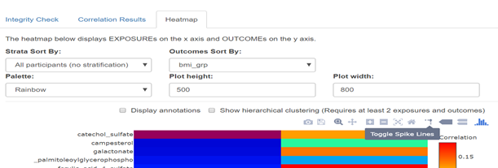
The Heatmap (2)
Additional features of the heatmap can be choosen
a
A. Additional toolbar: when moving the mouse in the top right corner of the graph an extra toolbar will be visible which allows you to:
Download plot as png
Save and edit plot in cloud
Zoom
Pan
Zoom in
Zoom out
Autoscale
Reset axes
Use Plotly features (Toggle Spike Lines, Show closest data on hover, Compare data on hover)

Slide 6
Annotations and hierarchical clustering
Annotations (display of the correlation coefficients in numbers) and hierarchical clustering(showing the metabolite clusters)­­ can be superimposed on the heatmap
a
b
c
A. Annotiations: ticking this box will allow you to display the correlation coefficients in the plot
B. Hierachical clustering: ticking this box will allow you to display the metabolite clusters on the left side of the heatmap
C. Choose your dimensions: by clicking e.g. 900*1100 dimensions the plot will show in the chosen dimensions

