Slide 1
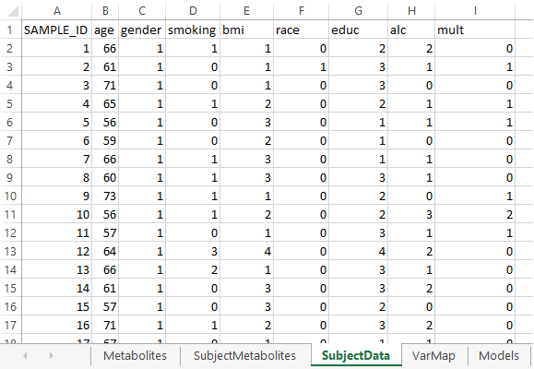
Create input file: subject DATA
The “SubjectData” sheet contains the subject-level covariate data for each sample.
b
c
A. SubjectData is a sheet in the input file that contains the subject-level covariate data for each sample. Examples include factors such as age, gender, smoking, body mass index, race and education.
B. SAMPLE_ID (column A) contains the sample identifiers.
C. Columns correspond to subject-level covariates, as used in the cohort of origin. Column names are in row 1 and (except the column named SAMPLE_ID) must match the entries in the column COHORTVARIABLE from the sheet “VarMap”.
D. Rows correspond to observations, with each row containing all of the subject-level covariate values for a given sample. Row names (i.e., SAMPLE_ID) are required to match the row names in the sheet “SubjectMetabolites”.
E. Cells (B2…Zn) contain subject-level covariate values.
d
e
a

