Slide 1
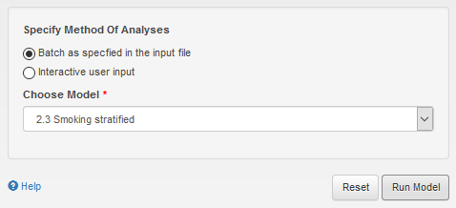
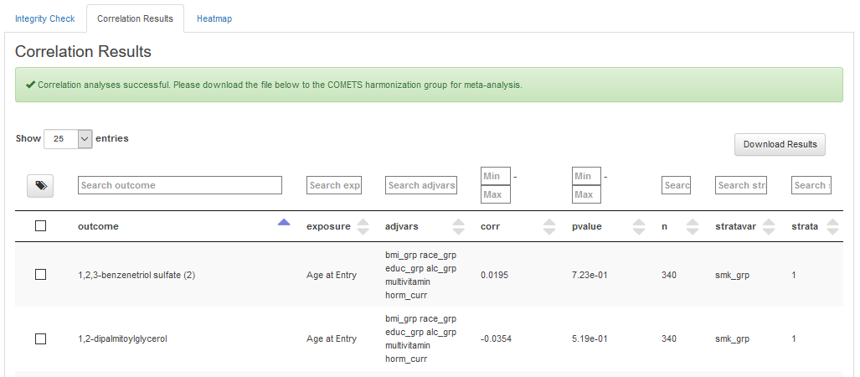
correlate: batch mode “SMOKING STATIFIED”
A. Batch as specified in the input file select this option to run the analysis in batch mode.
B. Choose Model select “Smoking stratified” from the dropdown menu.
C. Run Model once you hit this button the selected model will be run. The results will be shown in the Correlation Results tab.
D. Correlation Results tab displays the results of the correlation analysis.
E. „Correlation analysis succesfull“ message will be displayed if the analysis was performed without any errors. If this massage is not shown please go to (insert hyperlink)
Batch mode: “Smoking stratified”
a
b
c
d
f
F. Download results once you hit this button the results will be downloaded
G. Strata The results of the correlation analysis will be shown for each of the specified strata. In this case there are two strata, 1 = smoking and 0 = non-smoking. Once results for strata are meta-analyzed, heterogeneity across strata will be tested using the Wald Test for Homogeneity.
e
g

