Slide 1
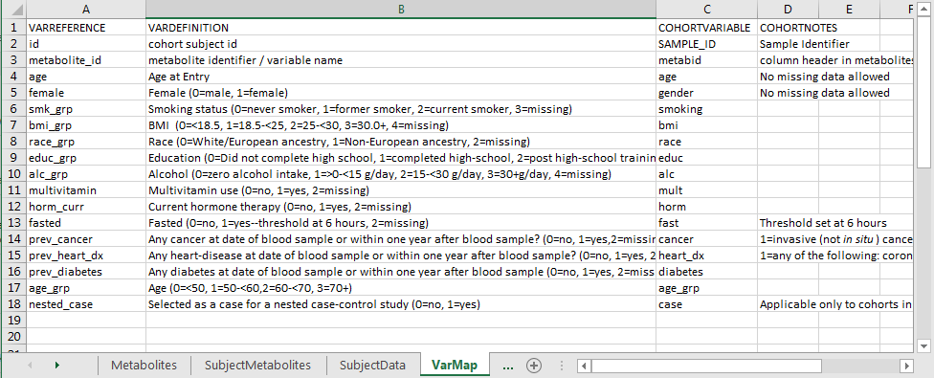
Create input file: Varmap
The VarMap sheet maps the cohort variable names to the COMETS internal variable names
b
c
A. VarMap is a sheet in the input file that maps the cohort variable names (“COHORTVARIABLE”) to the COMETS internal variable names (“VARREFERENCE”) and its definition (“VARDEFINITION”). Any additional notes can be entered into the “COHORTNOTES” column.
B. VARREFERENCE refers to the internal COMETS variable names
C. COHORTVARIABLE correspond to the original cohort variable name.
D. Missing data for some variables (e.g. “age”, “female”), missing values are not allowed.
E. Example The cohort variable “bmi” would be mapped to the COMETS internal variable “bmi_grp” and must be coded as “0” for BMI<18.5, “1” for BMI 18.5 to <25, “2” for BMI 25 to <30, “3” for BMI 30.0+, and “4” for if missing as defined in the column “VARDEFINITION”
.
d
e
a

