Slide 1
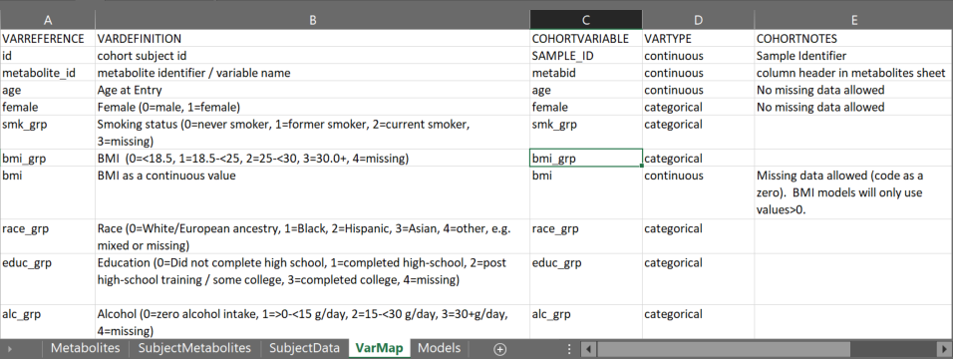
Create input file: Varmap
The VarMap sheet maps the cohort variable names to the COMETS internal variable names
b
A. VarMap is a sheet that maps the cohort variable names (“COHORTVARIABLE”) to the COMETS internal variable names (“VARREFERENCE”), its definition (“VARDEFINITION”) and type (“VARTYPE”). Notes are included under “COHORTNOTES”.
B. VARREFERENCE refers to the internal COMETS variable names
C. COHORTVARIABLE correspond to the original cohort variable name.
D. VARTYPE identifies the form of the variable, possible values are continuous or categorical.
E. Missing data some variables (e.g. “age”, “female”), missing values are not allowed.
F. Example BMI is used for analyses as continuous “bmi” and categorical “bmi_grp” with expected coding of “0” for BMI<18.5, “1” for 18.5 to <25, “2” for 25 to <30, “3” for 30.0+, and “4” for if missing as defined in the column “VARDEFINITION”
.
c
d
a
f

