Slide 1
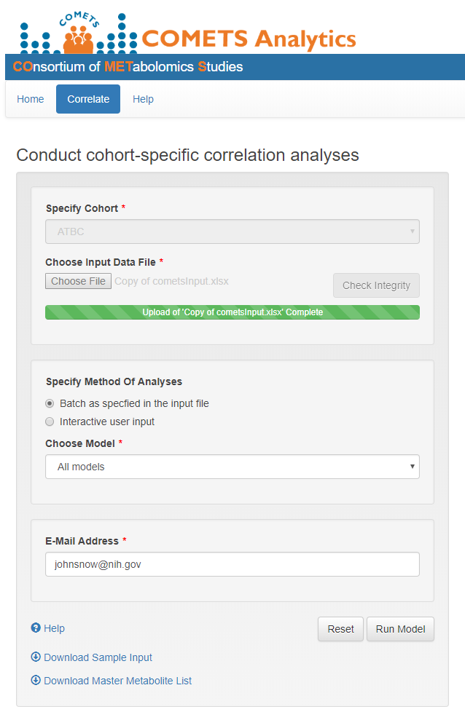
correlate: batch mode “All Models”
Batch mode: “All models” returns all models (1 to 2.9) specified in the “Choose Model” dropdown menu and returns the results to a specified email address as a zip link
a. Correlate from this tab you can run correlation analyses.
b. Batch as specified in the input file select this option to run “All models”.
c. Choose Model select “All models” from the dropdown menu.
d. E-Mail Address enter your email address here to have results returned to you as a zip link.
e. Run Model once you hit this button, you will receive the following pop-up message: “Your job will be sent to the queuing system for processing. Results will be sent to you via email when all model runs are completed.”
The run time should be relatively quick for the sample file (~7 minutes) but can be longer for larger files or during busy periods. Once the job is complete, you will receive an email with a zip link that can then be forwarded centrally, without having to download and send large files by e-mail.
a
b
c
d
e

Slide 2
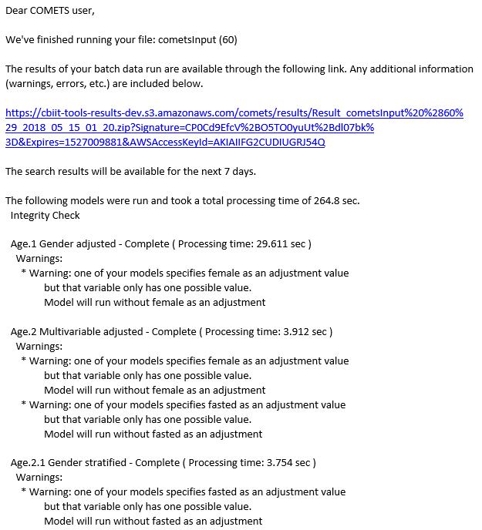
correlate: email return “all models”
Batch mode: “All models” returns an email with the following Subject: Comets Batch Mode Model Results - Result_cometsInput (##)_YYYY_MM_DD_01_20.zip
a. Link to zip file This link allows you to download your results.
b. Time limit Your results can be accessed for via this link for 7 days.
c. Titles Each model will be labeled and list the run status (e.g., Complete), and processing time.
d. Warnings These messages will inform you if variables were dropped from models or if there were too few observations (i.e. <15) to run analysis in a given stratum.
a
b
c
d

Slide 3
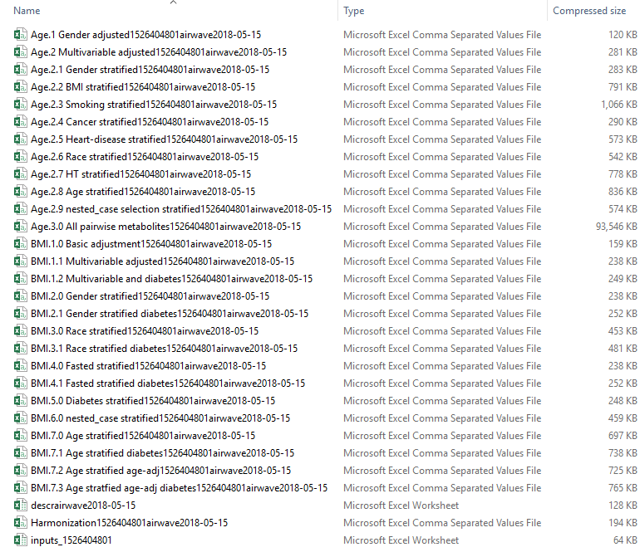
correlate: zip file “all models”
Batch mode: “All models” email contains a zip link with the following analysis files
a
b
a. Name each file is named according to the model results contained in it.
b. Type all results files are .csv files

