Slide 1
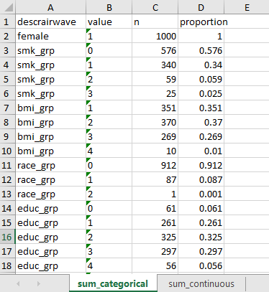
Output file: Descriptive statistics
The “descrairwaveYYYY-MM-DD.csv” workbook contains the descriptive statistics for all categorical and continuous variables included in the model
b
c
d
e
A. sum_categorical is a sheet in the output file that contains the descriptive statistics for the categorical variables.
B. descrairwave (column A) contains the variable name. For example, “smk_grp” is a cigarette smoking status variable with 4-levels.
C. value (column B) contains the value of the categorical variable in column A. For example, the values for “smk_group” are 0 (never), 1 (former), 2 (current), 3 (missing).
D. n (column C) corresponds to the number of observations for each value of the categorical variable in column A. For example, 576 participants in the example data set are never smokers.
E. proporiton ranges from 0 to 1 and corresponds to the proportion of observations in a given category. For example, the 0.576 (or 57.6%) is the proportion of never smokers in the example data set.
a

Slide 2
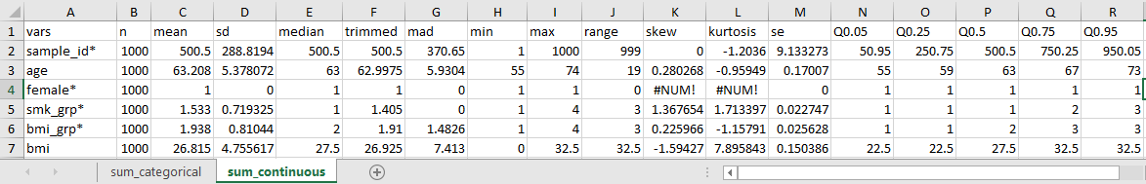
Output file: Descriptive statistics
The “descrairwaveYYYY-MM-DD.csv” workbook contains the descriptive statistics for all categorical and continuous variables included in the model
b
c
d
e
a
A. sum_continuous is a sheet in the output file that contains the descriptive statistics for the continuous variables. Note that the names of categorical variables appear in this sheet but are denoted with an “*”.
B. vars (column A) contains the variable name for both categorical and continuous* variables. For example, “age” is continuous age in years.
C. descriptive statistics (columns B:J) include descriptive statistics including the sample size (n), mean, standard deviation (sd), median, rounded median (trimmed), XXXX (mad), minimum observed value (min), maximum observed value (max), and range between the minimum and maximum observed values (range)
D. measures of distribution (columns K:L) include skewness (skew), a measure of symmetry, kurtosis, a measure of whether the data are heavy-tailed or light-tailed relative to a normal distribution, and standard error (se), a measure of how far the sample mean is from the true population mean.
E. Q0.05 to Q0.95 (columns N:R) represent the 5th, 25th, 75th, and 95th percentiles.

