Slide 1
L L I
Lab Load Interface

Slide 2
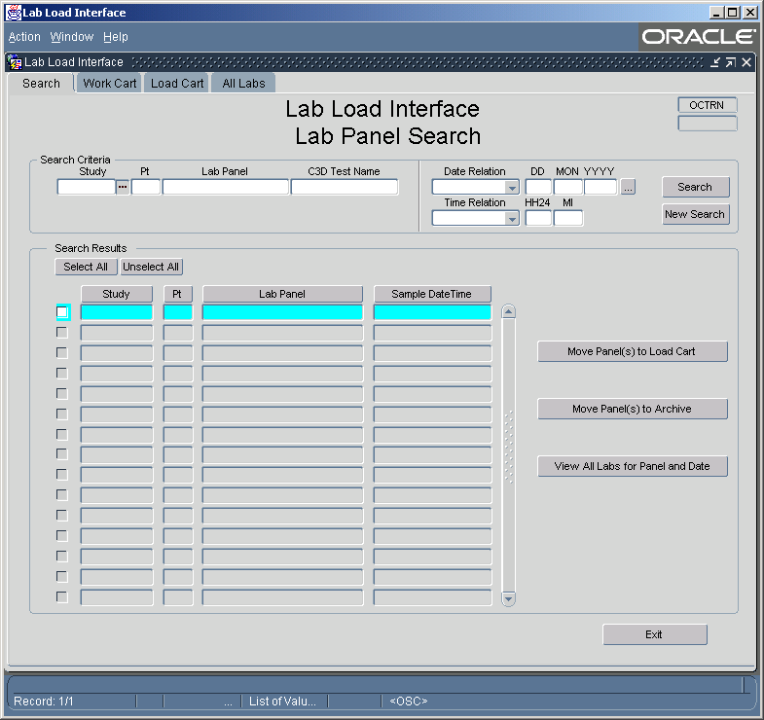
LLI Search Screen

Slide 3

LLI Search Screen
Searching
Searching
  Can search by Study, Patient Number, Lab Panel, OC Lab Question, Date and/or Time
    Each search field contains an LOV.
    Each LOV is self reducing, applying the previous fields values to it listing.
    Date and Time allows the ‘%’ wild card
    Date and Time provide the additional option of:
      “On or Before”, “On or After” and “LIKE” comparisons
      Partial dates can be entered as %NOV%

Slide 4
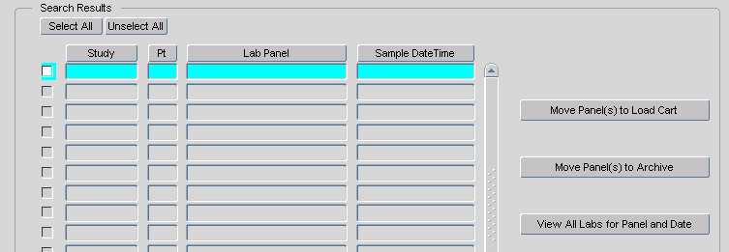
LLI Search Screen
Results
Search Results
  The result set lists those Lab Panels that have at least one lab test available for loading the meet the criteria entered into the search fields.
  The sort order can be changed using the column headings.
  Results can be selected/deselected for processing by using the individual select check box, or buy use of the select buttons.
  With one button, entire panels of lab tests can be moved to the Load Cart, or Marked for Archive.
  An entire panel of lab tests can be viewed using the “View All…” button or by double clicking the record you wish to view.

Slide 5
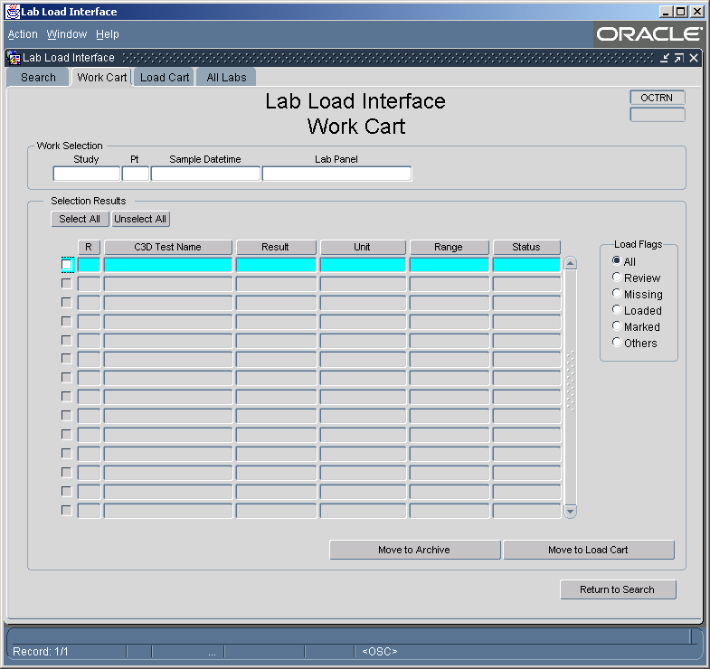
LLI Work Cart

Slide 6
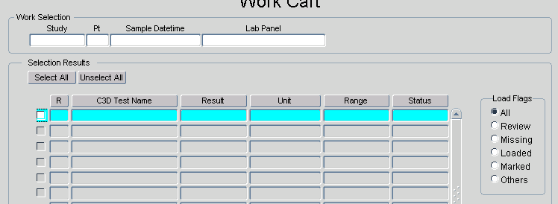
LLI Work Cart
Processing
Work Cart
  Sort by Question Repeat sequence.
  Show Entire Panel, included previous loaded and missing Lab Tests, identified by the field L Flag.
  The list can be filtered using the “Load Flag” radio buttons. Displaying only those records have the status requested.
  Results can be selected/deselected for processing by using the individual select check box, or buy use of the select buttons.
  Once selected, the lab tests can be moved to the Load Cart

Slide 7
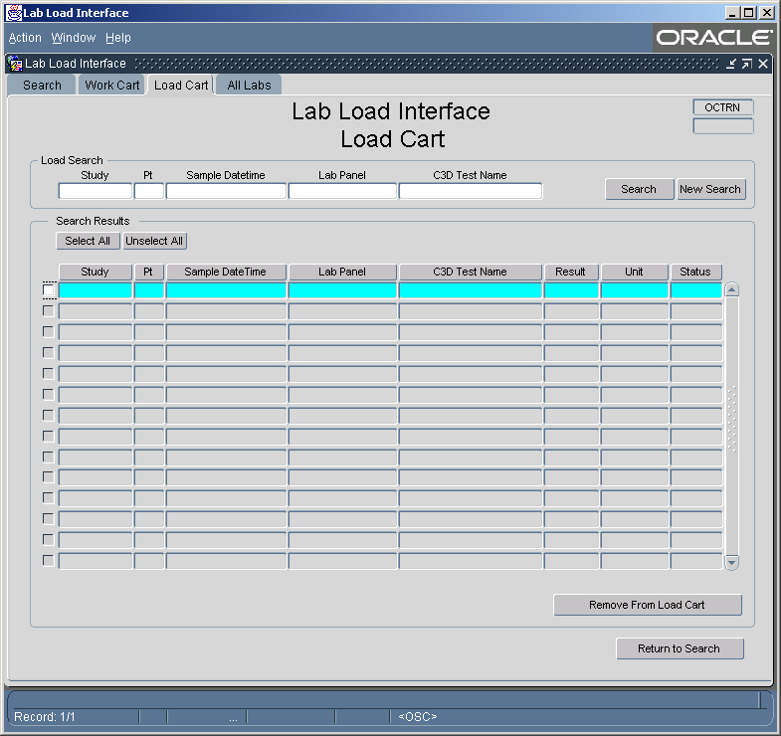
LLI Load Cart

Slide 8
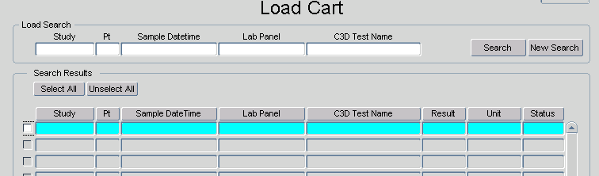
LLI Load Cart
Processing
Load Cart
  Sorted by Study, Patient and Sample Date
  Shows only those lab tests marked for loading
  The Load Cart can be search using the Search Area.
  LOVs for the fields of the Search Area work the same as those in the Primary Search screen except the results are limited to records marked for loading.
  Results can be selected/deselected for processing by using the individual select check box, or buy use of the select buttons.
  Once selected, the lab tests can be removed from the Load Cart.

Slide 9
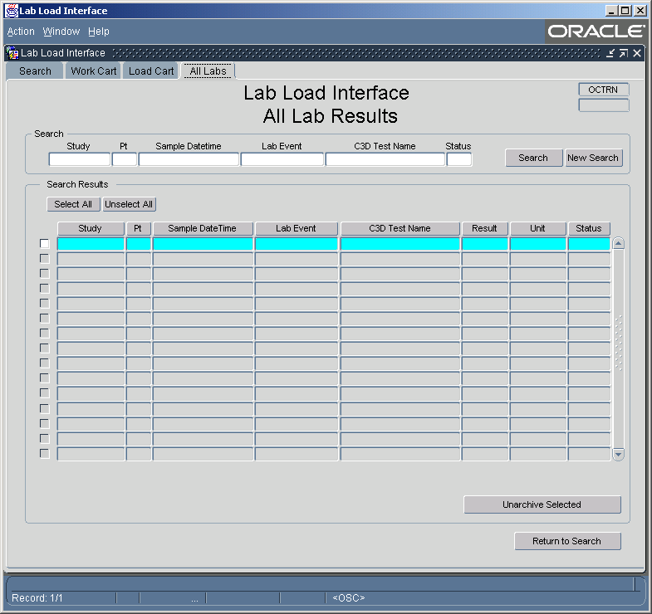
LLI All Labs

Slide 10
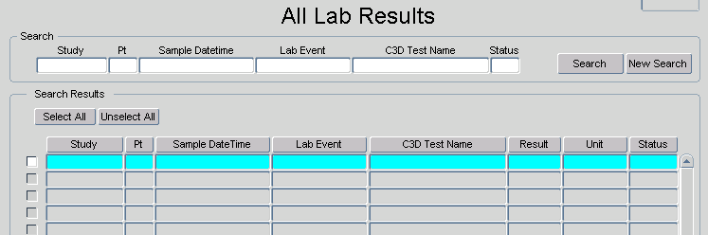
LLI All Labs
Processing
All Labs
  Sorted by Study, Patient and Sample Date
  Shows All Lab Records within the Lab Loader System.
  Searching is performed using the Search Area.
  LOVs for the fields of the Search Area work the same as those in the Primary Search screen except the results are not limited
  Results can be selected/deselected for processing by using the individual select check box, or buy use of the select buttons.
  Once selected, lab tests can be removed from Archive.

Slide 11
LLI
Additional Information
Security
  Oracle Clinical Study Security is maintained throughout LLI
    Only those studies that the user can access through OC are available to the user in LLI.
  There will be two roles with LLI Review and Read.
    Review access will allow lab tests to be marked for Loading or Archive.
    Read access will allow lab tests to be queried and viewed, but not marked. The Action buttons will not be available.

