Slide 1
C3D Lab Loader
Data Acquisition
Processing
Review
Loading

Slide 2
Lab Loader Background
Lab Loader Process
  PL/SQL Package
Batch Data Loader
  Oracle Clinical Product

Slide 3
Lab Loader Process
Acquires Lab Data
Prepare Data For Loading
Loads Data

Slide 4
Lab Loader Process
Acquiring Data
Currently, reads FTP transmitted files provided by CDW processes.
Incremental data provided 6 days a week
Cumulative data provided once a week
Data is read and prepare for further processing
Only new data is forwarded to the Lab Loader

Slide 5
Lab Loader Process
Prepare Data for Loading
Assigns lab tests to patients across all studies base on Patient Id and Dates
Maps inbound Lab Test to C3D Lab Question (data element of study)
Filters out duplicates/previously loaded
Identifies DCM, Event, Qualifying Value
Separates review data from load data

Slide 6
Lab Loader Process
Loads Data
Identifies subevent number
Separates new data from updates
Builds data into batches
Creates formatted BDL Data File
Calls BDL (Batch Data Loader)
Confirms Lab Test was loaded

Slide 7
Batch Data Loader
Oracle Clinical Tool
Loads Data from File
Files have Specific Formats
Lab Loader Format consists of
  Study, Investigator, Site, Patient, document number, Planned Event, Subevent, DCI Name, date and time, DCM Name, Subset, Question Group, Question Name, Occurrence, Repeat Sequence, Qualifying Value and Data Value

Slide 8
Lab Loader Interface
LLI
Used by end users to review and identify those lab tests that should loaded to study.
Displays data in a format familiar to end users
Groups data logically by panel and date

Slide 9
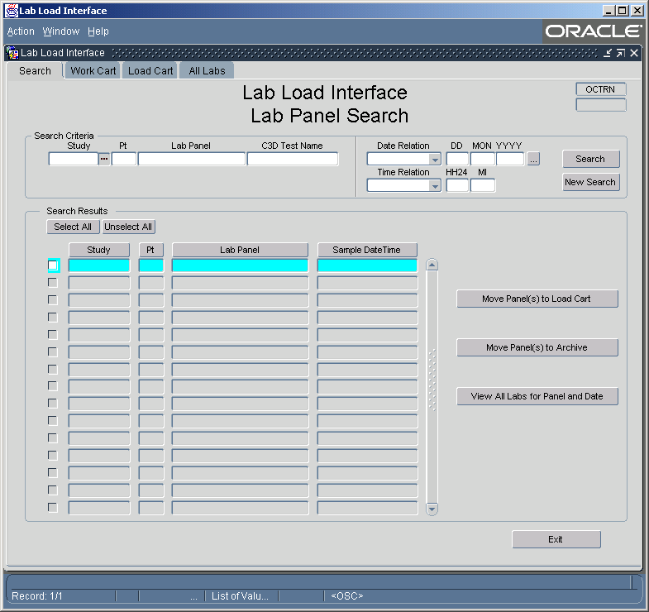
LLI Search Screen

Slide 10

LLI Search Screen
Searching
Searching
  Can search by Study, Patient Number, Lab Panel, OC Lab Question, Date and/or Time
    Each search field contains an LOV.
    Each LOV is self reducing, applying the previous fields values to it listing.
    Date and Time allows the ‘%’ wild card
    Date and Time provide the additional option of:
      “On or Before”, “On or After” and “LIKE” comparisons
      Partial dates can be entered as %NOV%

Slide 11
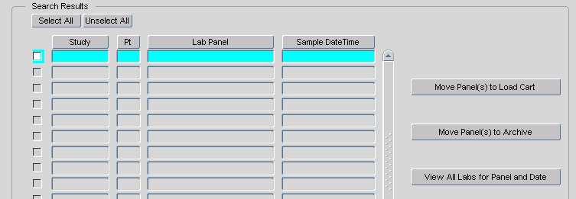
LLI Search Screen
Results
Search Results
  The result set lists those Lab Panels that have at least one lab test available for loading the meet the criteria entered into the search fields.
  The sort order can be changed using the column headings.
  Results can be selected/deselected for processing by using the individual select check box, or buy use of the select buttons.
  With one button, entire panels of lab tests can be moved to the Load Cart, or Marked for Archive.
  An entire panel of lab tests can be viewed using the “View All…” button or by double clicking the record you wish to view.

Slide 12
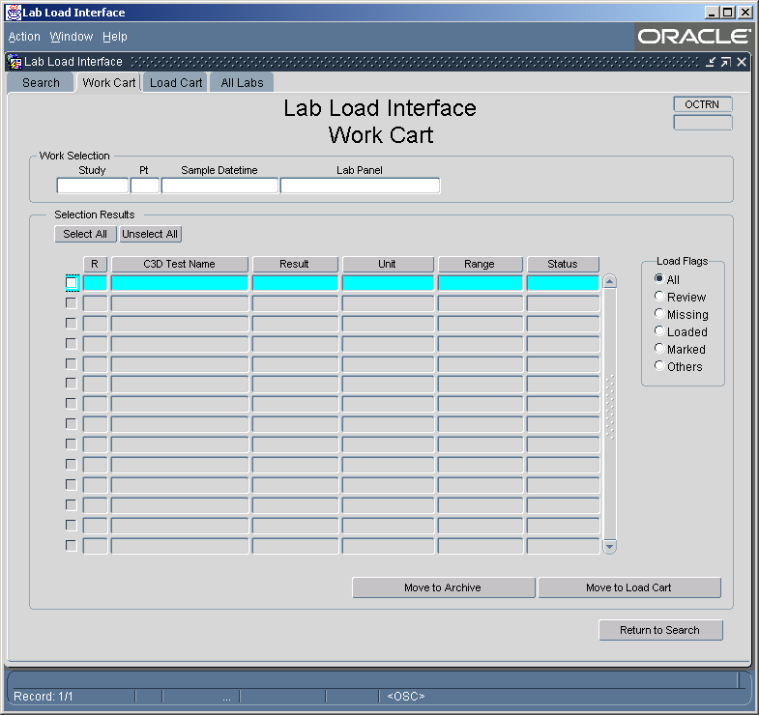
LLI Work Cart

Slide 13
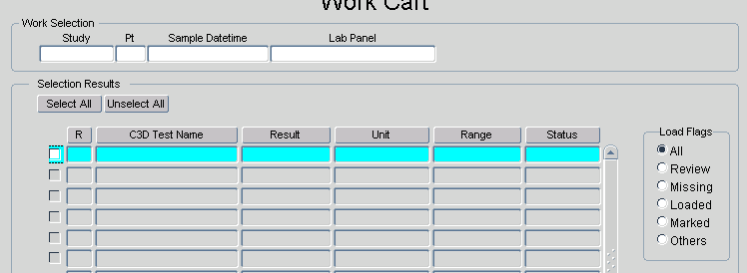
LLI Work Cart
Processing
Work Cart
  Sort by Question Repeat sequence.
  Show Entire Panel, included previous loaded and missing Lab Tests, identified by the field L Flag.
  The list can be filtered using the “Load Flag” radio buttons. Displaying only those records have the status requested.
  Results can be selected/deselected for processing by using the individual select check box, or buy use of the select buttons.
  Once selected, the lab tests can be moved to the Load Cart

Slide 14
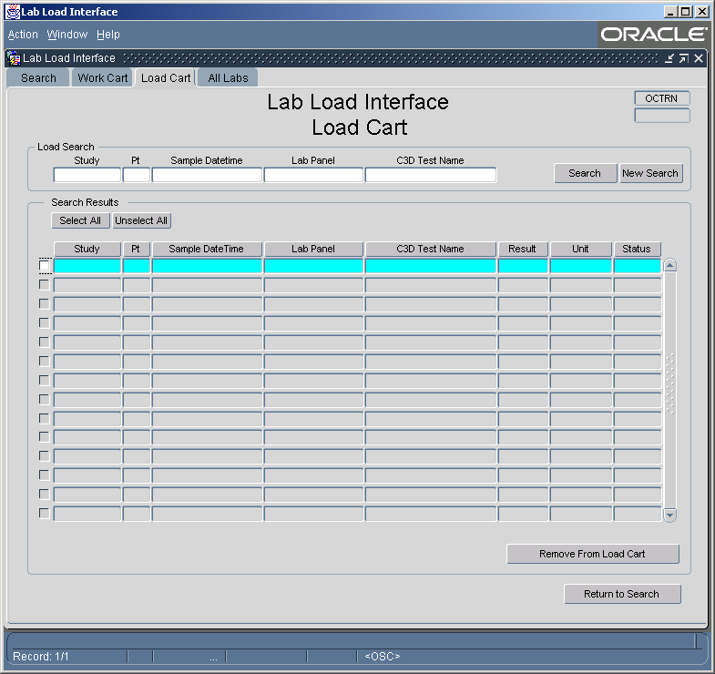
LLI Load Cart

Slide 15
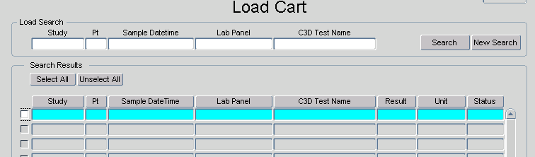
LLI Load Cart
Processing
Load Cart
  Sorted by Study, Patient and Sample Date
  Shows only those lab tests marked for loading
  The Load Cart can be search using the Search Area.
  LOVs for the fields of the Search Area work the same as those in the Primary Search screen except the results are limited to records marked for loading.
  Results can be selected/deselected for processing by using the individual select check box, or buy use of the select buttons.
  Once selected, the lab tests can be removed from the Load Cart.

Slide 16
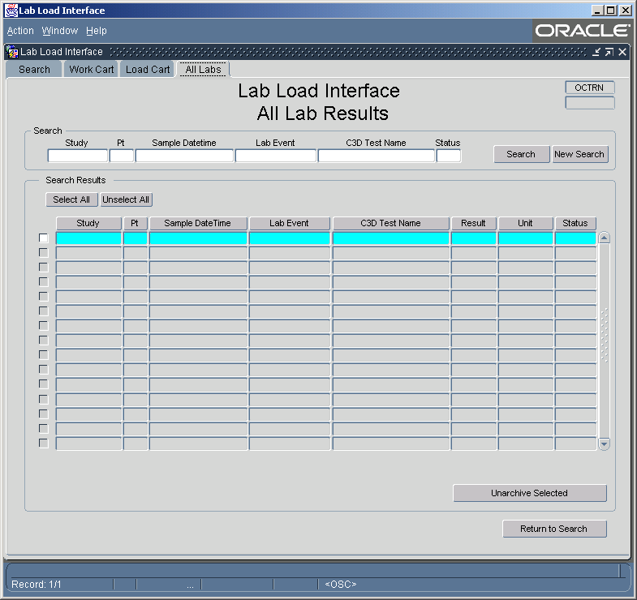
LLI All Labs

Slide 17
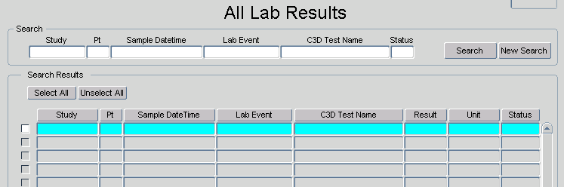
LLI All Labs
Processing
All Labs
  Sorted by Study, Patient and Sample Date
  Shows All Lab Records within the Lab Loader System.
  Searching is performed using the Search Area.
  LOVs for the fields of the Search Area work the same as those in the Primary Search screen except the results are not limited
  Results can be selected/deselected for processing by using the individual select check box, or buy use of the select buttons.
  Once selected, lab tests can be removed from Archive.

Slide 18
LLI
Additional Information
Security
  Oracle Clinical Study Security is maintained throughout LLI
    Only those studies that the user can access through OC are available to the user in LLI.
  There will be two roles with LLI Review and Read.
    Review access will allow lab tests to be marked for Loading or Archive.
    Read access will allow lab tests to be queried and viewed, but not marked. The Action buttons will not be available.

Slide 19
BTRIS Data Extractor
Acquires Lab Test Data from BTRIS
Identifies CRIS specific Lab Data via CRIS specific RED Codes
Query based upon:
  C3D Studies/Patients
  Creation or modified date
Has the following options:
  Writes to file or database
  Execution time is configurable
  Query date offset is configurable
  Feed straight to C3D Lab Loader is configurable

