Slide 1

Cross-Border Shopping:
Implications for Policy Evaluation
Dean R. Lillard
Cornell University and DIW Berlin
TUS-CPS Users’ Workshop
Phoenix, AZ
June 9, 2009
Department of Public Policy Analysis and Management

Slide 2
Outline
Cross-border shopping
  What is it?
  Where is it?
  Why care?
Conceptual framework
  Firm: an import/export approach
  Individual: cost/benefit of cross-border shopping
Practical considerations
  Ideal data
  Available data
  How to combine existing data to best advantage
    TUS-CPS
    Sales data
    Distance data
Evidence
Department of Public Policy Analysis and Management

Slide 3
Cross-Border Shopping
What is it?
Shopping across jurisdictional boundaries to get lower prices
Where does one find it?
Everywhere prices differ
Why care?
Proper evaluation of policy effects
Department of Public Policy Analysis and Management

Slide 4
Conceptual framework - Firm
Consider sales in a given state
Total Cigarette Sales_{st}=
  (1) Cigarettes would sell if no trade existed
  + (2) Cigarettes exported (out-of-state customers)
  (3) cigarettes imported (residents who bought elsewhere)
  if (2)≠(3) and analyst fails to account for them then estimation of policy effects on local consumption will be biased
Department of Public Policy Analysis and Management

Slide 5
Stated differently
If interested in total and partial policy effect
Must account for
  local smokers who buy in other jurisdictions
  out-of-state smokers who buy in local markets
  Inflow and outflow depends on factors that influence individual decisions
Department of Public Policy Analysis and Management

Slide 6
Conceptual framework - Individual
Decision about where to buy
  at home
  “abroad”
What factors influence decision?
  Travel cost (distance, gas prices)
  Time cost (wage rate, employment status)
  Potential savings (price/tax differentials)
  Durability of product (how quality deteriorates with time)
Potential savings
  increase with amount buy
  decreases if product quality deteriorates faster (wastage)
Department of Public Policy Analysis and Management

Slide 7
Hypotheses
If treat data as if generated on an “island” then estimated effect of tobacco control policies will be biased
upward the closer one is to lower-cost jurisdiction
downward the closer one is to higher-cost jurisdictions
Department of Public Policy Analysis and Management

Slide 8
Ideal Data
Would identify:
prices (in all markets)
each individual’s location (in all markets)
distance to each market
cost of travel to each market
market where buy
Department of Public Policy Analysis and Management

Slide 9
Available Data
TUS-CPS
State cigarette (stamp) sales
External data on
  population
  distances
  gasoline prices
Department of Public Policy Analysis and Management

Slide 10
TUS-CPS
Combine data from:
February 2003
June 2003
November 2003
May 2006
August 2006
January 2007
Department of Public Policy Analysis and Management

Slide 11
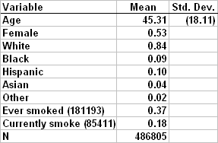
TUS-CPS
Department of Public Policy Analysis and Management

Slide 12
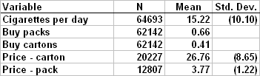
TUS-CPS
Department of Public Policy Analysis and Management

Slide 13
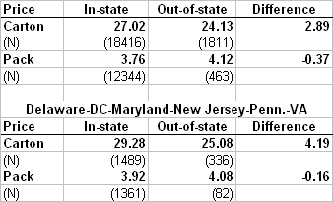
Price differentials
Department of Public Policy Analysis and Management

Slide 14
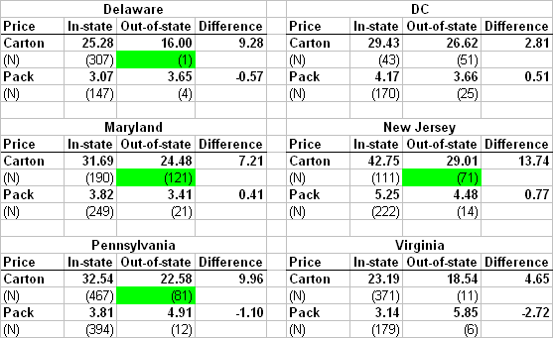
Price differentials – by state
Department of Public Policy Analysis and Management

Slide 15
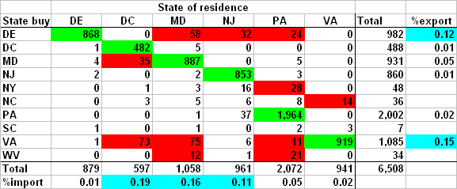
Origin and destination states
Department of Public Policy Analysis and Management

Slide 16
Monthly cigarette sales data
Next analyze data on cigarette packs sold each month from January 1983 to April 2009
Source: Delaware State Finance
Combine with
  Population (measure packs per capita)
  DE cigarette tax
  DE smoking ban
  Population weighted distance to VA/MD
Department of Public Policy Analysis and Management

Slide 17
External data used
For Neighboring state
  Population within 100 miles of DE border (divided by DE pop)
  Population weighted distance to DE
  Cigarette tax
  Gasoline price
  Gasoline price*distance
  Minimum wage (state and federal)
  Unemployment rate
Department of Public Policy Analysis and Management

Slide 18
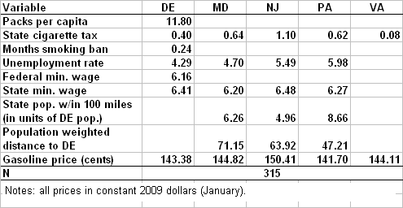
Sample means
Department of Public Policy Analysis and Management

Slide 19
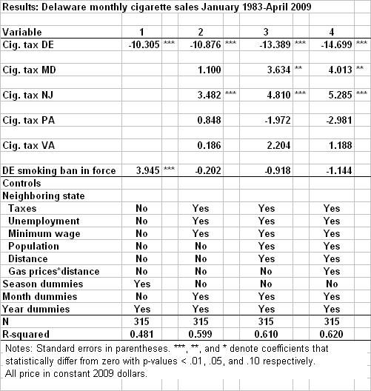
Department of Public Policy Analysis and Management

Slide 20
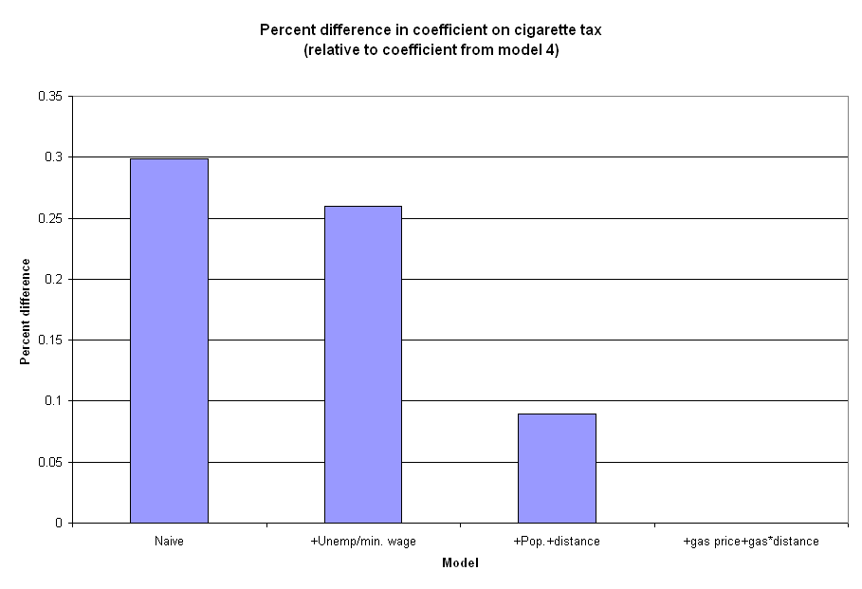
Department of Public Policy Analysis and Management

Slide 21
Discussion
TUS-CPS data provides insight about cross-border shopping
Can use to establish price advantages
Patterns in direction of imports/exports
Complementary with aggregate sales data
Department of Public Policy Analysis and Management

Slide 22
Discussion (cont.)
Aggregate sales data support hypothesis of bias
If fail to account for cross-border shopping and costs of traveling
  estimated effect of price biased by about 30%
  Smoking ban predicted to increase sales
Department of Public Policy Analysis and Management

Slide 23
Conclusions
TUS-CPS is valuable for richer understanding of tobacco consumption
Requires careful data construction
Can add significant value
Can usefully combine with external data for greater insights
Much more can be done
Department of Public Policy Analysis and Management

