Slide 1


A focus on racial/ethnic health disparities with the TUS
Dennis R. Trinidad, Ph.D., MPH
TUS CPS NCTOH
Pre-Conference Workshop
June 9, 2009
Notes:
The purpose of this talk is to provide examples of things we’ve done with the TUS CPS in terms of examining racial/ethnic disparities in smoking

Slide 2
Overview
Use of the TUS to compare
groups of states with differing tobacco control strategies
  Messer, Pierce, Al-Delaimy, Zhu
Examining factors associated with smoking cessation
  Pérez-Stable, Messer, Emery

Slide 3
Comparing Smoking in States with Different Tobacco Control Strategies
In the U.S. smoking prevalence rates have been historically higher for the African-American (AA) adult population compared to the non-Hispanic white (NHW) population
However, in recent years, the prevalence gap between AAs and NHWs has narrowed
Objective:
  To compare trends in AA and NHW smoking between states categorized as having three different levels of tobacco control practice in the 1990s
Notes:
I’m going to talk briefly about some of the work we’ve done with the TUS CPS to examine racial/ethnic disparities in smoking

Slide 4
What State Groups should we use to compare effects of the California campaign?
Group 1: Tobacco Growing States
  lower price
  lower excise tax
  less social norm against smoking
Group 2: New York & New Jersey
  2 large states with similar price and excise tax as CA but no comprehensive tobacco control program

Slide 5
Top 6 Tobacco Growing States
Tobacco and the Economy
        Cash receipts Excise Tax 1994 & rank 2005
North Carolina $871m $0.05 (50th)
2. Kentucky $615m $0.03 (51st)
3. Tennessee $178m $0.20 (45th)
4. South Carolina $187m $0.07 (49th)
5. Virginia $147m $0.20 (45th)
6. Georgia $133m $0.37 (41st)

Slide 6
Large Population States with High Excise Taxes on Cigarettes
1993 (rank) 2005 (rank)
New York $0.80 (3rd) $1.50 (8th)
New Jersey $0.64 (12th) $2.40 (2nd)
California $0.59 (17th) $0.87 (21st)

Slide 7
Different Strategies across States
California
  high cigarette price
  comprehensive tobacco control program
New York & New Jersey
  high cigarette price
  no comprehensive tobacco control program
Tobacco growing states
  low cigarette price
  no comprehensive tobacco control program

Slide 8
Methods
TUS CPS from
  1992-93
  1995-96
  1998-99
  2001-02
Examine Daily Smoking Prevalence in adults 20–64 years old
  Largest contributor to lung cancer
The respondents of TUS survey were asked:
  ‘‘Have you ever smoked 100 cigarettes?’’
    Yes → Ever Smoker
  ‘‘Do you smoke cigarettes every day, some days or not at all?’’
    Every day → Daily Smoker

Slide 9
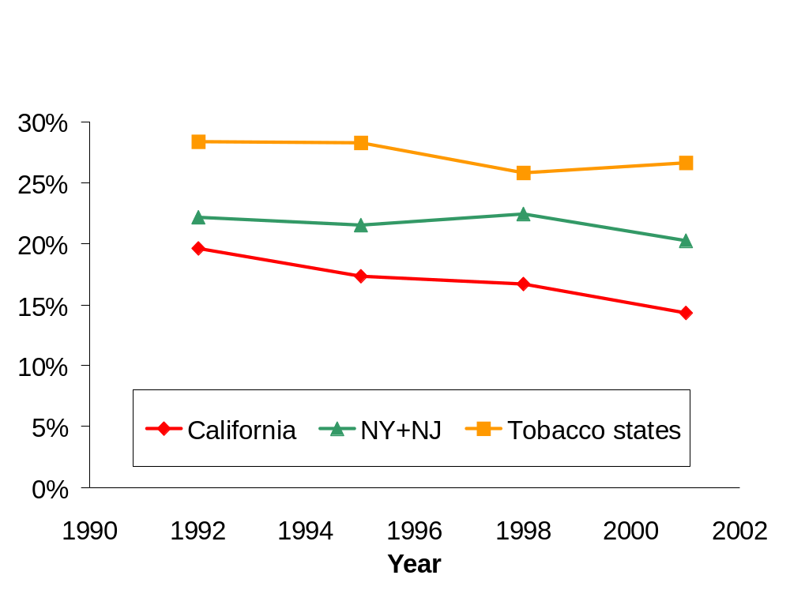
Prevalence of Daily Smoking
Non-Hispanic Whites, 1992-2001

Slide 10
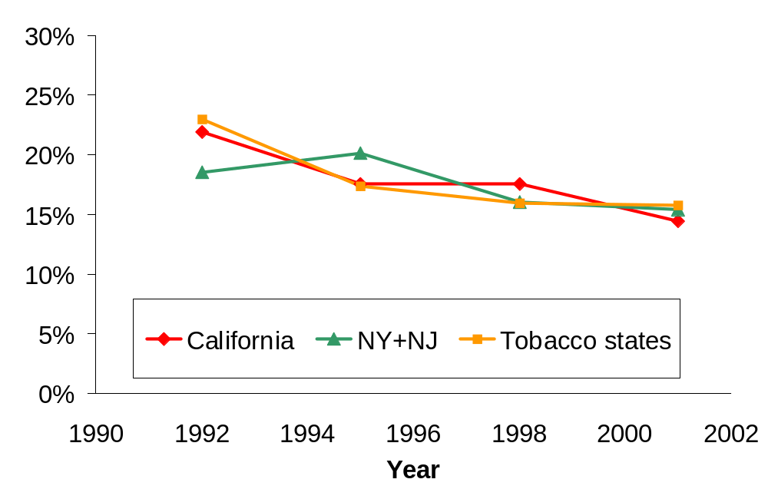
Prevalence of Daily Smoking
African Americans, 1992-2001

Slide 11
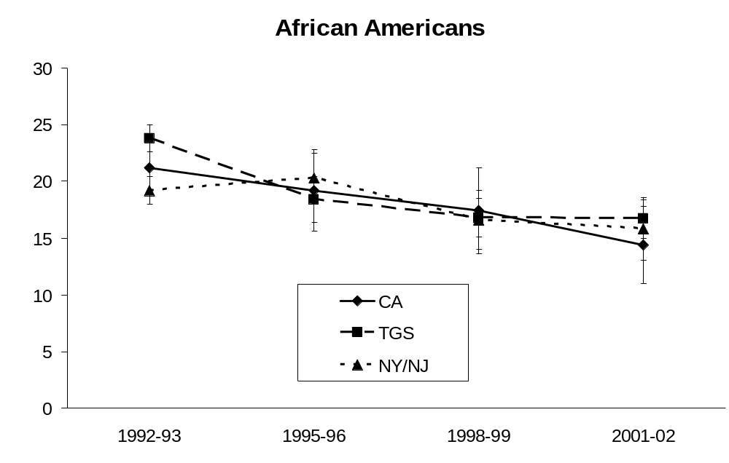
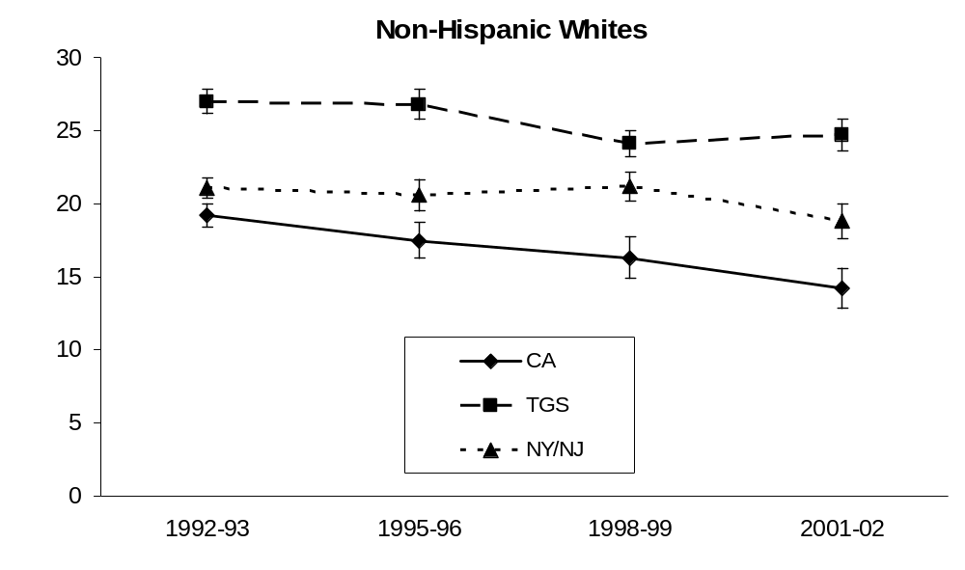
% Daily Smokers
% Daily Smokers

Slide 12
Results: African American Daily Smoking Prevalence
From 1992–93 to 2001–02, in models adjusted for age, income, education, gender:
  Large decline in daily smoking among African Americans across states
    ~3% decline/year
      P<0.001
  Non-Hispanic whites
    ~0.5% decline/year, NY/NJ & tobacco states
      P>0.2
    ~3% decline/year, CA
      P<0.001
Notes:
Findings suggest that more recent cohorts of AAs appeared to have taken up smoking at lower rates than older cohorts. Further research is needed to look into factors associated with smoking declines among AAs and may be of benefit to the other population groups.

Slide 14
Examination of factors associated with smoking cessation across race/ethnic groups in the U.S.
2003 TUS CPS Special Cessation Supplement
Analyzed for behaviors related to smoking cessation by race/ethnicity
Notes:
Goal is not to provide a definitive, be-all-end-all set of answers about disparities in smoking cessation, but rather to give a sense about some of the challenges in doing ethnic disparities research
Little recent research exists detailing smoking rates and cessation specific behaviors across race/ethnic groups based on nationally representative data

Slide 15
Smoking Categorizations
Ever Smokers
  100 cigarettes in lifetime
    Current Daily Smokers
      Smokes every day
    Current Occasional Smokers
      Smokes some days
Former Smokers
  100 cigarettes in lifetime
  Quit at least 1 year

Slide 16
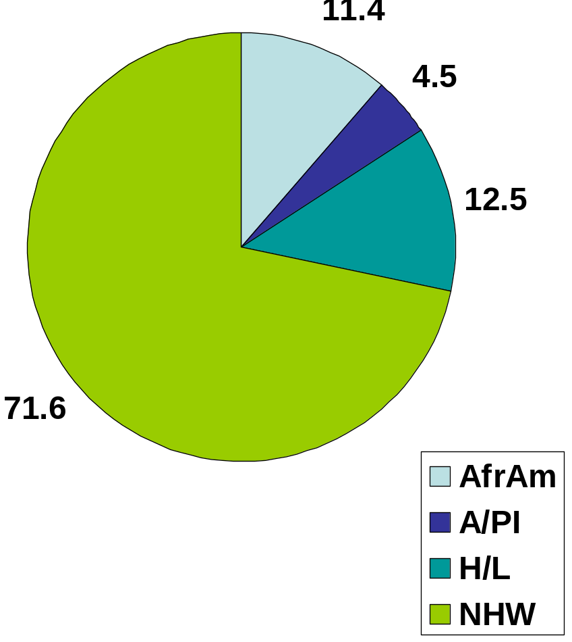
Population Description
Mean Age (adults 18+)
African American | 42.6
Asian/PI | 41.8
Hispanic/Latino | 38.8
Non-Hispanic White | 47.1
Notes:
HL bit younger
NHW bit older

Slide 17
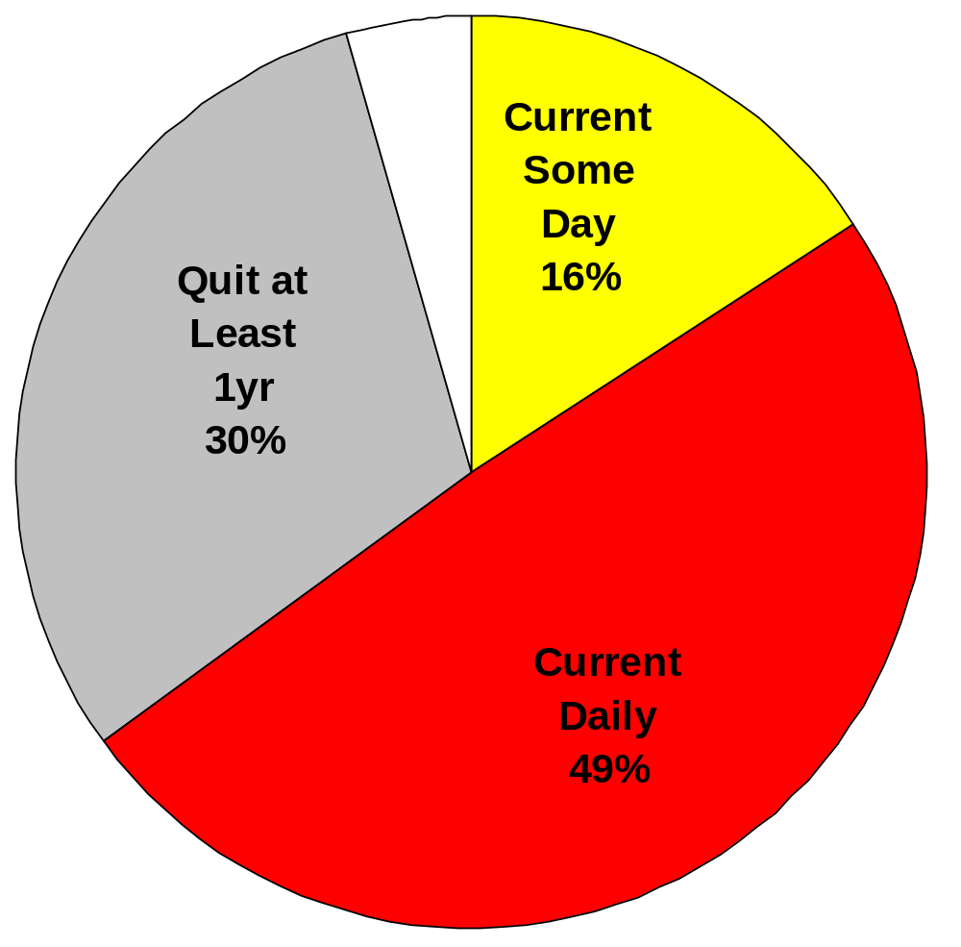
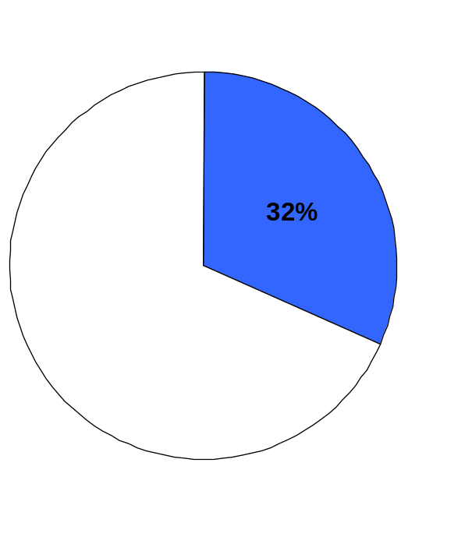
African Americans
Ever Smokers

Slide 18
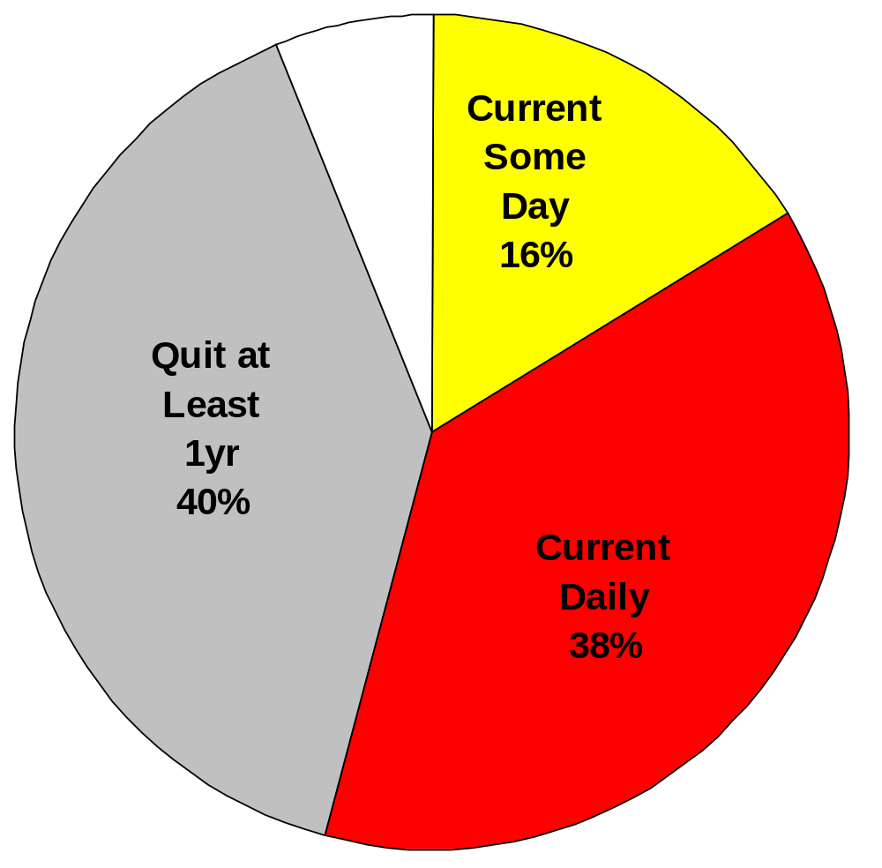
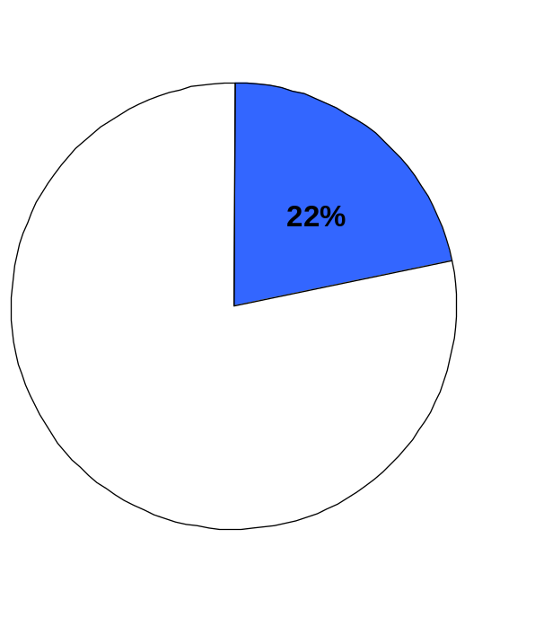
Asian/Pacific Islander Americans
Ever Smokers

Slide 19
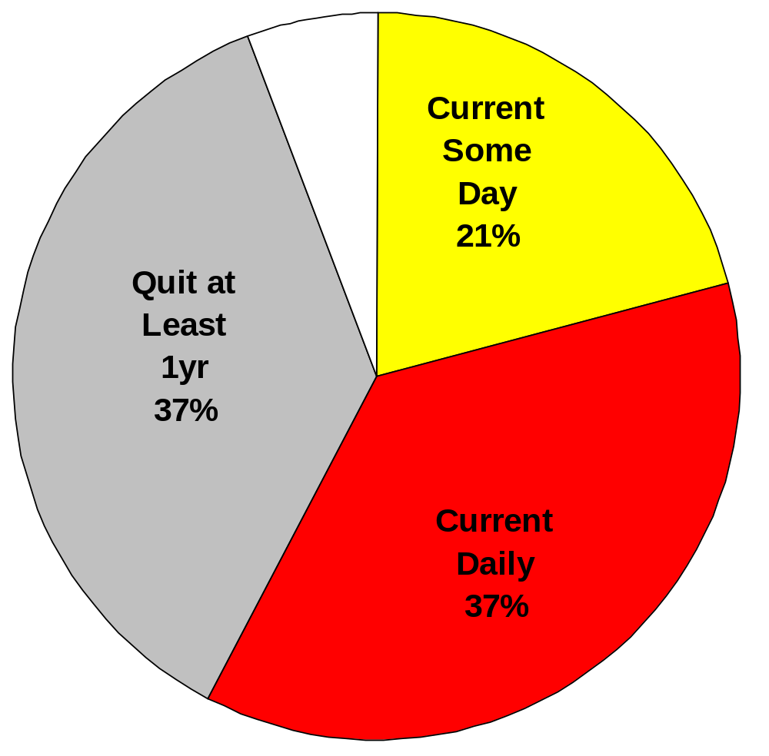
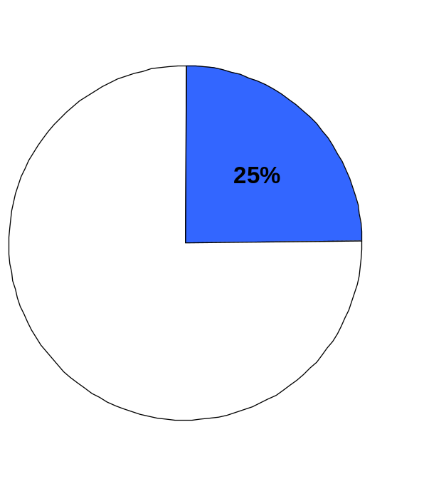
Hispanics/Latinos
Ever Smokers

Slide 20
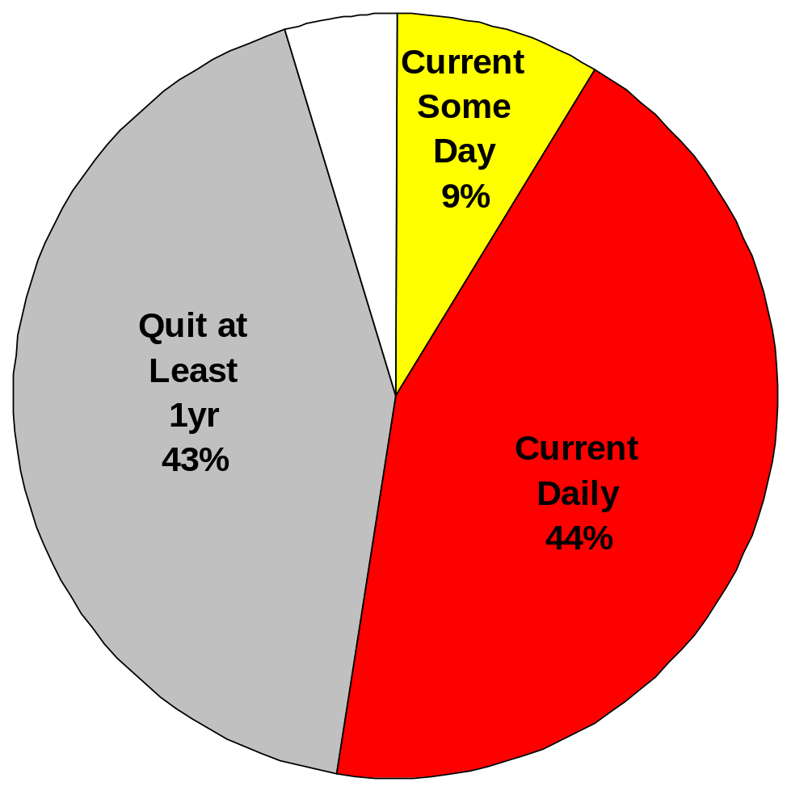
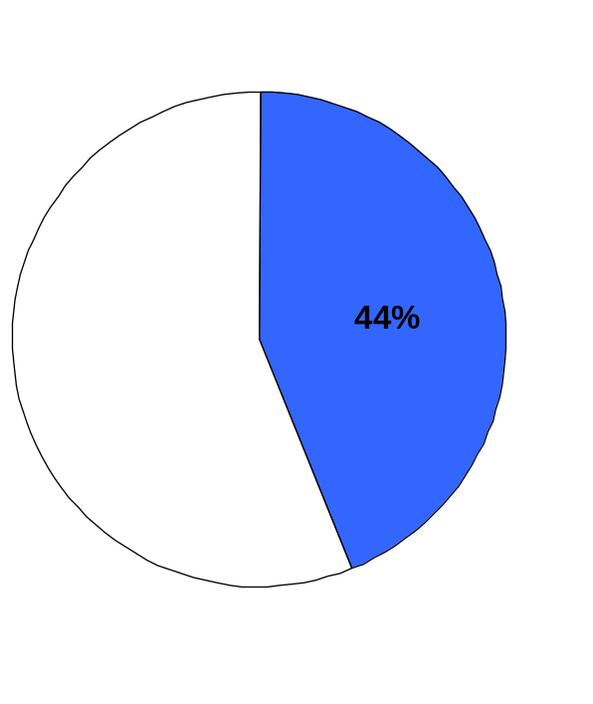
Non-Hispanic Whites
Ever Smokers
Notes:
REALLY…44% OF NHW POPULATION ARE EVER SMOKERS????????????

Slide 21
Ever Smokers
(100+ cigarettes in Lifetime)
Smaller proportion of the population of racial/ethnic minorities have ever smoked compared to Non-Hispanic Whites

Slide 22
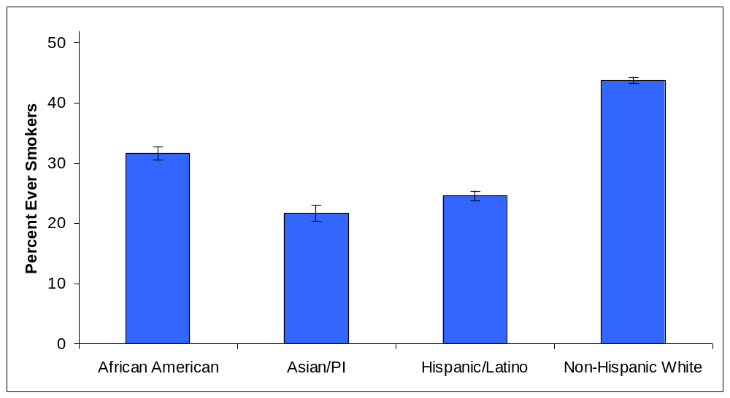
Ever Smokers
(100+ cigarettes in Lifetime)

Slide 23
Quitting Smoking
Smaller proportion of the population of racial/ethnic minorities have ever smoked compared to Non-Hispanic Whites
  But proportions of successful quitting are smaller among African Americans (especially) and Hispanics/Latinos

Slide 24
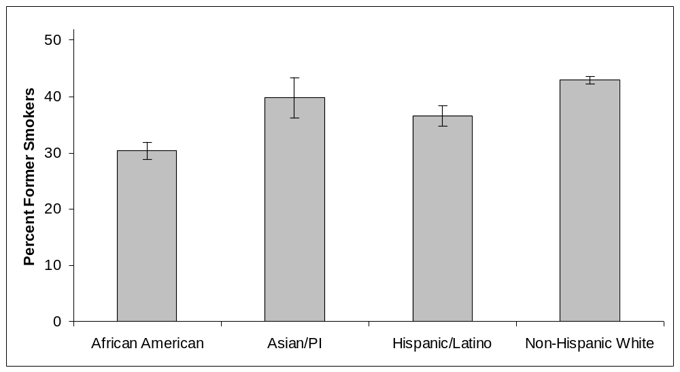
Former Smokers
(Quit at Least 1 Year)
Among Ever Smokers

Slide 25
Quitting Smoking
Smaller proportion of the population of racial/ethnic minorities have ever smoked compared to Non-Hispanic Whites
  But proportions of successful quitting are smaller among African Americans (especially) and Hispanics/Latinos
    Such that almost 50% of African American ever smokers still currently smoked daily

Slide 26
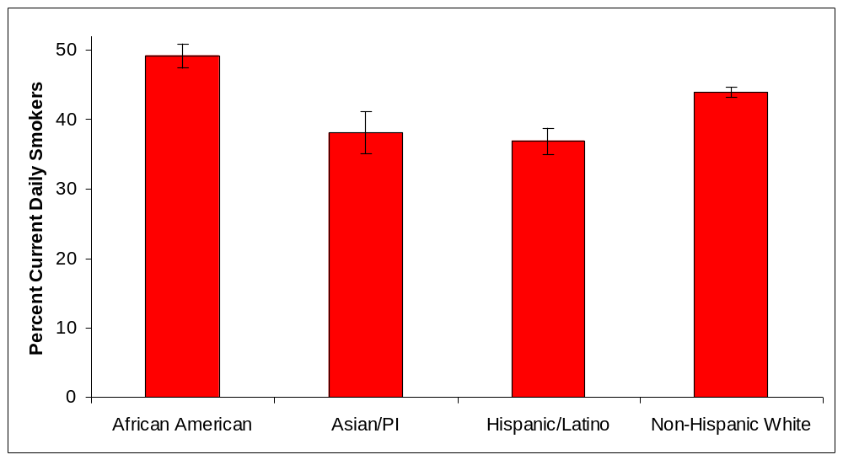
Current Daily Smoking
Among Ever Smokers

Slide 27
Quit Attempts

Slide 28
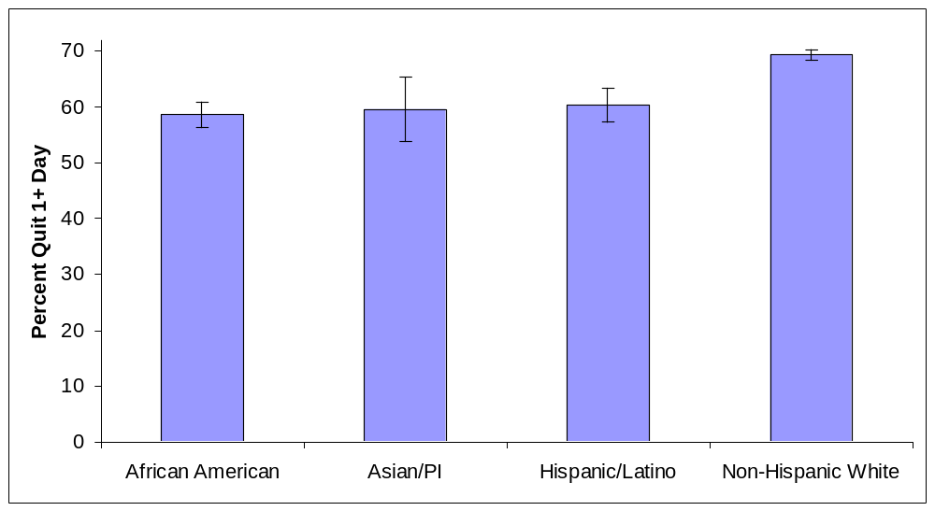
Stopped Smoking at Least 1 Day in Past Year in an Attempt to Quit
Among Daily Smokers
Notes:
Among CDS, 59% of AAs, 60% of APs, 60% of HLs, and 69% of WHs had ever stopped smoking for at least 1 day in an attempt to quit.
So there are diffs in daily such that about 70% of WHs vs about 60% of r/e minorities quit 1+ day in past yr in attempt to quit;

Slide 29
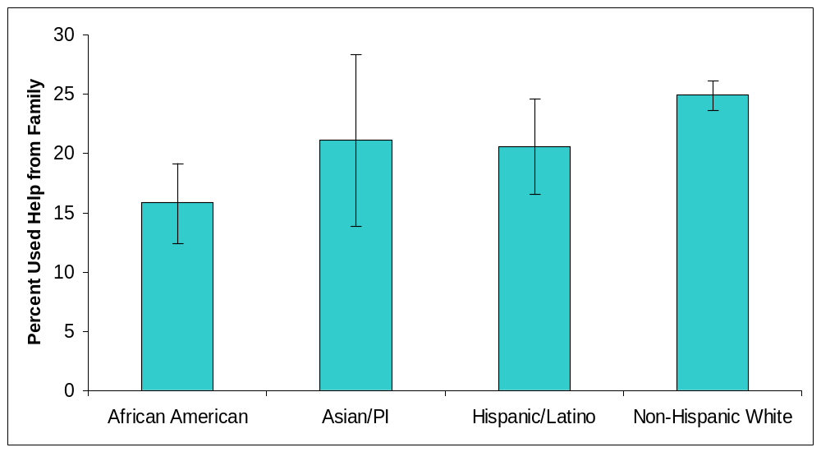
In Last Quit Attempt,
Used Help & Support of Family
Among Daily Smokers
Notes:
Less AfrAm vs WH

Slide 30
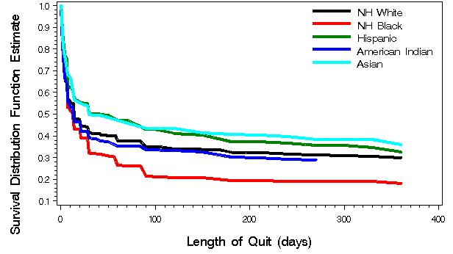
Relapse among smokers in the past year

Slide 31
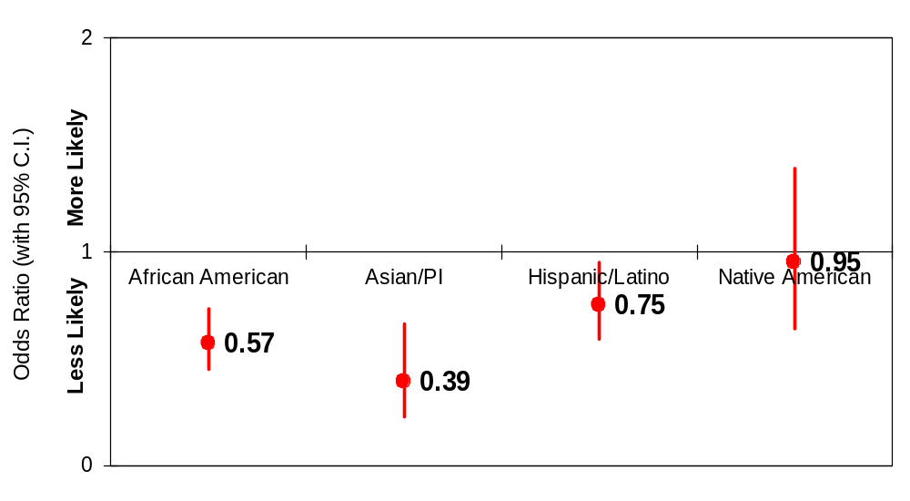
Odds of Using NRT
(among those who made a quit attempt last year)
Adjusted for age, sex, education, income, smoking consumption
Notes:
Minorities less likely to use NRT compared to NHWs
Logistic regressions adjusted for sex, age, education, income, marital status, smoking level, and seeing a health professional (doctor, dentist, nurse, etc.) in the past 12 months AND getting advised to use NRT or not

Slide 32
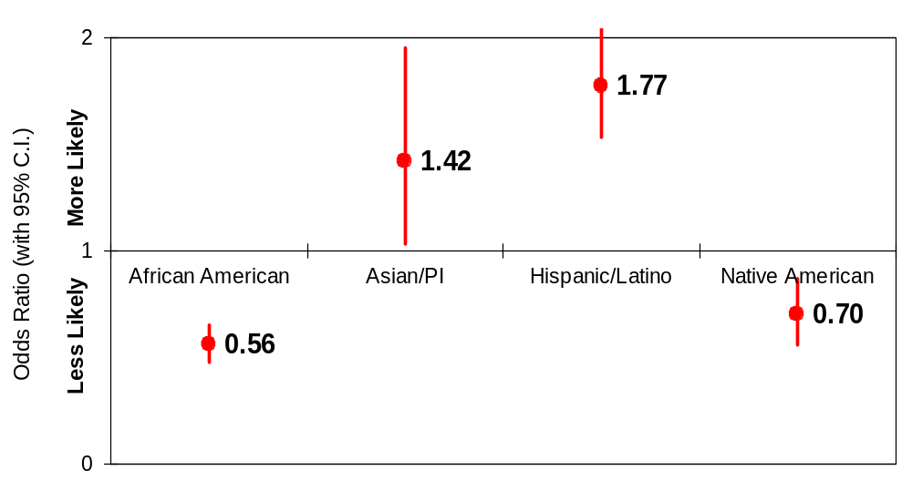
Presence of a Total Home Smoking Ban among Current Daily Smokers
Adjusted for age, sex, education, income, smoking consumption
Notes:
Minorities less likely to use NRT compared to NHWs
Logistic regressions adjusted for sex, age, education, income, marital status, smoking level, and seeing a health professional (doctor, dentist, nurse, etc.) in the past 12 months AND getting advised to use NRT or not

Slide 33
Successful (6 months +) quits among smokers in the last year who made at least a 1-day attempt
 |  | OR | L 95% | U 95% | p-value
Age group | 20-34 | 1.00 | 1.00 | 1.00 | .
 | 35-49 | 0.68 | 0.59 | 0.79 | <0.001
 | 50-64 | 0.84 | 0.72 | 0.97 | 0.022
Highest educational level | < H. S. | 1.00 | 1.00 | 1.00 | .
 | H.S. graduate | 0.99 | 0.79 | 1.25 | 0.945
 | Some college | 1.13 | 0.89 | 1.43 | 0.313
 | College graduate | 1.72 | 1.39 | 2.12 | <0.001
Under 2X poverty level | No | 1.00 | 1.00 | 1.00 | .
 | Yes | 0.81 | 0.69 | 0.95 | 0.012
Race/ethnicity | African American | 0.51 | 0.36 | 0.72 | <0.001
 | Asian/PI | 1.05 | 0.66 | 1.69 | 0.824
 | Hispanic/Latino | 1.22 | 0.92 | 1.61 | 0.159
 | Native American | 0.75 | 0.48 | 1.18 | 0.218
 | NH White | 1.00 | 1.00 | 1.00 | .
Notes:
2) Table showing results of logistic regression predicting successful (6+month) quits among smokers in the last year making a quit attempt, showing a significantly lower success rate for NH Blacks.

Slide 34
Discussion
Differences across race/ethnic groups highlight significant challenges in addressing smoking and smoking cessation for various groups
Specific needs and program focus for cessation may vary across groups such that 1 size fits all strategies might not be optimal

Slide 35
Future Research
Future research on reasons racial/ethnic minorities are less likely to use NRT
Population groups & subgroups
  Native Americans/American Indians
  Race/ethnic subgroups
  Gender
  Acculturation

Slide 36
Acknowledgements
Tobacco Research Network on Disparities
  Funded by the National Cancer Institute and the American Legacy Foundation
Tobacco-Related Disease Research Program of the University of California Office of the President (#12KT-0158, 15RT-0238)
National Institutes of Health (#CA12344)
National Cancer Institute (Redes En Acción, U01-CA86117)
Robert Wood Johnson Foundation (#RWJF04498)
American Cancer Society (#MRSGT 07-277-01)

