Slide 1






OSH/CDC Tobacco Use Supplement Uses and Tools
Angela Trosclair, MS
Statistician
Centers for Disease Control and Prevention
Office on Smoking and Health
Epidemiology Branch
TM
CS109353
Notes:
Thank you ______
For about the next half hour, Dr. Bob Robinson and I will give you a quick overview of both quantitative AND qualitative information about tobacco use among the racial and ethnic groups you will hear about today.
The reason why we will focus on both is that our work in OSH has taught us that quantitative data alone, cannot provide all we need to know and understand about tobacco-related disparities in these population groups.
Because of their individual, social, cultural and economic environments within our nation, each of these groups will reflect the burden of tobacco use in wholly unique ways. Therefore, we are compelled to understand as much as we can about them.
Today, I will focus my presentation on just a few areas of disparities. Let me say that we do not presume that today’s presentation is complete and comprehensive.

Slide 2
Background and Purpose
Highlight the Office on Smoking and Health’s uses of the Tobacco Use Supplement to the Current Population Survey including:
  Healthy People 2010 Tracking
  The STATE System
  The Question Inventory on Tobacco
  Tracking Progress Toward Elimination of Disparities
  Publications

Slide 3
Healthy People 2010 Tracking
The TUS-CPS is the data source for tracking progress toward 100% smoke-free workplaces, Healthy People 2010 Objective 27-12:
“Increase the proportion of persons covered by indoor worksite policies that prohibit smoking.”

Slide 4
Worksite indoor smoking bans, 2006/2007
55.0-71.5
71.6-75.5
75.6-79.8
75.6-79.8

Slide 5
The STATE System - CDC/OSH Data Warehouse http://apps.nccd.cdc.gov/StateSystem/index.aspx
The State Tobacco Activities Tracking and Evaluation (STATE) System is an electronic data warehouse containing up-to-date and historical state-level data on tobacco use prevention and control:
Behaviors (cigarettes, cigar, pipe, smokeless tobacco use, cessation)
Demographics (resident population estimates)
Economics (cigarette sales, agriculture, manufacturing, tobacco settlement revenue)
Environment (sales to minors, smokefree policies)
Funding (actual and recommended funding)
Health Consequences and Costs (state SAMMEC estimates, YPLLs)
Legislation (advertising, excise taxes, fire safety, licensure, preemption, smokefree indoor air, and youth access)

Slide 6
The STATE System - TUS/CPS
Current Smoking (overall, gender)
Cigarette Use (overall, gender, race/ethnicity, age, women of childbearing age, education)
  Current
    Everyday
    Some day
  Former
  Never
Cigar, Pipe, and Smokeless Use—Current, Former, Never (overall, gender)

Slide 7
The STATE System - TUS/CPS (cont)
Environment
  % Households with Complete Smoking Bans
  % Employed persons protected by policies
  prohibiting smoking in indoor work and common areas (overall, gender)

Slide 8
The Question Inventory on Tobacco http://apps.nccd.cdc.gov/qit/QuickSearch.aspx
The Question Inventory on Tobacco is an internet database developed by CDC's Office on Smoking and Health. The database categorizes more than 3400 tobacco-related questions from 19 different tobacco surveys.
This site can be used to:
Collect information on survey questions used in the past
Locate publicly available data, questionnaires and documentation for secondary analyses
Read brief descriptions of each survey’s methodology
Gather ideas for future instrument development

Slide 9
The Question Inventory on Tobacco http://apps.nccd.cdc.gov/qit/QuickSearch.aspx
The Question Inventory on Tobacco provides easy-to-use simple or advanced search capabilities to locate survey questions by:
Survey
Year of survey
Use of categories and keywords
Full-text searching

Slide 10
The Question Inventory on Tobacco http://apps.nccd.cdc.gov/qit/QuickSearch.aspx
Each survey question in the system provides an answer format and is:
Linked to other surveys that have used the same or a similar question along with respective answer formats
Includes years each question was used in each survey
Includes years for which each survey is currently available in the Question Inventory on Tobacco
Included to date are questions from 19 different health surveys, most of which are national surveys published on or after 1990. The list of questions and surveys is expected to grow as OSH continues to enhance the site and add questions from additional surveys such as state surveys and newer surveys.

Slide 11
Tracking Disparities - Indicators
Smoking status (current, former, never)
Use of pipes, cigars, and smokeless tobacco (snuff or chewing tobacco)
Prevalence of having quit for 1 day or more
Percent of former smokers among ever smokers (quit ratios)
Prevalence of having been advised by a doctor to quit
smoking
Prevalence of planning to quit smoking in the next 6 mos
Prevalence of work site and home smoking bans

Slide 12
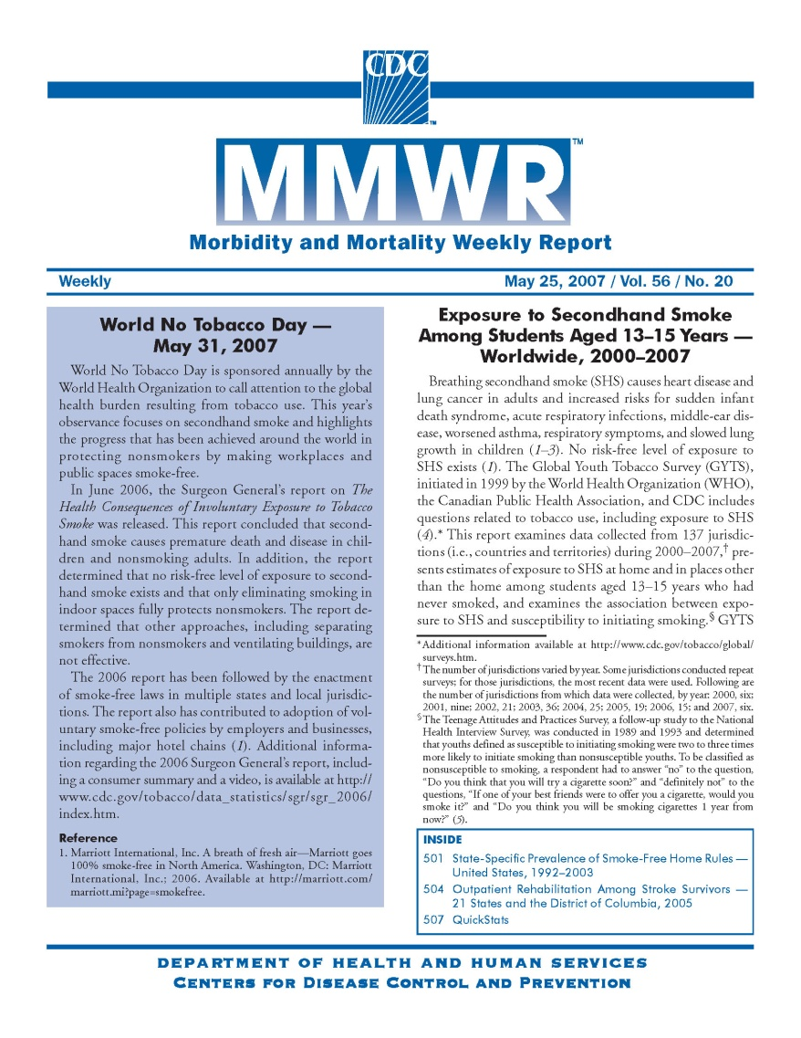
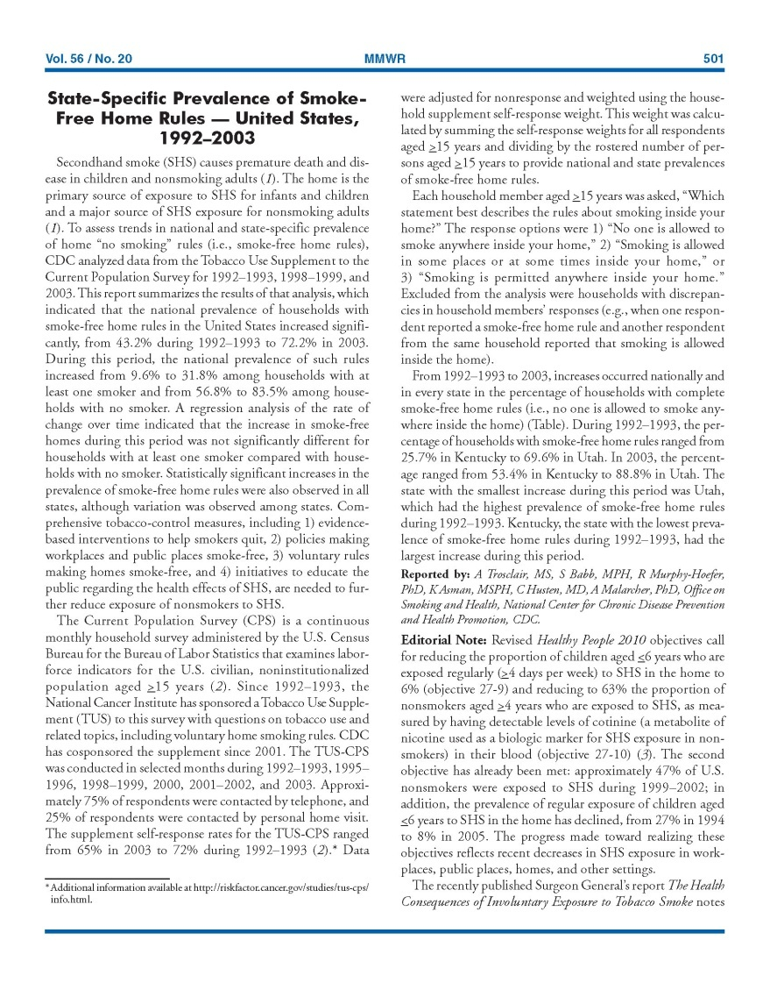
Publications
Vol. 56 / No. 20 MMWR 501
State-Specific Prevalence
of Smoke-Free Home Rules—
United States, 1992–2003
HH Type 1992 2003
Total 43.2% 72.2%
0 smokers 56.8% 83.5%
>= 1 smoker 9.6% 31.8%

Slide 13
Publications in Progress
In collaboration with Anne Hartman (lead author) and Alison Freeman at EPA, we hope to publish another MMWR article before the end of the year:
State-Specific Prevalence of Smokers’ Households Potentially Exposing Children Under 7 Years to Secondhand Smoke: United States, 1992-2003
Use and awareness of quitlines and other cessation services including physician referral to quitlines, United States 2006-2007

Slide 14
Acknowledgements
Anne Hartman, MS, NCI
James Todd Gibson, BS, IMS
www.cdc.gov/tobacco
The findings and conclusions in this presentation are those of the authors and do not necessarily
represent the official position of the Centers for Disease Control and Prevention.
CS109353
Notes:
Thank you ______
For about the next half hour, Dr. Bob Robinson and I will give you a quick overview of both quantitative AND qualitative information about tobacco use among the racial and ethnic groups you will hear about today.
The reason why we will focus on both is that our work in OSH has taught us that quantitative data alone, cannot provide all we need to know and understand about tobacco-related disparities in these population groups.
Because of their individual, social, cultural and economic environments within our nation, each of these groups will reflect the burden of tobacco use in wholly unique ways. Therefore, we are compelled to understand as much as we can about them.
Today, I will focus my presentation on just a few areas of disparities. Let me say that we do not presume that today’s presentation is complete and comprehensive.

