Slide 1
Tobacco Use Supplement to the
Current Population Survey
User’s Workshop
June 9, 2009
Tips and Tricks Analyzing TUS-CPS Data
Lloyd Hicks
Westat

Slide 2
Talk Outline
1. Uses of Standard Errors in Analyzing Data
2. Methods to Compute Standard Errors for TUS-CPS estimates
– Generalized variance functions (SE parameters)
– BRR replication – Fay’s method (replicate weights)
3. Special Topics for Analysts
– Change in Race/Ethnicity Questions
– 2002-03 Overlap Sample
– Replicate Weights when Data Sets Merged

Slide 3
Uses of Standard Errors
Constructing confidence intervals
- reflects the accuracy of survey estimates
Hypothesis testing
- compare estimates between subgroups (within same year)
- compare estimates across time

Slide 4

Uses of SEs: Confidence Intervals
Formula:
X = estimate
SE(X) = standard error
z = confidence interval coefficient (e.g. 1.645 for 90% CI)
Example: 90% CI for males 18+ smokers (20%)
20% ± 1.645 × 0.15% = 20% ± 0.25%
= [19.75%, 20.25%]

Slide 5
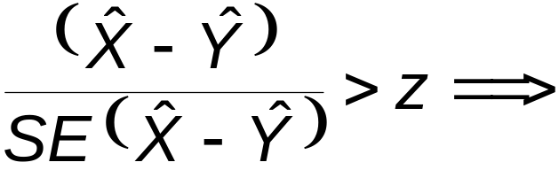
Uses of SEs: Hypothesis Testing
Formula:
statistical significance
X is the estimate for the 1st group
Y is the estimate for the 2nd group
SE(X – Y) is the standard error of difference
z = critical value threshold

Slide 6
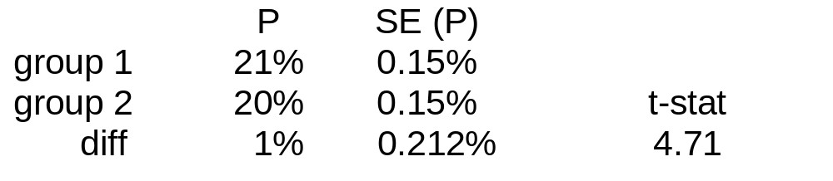
Hypothesis Testing: Example 1
Note: difference is statistically significant
(since 4.71 is greater than z where z =1.645 at 90% confidence level)

Slide 7
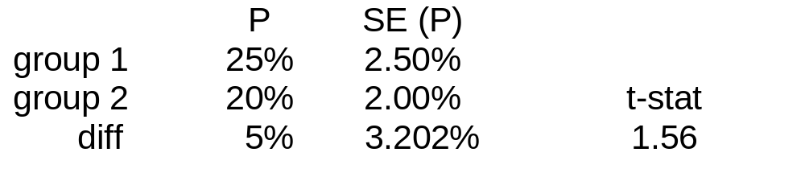
Hypothesis Testing – Example 2
Note: difference is not statistically significant
(since 1.56 is less than z where z =1.645 at 90% confidence level)

Slide 8
Methods of Estimating Standard Errors for TUS-CPS
Generalized variance functions (GVF)
  – Fast, easy but only approximate
  – More practical for large number of survey items
  – Requires a and b parameters from source and accuracy statements
  – Standard errors formulas for means, totals, percentages and their differences
  – Standard errors for complex estimates not possible (e.g. regression)

Slide 9
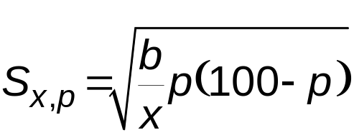
GVF Example
Standard error for a percentage
p is the estimate of the percentage
x is the estimate of the base of the percentage
b is the b parameter obtained from S&A statement

Slide 10
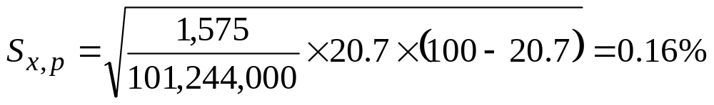
GVF Example
P = percentage of male smokers 18+ = 20.7%
X = 101,244,000
b parameter = 1,575 (from S&A table)
Note: Data from 2003 TUS-CPS

Slide 11
Methods of Estimating Standard Errors for TUS-CPS
2. Balanced repeated replication (BRR) based on replication weights
  – Replicate weights not on TUS-CPS public use file (available from NCI on request)
  – Requires special software (Sudaan, WesVar, etc.)
  – Provides a more accurate standard error than GVF
  – Standard errors for medians and other quantiles can be problematic

Slide 12
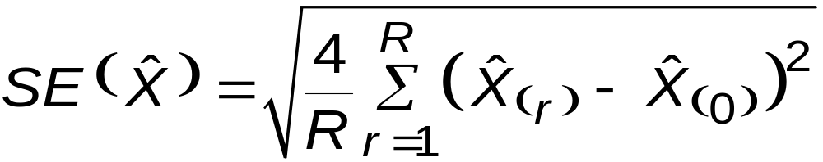
SE Formula for CPS-TUS Using BRR (Fay’s Method)
X(r) = replicate estimate
X(0) = full sample estimate
R = number of replicates
48 for 1992 – 1993 files (1980 decennial based samples)
80 for 1995 – 2003 files (1990 decennial based samples)
160 for 2006 – 2007 files (2000 decennial based samples)
4 = Fay Adjustment Factor (required in Sudaan)

Slide 13
Special Topics for Analysts
1. Changes in Race/Ethnicity Data
2. 2002/2003 Overlap Sample
3. Merging Data Sets

Slide 14
Special Topics 1: Changes to CPS Race/ethnicity data starting in 2003
Respondents can now select more than one race when answering the survey.
Asian or Pacific Islander (API) category split:
1. Asian
2. Native Hawaiian or Other Pacific Islander
(NHOPI)
The ethnicity question asked directly whether the respondent was Hispanic
Ordering of race and ethnicity reversed
Notes:
In response 1997 OMB mandate to allow for multiple race reporting,
BLS developed new questions for race/ethnicity

Slide 15
Implication of Race/ethnicity Change
On TUS-CPS data
1. No effect on estimates and trends for entire nation
2. Potential impact on estimates and trends by race/ethnicity

Slide 16
Issues when Analyzing TUS-CPS Data
By Race/ethnicity
Can’t use race data for post-2003 data in same manner as pre-2003
  Use single race = “only” category
  Use “any mention” category
  Neither group same as pre-2003 group
2. Analyzing Trends for single race groups spanning pre-2003 and post-2003
  NCI developed “race bridge” approach to construct single-race estimates for post-2003 data

Slide 17
TUS-CPS Race bridging approach
NCI developed model to predict pre-2003 race/ethnicities given post-2003 value (using May 2002 CPS data supplied by Census)
Paper summarizing the approach on website
(http:/riskfactor.cancer.gov/studies/tus-cps/race bridging 071307.pdf).
Paper summarizing application of approach on TUS-CPS data on website (http://www.fcsm.gov/07papers/Davis.VII-C.pdf)

Slide 18
Special Topic 2: 2002/2003 Overlap Sample (for Limited Longitudinal Analysis)
Persons in overlap sample (respondents in both)
  – TUS-CPS in Feb. 2002
  – TUSCS-CPS in Feb. 2003
  – Approximately 22,000 in overlap sample
Responses from both studies can be analyzed as a longitudinal study
New weights were developed for overlap sample

Slide 19
Development of Overlap Sample Weights
New weights for the overlap sample developed from 2003 weights
New weights were derived to reflect 2003 population for gender, race/ethnicity, age, and geography
Overlap sample weight
  w* = r * w
  Overlap weights = (adjustment factor) * (2003 weights)
Full sample and replicate weights using same approach

Slide 20
Overlap Sample Weights: Derivation of Adjustment factor
Choose adjustment factor so that sums of overlap sample weights match sums of 2003 sample weights in groups defined by
  – Census region (4)
  – Gender (2)
  – Race/ethnicity (4)
  – Age categories (19)
Details in http://riskfactor.cancer.gov/studies/tus-cps/TUS-CPS_overlap.pdf

Slide 21
Special Topic 3: Replicate Weights for Merged Data
Within Same Sample Design (Correlated)
  Blend replicates (no new replicate weights needed)
  Still Use Fay Factor of 4
Across Sample Design (Uncorrelated)
  Stack replicates (add replicate weights together)
    Ex. 80 + 160 = 240
  Adjust replicate weights to account for stacking
  Change Fay Factor from 4 to 16

Slide 22
Talk Recap
1. Uses of Standard Errors in Analyzing Data
2. Methods to Compute Standard Errors for TUS-CPS estimates
– Generalized variance functions (SE parameters)
– BRR replication – Fay’s method (replicate weights)
3. Special Topics for Analysts
– Change in Race/Ethnicity Questions
– 2002-03 Overlap Sample
– Merged Data Sets

