Slide 1
Quitting Cigarettes Completely or Switching to Smokeless Tobacco:
Do U.S. Data Replicate
the Swedish Results?
Shu-Hong Zhu
University of California, San Diego
TUS-CPS Users’ Workshop
Phoenix, June 9, 2009

Slide 2
Shu-Hong Zhu Julie B. Wang
Anne Hartman Yuerong Zhuang
Anthony Gamst James T. Gibson
Hans Gilljam* M. Rosaria Galanti
University of California, San Diego
National Cancer Institute
Information Management Services, Rockville
Karolinska Institutet, Stockholm, Sweden
Funded by NCI Grant 5 P30 CA 23100-22S4

Slide 3
Disclaimer
Grants/contracts from agencies that fund tobacco control research.
No interest in entering emotional debate on harm reduction.

Slide 4
Should We Encourage Smokers to Switching to Smokeless?
Pro: Many smokers can’t or will not quit
Con: Dilute the overall anti-tobacco message

Slide 5
Key Swedish Results
Male smoking prevalence < female’s
Men have a high prevalence of snus use
Many male smokers reported using snus to quit smoking
Male lung cancer rate drops faster than expected
Foulds et al. 2003 Tobacco Control 349-359

Slide 6
Reservations on Applicability of Swedish Results to Other Countries
Country/Culture-specific
Effects on smoking uptake vs. cessation
Price
Unrelated to perception of reduced harm
No such thing as Swedish results
Mostly logical exercises, little data when it comes to applications to other countries

Slide 7
Need Data
Data from countries other than Sweden
    U.S. is the other western country with a long history of smokeless tobacco use
Longitudinal population-based data
    Recall of ever use of smokeless tobacco has serious problems here
    TUS-CPS 2002-2003 longitudinal data set

Slide 8
Our Task
Focus on smoking cessation effects
  One survey cannot solve all problems
Summarize the relevant Swedish results
Repeat the analysis

Slide 9
How to Test for a Snus Effect on Smoking Cessation in Sweden
Men uses snus far more than women
Need of nicotine is cause of relapse
The test should be two-prolonged
  Sex difference in smoking cessation
  No sex difference in tobacco cessation (cigarettes and snus)

Slide 10
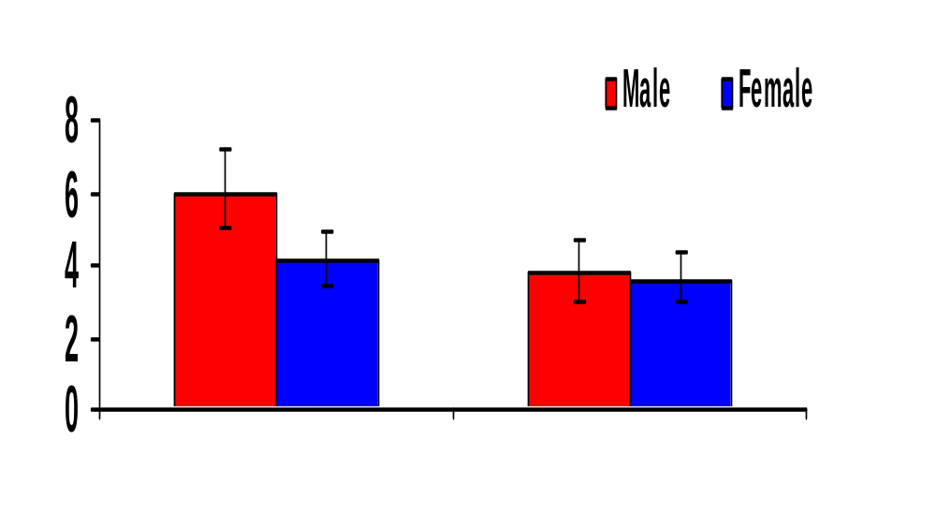
Annual Quit Rate for Smoking or for Smoking and Snus in MONICA Project (5-13 years), Sweden
% Quit
Quit Smoking
Quit Smoking and Snus
Based on results reported in Tables 3-5 in Rodu et al. (2003),

Slide 11
Annual Quit Rate for Smoking or for Smoking and Snus in MONICA Project (5-13 years), Sweden
% Quit
Quit Smoking
Quit Smoking and Snus
Based on results reported in Tables 3-5 in Rodu et al. (2003),

Slide 12
TUS-CPS 2002-2003
Define tobacco use status
  Smoking only
  Smokeless only
  Both
  Neither
Data reduction
  Ignore cigars and pipe (after finding them unimportant)
  Remove inconsistency

Slide 13
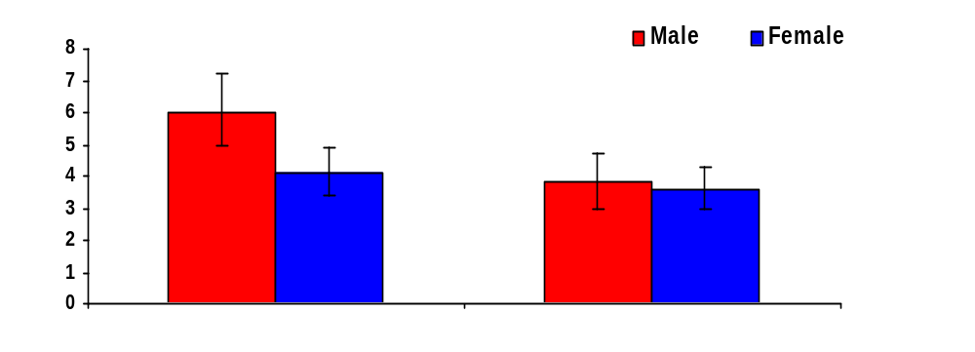
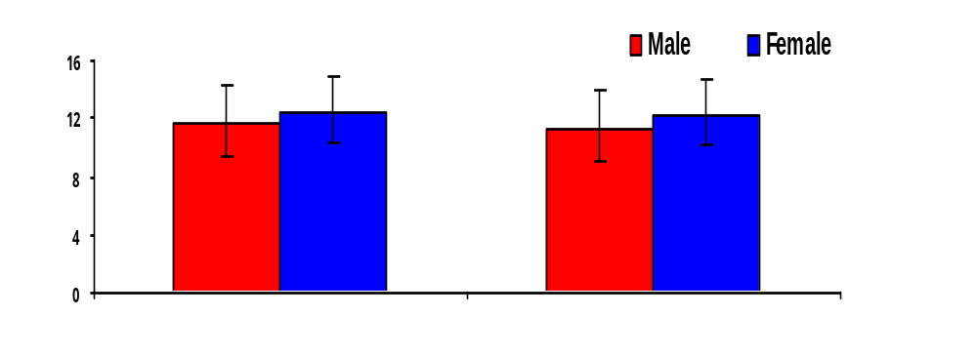
Figure 1A. Annual Quit Rate for Smoking or for Smoking and Snus in MONICA Project (5-13 years), Sweden
% Quit
Quit Smoking
Quit Smoking and Snus
Based on the multi-year followed up results reported in Tables 3-5 in Rodu et al. (2003),
Figure 1B. Percent of 2002 Smokers Who Quit Smoking or Quit Both Smoking and Smokeless In 2003, U.S.
% Quit
Quit Smoking
Quit Smoking and Smokeless
Based on US 2002-2003 TUS-CPS longitudinal sample

Slide 14
Figure 1A. Annual Quit Rate for Smoking or for Smoking and Snus in MONICA Project (5-13 years), Sweden
% Quit
Quit Smoking
Quit Smoking and Snus
Based on the multi-year followed up results reported in Tables 3-5 in Rodu et al. (2003),
Figure 1B. Percent of 2002 Smokers Who Quit Smoking or Quit Both Smoking and Smokeless In 2003, U.S.
% Quit
Quit Smoking
Quit Smoking and Smokeless
Based on US 2002-2003 TUS-CPS longitudinal sample

Slide 15
Other Key Results (for Male)
Switching is infrequent
  0.3% from cigarettes to smokeless
  3.9% from smokeless to cigarettes
Recent former smokers turn to smokeless
  1.7% turn to smokeless
  24.4% relapse to cigarettes

Slide 16
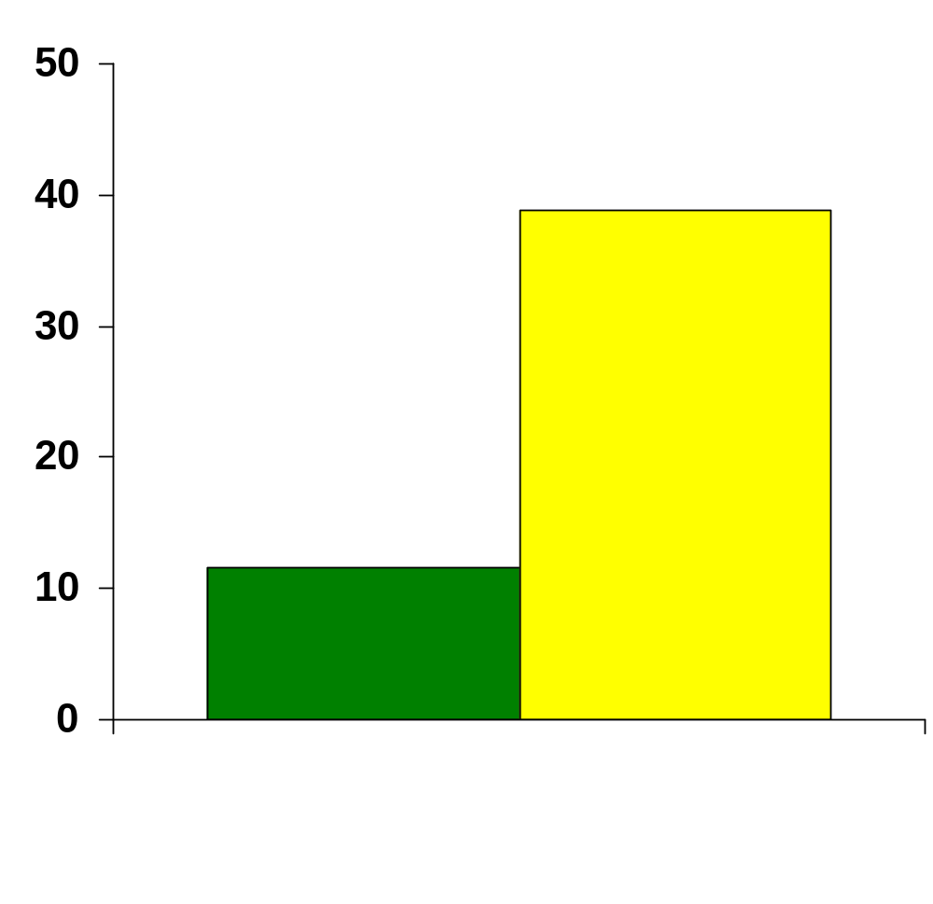
Quitting Among Exclusive Users (Cigarettes or Smokeless)
%Quit
Quit Smoking
Quit Smokeless

Slide 17
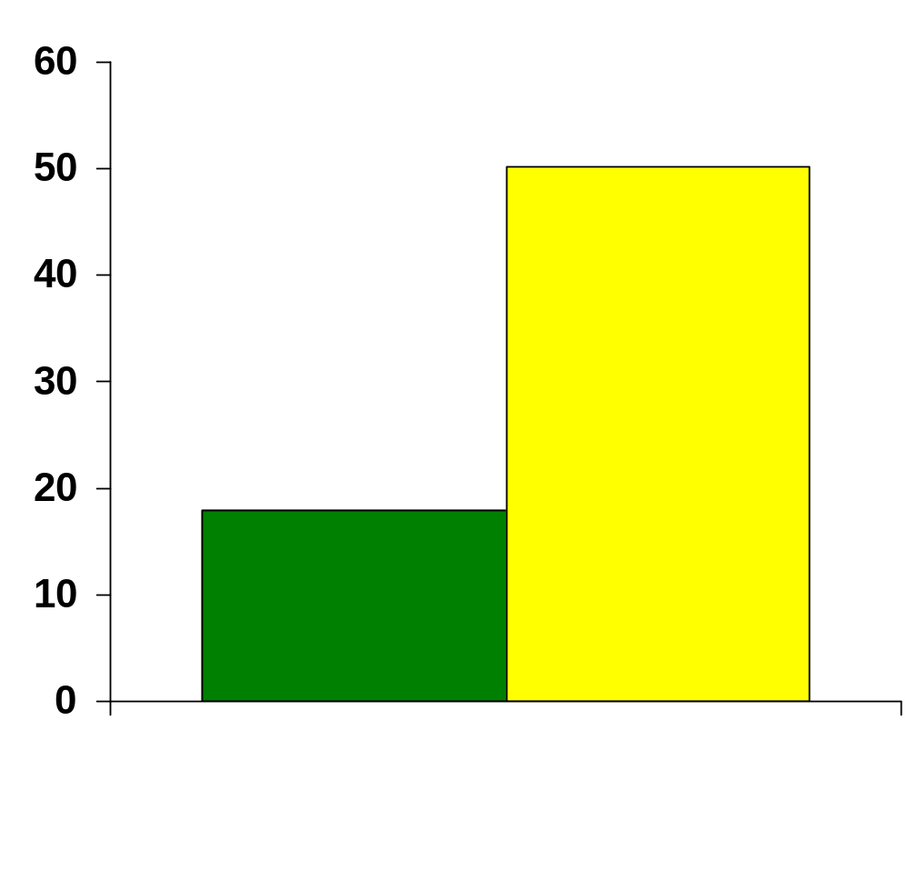
Quitting Among Dual Users (Cigarettes or Smokeless)
%Quit
Quit Smoking
Quit Smokeless

Slide 18
Figure 1A. Annual Quit Rate for Smoking or for Smoking and Snus in MONICA Project (5-13 years), Sweden
% Quit
Quit Smoking
Quit Smoking and Snus
Based on the multi-year followed up results reported in Tables 3-5 in Rodu et al. (2003),
Figure 1B. Percent of 2002 Smokers Who Quit Smoking or Quit Both Smoking and Smokeless In 2003, U.S.
% Quit
Quit Smoking
Quit Smoking and Smokeless
Based on US 2002-2003 TUS-CPS longitudinal sample

Slide 19
Possible Explanations
It was not promoted as safer products
Price differential is not big enough
Product difference
Not enough of them using it

Slide 20
Conclusions
U.S. Data do not replicate the Swedish results
U.S. male smokers seem to quit smoking at a high rate, without using smokeless
U.S. female smokers quit on the same level as males
Promoting smokeless tobacco as less harmful alternative may not lead to an increase of population smoking cessation rate in places like the U.S.
Price differential may have a greater effect in increasing switching to smokeless

Slide 21
Thank You!
szhu@ucsd.edu

