Slide 1
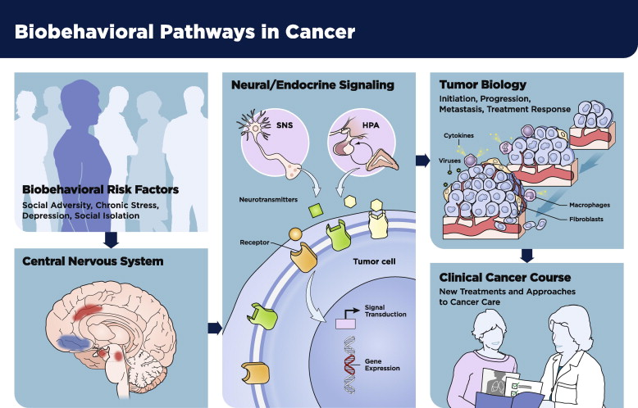
Fig. 1 Heuristic framework for research on biobehavioral risk factor influences on clinical cancer course.
Paige Green McDonald , Mary O’Connell , Susan K. Lutgendorf
Psychoneuroimmunology and cancer: A decade of discovery, paradigm shifts, and methodological innovations
Brain, Behavior, and Immunity Volume 30, Supplement 2013 S1 - S9
http://dx.doi.org/10.1016/j.bbi.2013.01.003

