Slide 1
An Analysis of
D&I Applications
Erin Eckstein
Presidential Management Fellow
National Cancer Institute
5TH NIH Conference on the Science of
Dissemination and Implementation
Technical Assistance Session
March 20, 2012

Slide 2

Two Analyses*
Examined summary statements of applications to the Trans-NIH D&I PARs
Extracted both strengths and weaknesses noted in the summary statements
Included:
Funded R01s, R03s, and R21s
Triaged NCI R01s
*with M. Khair ElZarrad, Cancer Prevention Fellow, NCI

Slide 3
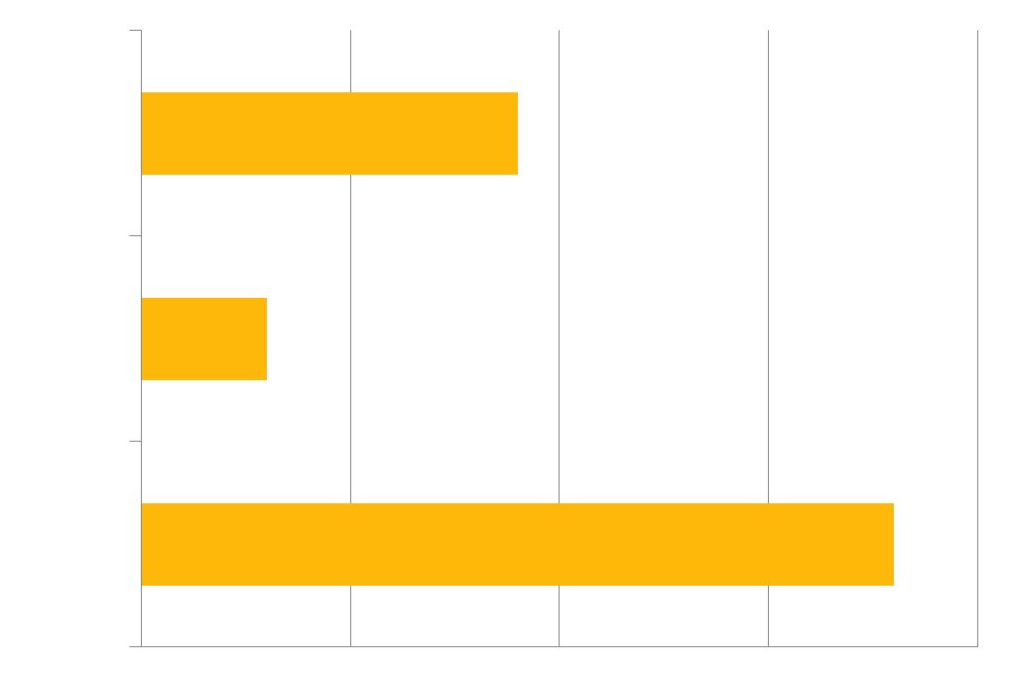
Funded R01s, R03s and R21s*
2008-2011
*Rated exceptional, outstanding and very good

Slide 4
Strengths of Funded R01s, R21s, and R03s
Significance: The proposal meets the goal of D&I PAR to improve practice through research.
  The proposal tackles a significant health issue.
  The proposal addresses a recognized practice problem or need, and presents the opportunity to fill a knowledge gap.

Slide 5
Sampling strategy and selection criteria
Regardless of the method, sampling strategies and selection criteria are well-articulated and justified.
  Criteria are appropriate to and follow the study aims.
  They are presented with clear explanation and rationale.
  When appropriate to the study aims and methodology, the sample size provides adequate statistical power.
  Detailed statistical considerations and power analysis are offered when appropriate.

Slide 6
Strong Study Teams
Proposals feature strong, experienced, inter-disciplinary study teams.
Strong study teams often:
  Reflect multidisciplinary expertise in terms of skills and disciplines
  Fill any gaps in knowledge or expertise by hiring or collaborating with relevant consultants or outside researchers
  Assure that teams members are sufficiently involved to adequately perform study tasks

Slide 7
Conceptual frameworks
Proposals present relevant and specific frameworks, theories or models to guide their work
Conceptual frameworks can be:
  Clear, appropriate and proven
  Integrated or multidisciplinary
  Multilevel, reflecting ecological or system approaches

Slide 8
Sustainability
The proposal might address the sustainability of the project or innovation by:
  Examining the factors leading to sustainability of an intervention
  Incorporating the existing resources (human, infrastructure, information technology systems, etc.) of the implementing site into the design of the study
  Conducting a cost analysis of the innovation, or comparing it to alternatives
  Explicitly evaluating the sustainability of the disseminated/ implemented intervention over time

Slide 9
Use of mixed methods
The proposal utilizes mixed methods, as encouraged by the PAR.
Plans for qualitative analysis are sufficiently detailed and conceptualized. For example, the proposals might:
  present sufficient justification for qualitative analysis
  discuss plans for coding and analyzing collected data
  present a potential interview guide
  indicate a method for triangulating interpretation
  consider inter-rater reliability and the role of the interviewer/interpreter
  plan for pre-testing and revision of interview questions
In addition, qualitative and quantitative analyses are often integrated, informing each other to present a comprehensive picture.
Notes:
In general, Methods are appropriate to the study settings and the research question at hand.

Slide 10
Feasibility and Generalizability
D&I is concerned with real-world applicability of interventions and innovations.
Proposals might demonstrate feasibility and generalizability by:
  Adequately considering or directly investigating barriers and facilitators to implementation
  Explicitly assessing the feasibility/acceptability of an intervention in a given setting
  Presenting evidence (e.g. preliminary data, results from pilot work) that the project is feasible, particularly for R01s
  Presenting appropriate project planning to demonstrate the research is itself feasible in terms of budget, human resources, and timeline
  Showing potential relevance to other systems, settings or populations
  Demonstrating that findings will not be limited to one field but are broadly applicable and relevant to D&I, helping to advance the field as a whole.

Slide 11
Targeting diverse, underserved and understudied populations and settings
D&I research is innovative because it reaches populations that may be ignored or underrepresented in traditional research.
The proposal might:
  Address health disparities
  Target underserved populations
  Consider the social and cultural characteristics of the community in the design and conduct of the study

Slide 12
Community Collaboration
Studies commended for strong community collaboration:
  Included participatory methods, perhaps forming a community advisory board to guide decision making
  Included well-delineated plans for stakeholder involvement
  Demonstrated that the needs and characteristics of the community informed the proposal
  Sought to experimentally test the effects of bottom-up, participatory approaches
  Demonstrated strong partnerships with communities and community-based organizations (often through letters of support, completion of prior projects together, community members or organizations taking responsibility for parts of the implementation).

Slide 13
Potential for advancing the methods of dissemination and implementation
To advance the field, a proposal might:
  Investigate the process of adaptation
  Compare adaptation vs. fidelity approaches
  Experimentally compare different methods of dissemination
  Introduce novel / innovative methods that reach underserved populations with new tools

Slide 14
Noted Weaknesses of Triaged NCI R01s
(2010-2012)
10 applications
The proposal fails to clearly articulate its overall significance, aims, relevance to the field of D&I, or generalizability and feasibility for broader settings and populations.
The proposal fails to adequately articulate its framework, theoretical background and conceptual models. As a result, there may be design, methodological or conceptualization problems that could inhibit the ability of the proposals to answer the stated research questions.

Slide 15
1. The proposal fails to clearly articulate its overall significance, aims, relevance to the field of D&I, or generalizability and feasibility for broader settings and populations.
Poor generalizability of the intervention to other real-world settings (due to costs, recruitment procedures, specific tools)
Little preliminary evidence justifying implementation or dissemination of the intervention
Inconsistent aims, unclear hypothesis, or poorly articulated central question.
The intervention or innovation to be disseminated/implemented is not sufficiently described.
Focus on scale-up or replication without indicating how it can advance D&I more broadly

Slide 16
2. The proposal fails to adequately articulate its framework, theoretical background and conceptual models. As a result, there may be design, methodological or conceptualization problems that could inhibit the ability of the proposals to answer the stated research questions.
Absent, unclear or inappropriately applied conceptual / theoretical framework resulting in limited contribution to the D&I field.
Study is not founded on a solid conceptual or theoretical framework. The conceptual framework may be unclear, unproven and lacking an evidence base, or unsophisticated and lacking a comprehensive ecological/multi-level perspective.

Slide 17
Continued…
Variables and their associated measures are insufficiently described, insufficiently specified, invalidated, inappropriate to the overall aims, or collected at time points that make them less useful or difficult to compare to the relevant literature; measures of fidelity are not comprehensive.
Unexplained inclusion and exclusion criteria for the selection of organizations, clinics, or respondents
Plans for Community Based Participatory Research are vague.
Insufficient description of study design including approach and methods. In particular, the approach, plan and resources for qualitative analysis may be insufficient or vague.

Slide 18
Thank you!
Erin Eckstein
Presidential Management Fellow
National Cancer Institute
erin.eckstein@nih.gov
Acknowledgements:
M. Khair ElZarrad
Cancer Prevention Fellow, NCI/NIH
IOTF Fellow, FDA-CDER-DMA
http://cancercontrol.cancer.gov/IS/

