Slide 1


Mark Clanton, M.D. M.P.H.
Deputy Director
Cancer Care Delivery Systems
Moving Discovery Through to Delivery:
A Critical Opportunity for Leadership and Partnership
January 25, 2005

Slide 2
Importance of Disseminating the Evidence
Scientific knowledge achieves its highest value and best purpose when that knowledge is used to advance the human condition.

Slide 3
The Central Goals of Healthy People 2010*
Increase quality and years of healthy life
Eliminate health disparities
* USDHHS Healthy People 2010. Washington D.C. January 2000. Volume #1: page 2

Slide 4

Burden of Cancer in U.S.
Cancer is the leading cause of death for American’s under 85 years of age.

Slide 5
Burden of Cancer in U.S.
1,368,030 New Cancer Cases Projected in 2004
563,700 Cancer Deaths Projected in 2004

Slide 6
Cost of Cancer
Treatment
1963 1972 1985 2002
$60.9 billion
$18.1 billion
$3.8 billion
$1.2 billion

Slide 7
Cancer: A Disease Process
Prediction/Prevention
Modulation
Lethal Phenotype
Treatment
Narrowing Gap
Evolution/
Progression
  Cancer Burden
Malignant Transformation
Death Due to Cancer
Susceptibility
Pre-initiation
Birth
Life Span
Natural Death

Slide 8




Original research
18%
variable
Negative results
Dickersin, 1987
Submission
46%
0.5 year
Kumar, 1992
Koren, 1989
Acceptance
Negative results
0.6 year
Kumar, 1992
Publication
17:14
35%
Expert
opinion
0.3 year
Poyer, 1982
Lack of numbers
Balas, 1995
Bibliographic databases
50%
6. 0 - 13.0 years
Antman, 1992
Poynard, 1985
Reviews, guidelines, textbook
9.3 years
Inconsistent
indexing
Implementation
It takes 17 years to turn 14 per cent of original research
to the benefit of patient care
E.A. Balas, 2000
Notes:
This is a very busy slide, developed by Andy Balas.
The point is to illustrate how it takes so long for a published finding to actually get into practice: 17 years to turn 14% of original research to the benefit of patient care.
AHRQ’s TRIP and QI programs are intended to shorten this timeframe.

Slide 9
NCI’s Challenge: Close the Gap Between Discovery and Delivery
There is a critical disconnect between research discovery and program delivery and this disconnect is a key determinant of the unequal burden of cancer in our society.
Barriers that prevent the benefits of research from reaching all populations, particularly those who bear the greatest disease burden, must be identified and removed.
Notes:
An our commitment to reducing cancer health disparities also recognizes the important role that our historical failure to ensure equal access to new technologies plays in contributing to cancer health disparities. (mention Black/white differences in mortality)

Slide 10
THE DISCOVERY-DELIVERY CONTINUUM
Discovery
Development
Delivery
Oncology
Practice
Basic Science
Translational
Science
Community
Health
Practice
Primary Care
Practice

Slide 11
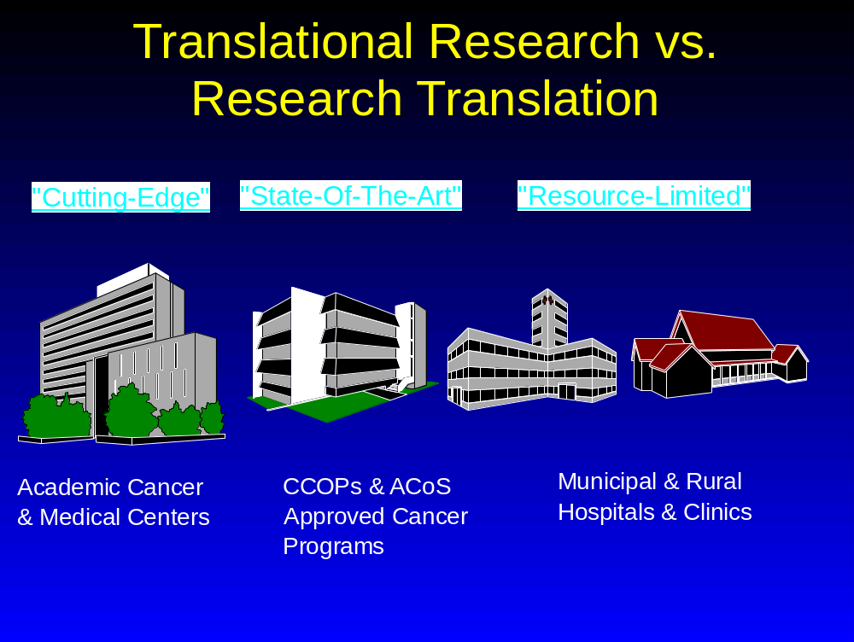
Discovery to Development
Discovery to Delivery

Slide 12
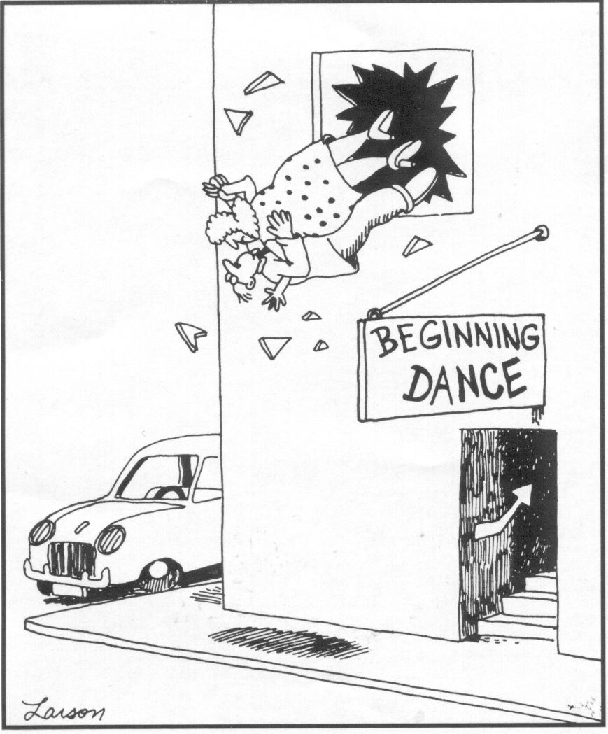
Research-Practice Partnerships?
“Getting a new idea adopted, even when it has obvious advantages, is often very difficult.” -- Everett Rogers, Diffusion of Innovations

Slide 13
Partnership Models
    State Cancer Plans (ACS, CDC, C-Change, ACoS, ICC, NAACCR, LAF)
    Collaborate with partners to support and expand the Cancer Control PLANET for Community Health Practice

Slide 14
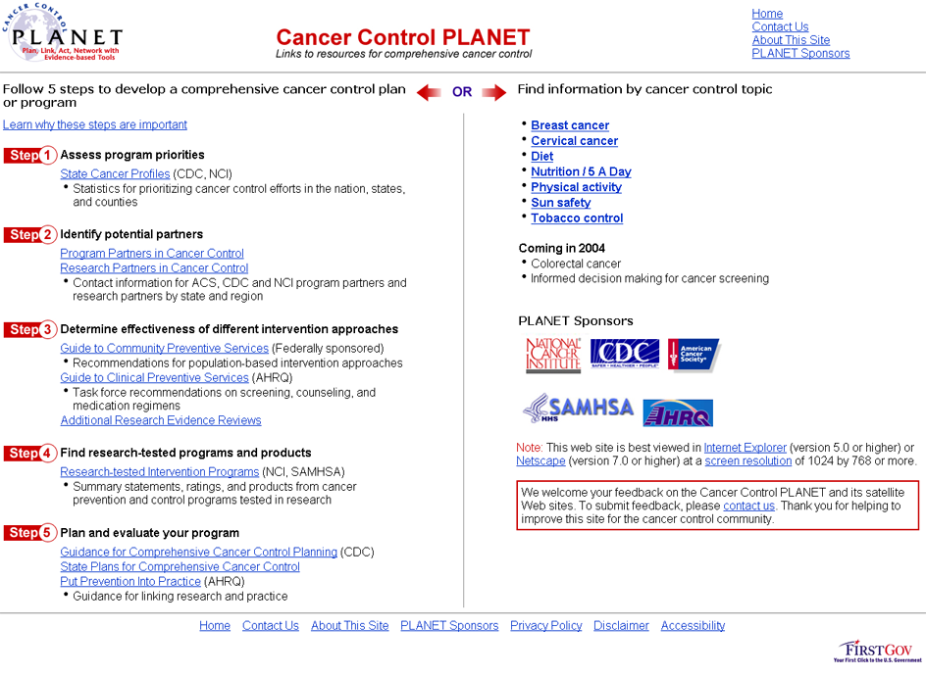
http://cancercontrolplanet.cancer.gov

Slide 15
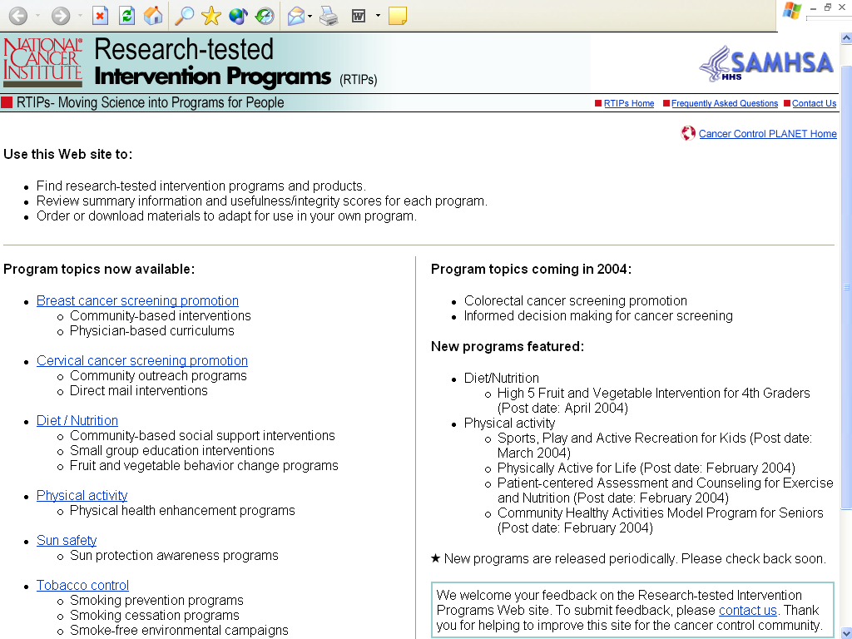

Slide 16
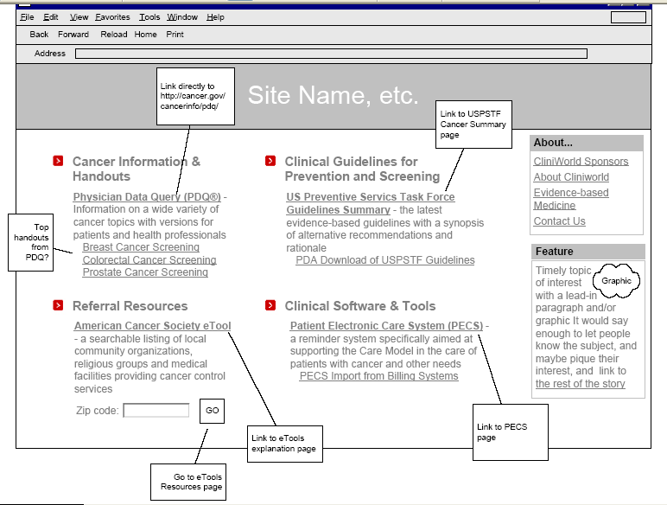
Development of Clinical PLANET

Slide 17
Screening implementation is complicated
Process of Care
OUTCOMES
Risk Assessment
Age
Family Hx
Exposure Hx
Genetics
Lifestyle
Detection
Screening
CBE/Mammography
Pelvic/Pap
FOBT/sigmoidoscopy
Symptomatic
Diagnosis
Mammography
Ultrasound
Colposcopy
Biopsy
Repeat Exams
Treatment
Surgery
Radiation
Adjuvant
Chemo
Palliative Care
Morbidity
Mortality
Quality of Life
Satisfaction
Quality of
Death
Intermediate Outcome
Invasive cervical cancer
Late-stage breast cancer
Limits of Epidemiologic Evidence
Failure to Screen/ Failure to act on symptoms
Failure to Detect
Sensitivity/
specificity of test
Technology
resources
Quality of
reading
Biologic
Characteristics
Failure in follow-up
System-
failure
Patient non-compliance
Failure in Dx
Sensitivity/
specificity
Technology
resources
Quality of
reading
Failure in Follow-up
System
Patient
Treatment Failure
Treatment
efficacy
Patient
compliance
Provider error
POTENTIAL FAILURES
Notes:
This figure describes the continuum of cancer care. It shows two important points: 1) that there are specific stages of care (I.e. detection, diagnosis, treatment) and, 2) transitions between these stages.
The quality of care is affected by both. Mandelblatt and colleagues have provided a comprehensive review of factors that influence access to care. I consider these the transitions. Her review focuses on both patient and physicians factors. It is one of several models that make one major point. Physicians and patients do not operate in isolation. They interact with each other and each operates in the context of a surrounding environment of culture, and a healtcare system.
At each point of transition these surrounding factors influence care. We know for example that outreach reminders can facilitate recruitment to screening. We know that follow-up after an abnormal screening examination are facilitated by mailed reminders.
There are many ways things can go wrong. People may never know that screening could help them. They may never receive a recommendation. Even if they receive a recommendation they may not be notified about the result. IF they are notified about the abnormal result do they get to the appropriate people for the next step in evaluation. Finally, do they understand the treatment could help them, that finding a cancer is not a death sentence, it is reason for hope.
Good quality care is about the entire process of care, the transitions, and the specific types of care that occur. We’re relatively good at mammography, sigmoidoscopy, and PAP smears. At least relative to managing the process of care.

Slide 18
Systems change is critical
Systematic implementation of evidence based medicine
  Guidelines are necessary but not sufficient
IOM report
  Systemic change is needed
The chronic care model
  An implementation guide for teams

Slide 19
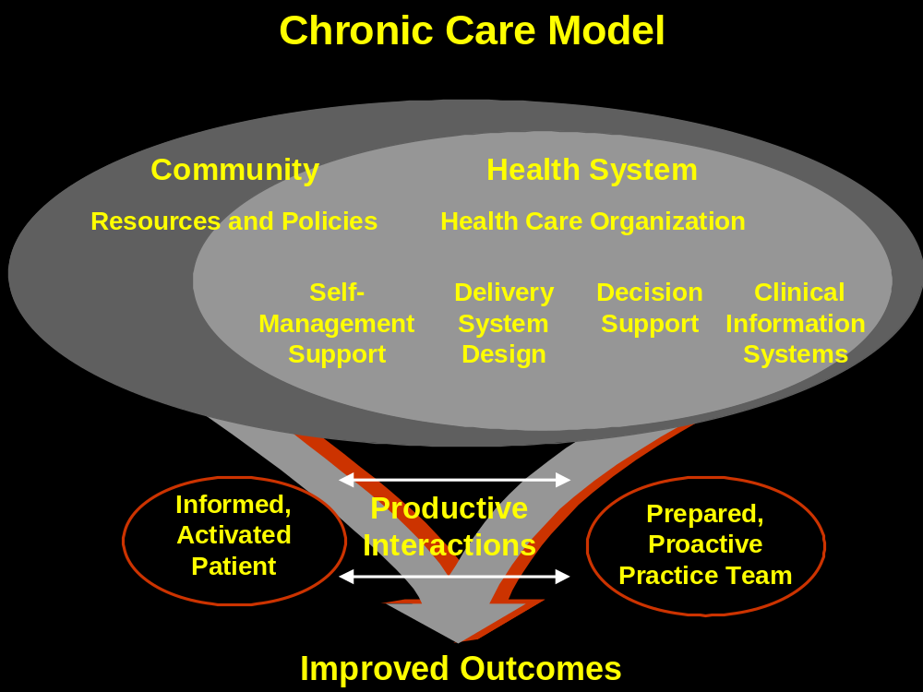
Organizing the chaos of change
Conceptual organization
  The chronic care model

Slide 20
Moving Science into Oncology Practice
Food and Drug Administration (FDA) Collaboration
Centers for Medicare and Medicaid Services (CMS) Collaboration

Slide 21
WE HAVE BEEN TALKING ABOUT DISSEMINATION FOR QUITE A LONG TIME
When the NCI was first authorized in 1937, Congress mandated that "NCI promote the useful application of research results."
"The Cancer Control section of the National Cancer Act of 1971 is designed to ensure more rapid and effective communication of research results to medical practitioners and, as appropriate, to the general public..."
Dialogue to Action!

Slide 22


